Slide 1
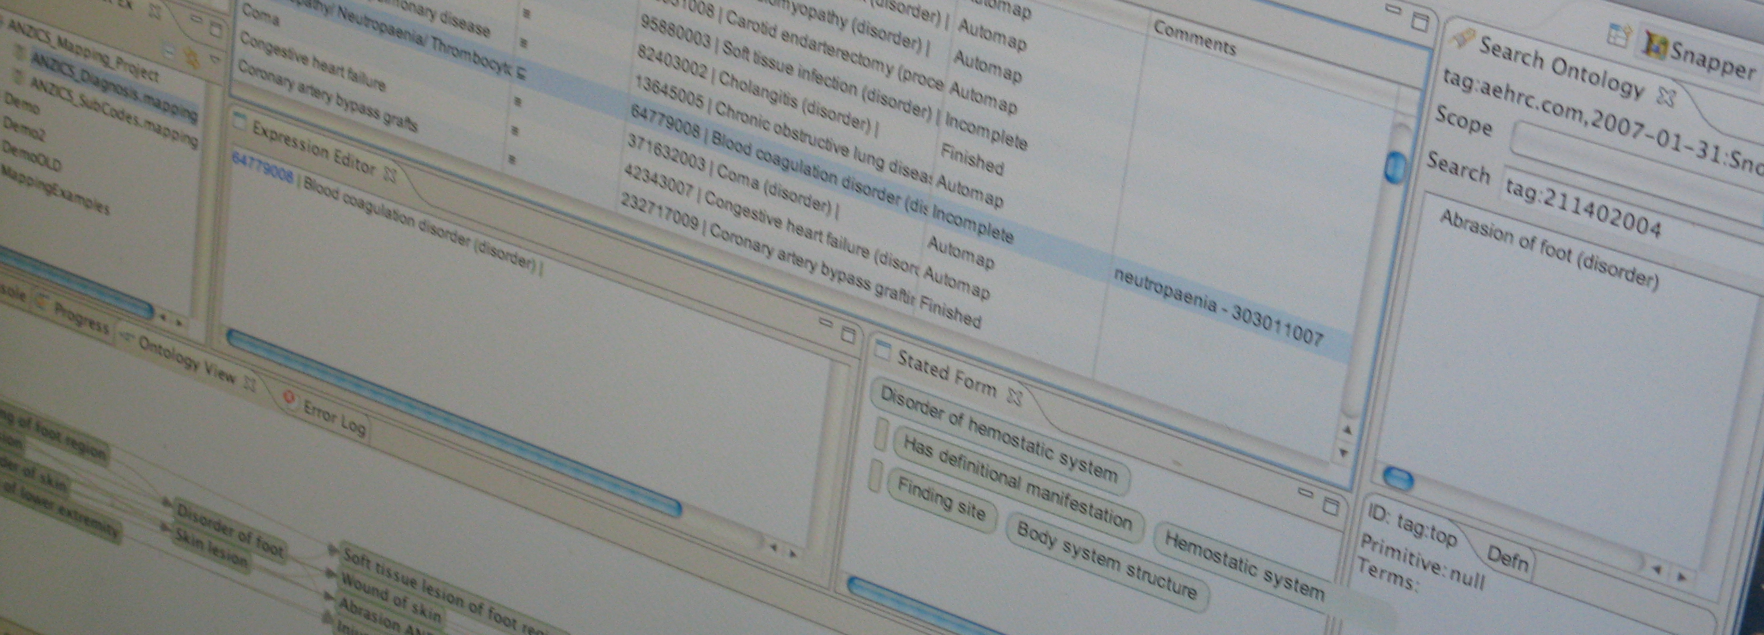
Ageing well and ageing in place – a comprehensive strategy for designing, developing and deploying a range of telehealth and telecare technologies at home and in residential care facilities
Prof. Branko Celler
Chief Scientist, CSIRO ICT Centre
30th May 2012
CSIRO ict centre
IFA 11TH GLOBAL CONFERENCE ON AGEING
28 May – 1 June 2012, Prague, Czech Republic

Slide 2


Slide 3
A Brief
Introduction to the CSIRO

Slide 4
CSIRO
Commonwealth Scientific and Industrial Research Organisation
  CSIRO is Australia's national science agency and one of the largest and most diverse scientific research organisations in the world. CSIRO employs some 6850 staff and has a budget in excess of $1.3 billion.
  CSIRO is a mission driven organisation with research priorities and funding aligned (from the top down) with Australia’s National Research Priorities and solving the major challenges facing our nation through the National Research Flagships program, which CSIRO leads.
  CSIRO is uniquely positioned in the Australian innovation system, holding an intermediate position on the continuum from fundamental research (mainly the realm of universities) to product specific work performed by companies.

Slide 5
The CSIRO ICT Centre
One of 15 CSIRO Divisions
  The ICT Centre has approximately 250 staff including 195 research staff, plus 109 postgraduate students co-supervised with universities.
  The core research capabilities of the ICT Centre are organised into five Laboratories:
    Wireless and Networking Technologies Laboratory (Marsfield in Sydney)
    Information Engineering Laboratory (Marsfield, and Acton in Canberra)
    Autonomous Systems Laboratory (Pullenvale in Brisbane)
    Intelligent Sensing and Systems Laboratory (Tasmania, Hobart).
    Australian e-Health Research Centre (Herston in Brisbane and Floreat in Perth)

Slide 6
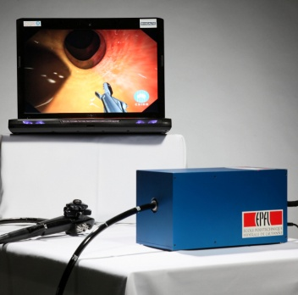
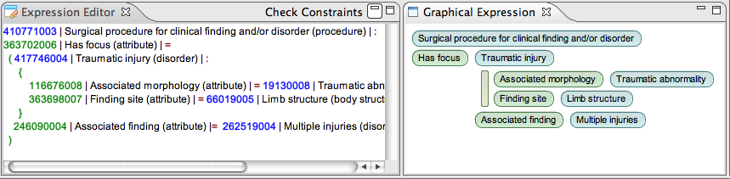



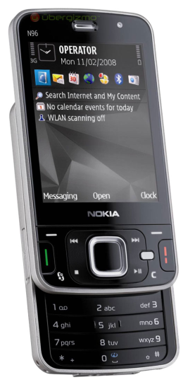
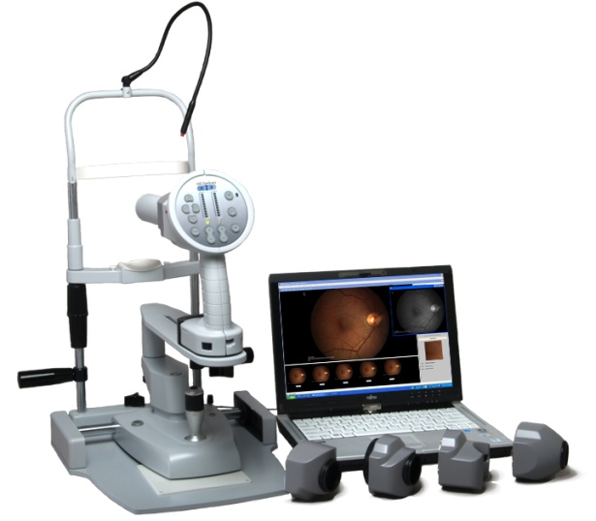
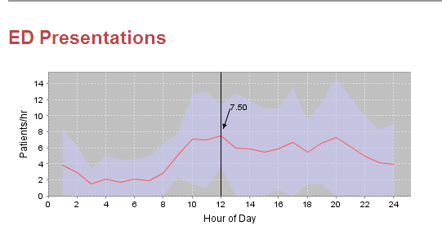
AEHRC Capabilities
Health Data Management
and Semantics
Biomedical Imaging
Mobile and Tele-health
Forecasting and Scheduling

Slide 7
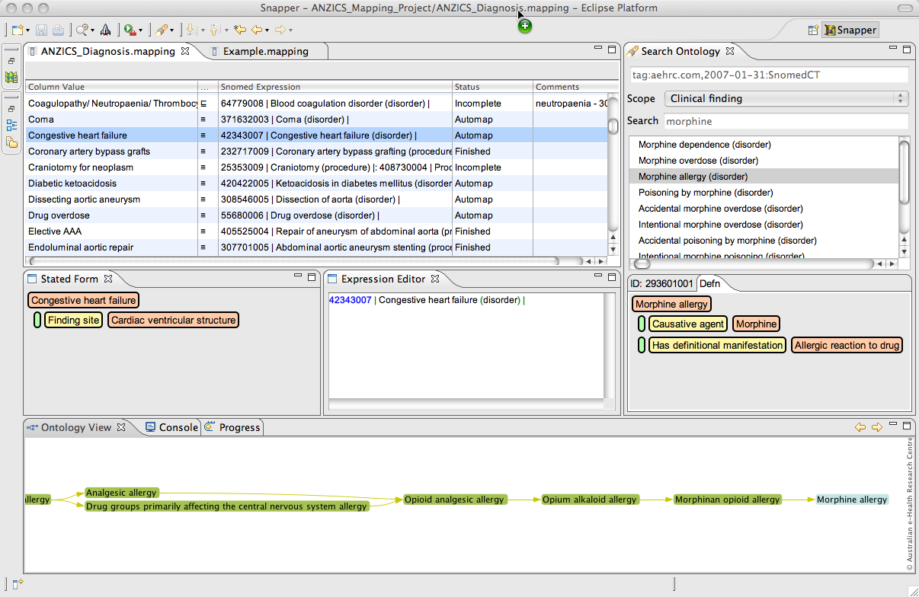
Snapper: A mapping tool for SNOMED CT
Search
SNOMED
Mapping
Expression building
Browse SNOMED

Slide 8
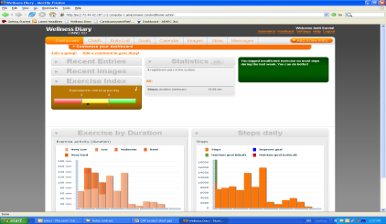

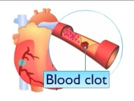
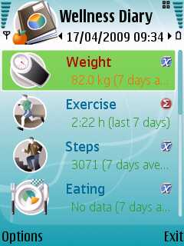
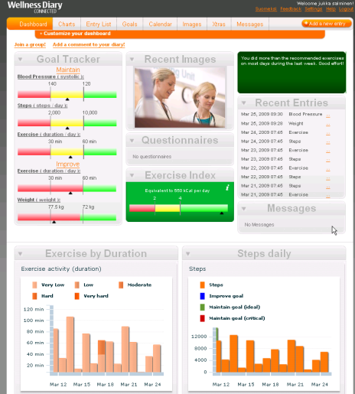
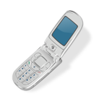
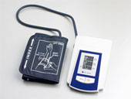
CAP2: Mobile Phone based Cardiac Rehabilitation Program
Service Provider
Wellness Diary Connected
Diary data
Measurement
data
Health
Reports
Educational
material
Discussion,
messaging
Community Care Team
Patient in the Community

Slide 9
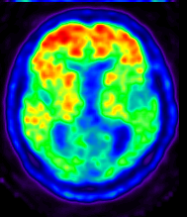
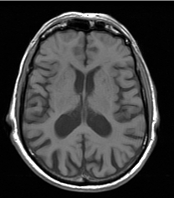
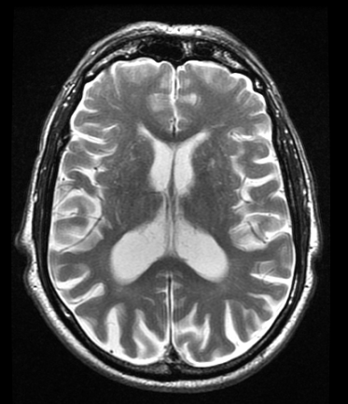
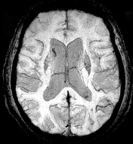
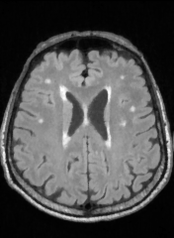
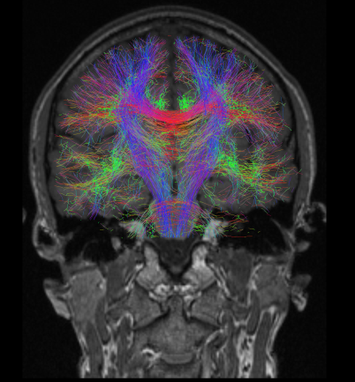
Australian Imaging Biomarker Lifestyle Study (AIBL)
A Multimodality Alzheimer's Disease clinical study
^{Databases}
^{PET-PiB}
^{Amyloid beta load}
^{Cognitive}
^{functions}
^{Blood}
^{biomarkers}
^{Genomic}
^{Demographic}
^{And}
^{Lifestyle}
For each patient (1000) for each time point (4)
^{FLAIR}
^{White matter lesions}
^{DWI}
^{White matter connection}
^{T1W}
^{Anatomy}
^{T2W}
^{CSF and structures}
^{SWI}
^{Veins and haemorrhages}

Slide 10
INDEX
Brief introduction to the CSIRO and the ICT Centre
The impact of Ageing Demographics
An overview of Telecare Services
An overview of Telehealth Services
The Science Frontier – Clinical Excellence
  Improving data quality and feature extraction
  Clinical Data Management
  Automated Decision support
Development of a National eHealth infrastructure
  National eHealth Transition Authority (NeHTA)
  The National Broadband Network initiative (NBN)
  The Personally Controlled Electronic Health Record (PCEHR)

Slide 11
DEMOGRAPHICS OF OLDER PERSONS
"We are in the midst of a silent revolution, one that extends well beyond demographics, with major economic, social, cultural, and psychological and spiritual implications."
Kofi Annan, UN Secretary-General
(1 October 1998)

Slide 12
Key Drivers working against
“a business as usual” approach
  Rapidly ageing demographics
  Increasing burden of chronic disease
  Large projected deficits in clinical HR (doctors and nurses)
  Evidence of access block and crises in hospitals
  Unsustainable increases in health budgets
  Increasing entry to ED from risk averse Residential Care Facilities

Slide 13
Meeting Challenges of Ageing Demographics
Enlightened prevention and self maintenance
  Help elderly maintain vitality and independence
Create new living environments – “making a smart home health aware”
  Actively manages changes and disabilities that come with advanced age
LONG TERM CARE IS ESSENTIAL – IT INTEGRATES HEALTH SERVICES AND SUPPORT FOR DAILY LIVING

Slide 14
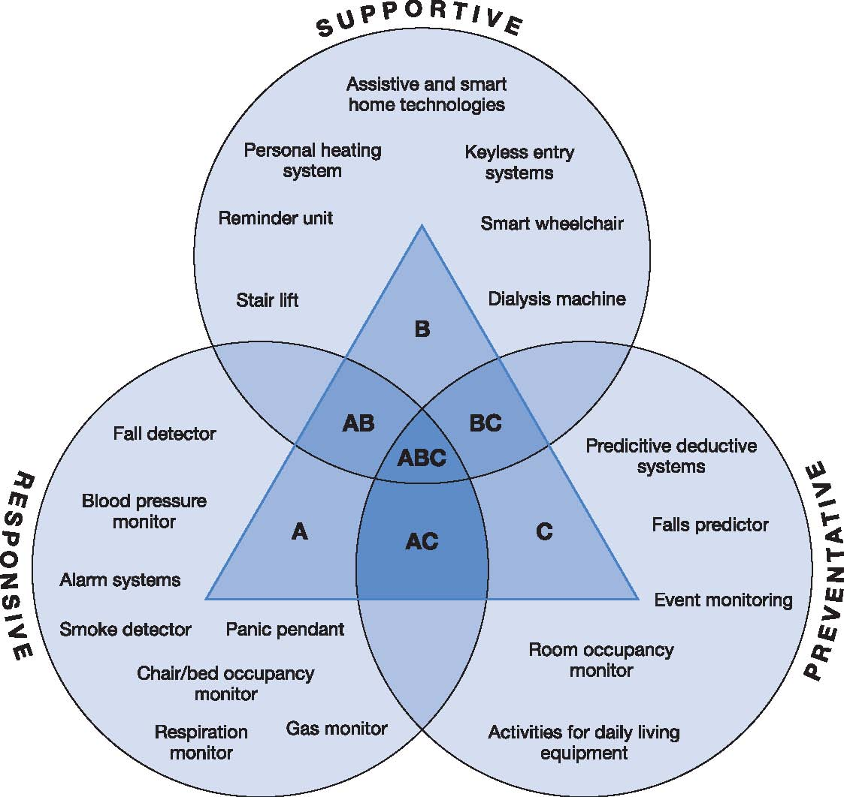
Assistive Technologies
“There is growing recognition that Assistive Technology offers tools to reduce long term care costs by maintaining the elderly in the community”
I will be concentrating on some of the newer electronic assistive technologies of telecare and telehealth, and in particular those that are embedded in a clinical model of care that is acceptable to both client and carer.
www.audit-commission.gov.uk/assistivetechnology
Notes:
Until recently, ‘aids and appliances’ resided in the organisational shadows of health and social services. This is now changing.
A more modern expression ‘assistive technology’, or AT for short, is now becoming commonplace as a result of technological advances and a growing appreciation of the ways in which such equipment can support independence.
‘traditional’ AT includes orthotics, prosthetics, wheelchair services, ‘standard’ community equipment and audiology services. I will be concentrating on some of the newer electronic assistive technologies of telecare and telehealthI. The core messages are still very relevant to all those with an interest in promoting the independence of older or disabled people.
New assistive technology can play a vital role in supporting the ways in which millions of older or disabled people can maintain or regain their independence. It also has the potential to modernise the way in which many aspects of health and social care are currently delivered to the benefit of users, carers, service providers and the taxpayer
New assistive technology can play a vital role in supporting the ways in which millions of older or disabled people can maintain or regain their independence. It also has the potential to modernise the way in which many aspects of health and social care are currently delivered to the benefit of users, carers, service providers and the taxpayer

Slide 15
Development of Assistive Technology in the aged care sector
Historical Overview
  1970’s Personal alarms with sirens
  1980’s Personal telephone alarms
  1990’s Personal alarms with two way voice communications
  1990’s Unobtrusive monitoring of functional health status
  Early 2000’s Clinical signs monitoring at home
  Ambulatory falls monitoring
  Middle 2000’s Integrated home telecare services, with ambulatory monitoring
  Late 2000’s + Knowledge management and GPS spatial information systems
  2010’s Wearable and implantable monitoring. Wearable “Smart” systems. National eHealth Architecture, and Interoperability Framework

Slide 16
Telecare Services

Slide 17
Historical Overview:
Unobtrusive monitoring of functional health status.
“How to make a smart home health aware”
British Telecom Funded Project
1993-1996

Slide 18
Unobtrusive monitoring of functional health status of the frail elderly at home
Ultimate objectives
  Unattended, remote monitoring of functional health status in the home, targeting health services to those most in need
  Part of a GP or local community centre Patient Management System
  Automatic report generation by expert system
  To make a SMART HOME HEALTH AWARE

Slide 19
FUNCTIONAL HEALTH STATUS
  The classification committee of the World Organization of Family Doctors (WONCA) defines functional health status as;
“the ability of a person to perform in, to adapt to and to cope with his given environment.”
  The functional health status of the individual is an important dimension of health and illness which reflects both the needs for service assistance and the outcomes resulting from service
  Functional status indicators provide a measure which can be used to assess and understand the impact of health problems on the daily lives of patients and to evaluate the effect of interventions
  All aspects of health are represented in functional health status including physical and emotional well-being, daily activities and social interaction

Slide 20
Home monitoring network

Slide 21
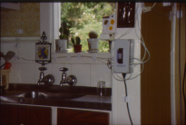
Prototype Home Monitoring Technology

Slide 22
43, w46d5043.m
40
LOUNGE: Movement
1
KITCHEN: Use of Sink
24
LOUNGE: Ambient Temp
20
0.5
23
0
0
22
0
6
12
18
24
0
6
12
18
24
0
6
12
18
24
40
KITCHEN: Movement
1
KITCHEN: Use of Stove
24
KITCHEN: Ambient Temperature
20
0.5
23
0
0
22
0
6
12
18
24
0
6
12
18
24
0
6
12
18
24
100
BEDROOM: Movement
1
KITCHEN: Use of Pantry
24
BEDROOM: Ambient Temperature
50
0.5
23
0
0
22
0
6
12
18
24
0
6
12
18
24
0
6
12
18
24
1
BATHROOM: Use of Shower/Bath
1
KITCHEN: Use of Refrigerator
100
LOUNGE: Ambient Light
0.5
0.5
50
0
0
0
0
6
12
18
24
0
6
12
18
24
0
6
12
18
24
1
BATHROOM: Use of Sink
1
FRONT DOOR USE
200
KITCHEN: Ambient Light
0.5
0.5
100
0
0
0
0
6
12
18
24
0
6
12
18
24
0
6
12
18
24
1
BATHROOM: Use of Toilet
1
BACK DOOR USE
200
BEDROOM: Bedside Lamp
0.5
0.5
100
0
0
0
0
6
12
18
24
0
6
12
18
24
0
6
12
18
24

Slide 23
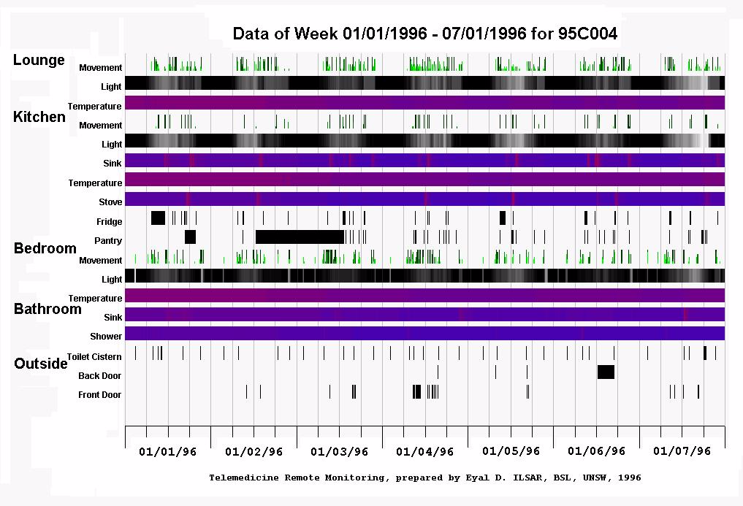

Slide 24
Telecare Monitoring Systems available commercially
Fall detection
Wandering monitoring
Medical monitoring
Medication dispensing
Security
Fire
Gas detection and turn off
Bed sensors
Lone walking monitors

Slide 25
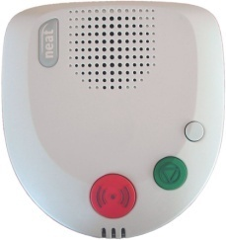
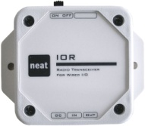
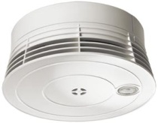


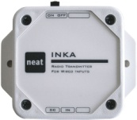
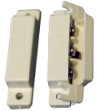
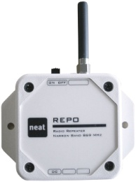
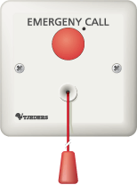
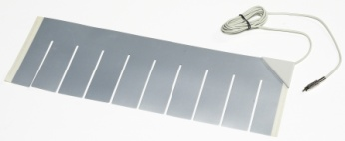


NEO system
PSTN
GSM
IP
Specials

Slide 26

NEMO system
Specials

Slide 27
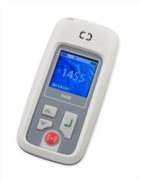
TREX system
Specials

Slide 28
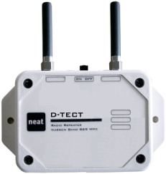
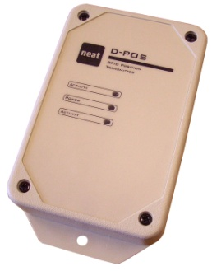
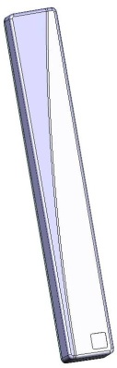
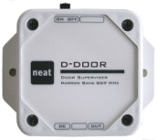
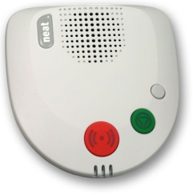

RFID positioning and wandering
D-POS
D-POS ANT
D-ATOM

Slide 29
THE FUTURE: As yet unattained!
Design and Implementation of a health monitoring and evaluation system based on Wireless technology
  The system provides a complete, end-to-end and scalable solution for a wide range of applications ranging from remote healthcare monitoring of elderly people living alone to those living in residential care facilities
  The system would be pervasive and unobtrusive and would provide an elevated level of objectivity in the assessment of healthcare needs, and thus lead to a better targeting of services and a significant reduction in service provision cost.
  The system architecture would support the collection of multiple types of data from both static and mobile sensors, transfer such data over either a homogeneous or hybrid wireless network to a central server, and perform data fusion to extract vital information about the health status of the person being monitored
  The system would be sensitive and adaptive to patients’ social and cultural needs as well as their cognitive capacity and health status

Slide 30
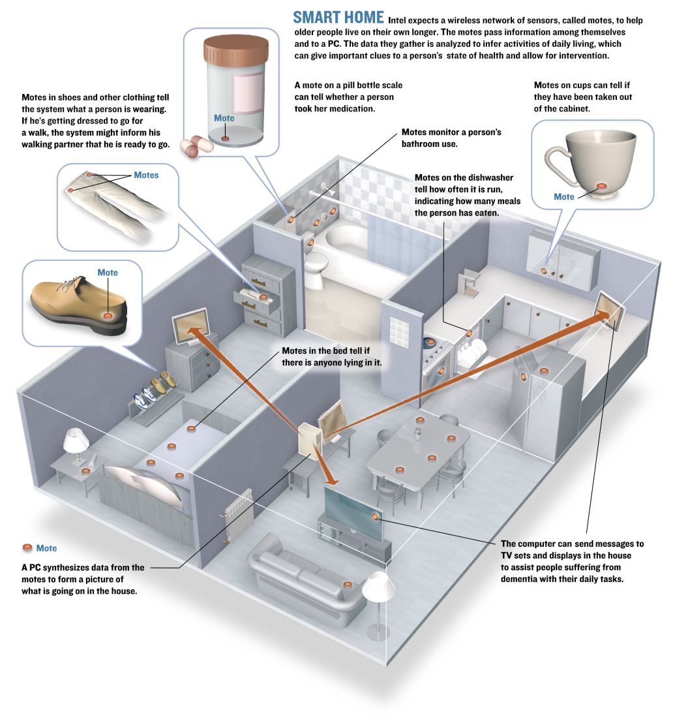

Slide 31
Telehealth Services
For the management of chronic disease in the community

Slide 32
Telehealth services have application beyond the home!
        GP practices
Community Health Centres
Rural and Remote facilities
Residential Care facilities
Occupational Health
Tele-rehabilitation
Scaling up services to a regional and national level creates new opportunities in technology innovation, wireless technologies, cloud computing, business process modeling, managing large and diverse longitudinal data sets and automated decision support.

Slide 33
Many Commercial Providers of Telehealth services are in the market! (>80 identified!)
Intel Care Innovations
Tunstall Myclinic
Telemedcare
Medtech Vitelmed
Telus
Docobo Doc@Home
Bosch Health Buddy
Honeywell Hommed
Alcatel-Lucent
Connected Health
IBM
KPMG
myHealth Sentinel
Vital Phone
Mediinspect
Clearbridge
WEB Biotechnology
Cadaq – ARCS
Asis Technologies
Business Gateway - GEMS
NDI Automation
CtrlWorks
Wipro Technologies
Playware Studios
Temasys Communications
Arkbridge

Slide 34


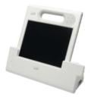
Wireless Telehealth Products
8.4” SmartHUB
PC
PC or Tablet Computers

Slide 35
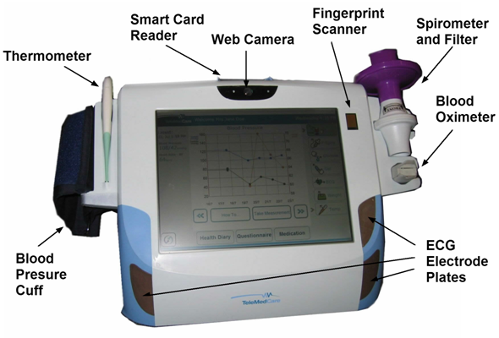
  Telemedcare TMC Clinical Monitoring Unit

Slide 36
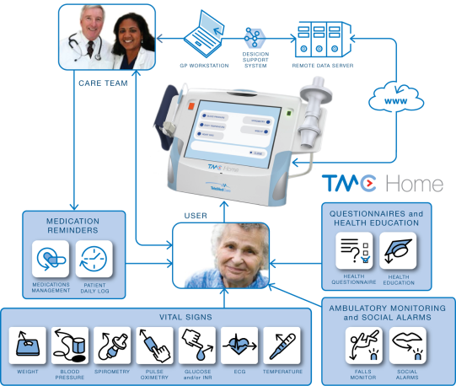
Telemedcare TMC Home
Single User for patients with complex chronic disease

Slide 37
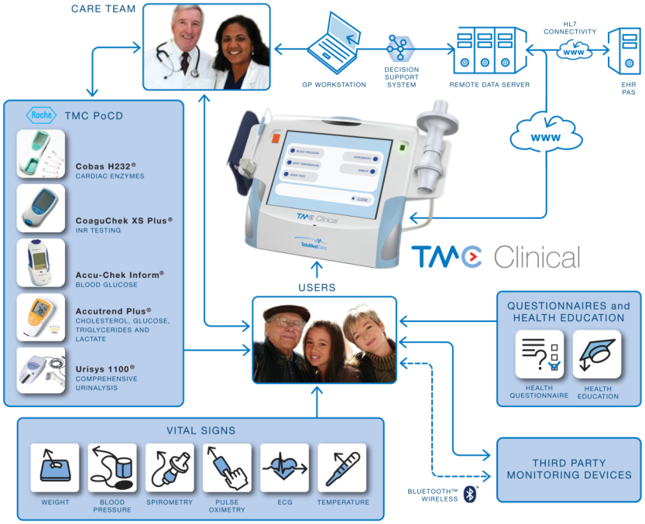
  Telemedcare TMC Clinical
  Multi-user monitoring system for primary care physicians and community health centres

Slide 38
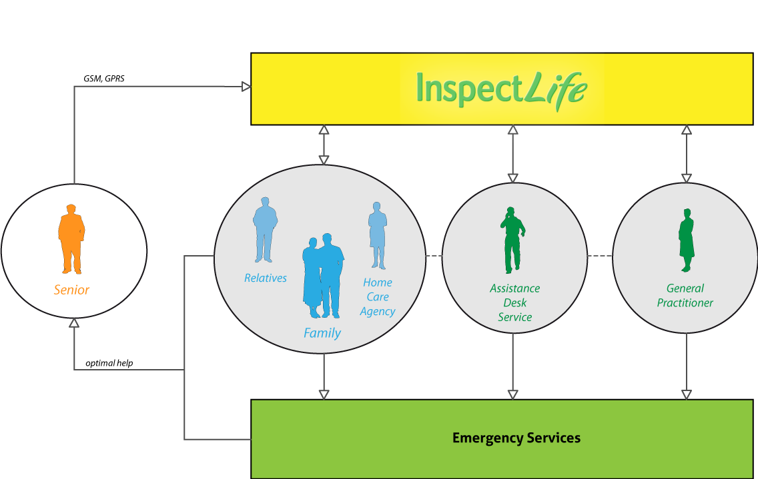
Mediinspect
Integrated healthcare management

Slide 39
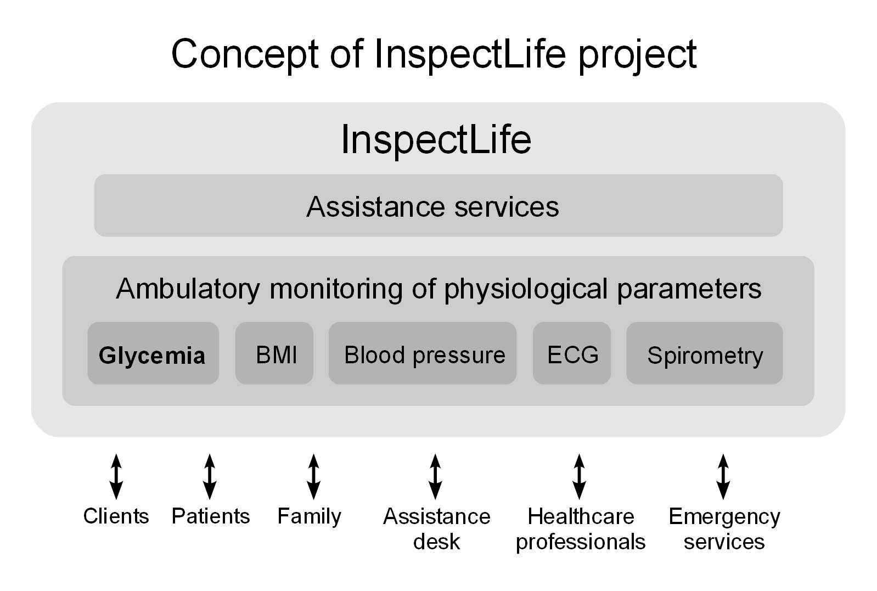
Integrating Telecare and Telehealth

Slide 40
The Science Frontier
Clinical Excellence
Improving data quality and feature extraction
Clinical Data Management
Automated Decision support
New research frontiers

Slide 41
Enhancing the value of BP Measurement
Oscillometric methods, in our experience, are inaccurate in up to 20% of cases and cannot handle patients with even mild arrhythmias
Improving reliability and accuracy using combined oscillometric and auscultatory methods.
Improve the accuracy of determination of the diastolic point (Phase 4 or Phase 5?)
Using the oscillometric envelope to determine arterial stiffness and compliance
Improving BP measurement in the presence of Atrial Arrhythmias

Slide 42
Accurate BP Monitoring
Oscillometric (Accurate Mean BP)
Auscultatory (Electronic stethescope) Accurate Systolic and diastolic BP

Slide 43
Auscultatory versus Oscillometric determination of Blood Pressure
Auscultatory Signal
Oscillometric Signal

Slide 44
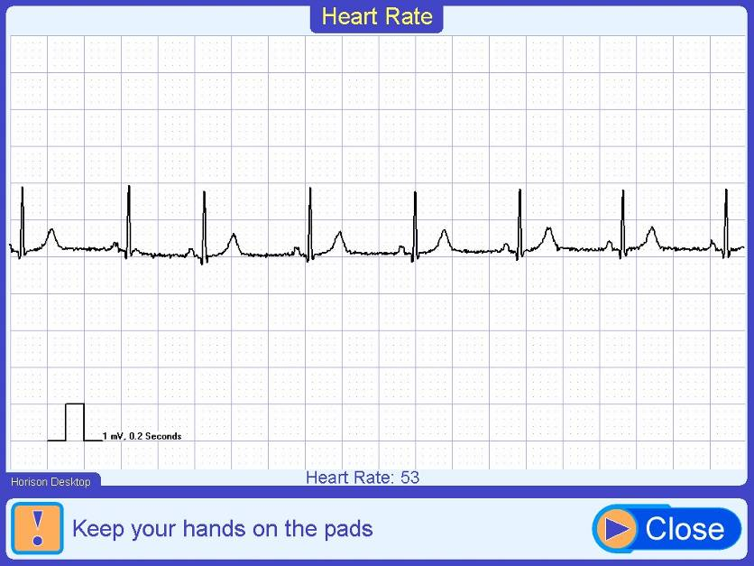
The single lead ECG recorded at home
(dry contact electrodes)

Slide 45
Improving the diagnostic value of the single lead ecg recorded at home
Developing Quality Measures for monitoring at home ecg recording
Feature extraction of key clinical parameters,
  PR, RR and QT intervals QT and QTc corrected
Arrhythmia classiﬁcation system based on the RR-interval signal
    Identify normal, premature ventricular contractions, ventricular ﬂutter/ﬁbrillation and heart block
    Classify six rhythm types: ventricular bigeminy, ventricular trigeminy, ventricular couplet, ventricular tachycardia, ventricular ﬂutter/ﬁbrillation and heart block.

Slide 46
Determination of Signal Quality during Unsupervised Recordings

Slide 47
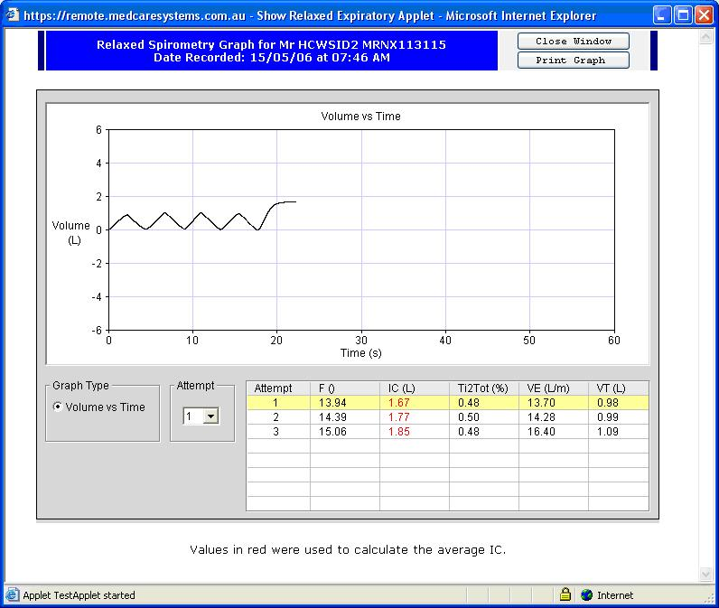
New Modalities for assessing COPD:
Relaxed Spirometry

Slide 48
The importance of recording vital signs signals!

Slide 49
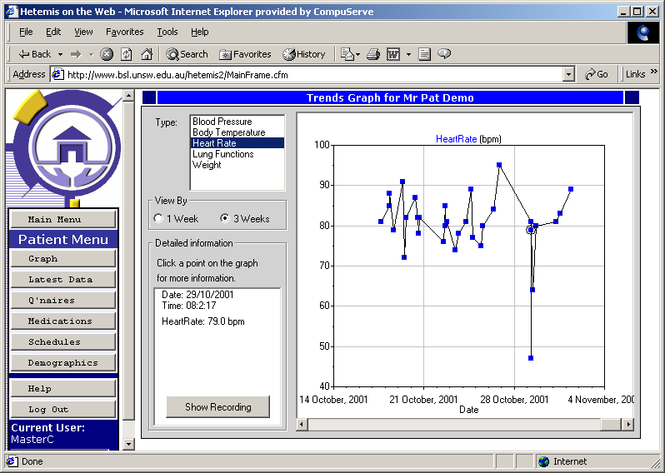
Clinician View of Longitudinal Data
Note unusual Bradycardia!

Slide 50
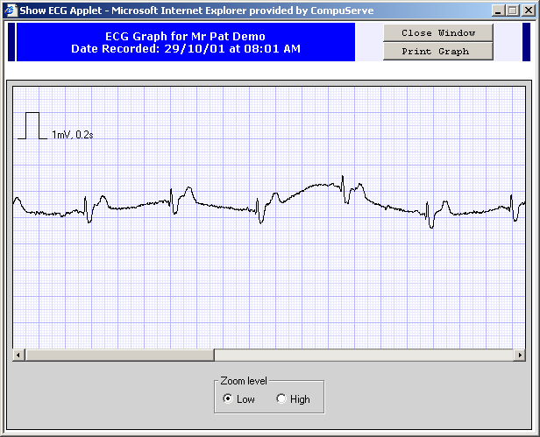
Patient initiated recording at 8.01 am (triggered by bradycardia)

Slide 51
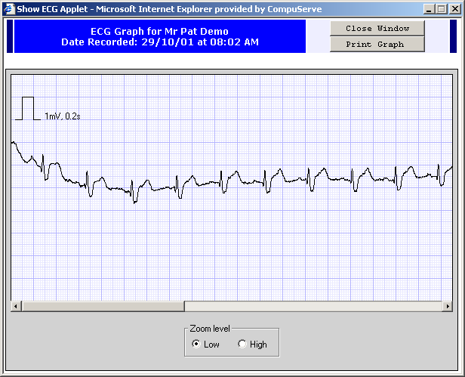
Return to “Normal” ECG at 8.02 am

Slide 52
The Science Frontier
Clinical Excellence
Automated Decision support

Slide 53
Clinical Role
In chronic disease management, home telehealth offers the ability to:
  Identify earlier a deterioration in health status
    Monitor the effect and response to a specific therapy
    Confirm convalescence after treatment of a disease exacerbation
    Monitor the effect of maintenance therapy
    Identify the requirement for, and monitoring of preventative therapies

Slide 54
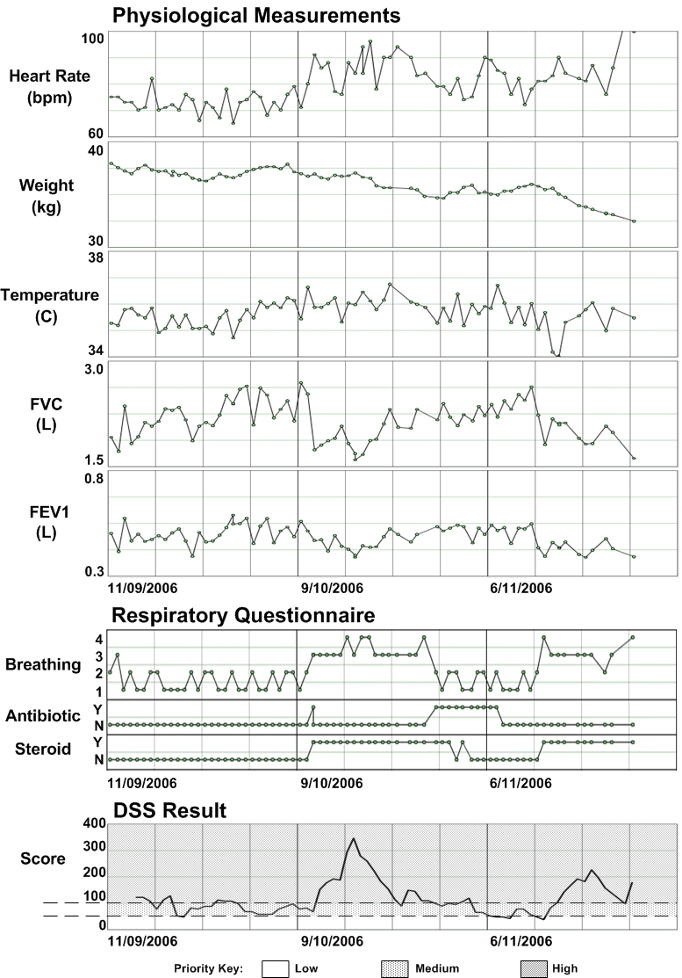

Slide 55
Clinical Analysis
Patients with exacerbations of chronic disease often have changes in their physiological state well before they realize they are unwell or report problems to their health carers.
A lot of information is automatically and remotely available that gives the clinician confidence that a particular clinical data pattern is indicative of health deterioration.
  Enough data is available to develop an understanding of what is ‘normal’ for the patient
  Multiple changes across measurements can be correlated for the same period
  Pattern changes cannot be explained by another reason (eg. changes to medications)
  Useful knowing beforehand the particular pattern of changes occurring when the patient’s health deteriorates

Slide 56
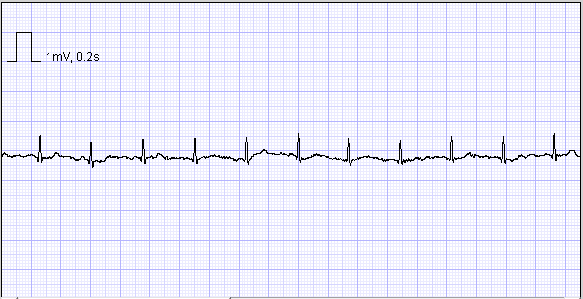



Decision Support: at the Signal Analysis Level
Patient 1
Patient 2
“Normal”
“Abnormal”

Slide 57

Decision Support
Statistical analysis of trends

Slide 58

Identifying Data Patterns using Piecewise Linear Regression (PLR)

Slide 59
Decision Support Architecture

Slide 60
Status Determination
Interpretation of the combination of trends, thresholds and average shifts in the data to reach a conclusion about the underlying health status of each patient on a daily basis
Each clinical measurement and questionnaire result is weighted differently according to the type of change in the data and to the relatively importance of the result to the final overall health status
Final DSS output score stratifies patient results on a daily basis into high, medium, and low health risk status categories, to assist health carers orchestrate the best response to avoid unnecessary hospitalisation.

Slide 61

Risk Stratification of Patients on a daily basis

Slide 62
Future DSS Research
Continuing research on evidence based decision support for ALL telehealth data irrespective of source
Development of automated Care Plans and care pathways for telehealth services
Integration with a wide range of alternative data sources including haematology, pathology, urinalysis, biochemistry and data from PCEHR sources
Providing enhanced resources for patient self management

Slide 63
The Science Frontier
Clinical Excellence
New Research Frontiers

Slide 64
NEW RESEARCH OPPORTUNITIES
New instruments for home telehealth
  Impedance tomography for Congestive Heart Failure
  Measurement of vascular stiffness
  Falls detection/falls monitoring. Risk of falling monitoring
At home telerehabilitation
  Fully supervised through video conferencing
  Unsupervised with automated assessment of physiological or psychological stress using automated facial recognition
Demonstration provided by Dr. Simon Lucey – CSIRO AS Lab

Slide 65
Building National Infrastructure to support eHealth Services
National eHealth Transition Authority (NeHTA)
National Broadband Network (NBN)
Personally Controlled Electronic Health Record (PCEHR)

Slide 66

National eHealth Transition Authority (NeHTA)
  NeHTA evolved from the Health Connect, Australia’s change management strategy to transition from paper-based and legacy digital health records towards electronic health records. Health Connect was funded in 2004. NeHTA began operation in 2006.
  NEHTA is the lead organisation supporting a national vision for eHealth for Australia. Its purpose is to lead the uptake of eHealth solutions of national significance for Australia and progress and accelerate their adoption through the health system.
  NeHTA is jointly funded by the Australian Government and all State and Territory Governments.

Slide 67

National eHealth Transition Authority (NeHTA)
  NeHTA work collaboratively with consumers, healthcare providers, the healthcare industry, the information and communications technology industry, policy makers and funders towards a safe, secure and efficient health system that will deliver better health outcomes for all Australians.

Slide 68

The National Broadband Network Initiative (NBN)
ICT Centre

Slide 69
National Broadband Network Initiative
The National Broadband Network (NBN) is a national wholesale-only, open-access data network under development in Australia. Up to one gigabit per second connections are sold to retail service providers (RSP), who then sell Internet access and other services to consumers.
The network is estimated to cost A$35.9 billion to construct over a 10-year period, including an Australian Government investment of A$27.5 billion.
The build cost has been a key point of debate. NBN Co, a government-owned corporation, was established to design, build and operate the NBN, and construction began with a trial rollout in Tasmania in July 2010.
The mainland rollout began with five first-release sites with the first services connected in April 2011.

Slide 70
National Broadband Network Initiative
The fibre to the premises (FTTP) rollout is planned to reach approximately 93 percent of the population by June 2021.
Construction of the fixed wireless network began in 2011 and delivered its first services in 2012, and will be completed by 2015.
Two satellites will be launched by 2015. The network will gradually replace the copper network, owned by Telstra and currently used for most telephony and data services.
As part of an agreement with NBN Co, Telstra will move its customers to the NBN, and lease access to its exchange space and extensive network ducting to assist in the rollout.

Slide 71
The Personally Controlled Electronic Health Record (PCEHR)
: a $467m investment
Patient centric – Personally controlled
Key Design Features
Phased implementation
Lead implementation sites
Market readiness
1st of July 2012 and beyond
CSIRO ict centre
Acknowledgement: PCEHR Data and slides provided by Paul Madden, Deputy Secretary, Chief Information and Knowledge Officer, Department of Health and Ageing

Slide 72

The patient at the centre of the process:
Personal Control
Access information
Set controls
Authorise access
Choose what information is published
View activity history
Make enquiries and complaints

Slide 73
The National Personally Controlled Electronic Health Record (PCEHR) Program – Key Design Features
SYSTEM;
  National infrastructure
  Standards based – allowing integrated solutions
  Complementary to existing information systems
  Adoption when ready to connect and use national system
  Driving incremental implementation
PARTICIPATION;
  Voluntary / opt-in
  Self register or with assistance
  Consumer controlled access settings
  Self-entered and provider-entered clinical content
  Clinical content grows as you use healthcare

Slide 74
Is Australia ready for the PCEHR?
Four in five Australians want to move from paper based records
Most consumers believe they have knowledge required to use eHealth records
Over 95 percent of GPs have access to a computer and Internet in their offices
Most GPs have access to the patient information required for creation of eHealth records
38 percent of GPs agree that they would encourage their patients to register for a PCEHR

Slide 75

Thank you
Questions?
  Tel: +61 2 9372 4289
    E: branko.celler@csiro.au
The CSIRO ICT CENTRE

