Slide 1
ACTIVE AGEING:
A Source of Empowerment?
Alan Walker
Professor of Social Policy and Social Gerontology
The University of Sheffield
UK
Daniel Thursz Memorial Lecture
IFA 11th Global Conference on Ageing
Prague
31st May 2012

Slide 2
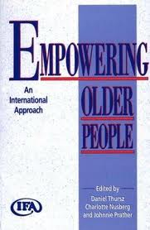
POINTS OF DEPARTURE
Copyrighted Material: Alan Walker, Active Ageing, Prague, 31st May 2012

Slide 3
ACTIVE AGEING: A SOURCE OF EMPOWERMENT?
AGENDA
Models of Ageing – A Critique
From Activity Theory to Active Ageing
The Conflict within Active Ageing
Can Active Ageing Empower?
Copyrighted Material: Alan Walker, Active Ageing, Prague, 31st May 2012

Slide 4
KEY MESSAGES
Active Ageing has the potential to prevent many of the negative effects of ageing at the individual, organisational and societal levels BUT..............IT MUST BE:
Comprehensive (age, activity, policy)
Inclusive (bottom-up/top-down)
Active Ageing could be a major source of empowerment across the life course and into advanced old age BUT..............IT MUST BE
Aligned with a new vision of ageing
Explicit and based on clear principles
Copyrighted Material: Alan Walker, Active Ageing, Prague, 31st May 2012

Slide 5
MODELS OF AGEING
Successful, Productive, Positive, Healthy, Active
CHARACTERISTICS:
Ideal types not theories
Policy oriented: prescriptive, top-down
Ethno-centric: western capitalist values/
priorities
Homogenisation of ageing/older people
Tendency towards exclusion: one size for all
Normative: the structural vacuum
(political economy, ageism)
BUT: projecting positive perspective of ageing in contrast to dominant negative stereotypes
Copyrighted Material: Alan Walker, Active Ageing, Prague, 31st May 2012

Slide 6
FROM ACTIVITY THEORY TO ACTIVE AGEING
Functionalist Theories of Ageing:
Isolation ‘from kinship,
occupational and community ties’ (Parsons, 1942)
‘Normal ageing is a mutual withdrawal or “disengagement” between the ageing person and others in the social system to which he belongs’ (Cumming, 1963)
Copyrighted Material: Alan Walker, Active Ageing, Prague, 31st May 2012

Slide 7
CRITIQUE OF DISENGAGEMENT THEORY
Selective use of evidence
Deterministic
Narrowly constructed: disengagement not exclusion
Homogenised older people
Awful basis for policy and practice
….
Copyrighted Material: Alan Walker, Active Ageing, Prague, 31st May 2012

Slide 8
THE ACTIVITY PERSPECTIVE
‘…the greater the number of optional role resources with which the individual enters old age, the better he or she will withstand the demoralising effects of exit from the obligatory roles ordinarily given priority in adulthood.’ (Blau, 1973)
Activity promotes social and psychological health and well-being
The individual must compensate for losses in the ageing process
Confirmation of roles and activities associated with middle age
Copyrighted Material: Alan Walker, Active Ageing, Prague, 31st May 2012

Slide 9
CRITIQUE OF ACTIVITY PERSPECTIVE
Oversimplification of scope for agency
Naïve equation of activities
Biased towards US norms and values
Homogenises older people
BUT: research has demonstrated that the association between morale, physical and mental health and activity levels is incontrovertible
Copyrighted Material: Alan Walker, Active Ageing, Prague, 31st May 2012

Slide 10
POSITIVE IMPACT OF ACTIVITY ON WELL-BEING
Physical activity is positively associated with psychological well-being in older adults
Physical activity improves balance and reduces falls
Strength training can control muscle loss and other age-related conditions
This holds true even among very frail older people
Employment in later life (59 to 69) promotes overall well-being
Activity critical to quality of life in old age
Copyrighted Material: Alan Walker, Active Ageing, Prague, 31st May 2012

Slide 11
PHYSICAL ACTIVITY SUBSTANTIALLY REDUCES THE RISK OF COMMON DISEASES
Disease | Effect of physical activity
Coronary heart disease | Moving to moderate activity could reduce risk by 10%
Stroke | Moderately active individuals have a 20% lower risk of stroke incidence or mortality
Type 2 diabetes | Active individuals have a 33-50% lower risk
Colon cancer | The most active individuals have a 40-50% lower risk
Breast cancer | More active women have a 30% lower risk
Osteoporosis | Being physically active reduces the risk of later hip fracture by up to 50%
Sources: Chief Medical Officer’s report on physical activity and a range of published studies – full references listed at the end of this Report
Copyrighted Material: Alan Walker, Active Ageing, Prague, 31st May 2012

Slide 12
CYCLE OF WELL-BEING
Increased ability, confidence and opportunities
Increased participation
The positive effects on health of enhanced well-being have been found to be even larger than the effects from body mass, smoking and exercise
Increased
personal health
and well-being
and social
ODPM (2006)
Copyrighted Material: Alan Walker, Active Ageing, Prague, 31st May 2012

Slide 13
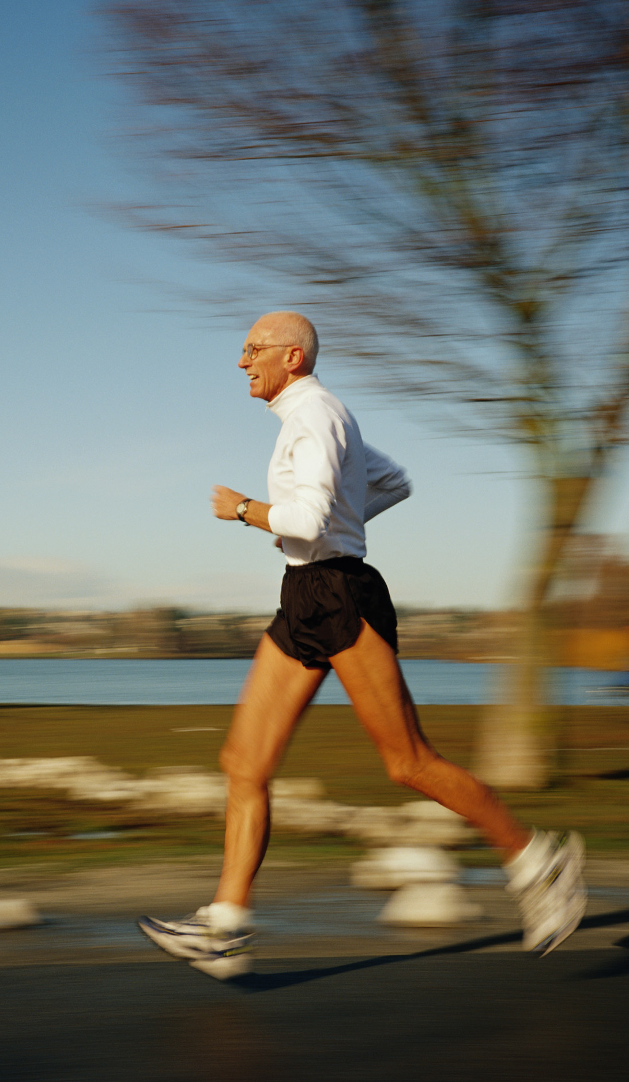
FROM ACTIVITY THEORY TO ACTIVE AGEING
Via…
Successful Ageing
Healthy Ageing
Optimal Ageing
Positive Ageing
Productive Ageing
Active Ageing
Copyrighted Material: Alan Walker, Active Ageing, Prague, 31st May 2012

Slide 14
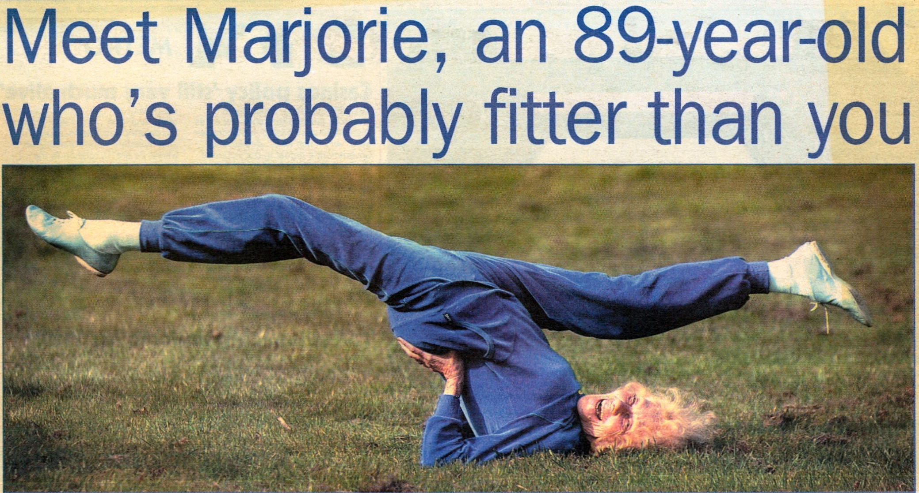
SUCCESSFUL AGEING
Copyrighted Material: Alan Walker, Active Ageing, Prague, 31st May 2012

Slide 15
SUCCESSFUL AGEING
Components:
No/low disease or disability
High cognitive and physical functioning
Active engagement in life
No physical disability over 75
Good subjective health
Good mental health
High self-rated life satisfaction (marriage, work, children, friendships, community service, religion, recreation/sports)
Social support network
Indicators:
Copyrighted Material: Alan Walker, Active Ageing, Prague, 31st May 2012

Slide 16
FROM ACTIVITY THEORY TO ACTIVE AGEING
Via…
Successful Ageing
Healthy Ageing
Optimal Ageing
Positive Ageing
Productive Ageing
Active Ageing
Copyrighted Material: Alan Walker, Active Ageing, Prague, 31st May 2012

Slide 17
PRODUCTIVE AGEING
‘Anything that produces goods and services’ (Morgan, 1986)
‘Produces goods or services, whether paid or not, or develops the capacity to produce goods or services’ (Bass, Caro, Chen, 1993)
‘The capacity of an individual or a population to serve in the paid workforce, to assist in the family, and to maintain himself or herself as independently as possible’ (Butler & Schechter, 1993)
Copyrighted Material: Alan Walker, Active Ageing, Prague, 31st May 2012

Slide 18
PRODUCTIVE AGEING
Emerged as a positive response to structural lag
Challenges stereotypes of unproductiveness
Assigns positive value to age in contrast to constructions of passivity, decrescence, decline.
BUT…
Prioritises paid employment
Reflects US values (productivity and success)
Individualistic, utilitarian
Comodifies, marginalises/excludes
Copyrighted Material: Alan Walker, Active Ageing, Prague, 31st May 2012

Slide 19
FROM ACTIVITY THEORY TO ACTIVE AGEING
Via…
Successful Ageing
Healthy Ageing
Optimal Ageing
Positive Ageing
Productive Ageing
Active Ageing
Copyrighted Material: Alan Walker, Active Ageing, Prague, 31st May 2012

Slide 20
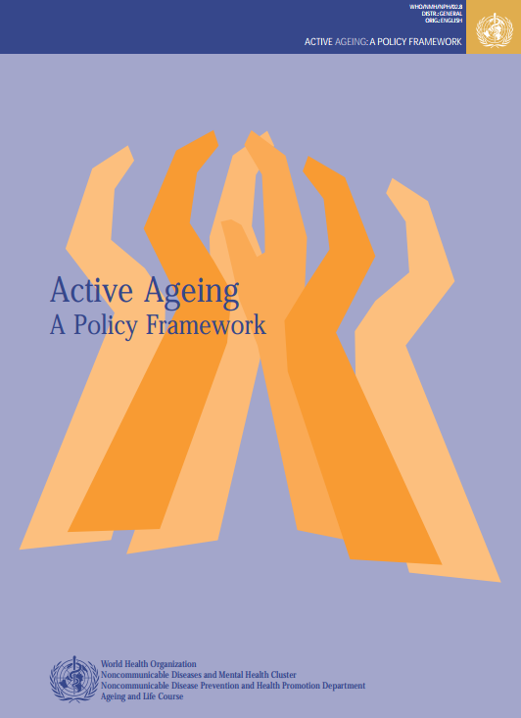
ACTIVE AGEING
Active ageing is the process of optimising opportunities for health, participation and security in order to enhance quality of life as people age
WHO 2002
Copyrighted Material: Alan Walker, Active Ageing, Prague, 31st May 2012

Slide 21
MADRID INTERNATIONAL PLAN OF ACTION ON AGEING
Older Persons and Development
Issue 1: Active Participation in Society and Development
Advancing Health and Well-being into Old Age
Issue 1: Health Promotion and Well-being Throughout Life
United Nations, 2002
Copyrighted Material: Alan Walker, Active Ageing, Prague, 31st May 2012

Slide 22
THE CONFLICT WITHIN ACTIVE AGEING
TWO POLES OF A POLICY CONTINUUM:
WORKING LONGER
Narrow (employment and older workers)
Top-down
Neglects other critical policy levers
Dis-empowering
Blunt instrument
ACTIVE AGEING
Comprehensive multi-dimensional (links employment, health and well-being)
Bottom-up and top down
Priority to the life course
Wide range of policy levers
Empowering
Copyrighted Material: Alan Walker, Active Ageing, Prague, 31st May 2012

Slide 23
KEY ELEMENTS OF ACTIVE AGEING
Life course, preventative
Ageing as inevitable but malleable
Heterogeneity in ageing process and diversity in old age
Reflects lay as well as expert perspectives
Comprehensive: all contributions to well-being
Macro, meso and micro aspects
Wide range of policy levers
Copyrighted Material: Alan Walker, Active Ageing, Prague, 31st May 2012

Slide 24
MAINTAINING FUNCTIONAL CAPACITY OVER THE LIFE COURSE
Copyrighted Material: Alan Walker, Active Ageing, Prague, 31st May 2012

Slide 25
A Healthy 70- year old has a 54% chance of living to 90. If you have one of the conditions below, it reduces to.....
Sedentary lifestyle
Hypertension
Obesity
Smoking
Three Factors
Five Factors
Eg sedentary lifestyle, obesity and diabetes
Eg sedentary lifestyle, obesity, hypertension, diabetes and smoking

Slide 26
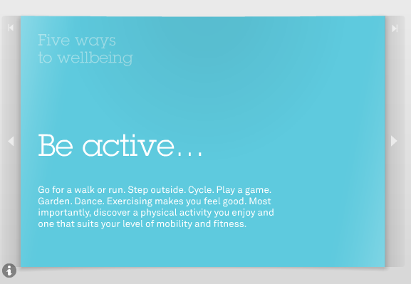
FIVE WAYS TO WELL-BEING
Five ways to well-being website
Copyrighted Material: Alan Walker, Active Ageing, Prague, 31st May 2012

Slide 27
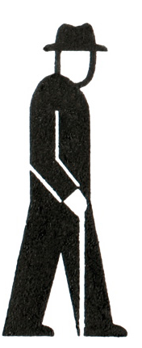
AGEING IS INEVITABLE BUT MALLEABLE
ENVIRONMENTAL
DAMAGE
ENVIRONMENTAL
DAMAGE
EXTRINSIC
EXTRINSIC
INTRINSIC
(GENETIC)
AGEING= LOSS OF FUNCTION/ ADAPTABILITY
Adapted from Grimley Evans (2004)
Copyrighted Material: Alan Walker, Active Ageing, Prague, 31st May 2012

Slide 28
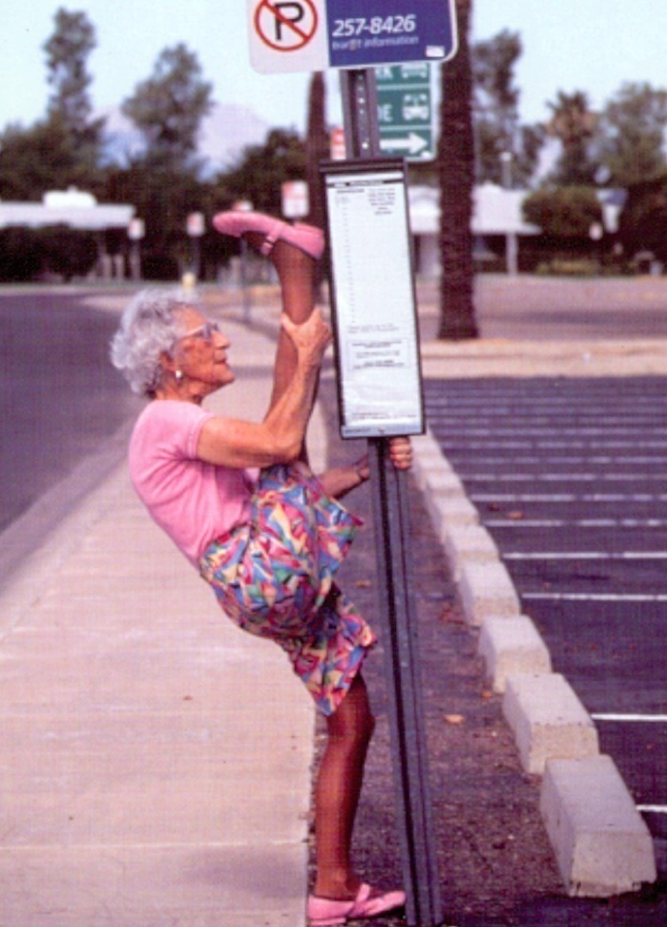
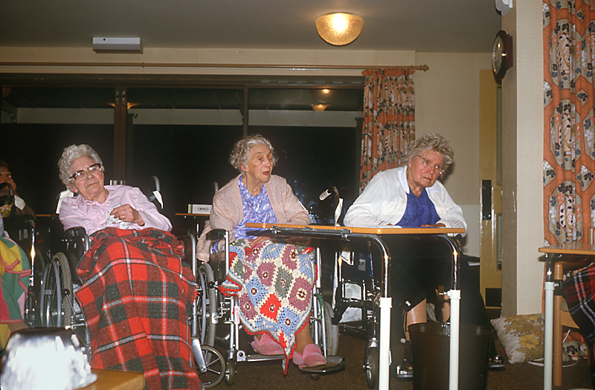
VARIABILITY IN AGEING
Copyrighted Material: Alan Walker, Active Ageing, Prague, 31st May 2012

Slide 29
LIVE LONGER AND HEALTHIER, DIE FASTER
Prevention (postponement)
lifestyle: education, knowledge, opportunities, incentives
public health and medical care
Enabling environments
architecture, transport, education,
working conditions, culture and
sport, safety
prosthetics: physical supports, ICTs
Disability-reducing interventions
Copyrighted Material: Alan Walker, Active Ageing, Prague, 31st May 2012

Slide 30
THE FOUNDATIONS OF A GOOD QUALITY LIFE IN OLD AGE
Having good social relationships with family, friends and neighbours;
Having social roles and participating in social and voluntary activities, plus other activities/hobbies performed alone;
Having good health and functional ability;
Living in a good home and neighbourhood;
Having a positive outlook and psychological well-being;
Having adequate income;
Maintaining independence and control over one's life.
Source: Bowling et al (2002)
Copyrighted Material: Alan Walker, Active Ageing, Prague, 31st May 2012

Slide 31
MAXIMISING QUALITY OF LIFE
Maintaining health and independence, social activities and relationships
Neighbourly and safe areas
Local amenities and services
Participation
Transport
Finance
Source: Bowling et al (2002)
Copyrighted Material: Alan Walker, Active Ageing, Prague, 31st May 2012

Slide 32
A COMPREHENSIVE MULTI-LEVEL STRATEGY
Challenging Ageism
Age Management
Combating Inequalities and Social Exclusion
(Health, Diet, Access to Health Care, Income, Living Environments, Social Participation)
Health Promotion Across the Life Course
Targeting Mental Health and Well-being
Active Civic and Community Participation
Redistribute Resources from Cure to Prevention
Enhance Social Care / Social Support (eg use of telecare)
Activities in Care Homes
Intergenerational Cycling, Walking, Swimming
Improve Access: Design for All Ages
Copyrighted Material: Alan Walker, Active Ageing, Prague, 31st May 2012

Slide 33
CAN ACTIVE AGEING EMPOWER?
Great potential BUT....
...... IT MUST BE:
Rescued from the deficit paradigm
Comprehensive: age, activities, actors, policies
Preventative
Sensitised to unequal ageing
Based on an empowering, human rights perspective
Optimistic about ageing and the potential of older people
Copyrighted Material: Alan Walker, Active Ageing, Prague, 31st May 2012

Slide 34
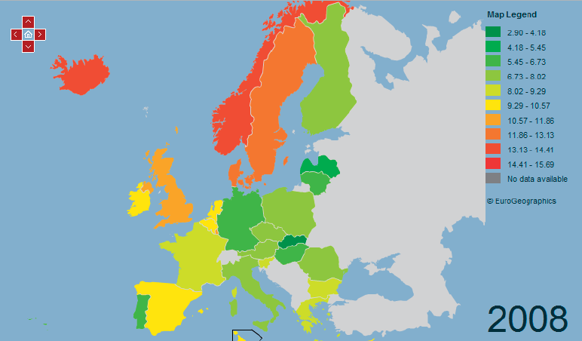
HEALTHY LIFE YEARS AT AGE 65 FOR MEN
Copyrighted Material: Alan Walker, Active Ageing, Prague, 31st May 2012

Slide 35
PRINCIPLES OF AN ACTIVE AGEING STRATEGY
All Activities That Contribute to Well-being (Mental and Physical)
A Life Course Perspective: Maintaining/Regaining Mental and Physical Capacity
Emphasise Prevention (Primary and Secondary)
Use All Policy Levers – Upstream and Downstream
Include All Ages (all older people)
Recognise unequal ageing
Empowerment Approach
Respect for Cultural Diversity
Copyrighted Material: Alan Walker, Active Ageing, Prague, 31st May 2012

Slide 36
ACTIVE AGEING
Active ageing should be a comprehensive strategy to maximise participation and well-being as people age. It should operate simultaneously at the individual (lifestyle), organisational (management) and societal (policy) levels and at all stages of the life course
Copyrighted Material: Alan Walker, Active Ageing, Prague, 31st May 2012

Slide 37
ACTIVE AGEING
AGENDA
Models of Ageing – A Critique
From Activity Theory to Active Ageing
The Conflict within Active Ageing
Can Active Ageing Empower?
Copyrighted Material: Alan Walker, Active Ageing, Prague, 31st May 2012

Slide 38
KEY MESSAGES
Active Ageing has the potential to prevent many of the negative effects of ageing at the individual, organisational and societal levels BUT..............IT MUST BE:
Comprehensive (age, activity, policy)
Inclusive (bottom-up/top-down)
Active Ageing could be a major source of empowerment across the life course and into advanced old age BUT..............IT MUST BE
Aligned with a new vision of ageing
Based on clear principles
Copyrighted Material: Alan Walker, Active Ageing, Prague, 31st May 2012

Slide 39
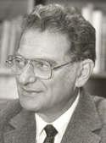
ACTIVE AGEING:
A Source of Empowerment?
Daniel Thursz (1929 - 2000)
Thank you, Děkuji
http://www.newdynamics.group.shef.ac.uk/
Copyrighted Material: Alan Walker, Active Ageing, Prague, 31st May 2012

