Slide 1
Midlife working conditions and health later life – comparative analyses.
Morten Wahrendorf
International Centre for Life Course Studies in Society and Health
Imperial College London

Slide 2
Background
Whereas the descriptive evidence of current health inequalities of older populations is convincing, the explanations proposed so far are less conclusive.
From a life course perspective, conditions during earlier stages of the life course, such as working conditions during midlife are of interest.
Moreover, it is of interest to invest if national social and labour market policies affects working conditions.

Slide 3
Background
Socio-political background (welfare state)
Midlife working conditions
Health and retirement behavior
40 | 45 | 50 | 55 | 60 | 65 | 70

Slide 4
Objectives
To describe midlife working conditions based on retrospective lifegrid data (SHARE and ELSA).
To study long-term influences of these mid-life working conditions on…
… health among men and women who left the labour exit.
… retirement behaviour.
To analyze possible cross-national variations of working conditions according to different macro indicators related to labour market policies (SHARE, ELSA, HRS, KLoSA, JStar).

Slide 5
Methods
How to collect information on mid-life?
While `regular´ waves of SHARE and ELSA collect information among employed people only, both surveys also include a specific retrospective survey with information on working life among people who already left the labour market.
This enables to link retrospective information on mid-life working conditions with data on health after labour market exit.

Slide 6
Lifegrid
Information on each job since leaving full-time education
Social position (based on ISCO groups)
Job industry
Full or part time job
Monthly wage
Quality of work (main job or present job)
Information on each existing gap lasting 6 month or longer
Unemployed
Sick and disabled
Looking after home or family
Retired from work
Job loss

Slide 7
Background
On this basis, we derived the employment situation for each age between 15 and 65.
. lab list sitprof
1 working / full-time
2 working / part-time
3 unemployed
4 domestic work
5 retired
6 full-time education
7 other

Slide 8
Results

Slide 9
Background

Slide 10
Measures
To measure working conditions, we rely on core assumptions of existing theoretical models of work stress (the demand-control-support and the effort-reward imbalance model) and distinguish four types of unhealthy working conditions – referring to the time frame between the age of 40 and 55:
a stressful psychosocial work environment (in terms of low control and low reward in main mid-life occupation)
a disadvantaged occupational position throughout the whole period of mid-life (mean occupational position)
experience of involuntary job loss during mid-life (being left off)
job instability during mid-life (unemployment, discontinued, fragmented working career)

Slide 11
Results

Slide 12
Results
Association between mid-life working conditions and high depressive symptoms in older ages: Results of multilevel logistic regression analyses (odds ratios and significance levels, N=8609).
 |  |  | Male |  | Female
Psychosocial stress during mid-life
 | Low work control | Yes | 1.68*** |  | 1.27**
 |  | No | - |  | -
 | Low reward | Yes | 1.58*** |  | 1.37***
 |  | No | - |  | -
Disadvantaged occupational position throughout mid-life
 | Mean occup. position during mid-life | Very low | 1.77*** |  | 1.92***
 |  | Low | 1.26 |  | 1.50**
 |  | High | 1.22 |  | 1.28
 |  | Very high | - |  | -
Involuntary job loss
 | Laid off | Yes | 1.54* |  | 0.84
 |  | No | - |  | -
Job instability
 | Period of unemployment | Yes | 1.72* |  | 0.78
 |  | No | - |  | -
 | Discontinuous and fragmented career | Yes | 1.67*** |  | 1.17
 |  | No | - |  | -
* p < 0.05; ** p < 0.01; *** p < 0.001
adjusted for age, childhood social position and child health

Slide 13
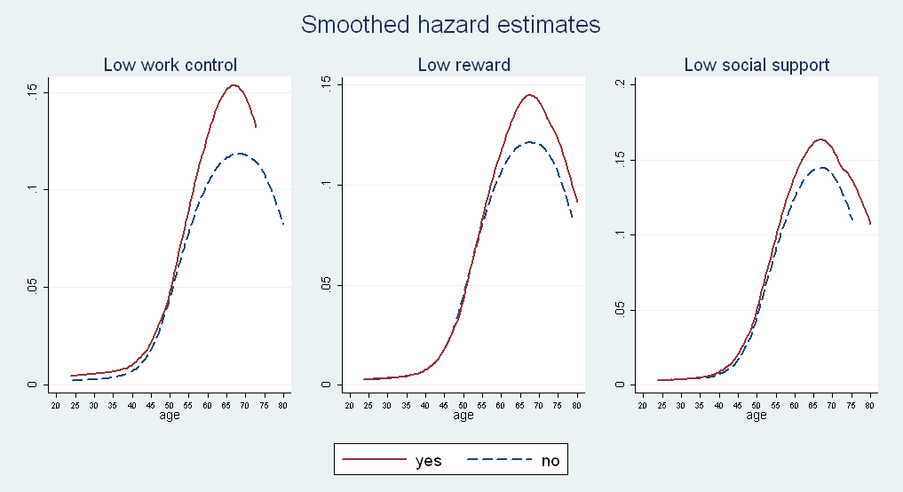
Results

Slide 14
Summary I
We found evidence that people who experienced psychosocial stress at work or had low occupational positions during mid-life are more likely to report poor health during retirement (similar results for other health outcomes).
Moreover, men with unstable working careers and an involuntary job loss were at higher risks to report poor health in later life.
We also found higher hazards of earlier labour market exits among workers who experienced poor working conditions, in terms of low control at work and low reward.

Slide 15
Methods
To study the next research question (variations of midlife working conditions), we focus on work stress among employed people and include additonal data from three ageing studies (Total: 18 countries).
 | ELSA | SHARE | HRS | KLoSA | JStar
Countries | England | Sweden, Denmark, the Netherlands, Germany, Belgium, France, Switzerland, Austria, Italy, Spain, Greece, Czech Republic, Poland | United States of America | South Korea | Japan
Year | 2293 (2006) | 8692 (2006) | 1739 (2006) | 1893 (2006) | 1512 (2007)
Mean age | 56.2 | 55.9 | 57.4 | 55.9 | 57.5

Slide 16
Methods
We choose specific macro indicators related to labour market policies of a country taken from OECD.
Percentage of adult workers who stated that they received workplace training or education, such as training programs for older adults (lifelong learning)
the amount of the state’s investments in active labour market policies (as % of GDP)
Both aspects are thought to be related to `good´ Working conditions, since they improve the level of qualification and influence job stability.

Slide 17
Results

Slide 18
Results

Slide 19
Results
We additionally conducted multilevel models and studied to what degree between-country variations of work stress can be attributed to the macro factors under study.
Importantly, this also allows to account for population composition by including individual variables (gender, age, education, income, self-employment, work time).
 |  | Effort-Reward Imbalance | Low control
Individual factors |  | 28 % | 1 %
Individual factors + ALMP |  | 32 % | 27 %
Individual factors + Lifelong learning |  | 62 % | 64 %

Slide 20
Summary II
Midlife working conditions, in terms of psychosocial stress at work, were generally better in countries with a pronounced active labour market policy and high participation rates in training programs for adults (lifelong learning).
Multilevel analyses suggest that between-country variations can substantially be explained by lifelong learning.

Slide 21
Conclusions
In conclusion, results demonstrate robust associations of the studied working conditions in mid-life with health after labour market exit and hazards of earlier labour market exits.
Furthermore, results show that an active labour policy for older workers and the investment into continued education during working are positively related to a favourable psychosocial work environment.

