Slide 1
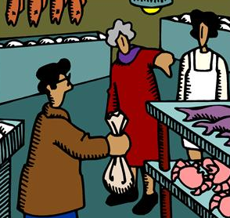
Older Peoples’ Interaction
in their Local
Neighbourhood Shops
Image permission: Microsoft
Joan Stewart
Professor Colette Browning
Dr Jane Sims

Slide 2
A exploratory classic grounded theory investigation into older peoples’ social interactions
in their local neighbourhood shops

Slide 3
Why?
The social aspect of shopping is apparent
We know little about this social activity of older people, especially two-way interaction

Slide 4
club
family
church
friends
?
neighbours
consequential strangers / peripheral ties
Fingerman,2004

Slide 5
Implications of incomplete understanding
Research compromised
Assessment of whether an older person has social deficit may be flawed

Slide 6
MethodSample
Data
Site
Classic grounded theory
Theoretical
Older shoppers (av. age 79) Shop-keepers
Interviews
Observation

Slide 7
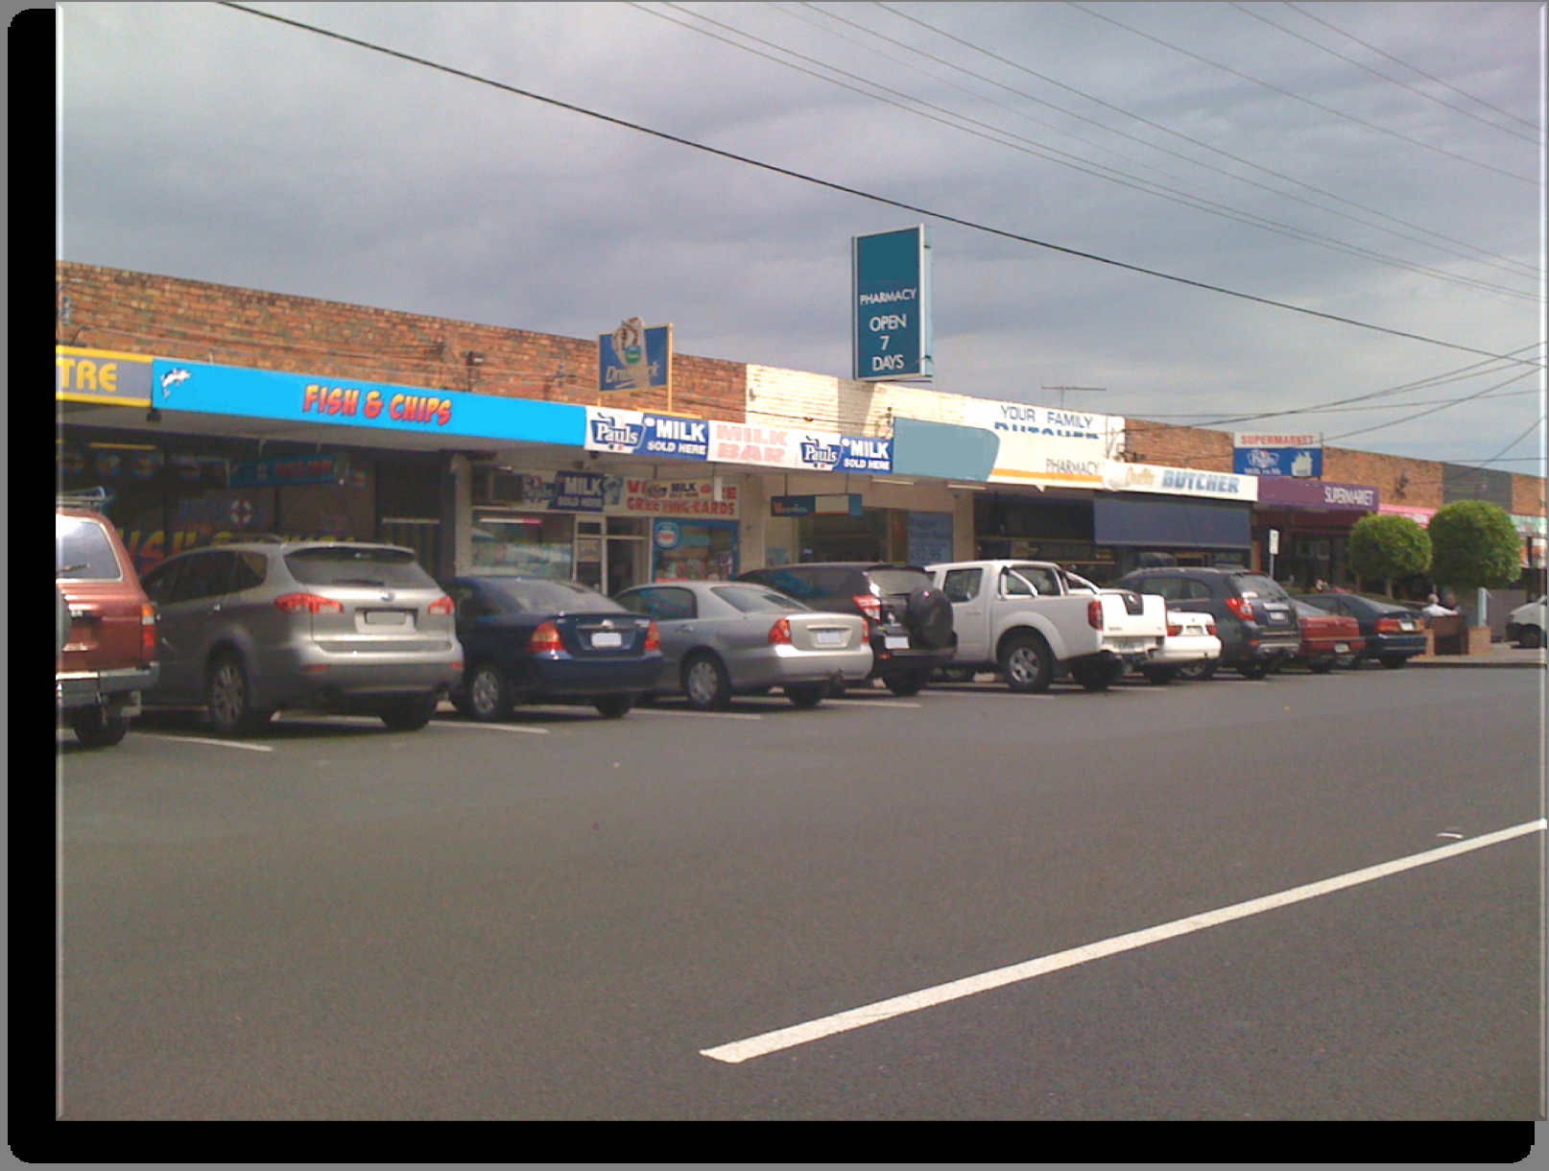

Slide 8
Classic Grounded Theory
Barney Glaser & Anselm Strauss 1967
Underpinned by no theoretical stance
An inductive method
Emergence of the participants’ main concern
Conceptual theory of how participants resolve their concern

Slide 9
Coding
Identity work
Status work
Trust
‘You get to know the people (shopkeepers) an they get to know you’
‘I feel if I’m buying something they (shopkeeper) should be polite to me’
‘People who go there all the time it’s a bonding experience …that stems out into this society we all help each other because we know and we see each other’

Slide 10
Monitoring
Censoring
Maintaining
‘It’s a nice you feel safe how can I put it you don’t see anybody there and you think, oh I don’t like the look of them’
‘That was the grocer yes he wanted a a licence for liquor but we already had a liquor shop see so we all howled that down’
‘We’ve got everything if we wanted it... say we don’t drive a car anymore you could go down here and almost get anything you want’

Slide 11
Identity work
Status work
Trust
Monitoring
Censoring
Maintaining
Codes
Category
Authentication
Membership
Influence
Main
concern
of
the
participants

Slide 12
Main concern
Consolidation

Slide 13
Aim
Civic Socialising
Selecting
Surveilling
Strategising

Slide 14
family
friends
older person
older person
church
incomers
older person
older person
friends
club
family

Slide 15
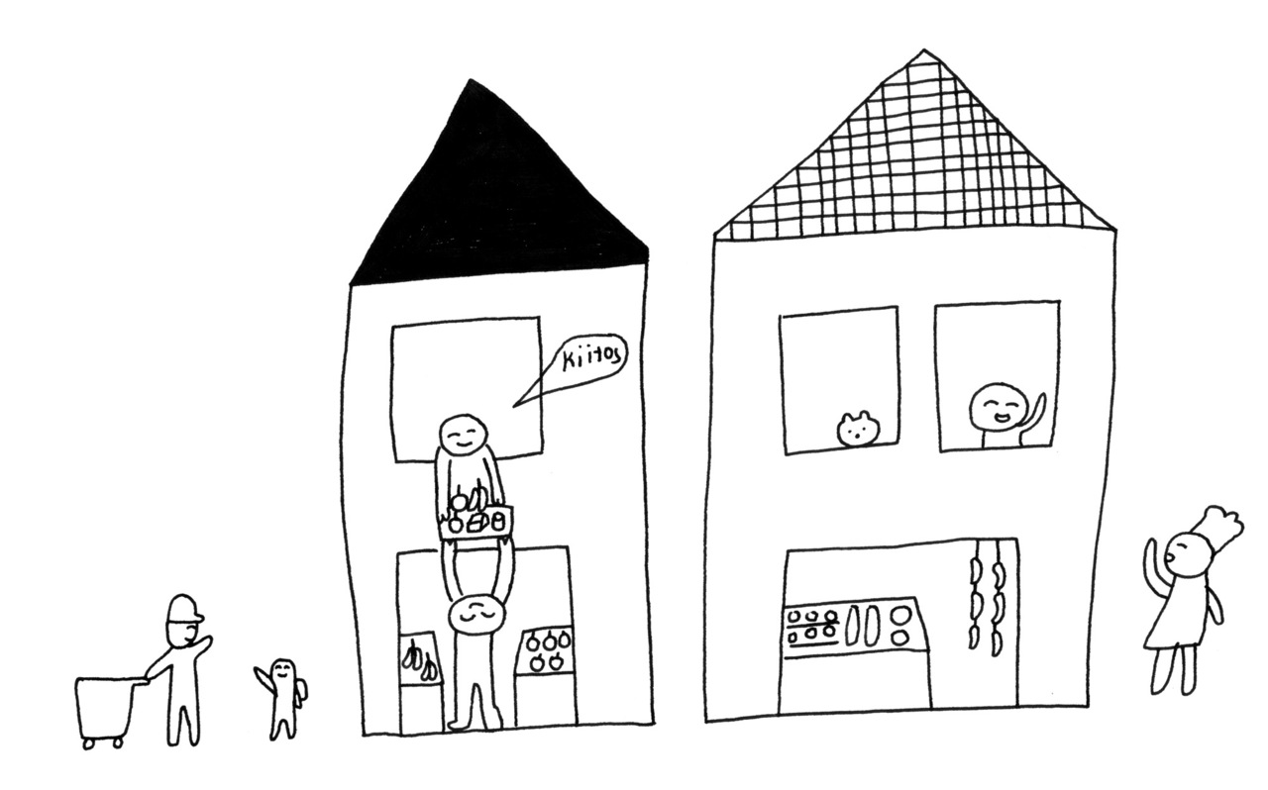
Open Helsinki project
A collaboration between Sitra and OK Do
World Design Capital
Creative Commons Attribution-Noncommercial 3.0.

