Slide 1
Wellness and 21st Century Social Stability: The Challenges Ahead
Michael Hodin
Executive Director, Global Coalition on Aging
31 May 2012

Slide 2
About the Global Coalition on Aging
VISION
MEMBERS
Global in scope
With a diverse, cross-sector membership
Animated by an optimistic view of the longevity miracle
With a clear intellectual framework, strategy, and narrative
Focused on political advocacy to decision makers in institutions of influence in society
Powered by private-sector will, commitment and innovative solutions

Slide 3
The Facts on Population Aging…
Over the past 50 years, life spans have been increasing and birth rates have been declining…
Over the past 50 years, life spans have been increasing as birth rates have been declining…
…Which is resulting in the rapid “aging” of the global population…
…Leading to a sharp increase in the old-age dependency ratio
(the ratio of the population aged 65 years or over to the population aged 15-64)

Slide 4
…The Most Seminal Issue of Our Time
Together, these demographic trends are leading to populations far older than any the world has ever seen. This phenomenon presents a unique opportunity for individuals, corporations, and governments to find new, smarter ways to live, work, and prepare for a future with a significantly greater proportion of the population over the age of 60.

Slide 5
The Growing Proportion of 65+ Population Will Lead to Skyrocketing Health Needs
1.5 billion people over 65 by 2050
65+ Population by Continent, 1950-2050
This dramatic ageing of the global population will require a new way of thinking across all sectors.
Healthy and active aging will be an essential part of keeping our populations productive and engaged.
Billions
Source: United Nations, World Population Prospects 2008 Revision, Medium Variant Forecast

Slide 6
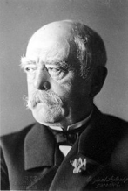
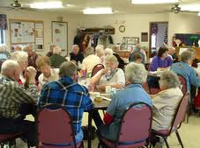
What’s Wrong? – Outdated 20th-Century Thinking…
Old People
Social/Economic Changes
Health
Economics & Growth
Social
Responsibility
Commercial Goals and Workforce Changes
Aged
Life Course
Compassion
Arithmetic
5

Slide 7
…And Obsolete 20th-Century Policies
Positioning
Today
Tomorrow
Health
Preventing and curing NCDs
Long-term care
Education
Life-course approach to learning
No specific focus
Work and Retirement
Innovative instruments for active aging
Pensions and Benefits
Fiscal
Subsidies post-50
“Headroom” for the oldest-old who need it most
6

Slide 8
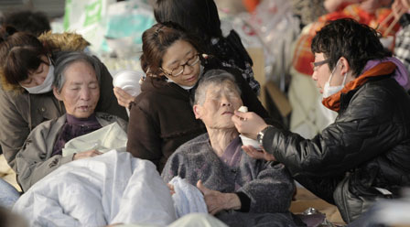
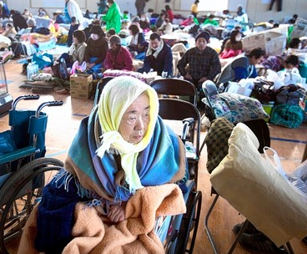
Misaligned Health Policy Leads to Social and Political Turmoil
Are our entitlement programs fit for 21st-century political discourse?
Can we afford 21st-century aging with 20th-century health and retirement models?
Do aging populations have to be so fragile?
8

Slide 9
Game Changers
Feb 13, 2012 - U.S. to Boost Alzheimer’s Research Funding by $50 Million
How Aging Is Becoming (Surprise!) Sexy
The Fiscal Times | January 26, 2012
What was most remarkable about [the 2012] Golden Globe Awards in Hollywood – that impossibly trendy and ever-cool mecca of glitz and youth – was the age of so many of its winners.
Oct 6, 2011 – Baby Boomers Keep Learning With Continuing Education Classes
Is 60 really the new 40?
It all depends on how you define the middle years of life, says author Patricia Cohen. In her new book, "In Our Prime: The Invention of Middle Age," Cohen shows how technical advances, social change and shifting tastes in beauty and fashion have redefined what we consider middle age.
9

Slide 10
Global Institutions Take Action, Elevate Population Aging to Become Part of 21st-Century Wellness
Sept. 2011: United Nations hosts high-level summit to address NCDs. Outcomes document includes focus on age-related NCDs.
June 2011: OECD 50th anniversary focus on ageing carried to 2012
Sept 2011: First International Age-friendly Cities Conference
Nov. 2011: APEC ministerial statement includes plan to “develop and APEC Strategy on Ageing”
2012: EU Year of Healthy and Active Ageing
May 2012: Japan-sponsored resolution on creation of a healthy aging strategy being presented to World Health Assembly
Jan 2012: World Economic Forum publishes Global Population Ageing: Peril or Promise?

Slide 11
And a Growing Priority at the National Level, Across All Continents...
March 2012: 1st World Congress on Healthy Ageing hosted by Malaysia
June 2011: China includes ageing on the 12th Five-Year Plan
Sep 2008: Netherlands Consortium for Healthy Ageing is launched and tasked with creating a national healthy ageing plan through 2030
Sep 2003: Tanzania’s Ministry of Labour, Youth Development and Sports launches a National Ageing Policy
Nov 2007: Australia launches new “Aged Care Australia” program within the Dept of Health and Ageing
Aug 2006: World Health Organization launches Global Network of Age-friendly Cities and Communities

