Slide 1
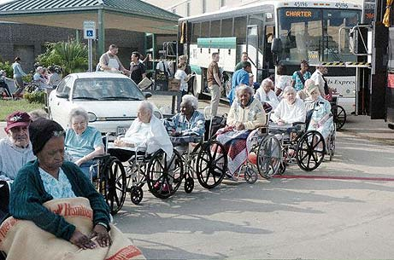
ARE WE THERE YET?
AN OVERVIEW OF WHAT HAS BEEN DONE TO MEET THE MIPAA OBJECTIVES FOR EMERGENCY SITUATIONS AND OLDER ADULTS
Kelly G. Fitzgerald, PhD
University of Zürich
Western Kentucky University

Slide 2
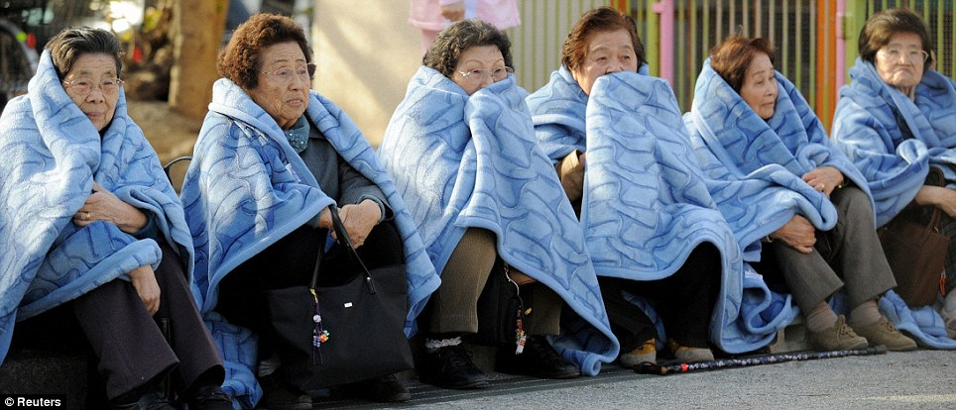
A few myths…
Myth 1: There are no older people in developing countries.
Myth 2: The extended family and community will protect older people at all times.
Myth 3: An agency will look after older people.
Myth 4: Older people can be covered by general aid distributions.
Myth 5: Older people only have themselves to worry about.
Myth 6: Older people are waiting to be helped.
Myth 7: Older people are too old to work.

Slide 3
But the facts are…
Why they might be vulnerable:
Community Dwelling
Live alone or secluded
Frail
Gender, race, education
Language/cultural barriers
Limited income and material resources
Long-Term Care Facility
Chronically ill
Higher levels of dementia
Depend on staff
Evacuation issues
How they can contribute:
Knowledge of community resources & helping networks
Volunteer with relief organisations
Assist in system restoration
Provide social support
Provide experience

Slide 4
MIPAA – Issue 8:
Emergency Situations
In emergency situations, such as natural disasters and other humanitarian emergencies, older persons are especially vulnerable and should be identified as such because they may be isolated from family and friends and less able to find food and shelter.
They may also be called upon to assume primary caregiving roles. Governments and humanitarian relief agencies should recognize that older persons can make a positive contribution in coping with emergencies in promoting rehabilitation and reconstruction.

Slide 5
MIPAA Objectives
1. Equal access by older persons to food, shelter and medical care and other services during and after natural disasters and other humanitarian emergencies.
2. Enhanced contributions of older persons to the reestablishment and reconstruction of communities and the rebuilding of the social fabric following emergencies.

Slide 6
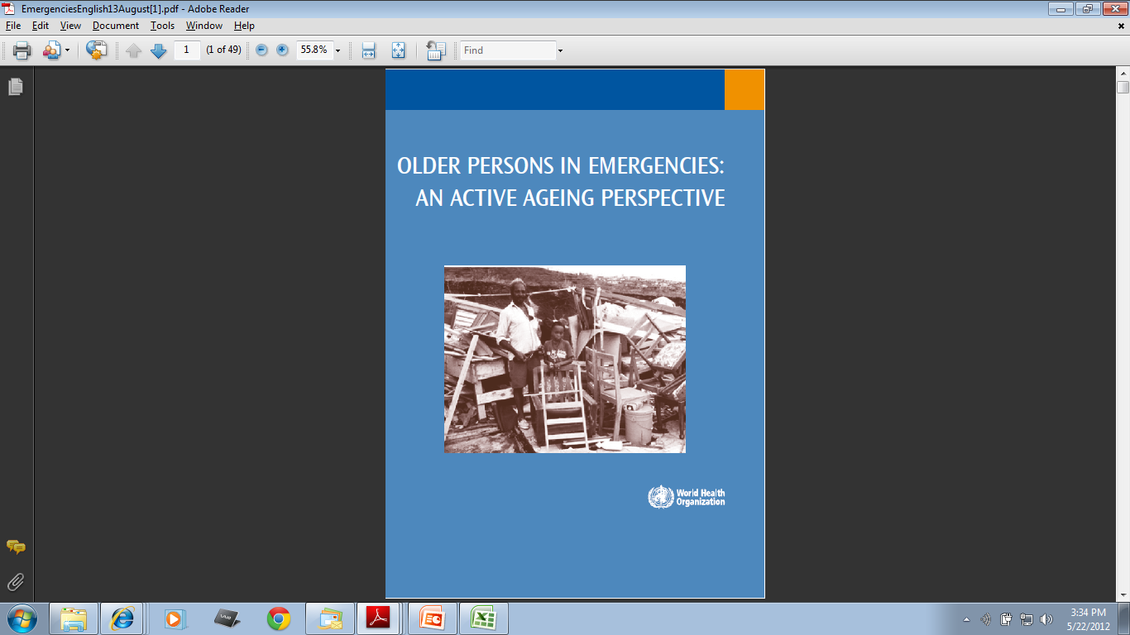
2006-2007
WHO response to MIPAA
Case studies
How did older people fare in disasters in both developed & developing countries
Recommends Active Ageing framework

Slide 7
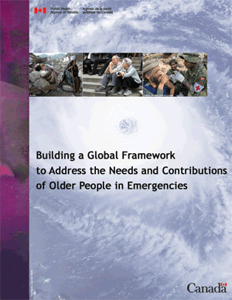
Since 2006, the Public Health Agency of Canada’s Division of Aging and Seniors and Centre for Emergency Preparedness and Response have spearheaded efforts to bring together experts from gerontology and emergency management to raise awareness of key issues and create new partnerships with a mandate for advocacy and action.

Slide 8
Q: What do we know about caring for frail older persons in disasters…
A: Our knowledge synthesis confirms the opinion of AARP after Hurricane Katrina: We know enough to do better.

Slide 9


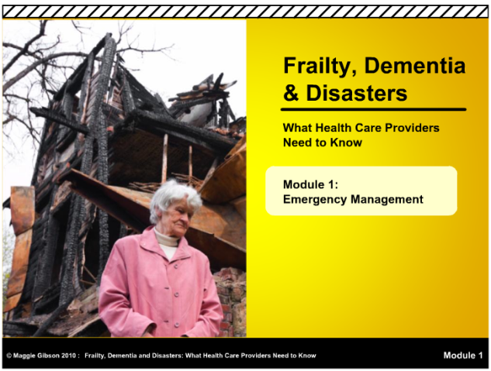
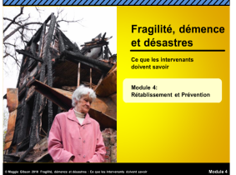
Frailty, Dementia and Disasters:
What Health Care Providers Need to Know:
A Knowledge Translation E-learning Resource
Maggie Gibson, Veterans Care Program, St. Joseph’s Health Care, London, Ontario; Danielle Maltais, Department of Human Science, University of Quebec, Chicoutimi, Quebec; Louise Hardy, Health and Social Services, Yukon Territory Government, Whitehorse, Yukon Territory; Sonja Ruthe, Emergency Program, Corporation of the District of Oak Bay, Victoria, British Columbia; CANADA Contact: maggie.gibson@sjhc.london.on.ca
Purpose
To contribute to international efforts to reduce the disproportionate vulnerability of older adults in natural and human-made disasters by developing, piloting, evaluating and disseminating an e-learning resource on frailty, dementia and disasters for health care providers. The objectives of the e-learning resource are to raise awareness of the:
Disproportionate vulnerability of older adults who are frail and those who have dementia, in emergencies and disasters;
Components of the emergency management cycle and how they apply to this target population;
Best practice resources that can be used to improve emergency preparedness, response, recovery and mitigation; and
Role of health care organizations and providers in emergency management for older adults who are frail and those who have dementia.
Knowledge Translation (KT) Process
Knowledge Synthesis
The Seniors and Emergencies: International Working Group on Health Care Providers and Continuity of Health Services (IWGHP) sponsored by the Public Health Agency of Canada provided content expertise.
Content was formatted as a powerpoint presentation and piloted in an invited workshop in London, ON (N~50).
E-learning Development
Care providers and educators from across Canada (N=14) provided feedback on storyboards and the first version of the e-learning tool as it evolved from powerpoint to e-learning modules.
Two in-person pilots were conducted in each of Whitehorse, YK (N=33) and Chicoutimi, QC (N=17).
An on-line pilot was conducted in South Vancouver Island, BC (N=13).
Webhosting
E-learning Modules
Emergency Management
This Module provides an introduction to:
Preparedness
This Module uses an extreme weather scenario to illustrate :
Response
This Module invites learners to:
Recovery and Mitigation
In this Module learners:
The vulnerability of older people who are frail and those who have dementia in disasters;
The components of the emergency management cycle.
What can happen when a health care provider doesn’t pay attention to emergency preparedness;
How to help clients and their caregivers prepare for an emergency.
Reflect on how health care providers can contribute to the response component of the emergency management cycle;
Become aware of two best practices – Psychological First Aid and the SWiFT triage tool.
Learn about the importance of addressing the recovery challenges of older adults;
Reflect on how care providers can contribute to mitigation activities;
Are encouraged to complete an Emergency Management Action Plan.
A KT Resource Group provided technical guidance in support of webhosting by CDRAKE at www.dementiaknowledgebroker.ca

Slide 10
2008…
UN Department of Economic and Social Affairs report “Regional Dimensions of the Ageing Situation”
First review & appraisal at national, regional & international level
African region highlights:
  Drought, floods, and pestilence (along with other natural disasters), & forced migration to displacement camps
  Disasters impede poverty reduction
  Disasters compound other problems and older people can not fend for themselves or access relief

Slide 11
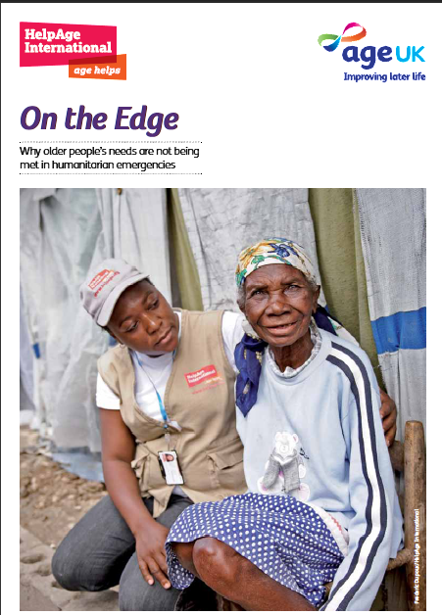
HelpAge International
HelpAge has 20+ years' experience of working with and for older people in emergencies.
They work to ensure that older people are included in immediate and long-term humanitarian relief efforts on the ground, and in humanitarian policies and guidelines.
www.helpage.org

Slide 12
Economic & Social Commission for Asia & the Pacific (ESCAP)
AUSTRALIA: Out of your budget for programmes for older persons, which areas receive the highest budgetary allocation? Please rank the areas below in order of budget allocation.
Provision of old age pension schemes | 1
Access to affordable health care | 2
Development and strengthening of geriatric services | 7
Provision of long-term care services for older persons | 3
Training and support for caregivers | 4
Provision of affordable and age-friendly housing for older persons | 6
Research on ageing | 5
Support to older persons in emergency and conflict situations
Other, please specify:
[1 = highest amount, 9 = lowest amount]
Source:
United Nations Economic and Social Commission for Asia and the Pacific, Regional Survey on Ageing 2011: Australia
Name of the coordinating body - Office for an Ageing Australia
http://www.health.gov.au/internet/publications/publishing.nsf/Content/ageing-un-report-regional+survey-ageing-2011-toc~i.htm

Slide 13
Issue : Emergency situations | Objective 1: Adequate and appropriate access of older persons to disaster risk reduction measures and management plans, including food, shelter and medical care and other services before, during and after natural disasters and other humanitarian emergencies. | 3 Actions: *Ensure that the needs of older persons are addressed in disaster risk reduction and management plans. *Ensure the voice of older persons is heard in response to disasters and in reducing the impact of climate change. *Address the issue of social isolation of internally displaced older persons in time of social conflict and emergency situations.
 | Objective 2: Enhanced contributions of older persons to the reestablishment and reconstruction of communities and the rebuilding of the social fabric following emergencies.
Source: ESCAP - Preparatory Meeting for the Asia-Pacific Intergovernmental Meeting on the Second Regional Review
and Appraisal of the Madrid International Plan of Action on Ageing

Slide 14
UN Economic Commission for Europe (UNECE)
Country Reports 2012
Implementation of the UNECE Regional Implementation Strategy (RIS) of the Madrid International Plan of Action on Ageing (MIPAA)
  http://www.unece.org/pau/age/mica2011/country_reports_2012.html
Quick review of several English reports do not mention ‘disasters’ or ‘emergencies’ (as related to disasters)

Slide 15
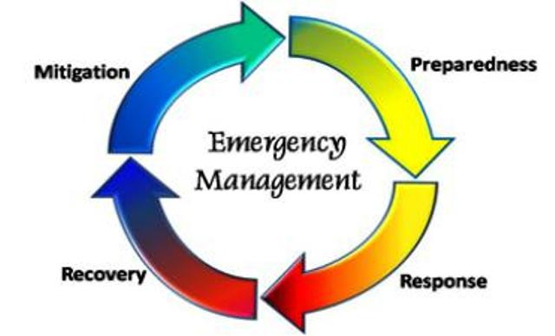
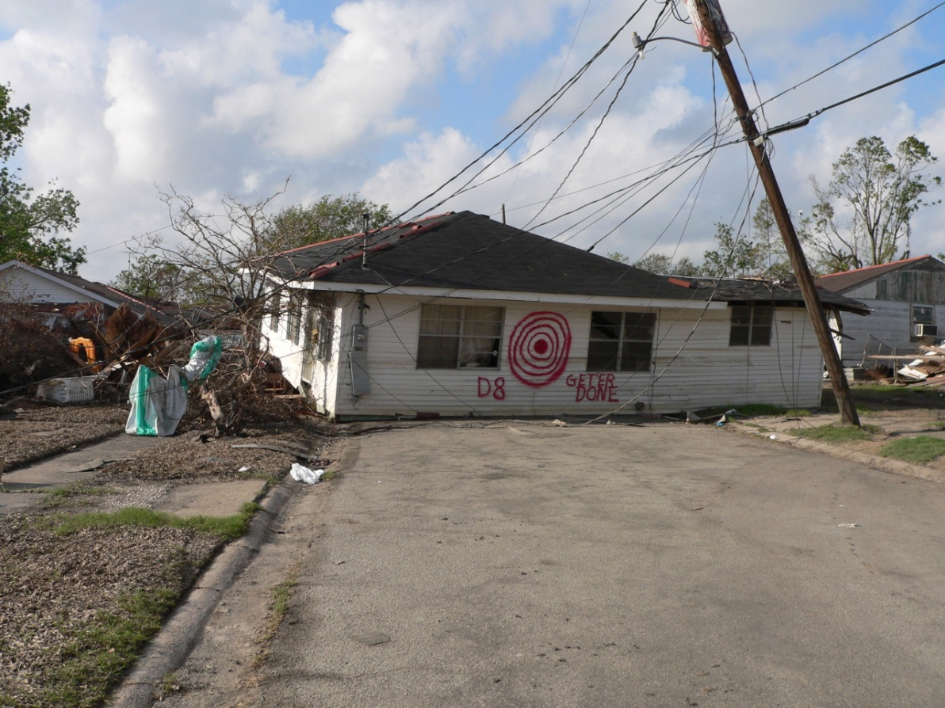
Are we there yet?...
Probably NOT!

