Slide 1
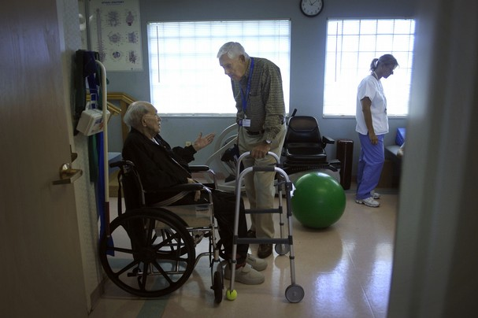
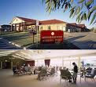
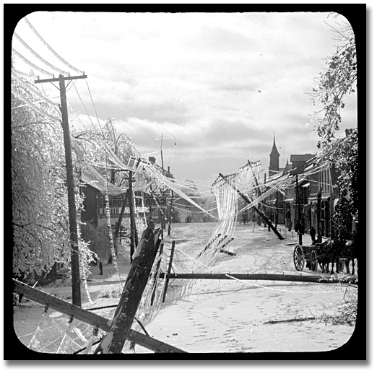
Long Term Care Facilities: Are they Equipped to respond to Disasters?
Sandra P. Hirst RN, PhD, GNC(C)
IFA, 2012
Notes:
Disasters, by their very nature, overwhelm the available resources of a community to respond. Lives will be disrupted and injuries, even death may result. As disaster response has become more formalized within Canadian society in general and in its communities in particular, disaster planning has assumed more prominence. Authorities, at all levels of government, are mandated to both prepare for unanticipated disasters and to take steps to prevent them from occurring. However, not all disasters are preventable.
Older adults, especially those residing in long term care facilities, are among the most vulnerable within Canadian society when a disaster occurs. Most of these residents have serious physical limitations, diminished cognitive functioning, and chronic disease pathologies that prevent them from acting independently in response to a disaster.
Discussed in this presentation are some of the challenges faced by the administrators and staff of long term care facilities in modifying emergency disaster responses to meet the needs of older adults under their care. A systematic review of the literature revealed that relatively little has been published on this topic. However, the insights gained from the literature will facilitate in building a health care practice model that will both ensure that long term care administers have a place as leaders in the response effort and will promote the safety of the older adults.

Slide 2
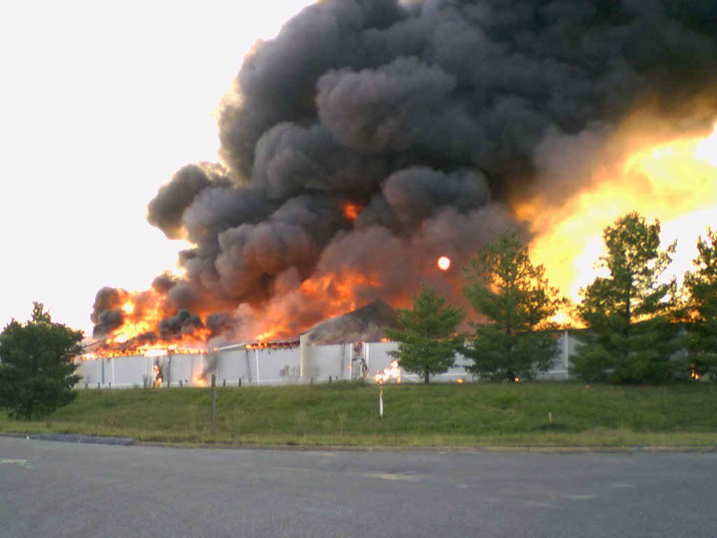
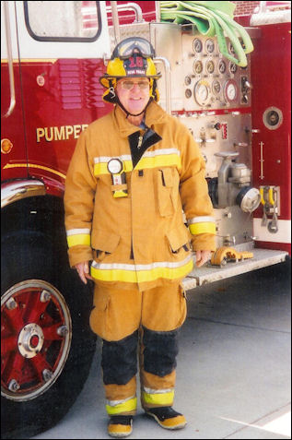
Notes:
Assume that 20 minutes from now, a fire breaks out in a building down the street from your facility. Flames burst from the windows, while black smoke shrouds the neighbourhood. A firefighter appears at your reception desk and says that he might ask you to evacuate your staff and residents shortly, "depending on the toxic fume hazard."
Are you prepared for such an event? Many long term care facilities aren't, despite occasional fire drills and binders crammed with directions from emergency response agencies.

Slide 3
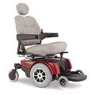
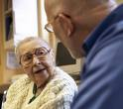

Outline
  Laying the context of our work
  Population of LTC facilities
  Literature review
Initial review
Overview of study
  Questions
  Method
Findings
  Challenges
    Promoting connections
    Population specific
    implementation
Discussion of Findings

Slide 4
Context of Our Work: LTC
Residents
Staff
Policies, practices, legislation
Physical structure

Slide 5
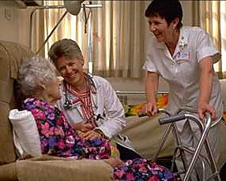


Resident Population of LTC
Special challenges
  Functional ability e.g.
  walking, ability to follow
  instructions
  Medications / life essential
  treatments e.g. O2
  Equipment e.g. wheelchair,
  walkers
Notes:
Older adults in LTC facilities are among the most vulnerable of Canada’s population for they do not often have the ability to make decisions or take actions for themselves.
Caring for residents with Alzheimer's disease or dementia during a disaster situation is of concern for many facilities. These older residents are especially vulnerable to the stress of a disaster. If pharmaceutical supplies ran out or were destroyed and they were without their medications, some of these residents may present a danger to themselves and others. Residents with Alzheimer's and related dementia are typically located in secure units where staff can monitor them closely. Some facilities have monitoring systems (e.g., Lifeline, WanderGuard) to prevent residents with these conditions from wandering beyond supervised areas. In the case of a power outage, these systems would cease to function (since they require electricity), resulting in the need for additional staff to supervise these residents to keep them safe.

Slide 6
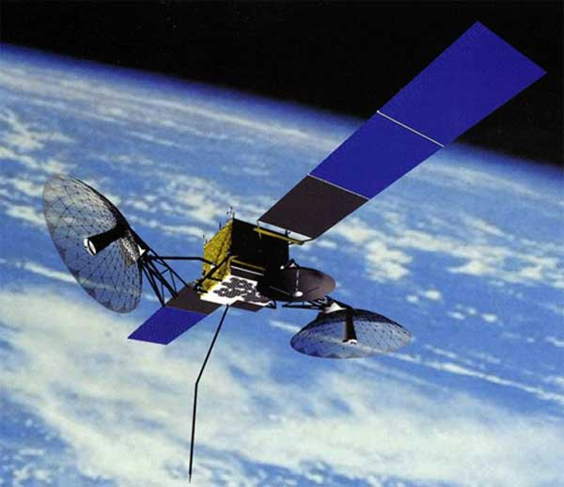
Residents
Staff
Policies, practices, legislation
Physical structure
Notes:
Technology and old age are not strangers to each other.
What is new is the emerging attention being given to the interface between technology solutions specific to disaster management and long term care facilities.
Technology is a potential enabler in creating disaster management systems that are integrated, reliable, and addresses the needs of older adults living in long term care facilities in efficient and effective ways.

Slide 7
Policies, regulations, and laws
  Brown, Hyer & Polivka-West, 2007
  Hyer, Polivka-West & Brown, 2007
Evacuation plans used by LTC facilities
  Castle, 2008
  Fitzgerald, 2008
Response systems
  Castro, Pearson, Berstrom & Cron, 2008
  Hyer, Brown, Berman & Polivka-West, 2006
  Laditka, Xirasagar, Cornman & Ritchter, 2008
Impact upon residents
  Castle & Engberg, 2011
Notes:
Brown experienced prolonged power failure A comparative study of laws, rules, codes and other influences on nursing homes' disaster preparedness in the Gulf Coast states.
Hyer et al., During Katrina, NHs were not recognized as health care providers by emergency management offices
Federal regulations mandate emergency electrical power for lighting entrances, exits, and life support systems; Respondents recognized that prolonged power outages challenge staff and create potentially dangerous conditions. Nursing staff did not want to administer medications by flashlight but had no choice. Regulations should require sufficient generator power to run air conditioning, laundry, and lighting.
Castle - compared health outcomes Louisiana NH sfollowing Katrina – to matched sample in other southern southern NHs – relocated residents more likely to die & more likely to have pressure sores
Fitzgerald status / evaluated potential efficacy of nursing home plans Mass.; findings: 97% had a plan; but 90% of respondents expected to receive emergency info via telephone, 65% from telephone
Laditka, Xirasagar, Cornman & Ritchter - the experiences of nursing homes that sheltered evacuees from Hurricane Katrina (14 NH in 4 states – 458 evacuees); findings: most facilities were well prepared for emergency triage / treatment, facilities not included in community planning – insufficient, communication / information about older residents provided
Indicates potential role for technology

Slide 8
Overview of our Study: Questions
What challenges are faced in the introduction of disaster management technology into long term care facilities?
What recommendations / strategies might facilitate the adaptation of disaster management technologies into long term care facilities?

Slide 9
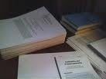
Method
Environmental scan
  specialized searches of Academic One File, Academic Search Complete, and Credo databases
  free word texts
  Interlibrary loan
Internet search
Informal conversations key stakeholders
Notes:
Environmental scanning is “the acquisition and use of information about events, trends and relationships in an organization’s external environment, the knowledge of which would assist management in planning the organization’s future course of action.”
The goal of scanning is “the gaining of new knowledge that enables action.”
Not met to be all inclusive – to obtain all information

Slide 10
Limitations
English speaking resources
  Research
  Some translation from French
Obtainable by reviewers
Last decade for publications / credibility / current trends

Slide 11
Findings
Promoting Connections
  Challenges
    Promoting communication and meeting information needs
    Structural specific factors
    Inadequate infrastructures
Notes:
Challenge - promoting communication and meeting information needs. During a disaster, it is essential to have the right data, at the right time, displayed logically, to respond and take appropriate action. Overarching requirements for the success of these technologies include the interconnectivity between different information systems to guarantee completeness and continuity of information between long-term care facilities, transfer locations, and care documentation systems.
The lack of interconnectivity between safety monitoring technologies and other devices, such as telemedicine and tele-health devices.
Lack of information systems’ interoperability and device interconnectivity.
Challenge - structural specific factors. Disaster personnel need detailed information concerning pipelines, building layout, electrical distribution, sewer systems, and so forth. Without this capability, workers must gain access to a number of long term care department managers, their unique maps, and facility specific data. Most disasters do not provide time to gather these resources. This results in responders having to guess, or make decisions without adequate information. This costs time, money, and perhaps lives.
Evacuation when electricity fails for e.g. out of long term care facility, electric generated wheelchairs
Challenge - inadequate infrastructures.

Slide 12
Population Specific
  Challenges
    Transportation of older adults with complex needs
    Medication and equipment management
    Location / Tracking
Notes:
This category of challenges relates to the older resident per se.
Challenge - transportation of older adults with complex needs both within facility and relocation if required outside the facility.
Challenge - medication management
Challenge – location / tracking
Meeting needs of families specific to the location of their older member

Slide 13
Implementation
  Challenges
    Lack of consensus on value
    Negative misconceptions
    Lack of financial incentives
Notes:
Challenge - lack of consensus on value. There is a shortage of outcome studies demonstrating the value of the technologies, especially regarding their cost-effectiveness and efficiency. Research is needed to quantify the value that disaster technology can hold for older residents and long term care facilities. The few studies conducted have been on a small scale, leaving researchers questioning whether larger-scale studies would produce similar results. Without such evidence, stakeholders are unable to reach consensus about the value of disaster management technologies within long term care facilities.
The shortage of funding for large-scale research projects, particularly outcome-oriented research with providers and funders to demonstrate technologies’ efficacy and cost-effectiveness.
There is a need to understand how residents interact with technology and use the lessons learned to design technologies that would promote use among LTC facilities.
Challenge - negative misconceptions. Administrators remain either unaware of or are resistant to new technologies that could enhance the mandate of their facilities. This lack of awareness can be attributed, in part, to a lack of educational initiatives that could raise awareness of technology's potential benefits. In addition, administrators who have had previous problems using technology are uncertain about whether these technologies are right for them and with misconceptions about their own need for this technology they are likely to be particularly resistant to trying new high-tech devices within their facilities.
LTC facilities’ denial that they need assistance. The complexity of simplifying technology use to cater for a broad spectrum of users, and their varied levels of capabilities, competence, and comfort with the technology – many staff might not be familiar with technology and have English as a second language
The perception that using technology will increase liability exposure for care providers and the lack of legislation to reduce or limit such liabilities.
Perceived intrusiveness of the technologies and emphasis on privacy, without perhaps regard to the value of effective and controlled sharing of health information.
Challenge - lack of financial incentives. Administrators and long-term care facility owners / operators will be hesitant to invest in operational processes that make the most of aging services disaster technologies unless they have financial or other incentives (for e.g. legal, mandated by health authorities) to do so.
Technology costs including the cost of the devices and the infrastructure needed to support them. In healthcare, technology is often cited as the reason for increased costs of delivering services
Particularly when technology is first introduced and lack of clarity about who should pay for it or the interventions that these technologies enable.
Significant upfront research and development cost for cutting-edge technologies and the shortage of funding for such projects.

Slide 14

Strategies to Address Identified Challenges

Slide 15

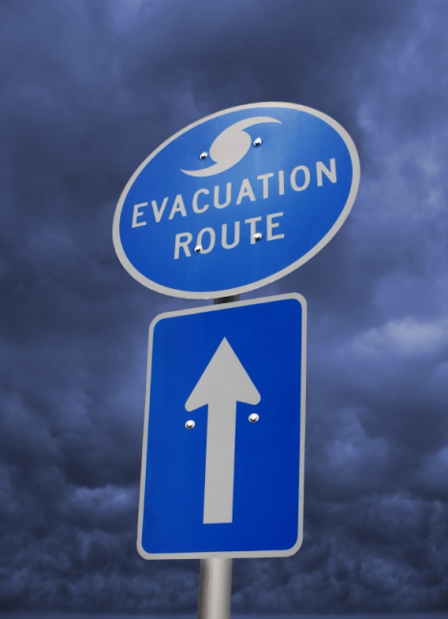

Connectivity Specific Strategies
Raise awareness of benefits of disaster management technologies in LTC
Improve interconnectivity
Consider GPS technology
Integrate social connectedness
Notes:
Raise awareness - Educational efforts geared toward consumers, their formal and informal caregivers, LTC providers, health care professionals, policy makers, industry leaders. Messages should be communicated by appropriate credible organizations through conferences, demonstrations, and awareness campaigns aimed at key audiences.
Improve interconnectivity between social connectedness and home-based technologies (such as cell phones, email) so that families are informed of the status of their older member.
Disaster distribution centres supplies (medical, food, water, clothing, etc.) can be assigned in appropriate amounts to shelters based on the numbers / medical diagnosis / health needs of older residents in each area.
Simplified device and user interface designs through participatory design approach that engages the users, particularly administrative staff; consider needs of families; GPS can locate within each damaged facility, the type and amount of damage, and begin to establish priorities for action (triage).
Laptop computers can update the primary database from remote locations. GPS can display overall current damage assessment as it is conducted / and geographic area near LTC facility.
GPS - Personnel share information through databases on computer generated maps in one location. Most data requirements for disaster management are of a spatial nature & can be located on a map.
Preparedness includes those activities that prepare for disasters. Questions: Where should evacuation buses be? How many paramedic units are required and where should they be located? How will family members be notified? What facilities will provide evacuation shelters? What quantity of supplies, bed space, and so forth, will be required at each shelter based on the number of expected evacuees?
Depending on the disaster, a GIS can provide detailed information before the first units arrive. For example, during a long term care facility fire, it is possible to identify the closest hydrants, electrical panels, hazardous materials, and floor plan of the facility while en route to the disaster site.
Integrate social technologies with other technologies and gov’t cover part of the cost to overcome the financial challenges and make the technologies accessible.

Slide 16



Population Specific Strategies
Initiate resident tracking systems
Design and market technologies with LTC in mind
Advance vehicle locating
Notes:
Initiate resident tracking systems for those who experience cognitive decline; they may wander off during an evacuation.
Design and market technology with long term care facilities in mind. Designers of disaster technology devices need to work closely with long term care administrators throughout the design process in order to learn their preferences, the capabilities of the facility’s structure relate to technology adoption, and how products and services can be designed to promote their use.
Staff are more likely to accept technology if they receive hands-on and on-going training as well as responsive and easy to access technical support.
Advanced vehicle locating (AVL) can be incorporated to track (in real time) the location of transportation buses. It would permit the monitoring the location of residents and a response to any situation that might arise during their transportation to other facilities.

Slide 17
Implementation Specific Strategies
Develop the infrastructure necessary to make disaster management technology initiatives effective
Provide incentives for various technology providers
Support research that values aging services / disaster management / technology
Raise awareness about effective disaster management technologies for LTC
Advocacy efforts
Identify and learn from “best practices”
Promote a culture of under-promising and over-delivering
Notes:
Develop the infrastructure - technology-enhanced disaster management systems consist of many different technologies that need to communicate with one another.
Bringing these technologies together -- that is, making them interoperable -- is critical if providers and other stakeholders want to exchange health information efficiently and effectively.
Encourage collaboration and ingenuity among technology providers. No single organization can by themselves fully integrate disaster management technology into LTC
Convene a meeting of technology companies, consumers, funders, LTC administrators, industry to define the challenges facing the use of disaster specific technologies in facilities / develop recommendations.
Support research - As awareness of technology's potential grows, consumers, funders will want to see evidence that specific technologies increase independence, enhance quality of care and lower health care costs.
technology researchers must carry out adequately scaled demonstration projects and outcome-oriented pilot studies that incorporate health economics and policy perspectives. Independence from technology manufacturers should be emphasized to add to the credibility of research findings.
Demonstrate value including convenience, simplicity, and safety through outcome-oriented demonstration projects. A conference convening LTC facility leaders with government, technology companies, consumers, physicians, funders, family and other informal caregivers, industry consortiums might help define the value proposition problems and brainstorm recommendations to attain such consensus.
Raise awareness - through a variety of credible influence channels, including adult children, physicians, gerontological associations
Raising awareness through exhibits and demonstrations through professional organizations and consortiums. There is a role for public policy, as well as major industry, to raise awareness about existing safety technologies and their value to long term care facilities and older residents.

Slide 18
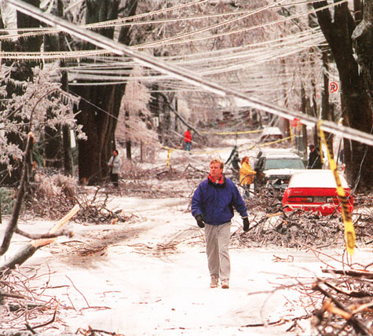
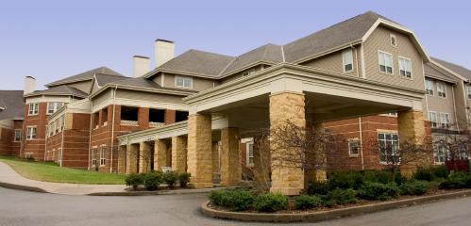
Thank you

