Slide 1
PSYCHOLOGICAL ISSUES FOR SENIORS DURING AND AFTER DISASTERS: THE IMPORTANCE OF TAKING GENDER AND OTHER MODERATING FACTORS INTO CONSIDERATION Gloria Gutman, PhD – Simon Fraser University Gerontology Research Centre, Vancouver, Canada & Maggie Gibson, PhD, C.Psych- Veterans Care Program, St. Joseph’s Health Care, London, ON, Canada
IFA 11th World Conference, Prague, Czech Republic, May 28-June 1, 2012

Slide 2
Overview of Presentation
Disaster concepts, classification and trends
Vulnerability factors: Age
Vulnerability factors: Beyond Age
Risk & Resilience Factors for Psychological Distress Following Disasters
Intervention

Slide 3
1. Disaster Concepts, Classification and Trends

Slide 4
A disaster occurs when the impact on the community exceeds its normal coping resources.
Source: F/P/T Network for Emergency Preparedness and Response, 2004

Slide 5
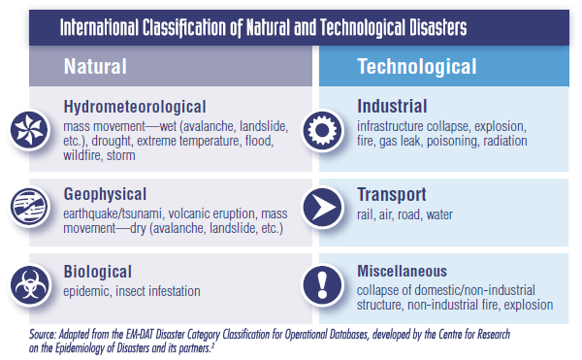
St John R, Berry P, Shropshire D, Lindsay J. (2009). Disasters: A snapshot of trends and Issues. Health Policy Research Bulletin, 15, 8-13.
www.hc-sc.gc.ca/sr-sr/pubs/hpr-rpms/bull/2009-emergency-urgence/index-eng.php#f1

Slide 6
Canadian Disaster Timeline
Year | Disaster | Year | Disaster
1916 | Cochrane& Matheson Forest Fire - Ontario | 1997 | Floods – Southern Manitoba
1917 | Halifax Harbour Explosion | 1998 | Ice Storm – Ont/QU/NB
1918 | Spanish Influenza Pandemic | 1998 | Swissair Crash, N. Scotia
1936 | Heat Wave across Canada | 2000 | Contaminated water supply, Wakerton ON
1950 | Red River Flood - Manitoba | 2003 | SARS Outbreak - Toronto
1953 | Polio Epidemic Canada-wide | 2003 | Blackout – ON & NE USA
1954 | Hurricain Hazel - Ontario | 2003 | Forest Fires - BC
1979 | Train Derailment - Ontario | 2003 | Hurricane Juan, Maritimes
1979-80 | Drought – Prairie Provinces | 2004 | Hailstorm, Edmonton
1985 | Plane Crash – Gander, NFLD | 2005 | Extreme Rain, Toronto
1996 | Flood – Saguenay, Quebec | 2006 | Rain & Windstorm, BC

Slide 7
In Canada & Around the World Weather-related Disasters are Increasing in Frequency

Slide 8
2. Vulnerability Factors: Age The Madrid International Plan of Action on Aging acknowledged the need to improve both protection of older adults and their inclusion in disaster management activities.

Slide 9
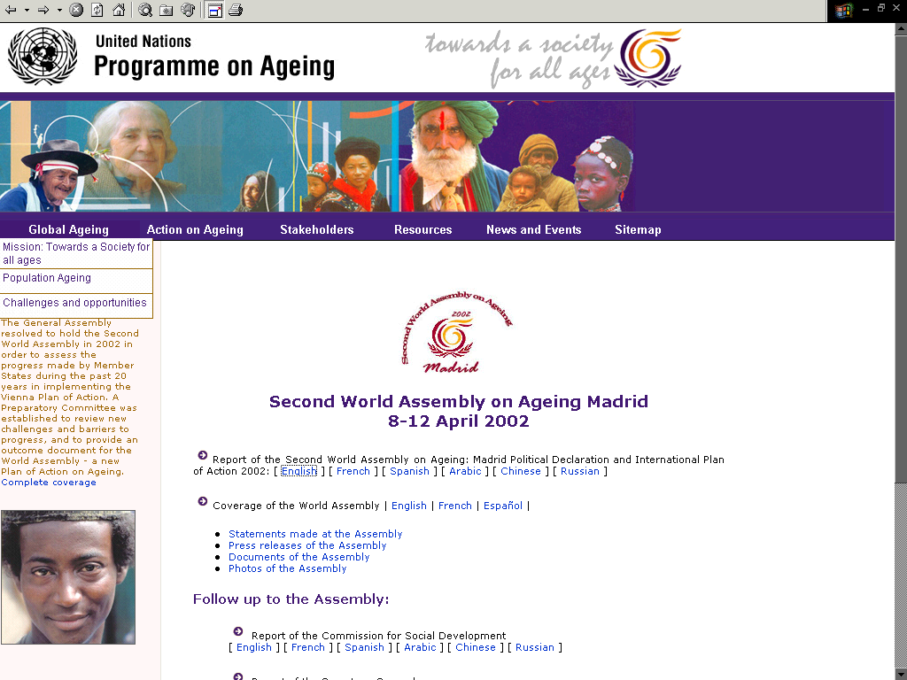

Slide 10
Recognizing Older People as a Vulnerable Population: History
Presidential Symposium “Tsunami and Older Persons” at IAGG World Congress, July 2005

Slide 11
Hurricane Katrina – August 2005

Slide 12
Age as a Predictor of Mortality
“Age has emerged as a central theme in post-Katrina death analyses. Victims tended to be older, unable or unwilling to travel and, in many cases, suffering from medical problems that increased the risk they would drown or succumb to heat exhaustion, experts said”

Slide 13
Age of 853 deceased Katrina Victims (Source: Family Assistance Center, April, 2006)
0-5 | 1
6-10 | 1
11-15 | 5
16-20 | 5
21-30 | 13
31-40 | 26
41-50 | 75
51-60 | 119
61-75 | 196
75+ | 388
Unknown | 24

Slide 14
3. Vulnerability Factors: Beyond Age

Slide 15
More recently
Disaster management has shifted from emergency response only to disaster risk reduction (APEC-GFPN, 2008)
There has been growing awareness of the relationship among disaster vulnerability, gender, age, socio-economic status and other personal and environmental variables

Slide 16
Since Katrina, there has been growing recognition that there are special issues for seniors not covered in “all hazards” and “one size fits all” approaches and that there are vulnerable subgroups within the 65+ age group
Vulnerable Groups include
Socially isolated
Frail
Chronically ill
Cognitively impaired
Persons who have a history of exposure to extreme or prolonged traumatic stressors
Morbidity
Physical health
Psychological
PTSD
depression
anxiety
Notes:
Mason, Andrews and Upton (2010) note that several psychological sequela have consistently been found after exposure to natural disasters. The most common is PTSD. The symptoms include trauma re-experiencing, emotional numbing and/or avoidance and exaggerated arousal. They note that exposure alone does not explain the onset of PTSD as not everyone develops such symptoms. They also state that research suggests the sequela are similar regardless of type of disaster (e.g. flood, earthquake, fire)

Slide 17
Race & Sex of 853 Katrina decedents (Source: Family Assistance Center, April 2006)
Race |  | Sex
African-American | 451 (53%) | Male | 432 (53%)
Caucasian | 334 (39%) | Female | 421 (47%)
Hispanic | 18 (2%)
Asian Pacific | 6 (<1%)
Native American | 4 (<1%)
Other | 5 (<1%)
Unknown | 35 (5%)

Slide 18
Gender Issues in Phases of Disaster
Pre-disaster
Minimal involvement of women in planning & decision-making
Lack of appreciation of need for gender training of first responders
During disaster
Women’s health, hygiene & security needs not addressed
Post-disaster
Lack of access to livelihood/employment, financial resources & social services
Source: APEC-GFPN (2008)

Slide 19
Challenges in responding to the unique psycho-social needs of older women and men in disaster management
Lack of knowledge
Lack of links between policies on gender mainstreaming and disaster management
Source: APEC-GFPN (2008)
“Biological and physiological differences between the sexes are unlikely to explain the gender differences in mortality rates…what is likely to matter most is everyday socio-economic status of women”
Source: Neumayer & Plumpert, 2007

Slide 20
Gender considerations in disaster management (WHO/GWH 11 January 2005)
Involve women in all stages of decision-making. Make sure that information about the needs of family/community is obtained from men and women.
Collect data disaggregated by sex and use this data for program planning and for documentation of short- and long-term effects.
Identify and provide for sex-specific needs.
Consider and assess the impact of all response activities on women and men.
Pay special attention to those who may experience some social exclusion (widows, female heads of household, disabled women).
Ensure that distribution of assistance allows women access to supplies without placing them at increased risk for injury by including women as distributors.
http://www.who.int/gender

Slide 21
4. Risk & Resilience Factors for Psychological Distress Following Disasters

Slide 22
Social-Experiential Factors
Disaster-Related Factors
Degree of exposure
“Dose-response” relationship - PTSD rates highest in those directly exposed followed by people in close contact with victim and first responders.
Displacement (being forced to leave home)
Extensive property loss
Environmental Factors
Social support
Can weaken as people need to get on with their own lives
Sometimes responses of others are negative (e.g. play down victim’s problems, needs)
Social Conflicts
Ethnic, racial, religious l conflicts may re-emerge as people compete for resources

Slide 23
Individual Factors
Pre-disaster functioning
Bereavement, injury to self or family, life threat, or panic during the disaster
Gender and family variables
Females more affected
Marital stress increases after disasters
Risk of abuse increases
Age
US Natl. Center for PTSD states adults aged 40-60 are likely to be more distressed after disasters
“The thinking is that if you are in this age range, you have more demands from job and family”
Research on children and older adults is limited

Slide 24
Resilience Factors
Social Support
Provides information
Help solving problems
Sharing of trauma experience
Shared tips on coping
Coping self-efficacy
Hope

Slide 25
Assessing Psychological Resilience and Vulnerabilities
Scales that have been used in studies conducted post-disaster to assess symptoms of PTSD, depression and anxiety include:
Harvard Trauma Questionnaire Revised –Part IV (trauma and symptoms associated with PTSD – Mollica et al, 1992)
Hopkins Symptom Checklist (anxiety and depression – Parloff, Kelman & Frank, 1954).
Resilience factors have been assessed using the Coping Styles Questionnaire (Roger, Jarvis & Najarian, 1993)

Slide 26
5. Intervention

Slide 27
Disaster Recovery
Conventional wisdom suggests people affected by disasters need immediate psychological help.
12 controlled trials of persons in traumatic events found immediate psychological counseling made matters worse in the long-term.
What people need immediately after a disaster is support of family and friends to help them get back to a semblance of normalcy – e.g., paying bills, relocating, etc. Depression and PTSD can be treated later.
At 18+ mos. persons with PTSD vs. none had vascular, musculoskeletal, and dermatologic problems & older adults can have delayed reactions 12 mos. post event.
Source: Wessely,(2005); Dirkzwager, et al (2007)

Slide 28
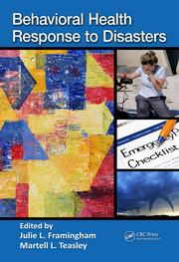
Intervention-Focused Resources to Support Psychological Well-Being for Older Adults in Disaster Situations Include:

Slide 29
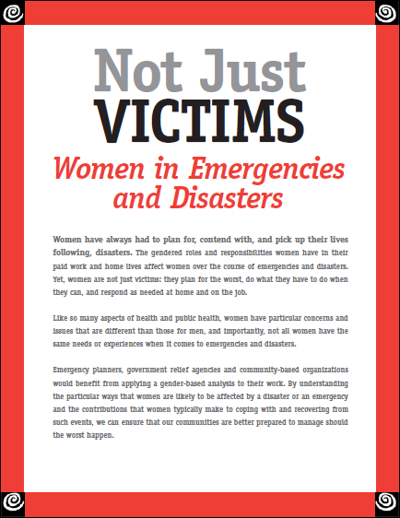
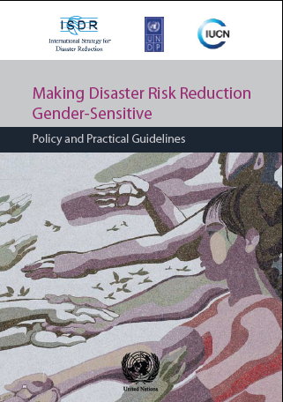
Gender-Sensitive Resources for Disaster Situations Include:

Slide 30
References
Asia-Pacific Economic Cooperation (2009, May). The study on “Women in Times of Disaster”: The integration of gender issues and gender perspectives in disaster management. Gender Focal Point Network.
Brown LM, Frahm KA, Hyer K, Gibson M. (2011).Psychological First Aid: Field Operations Guide for Nursing Homes, 2nd edition. http://amhd.cbcs.usf.edu/docs/pfanh2ed.pdf
Gibson, M. (2010) Frailty, Dementia and Disasters: What Health Care Providers Need to Know. E-learning program hosted by Canadian Dementia Research and Knowledge Exchange (CDRAKE). Available at: http://www.dementiaknowledgebroker.ca/emergency-management
Gibson M, Gutman G, Roush RE, Fisher R, Mazurik L, Hirst S, Fitzgerald K, Kronfol N. (2012). Activities of a voluntary, international, inter-professional, inter-sectoral partnership on emergency management and older adults: Focus on health care providers and disaster recovery. In Rebuilding Sustainable Communities with Vulnerable Populations after the Cameras Have Gone: A Worldwide Study. Edited by Adenrele Awotona, Cambridge Scholars Publishing, United Kingdom.
Mason, V., Andrews. H. & Upton, D. (2010). The psychological impact of exposure to floods. Psychology, Health & Medicine, 15 (1), 61-73.
Neumayer, E. & Plumper, T. (2007). The gendered nature of natural disasters: The impact of catastrophic events on the gender gap in life expectancy, 1981-2002. Annals of the Association of American Geographers, 97 (3), 551-566.
National Center for PTSD (2012). Effects of disasters: Risk and resilience factors. United States Department of Veterans Affairs . Retrieved May 25, 2012 from http://www.ptsd.va.gov/public/pages/effects_of_disasters_risk _and_resilience_factors.asp
National Center for PTSD (2012). Mental health effects of disasters: Risk and resilience factors. United States Department of Veterans Affairs . Retrieved May 25, 2012 from http://www.ptsd.va.gov/professional/pages/effects-disasters-mental-health. asp
Pincha , C. (2008). Gender Sensitive Disaster Management A Toolkit for Practitioners. Mumbai: Earthworm Books for Oxfam America and NANBAN Trust.
Teasley, M., Framingham J. (Eds): Behavioural Health Response to Disasters. Boca Raton, Florida: Taylor & Francis Group.
United Nations (2009). Making Disaster Risk Reduction Gender-Sensitive. Geneva: United Nations.
Canadian Women’s Health Network. (2009). Not Just Victims: Women in Emergencies and Disasters. Author.

