Slide 1
Mandatory Reporting, Canada
There is mandatory reporting in the community and in institutions which varies across provinces and territories;
There are three approaches to reporting:
Mandatory reporting
Voluntary reporting
No reporting requirements

Slide 2
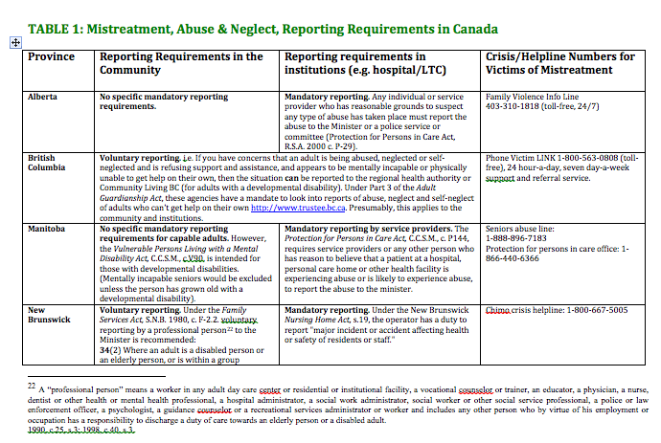

Slide 3
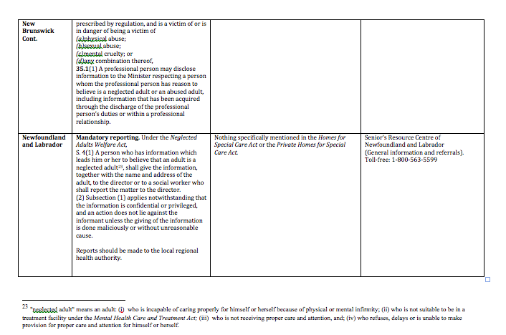

Slide 4
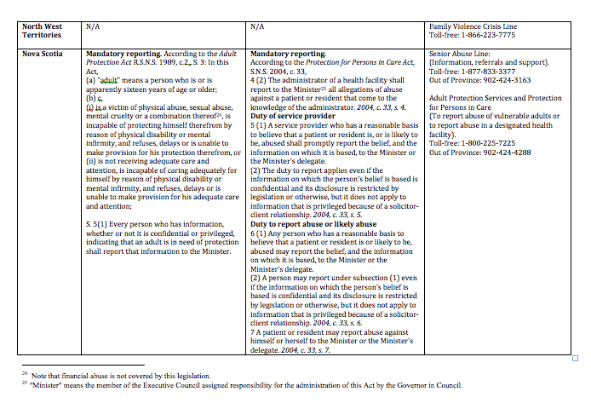

Slide 5
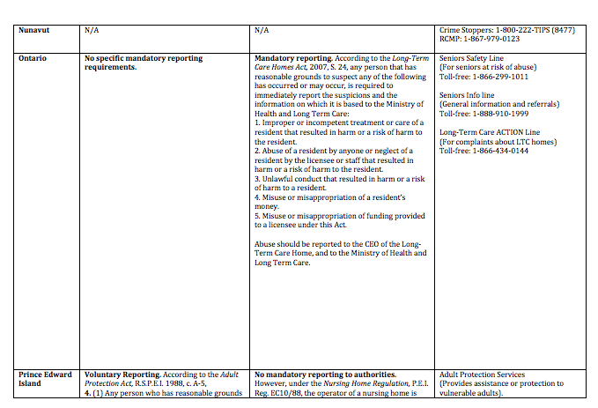

Slide 6
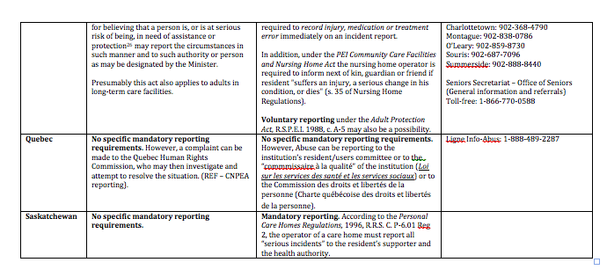

Slide 8
No Extant Evidence in Canada
Most recent study:
Public Opinion on Mandatory Reporting of Abuse and/or Neglect of Older Adults in Manitoba, Canada (JEAN) K. STIEBER ROGER & J. Ursel (2009).
Findings:
Older respondents stated that mandatory reporting was not always preferable, except when the person was incompetent or thought to be at risk.
With less awareness of the topic in general, and with less contact with older adults, younger adults had much stronger views in support of mandatory reporting in all cases.
Little knowledge and awareness of legislation existed in all age groups, although older adults knew more about such abuse and/or neglect than younger adults

Slide 9
Thank You

