Slide 1
Personal Alarms: Purchase and Outcomes
Gill Lewin and Kristen De San Miguel
May 2012

Slide 2
Background
Silver Chain
Silver Chain is a large community health and aged care organisation based in Perth, Western Australia
CareLink: Fee paying Personal Alarm service
Research
2005 – Small Qualitative Study
2006 – Survey of 1200 CareLink Users
2011 – ARC Linkage Grant Curtin University, Silver Chain and Tunstall

Slide 3
Previous survey results
Notes:
This slide shows what impact on their lives clients saw the personal alarm as having had. You can see they reported positive impacts in terms of feeling less anxious about falling, having greater confidence in performing everyday activities, feeling that it meant they were able to stay at home longer and gain faster assistance in an emergency. 75% also felt that it had some impact, but quite considerably less, on increasing their mobility. However 42% of clients also reported that having the alarm had led to a reduced amount of contact with their family.

Slide 4
Research Design
Study Design
Prospective Cohort Study
200 Users and 200 Non Users
Family members
12 Months Follow-up
Recruitment
By researcher following enquiry to CareLink
Eligibility
Over 65, English speaking
No Dementia or Palliative Care
Notes:
Our current research is a prospective cohort study which is closely following 400 older individuals who have been referred for/made enquiries about purchasing a personal alarm service, for one year. The intended sample size was two hundred who subsequently purchased the service within the next month and 200 who did not. It also includes family members who are identified by the older person as having been involved in the decision to purchase the service. Potential participants were identified by the Silver Chain Customer Centre - users being anyone who has just commenced on the Silver Chain Carelink Personal Alarm Service and Non Users being anyone who rang and made an enquiry with the Silver Chain Carelink team but after 4 weeks for whatever reason did not follow through with getting an alarm. Each week the customer centre provided the Research Team with a list of older people meeting these and the other eligibility criteria and the research assistants would then ring them and ask them whether they were willing to participate in the study.

Slide 5
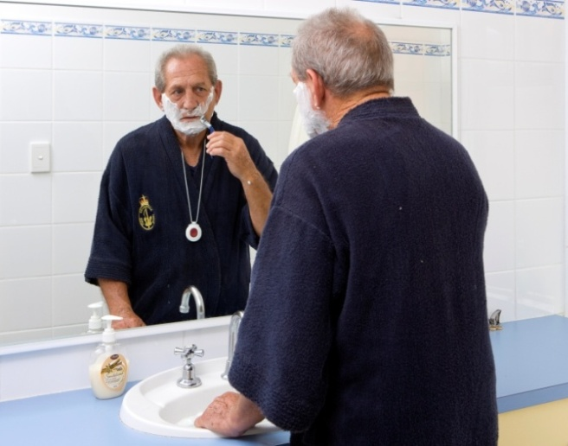
Objectives
Describe characteristics and “risk profile”
Explore the decision making process
Explore use of alarms in emergencies
Explore whether having an alarm has impact in terms of:
Receiving faster assistance
Overall wellbeing
Feeling safe/more secure
Gaining confidence
Loneliness and social isolation
Family contact
Notes:
The study aims to describe the characteristics of those with and without alarms in order to determine their risk profile and whether they would have met the eligibility criteria for some funded programs of personal alarms in other states. In WA personal alarms are not currently subsidized.
We wanted to explore the decision making process, so who’s decision is it to get the alarm, how often are family involved, does the older person make this decision for themselves or do they just get it as a christmas present? And what are the reasons behind deciding to get an alarm? Or on the other hand what are the reasons for not getting alarm? How much of a role does cost play or is it because they simply feel they don’t need the alarm?
We are also interested in the use of alarms in emergencies. How often do people need or use their alarm in an emergency? Do they wear their alarm all the time? And if they have a genuine emergency do they actually press their alarm? And what happens to those without an alarm when they have an emergency?
And finally we wanted to explore whether having an alarm or not has a measurable impact (rather than just a perceived impact, as in the earlier study) in terms of receiving rapid assistance in an emergency, overall wellbeing, feeling safe/more secure and able to remain living in their own home, gaining confidence in performing every day activities, loneliness and social isolation and whether having an alarm reduces contact with family (as already mentioned, the negative outcome experienced by some in our previous research).

Slide 6
Data Collection
Initial interview Demographics, Risk Assessment, Modified Falls Efficacy Scale, Lubben social network scale, Personal Wellbeing Index (PWI), decision making process
Interviews with Family Members Decision making, service expectations, PWI
Monthly Phone Calls and Service Data (Tunstall) Details of any emergencies, ongoing use of alarm
12 Month Follow-up Survey MFES, Lubben, PWI, perceived impacts, future plans
Hospital, aged and community care use data via Data Linkage
Notes:
Participants are closely followed during the year after recruitment.
In that time they receive an initial interview which collects information on demographics, risk assessment which is using the eligibility criteria from other funded personal alarm programs, MFES, Lubben, personal well being index and questions around the decision making process.
If family members are identified by clients as being involved in the decision to get or not get the alarm they are also interviewed by phone.
The research assistants then make monthly phone calls to clients to record any emergencies and changes in their health or living arrangements that may have occurred in the past month. Clients are also given an emergency diary to record these in to assist with client recall.
At the completion of the 12 months on the study all clients will be surveyed to collect data on the some of the original outcome measures tested in the initial interview.
Data linkage will be used to ascertain use of hospitals and community aged care services for the year prior to and the entire study period.

Slide 7
Recruitment
Partially complete
User sample complete
Non-user recruitment ongoing
Notes:
Whilst recruitment for the Users group is now complete, recruitment for the non-users group has proven difficult because:
Most of the enquiries being made are by a family member and therefore due to privacy we are unable to contact their family member directly.
Of the participants that are making an enquiry for themselves, some of them are then actually purchasing the alarm.
Staff turnover in the customer centre has meant that some weeks the number of enquiries recorded has been low as new staff are trained etc.

Slide 8
Baseline Characteristics
 | User (160) | Non-User (54)
Mean Age | 83 | 80
Gender (% Female) | 80% | 76%
Has support services | 79% | 72%
Lives alone | 77% | 85%
Has days when doesn't see anyone | 44% | 33%
Fallen in the past 12 months | 61% | 54%
Worried about falling | 43% | 46%
Had fall resulting in a long lie | 36% | 21%
Restricts daily activities | 31% | 22%
Notes:
This slide presents the baseline data that we had collected just a couple of months ago before we had completed recruitment of the Users and when we only had 54 Non-users enrolled. As you can see the groups are fairly similar with the non-users being slightly younger and a smaller proportion of them having fallen but on the other being more likely to worried about falling. More than half of both users and non-users had fallen in the last 12 months and nearly half of the falls had resulted in a long lie, which we know leads to much poorer outcomes than if someone is assisted quickly. None of the differences between the groups are statistically significant.

Slide 9
Eligibility for PAV
Eligible | User | Non User
Yes | 59.5% | 46.5%
No | 40.5% | 53.5%
Notes:
This table shows what proportion of each of the groups would have been eligible in Victoria to get a govt. subsidised personal alarm. The risk assessment takes into consideration whether someone is alone a lot of the time, whether they are at risk of falls, has a major medical condition that puts them at risk of a medical emergency and is taking 6 or more different medications on a permanent basis prescribed by a medical practitioner. You can see that more than half of the total study sample would be likely to be receiving a subsidised service in another state. While a smaller proportion of the non-users would be eligible, again this difference is not statistically significant.

Slide 10
User Decision Making
Family major driver in 58% of decisions
Main factors prompting decision: living alone, previous falls, fear of falling, family pressure, health/medical condition, remaining independent and peace of mind
“Well I think when you’re on your own and you fall…you could lay there for probably hours before anybody would know.”
“My son didn’t want me to come home from hospital and be by myself, he wanted me to go to a care facility, and I didn’t really want to do that, so I said I’d get the alarm thing because I live by myself and it was mainly for his peace of mind.”
Notes:
When we asked users about their decision making we found that in nearly 2/3 of cases the older persons family was involved. Family involvement usually means finding out about the alarm, initiating the discussion with their relative and then ringing up and organising it on their behalf. In 8% of cases the client were not involved in the decision at all and the family just organised the alarm without discussing it with their relative. Being alone and frightened of falling were frequently identified as the main reasons for older people deciding on the alarm, for others it was family pressure and their peace of mind as much as anything.

Slide 11
Non-User Decision Making
Less family involvement, 65% clients made own enquiry
Key factors prompting decision: cost, feeling that they did not need it just yet, limited range
“I think it’s a good idea but it’s not a good idea for my purse.”
“It’s not the right time yet, but I needed to make the enquiries.”
Notes:
Non-users reported less family involvement in the decision making process. The main reasons they gave for deciding not to purchase the alarm service were: cost and not yet feeling that they needed it.

Slide 12
Emergency Use
Users
53 out of 201 (26.4%) had emergency in first three months
60.3% of emergencies related to falls
Evidence that alarm is not always being used
Non-Users
22 out of 58 (37.8%) had emergency in first five months
62.8% of emergencies related to falls
Evidence that people without alarms are having emergencies and are not able to reach help quickly
Notes:
As it is early days we were only able to look at emergencies in the first 3 months since enrolling in the study. As shown here, Non-users have had proportionally more emergencies and it is taking longer for them to get help than it is for the people with the alarms. As in our previous studies we are finding that the people using the service are not always wearing their pendant when they have an emergency and this then results in a delay in them getting assistance.

Slide 13
Project Status
Summary of Findings:
~ 50% subjects eligible for subsidy elsewhere
Families influence alarm purchase
Alarm results in faster response to emergencies
Future:
Recruitment continuing for Non-Users, complete in May 2012.
Final analysis complete in April 2014

Slide 14
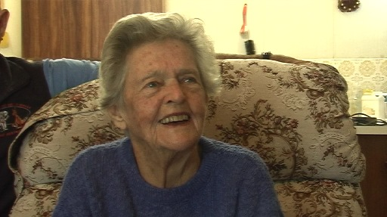
Contact Details
Project funded by an
Australian Research Council Linkage Grant
For more information:
g.lewin@curtin.edu.au

