Slide 1
How Assistive Technology Use by Older Individuals with Disabilities Impacts their Informal Caregivers
W. Ben Mortenson, Louise Demers, Louise Roy, Jim Lenker, Jeffrey Jutai, Marcus Fuhrer, Frank Deruyter
Notes:
How Assistive Technology Use by Older Individuals with Disabilities Impacts their Informal Caregivers
Assistive technology (AT) can facilitate activity performance and social participation among older adults with physical disabilities. Although many AT users also receive help from others, limited attention has been paid to the impact of AT on their informal, unpaid, caregivers. This neglect produces an incomplete portrayal of the benefits of this technology.
Objectives
To evaluate the efficacy of a formalized approach to AT provision that is inclusive of AT users and their caregivers by testing whether it will 1) increase AT users' occupational engagement and 2) decrease their caregivers' sense of physical and emotional burden.
Methods
We enrolled individuals with physical disabilities and their informal caregivers in a randomized control trial. Each dyad was assigned to either an immediate intervention group or a delayed intervention group. The intervention involved three steps: 1) a detailed in-home assessment, 2) negotiation of a personal AT plan with both caregiver and AT user, and 3) implementation of this plan, including device provision and training and home modifications. Before and after intervention, we are measuring the user’s difficulty performing selected activities using the Individualized Prioritized Problem Assessment and their caregiver’s sense of physical and emotional burden using the Caregiver Assistive Technology Outcome Measure.
Results
Forty-one dyads participated in the study. AT users and caregivers had mean ages of 82 and 70 years respectively. Preliminary analyses found that that the intervention significantly decreased users’ difficulty in performing selected activities and decreased caregivers’ physical and emotional burden.
Conclusions
This is the first study to demonstrate that provision of assistive technology decreases caregiver burden. Given growing concerns about caregiver burnout, our findings have significant policy

Slide 2
Assistive Technology (AT)
Defined as any item, piece of equipment, or product system that is used to increase, maintain, or improve the functional capabilities of individuals with disabilities.

Slide 3
Background
Beneficial results of AT for users (Gitlin et al, 2006; Mann et al., 1999; Wilson et al., 2009)
Scant attention paid to the impact of these devices on caregivers, especially informal ones.
Notes:
Assistive technology interventions offer the potential to help users overcome functional limitations while reducing the need for human assistance.
Interventions related to technical aids have the potential to overcome the disabilities of the elderly while reducing the need for human assistance. • Some research has shown beneficial results of the use of assistive technologies. 1.2 • But few studies have used controlled experimental studies and the results are often difficult to interpret because of vague descriptions of mobility assistive technology interventions.3 • In addition, little attention has been paid to the impact of mobility assistive technology on their caregivers. Objectives • To assess how a home-based intervention focused on assistive technology can improve the participation of older people while generating positive effects for caregivers, including reducing the burden of support. Methodology • The study is a randomized clinical trial. • The elderly are helping their close-are divided into groups currently experimental and comparison. • The two groups were assessed before and after surgery custom home, involving the elderly and near-helping, but staggered over time. • This intervention includes i) identification and assessment of problematic activity with the caregiver and helped ii) the choice of a collaborative solution, and iii) applying the solution including training and monitoring. • We used individually priority assessment of the problem (IPPA), 4 and a composite score of balancing performance and satisfaction of the Instrument of habits (LIFE-H) 5 to assess the results of user and Measurement the impact of aids on caregivers (Miata) 6 to assess their relative caregivers. • We recorded demographic data and their health (EQ-5D), 7 and their functional capacity (SMAF) 8 and cognitive (MMSE) .9 We present preliminary results from seven dyads with complete data. Discussion and conclusion: • It is the first randomized controlled study to explore the impact of an intervention of assistive technology on users and their caregivers. • The intervention seems promising. Despite the small number of subjects, several dependent variables are significant. • Although some non-experimental studies have found that assistive technology reduces the frequency of use of family caregivers, 10,11 this association was not significant in this ongoing study. • Perhaps this reflects the low number of participants in the study. • Perhaps a longer period of surveillance is required to observe changes in the frequency of caregiving. References 1. Chen TY, Mann WC, Tomita M, Nochajski S. Caregiver Involvement in the Use of assistive devices by Frail elderly persons. J Occup Ther Res 2000; 20 (3) :179-99. 2. Gitlin LN, Winter L, Dennis MP, Corcoran M, Hauck WW. A randomized trial of home intervention has multicompnent fucntional to Reduce Difficulties in older adults. J Am Ger Soc 2006 54 (5): 809-16. 3. Fuhrer MJ. (2001). Assistive technology outcomes research: challenges and is yet unmet. Am J Phys Med rehabil 2001; 80 (7) :528-35. 4. Wessels R, de Witte L, Andrich R, Ferrario M, Persson J, Oberg B, Oortwijn W VanBeekum T, Lorentsen O. (2000). IPPA, a user-Centred Approach to ASSESS Effectiveness of assistive technology provision, Disabili Technol 2000 13 (1) :105-15. 5. Desrosiers J, Noreau L, Robichaud L, Patrick Fougeyrollas P, Rochette A, Viscogliosi C. Validty of the assessment of life in older adults clothes. J Med rehabil 2004; 36: 177-182 6. Depa, M., Demers, L., Fuhrer, M., Jutai, J., Lenker, J., & Deruyter, F. (2009). A tool for Measuring assistive technology outcomes as Experienced by caregivers. Can J Occup There (Conference Supplement) 76: 54. 7. EuroQol Group: EuroQol - a new facility for the measurement of health-related quality of life. Health Policy 1990, 16:199-208. 8. Defrosters J, Bravo G, Hebert R, Dubuc N. Reliability of the revised Functional Autonomy Measurement System (SMAF) for Epidemiological research. Age Ageing. 1995 24 (5) :402-6. 9. Folstein MF, Folstein SE, McHugh PR. "Mini-Mental State": a practical method for grading the cognitive state of patients for the clinician. J Psychiatr Res. 1975, 12 :189-198. 10. Allen S, Resnik L, Roy, J. Promoting independence for wheelchair users: The Role of Home Economics. Gerontologist, 46 (1): 115-123. 11. Hoenig H, Taylor DH, Sloan FA. Does assistive technology substitute for personal assistance Among the disabled elderly? Am J Pub Health, 93 (2): 330-7. Funding Grant H133A060062 the National Institute on Disability and Rehabilitation Research through the Consortium on Assistive Technology Outcomes Research

Slide 4
Background
Informal caregivers provide 4x as much assistance as formal ones (Agree et al., 2004)
Caregiver burden is a serious concern (Egbert et al., 2008).
National US cross-sectional studies suggest AT use may decrease amount of care provided (Agree et al., 2000, 2004, 2005; Allen et al., 2001, 2006)

Slide 5
Background
Study design does not allow causality to be determined.
Experimental studies have not explored physical or psychosocial outcomes for informal caregivers.
Notes:
Assistive technology interventions offer the potential to help users overcome functional limitations while reducing the need for human assistance.

Slide 6
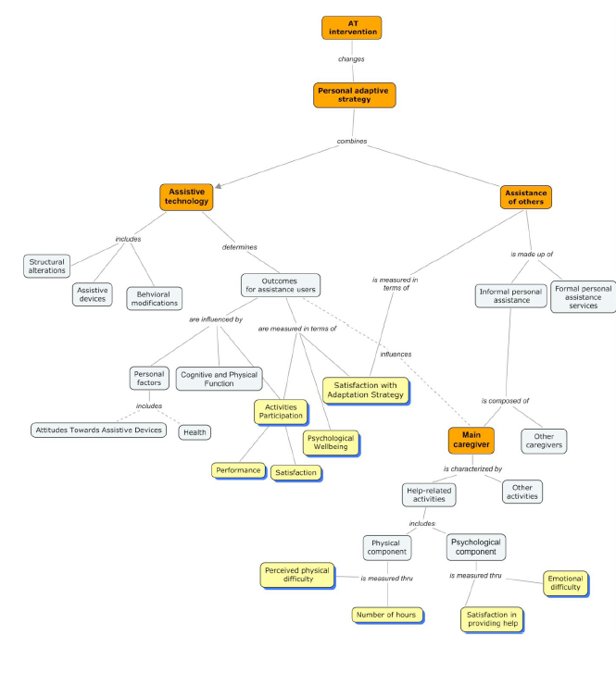
Conceptual Model

Slide 7
Hypotheses
Hypothesis 1: Following an intervention that increases the appropriateness of existing AT or provides new AT, older community-dwelling AT users will report less difficulty in performing selected activities and increased satisfaction in performing them.
Hypothesis 2: As a result of the intervention, caregivers will report decreased caregiving burden.
Notes:
To evaluate the efficacy of a formalized approach to AT provision that is inclusive of AT users and their caregivers by testing whether it will 1) increase AT users' occupational engagement and 2) decrease their caregivers' sense of physical and emotional burden.

Slide 8
Methods

Slide 9
Intervention
Included
i) identification and assessment of a problematic activity with the caregiver and assistance user
ii) development of a collaborative solution, and
iii) intervention, including device provision training and monitoring
Up to $350 worth of equipment

Slide 10
Methods
Delayed intervention RCT

Slide 11
Inclusion Exclusion Criteria
User:
>65
Physical disability
No cognitive impairment/ French or English speaking
Caregiver:
>age of consent
More than two hours of care per week
English or French speaking/ no cognitive impairment

Slide 12
User Outcome Measures
Primary User outcomes:
Measures accomplishment and satisfaction with selected activity from the Assessment of Life Habits (LIFE-H) (Noreau, et al., 2004)
Secondary User outcome measure
Individually Prioritised Problem Assessment (IPPA) (Wessels et al., 2000)

Slide 13
Caregiver Outcome Measures
Caregiver Assistive Technology Outcome Measure (CATOM) (Depa, Demers, et al., 2009).
Part 1: documents all of the activities that caregivers assist with
Part 2: records physical and emotional burden associated with the dyad selected activity (items include frequency of help provided, physical strain, perceived lack of free time, anxiety)
Part 3: records overall burden

Slide 14
Independent Variables/Covariates
Demographic and diagnostic data
Health (EQ-5D) (EuroQol Group, 1990)
Functional Capacity (Functional Autonomy Measurement System) (SMAF) (Desrosiers, et al, 1995)
Cognitive (MMSE) (Folstein et al., 1975)
Attitudes Towards Assistive Devices Scale (Roelands et al., 2002)

Slide 15
Analysis
Quantitative:
Descriptive Statistics
Independent sample T-test
RM-ANOVA
Paired samples T-test

Slide 16
Results

Slide 17
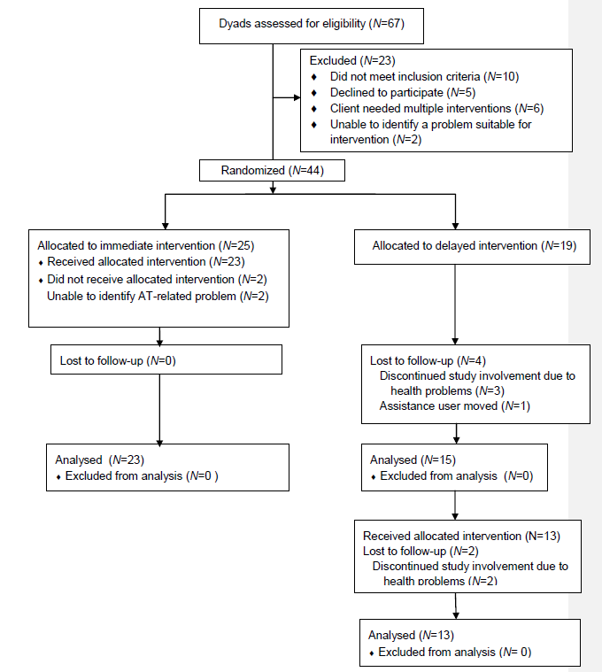
Consort Diagram

Slide 18
 | Delayed | Immediate
Assistance user background characteristics (range) | Mean or % | Mean or %
Age | 83 | 82
Sex (female) | 58% | 48%
Level of education | 11 | 10
MMSE (0-30) | 27 | 26
Function (-87-0) | -25 | -23
Perceived Health (0-100) | 52 | 56
Attitudes towards Assistive Devices (12-60) | 41 | 41
Assistance user outcomes
Difficulty (1-5) | 3.6 | 3.5
Satisfaction (1-5) | 2.7 | 2.4
Accomplishment (0-9) | 3.6 | 4.3

Slide 19
Caregiver Characteristics | Mean or (%) | Mean or (%)
Age | 74 | 68
Sex (female) | 58% | 76%
Relationship Spouse Child Other | 79% 16% 5% | 56% 40% 4%
Cohabitation | 84% | 76%
Level of education | 12 | 14
Hours of care provision | 12 | 18
Perceived Health (0-100) | 64 | 80
Caregiver outcomes
CATOM items 1-14 (14-70) | 55 | 52
CATOM item 15-18 (4-20) | 17 | 15

Slide 20
RM-ANOVA
Construct | Time*Grp:
User difficulty | .004
User satisfaction | <.001
User accomplishment | .305
Caregiver activity specific burden | .013
Overall caregiver burden | .995

Slide 21
Paired T-test for Delayed Group
 | Sig. (2-tailed)
Assistance Users
Difficulty | .051
Accomplishment | .037
Satisfaction | .041
Caregivers
CATOM (Q1-14) | .001
CATOM (Q15-18) | .817

Slide 22
Discussion

Slide 23
User Outcomes
Mixed results for users:
Satisfaction improved post intervention for both groups
Difficulty decreased generally for both groups
Accomplishment results mixed
Might be do to the nature of the measure, which uses a matrix scoring system (without difficulty, without device, without assistance =9)
Intervention may not have been as powerful as hoped for all users.

Slide 24
Caregiver Outcomes
First RCT to demonstrate AT is effective at decreasing caregiver burden.
These results are in keeping with those of non-experimental studies suggesting that AT provision can make caregiving tasks easier, safer, and less time consuming (Mortenson et al., 2011).
Lend support for funding for AT devices and training in that they provide an additional benefit to caregivers.
Notes:
Given the enormous contributions of informal caregivers^{6,7} and concerns about potential burnout¹⁹ and a rapidly aging population,²⁰ the findings

Slide 25
Limitations
Small sample size
Intervention focused on a single problematic activity
Unknown how intervention compares with standard of care

Slide 26
Conclusion
Future plans

Slide 27
Acknowledgements
Study participants
Research Staff (Michelle Plant, Louise Roy, Denise McCabe, Francine Giroux, Marie-Hélène Raymond, Amir Moztarzadeh)
Funding

