Slide 1
How can information and communication technologies support remote carers and the older people they care for? Seeking innovative solutions through cross-sector knowledge exchange
Project Leads: Prof. Judith Phillips
& Dr. Sarah Hillcoat-Nallétamby
Project Manager: Mark Allen
Notes:
Swansea Uni
Presenting on project called ‘Care in Business’ focused on...[read] / ‘remote’ carers = people caring for older friends/relatives from a distance.
[EU funded project lead by..., but interdisciplinary team. I am presenting as project manager]

Slide 2
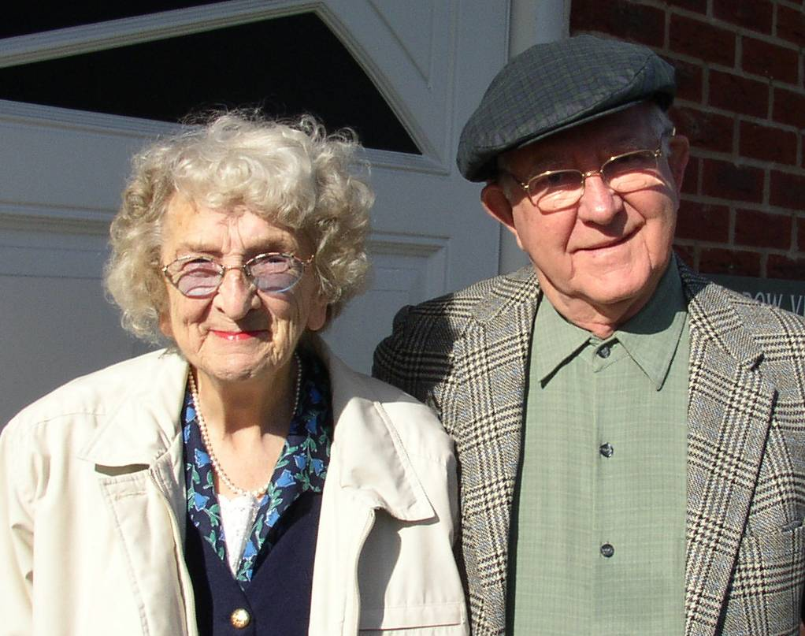
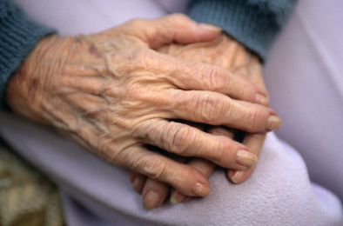
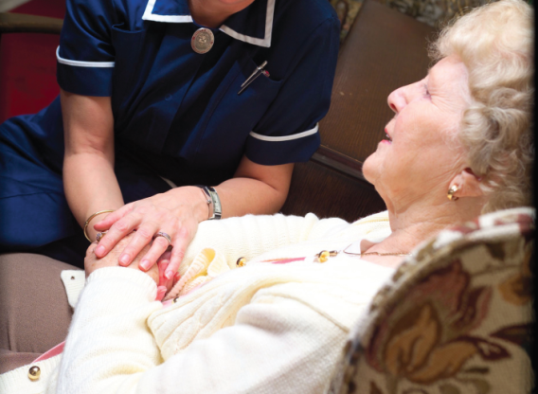
Overview
Project background
Project aims
Summary of findings
The future…

Slide 3
Project Funding
The Welsh Government’s
European Regional
Development Fund
Notes:
Swansea Uni secured funding via…

Slide 4
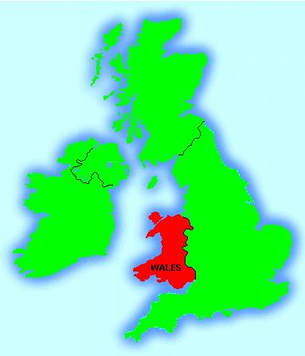
Wales (UK)
3 million people
Wales has the highest proportion of older
people in the UK
1 in 4 of the population is over 60
1 in 8 are over 70
Devolved Government since 1999
Strategy for older people
World’s first Commissioner for Older
People
Notes:
Project in Wales, small country within the UK.
Ageing population – [stats]
devolved government - provides opp to more directly respond to our ageing population, resulted in:
[Dedicated] strategy for OP in Wales
The world’s first Commissioner for OP

Slide 5
Carers & Technology
Carers
Almost six million informal carers in the UK - 1 in 10 people
In next 30 years, the number of informal carers will increase by around 60%
Over-65s currently account for 1/3 of all informal carers, providing more than 50 hours of care a week
Carers in the workplace
Nearly 1 in 8 workers is an informal carer
On average, carers retire 8yrs early, 1 in 5 carers give up employment to care
Family and caring responsibilities account for 26% of economic inactivity in the UK compared with 19% in Germany and 18% in the Netherlands
Role of technology: deinstitutionalisation, devolved services etc.
Notes:
‘informal’ – unpaid
Increasing #’s OP = increasing #’s carers [stats]
Particular impact to working carers
Role of technology – becoming increasingly imp in UK because of deinstitutionalisation (i.e. Moving away from care provided simply provided by institutions), devolved service prov, economic cuts = tech becoming cost effective mechanism for meeting op’s needs.
[economic inactivity = working age population]

Slide 6
Project Aims
1. Hold cross-sector,
cross-discipline
knowledge
exchange events.
Knowledge exchange events / activities
Older people
Carers
Esp. working carers
Carer’s organisations
Business
e.g. Cisco, BT, local SME’s
Academia
Cross-disciplines
Health and social care providers
Notes:
Methodology - bring together sectors & disciplines that do not normally come together & have opp to learn about developing challenges and opps in their respective fields:
[READ diff orgs]....through series of knowledge exchange events:
thematic seminars, scoping discussions and creative sandpit events.

Slide 7
Project Aims
2. Explore the daily challenges of
caring and being cared for
and the opportunities for
the innovative use of Information
Communication Technologies.
3. Facilitate the development of products and
services that meet end-user requirements.
Knowledge exchange events / activities
Older people
Carers
Esp. working carers
Carer’s organisations
Business
e.g. Cisco, BT, local SME’s
Academia
Cross-disciplines
Health and social care providers
Notes:
[READ]
Part of this process was to highlight the older consumer market to business / highlighting the business case alongside helping to support independent living & the role of carers.

Slide 8
Key discussion findings
Need for consumer-led rather than institution-led market
Older people and carers are prepared to spend money
Importance of inclusive/universally designed technologies
Better marketing needed to capture older/carer market
Notes:
**All participants v receptive, feedback highlighted value of process/method**
Need to bridge gap between producers & consumers & fuel a consumer-led rather than institution-led market
Means - involve OP & Carers in design process to develop products & services that reflect both needs and aspirations of a hugely diverse range of people
Prepared to spend money on ‘off the shelf’ solutions rather than relying on technologies issued via health professionals
Imp to develop inclusive/universally designed technologies. Costs can be reduced by producing larger amounts for all age groups.
Better marketing
- if products ‘out there’ why don’t they use them/know about them?!
- involve end-users – market in right way. e.g. use of term ‘AL’

Slide 9
Key discussion findings
Need for government and industry drive for interoperability to allow for ‘plug and play’ products
Technology and services need to be adaptable and flexible
Greater knowledge is needed at a policy level of the pressures and constraints on working carers
Ethical and legal considerations
Notes:
Interoperability [define] v. imp, a few companies have cornered market due to supplying closed systems
Tech & services need to be adaptable and flexible to meet changing physical & cognitive health & social needs in later life. OP say they would like services such as ‘try before you buy’; rental & lease options; & money back guarantees to account for changing circumstances.
Leading to flexible working practices that reflect pressures & constraints
Ethical and legal considerations. Very imp, rights of both the cared for person and the carer.
“When people enter a computer room, they leave ethics outside the door”
Donn Parker, Stanford Research Institute, 1968

Slide 10
The Future...
Assumption of next generation that they will be IT literate, engaged
Need to challenge ageist assumptions, recognise older consumer market
Education, equality, business case
Proactive involvement of diverse consumers in development process
Notes:
Next 20 year, tech will undergo similar transformation, beyond recognition. Dangerous assumption we will be able to keep up, speak same language.
e.g. YP – Email vs. social networking [my son, ‘Dad uses Facebook’....]
Education, equality agenda / business case - cross-sector knowledge exchange & promoting view of older people as active consumers & how to expand market base without negatively affecting perceived image of company.
development process - all aspects of design considered – not just medical/functional specifications. - E.g. 3rd age suit..?!
We’re developing # of products with Welsh companies as result of project. We
would also like to sustain the work in exchanging knowledge across sectors and help change the prevailing cultural view of the older consumer market.

Slide 11
Thank you
Mark Allen
Centre for Innovative Ageing,
College of Human and
Health Sciences,
Swansea University
m.c.allen@swansea.ac.uk
www.opanwales.org.uk

