Slide 1

A NETWORK SYSTEM INTEGRATING SERVICES TO PROMOTE ELDER CARE IN SMALL COMMUNITIES
Masaki Ishizuka
Medical Corporation Junkei-Kai
Japan
Notes:
Hello, ladies and gentlemen. My name is Masaki Ishizuka. I am a social worker at the Medical Corporation Junkei-kai in Akita City in Japan. The Medical Corporation Junkei-kai runs a hospital, an outpatient clinic and 6 facilities for the elderly. My office provides care and support services to elderly persons with dementia and their families to improve on their quality of life in the Community.
As part of the solution to improve and encourage care for the elderly in Akita City, I would like to introduce to you “A network System Integrating Services to Promote Elder Care in Small Communities”.

Slide 2
Presentation Outline
1．Population Ageing in Japan
2．Basic Statistics
3．The Elderly with Dementia
4．Network Support System
5．Conclusion
Notes:
Here is an outline of my presentation: first, by way of introduction, I would like to share with you some basic statistics on the elderly and ageing situation in Japan. Next, I will highlight some of the problems we have recorded among families with elderly members suffering from dementia. The next will demonstrate the shortcomings of the existing services as well as proposed solutions.

Slide 3
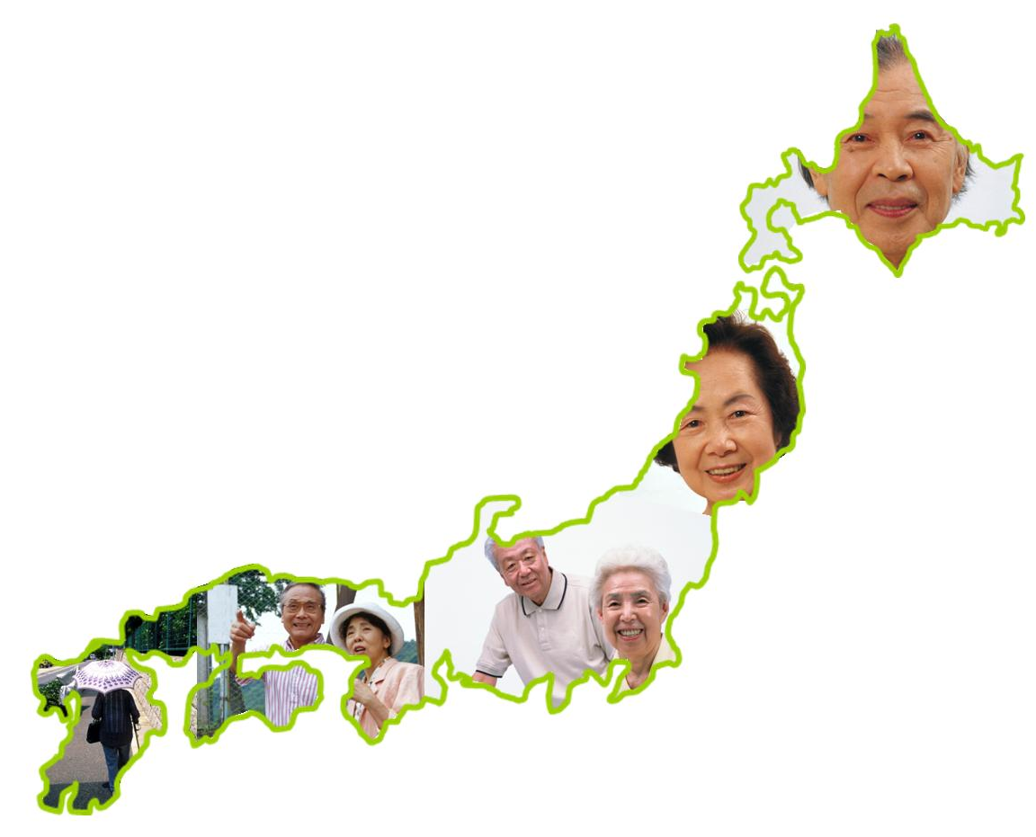
Population Ageing in Japan
Notes:
Japan is currently one of the countries with rapid growth of the ageing population. In line with this, the number of elderly person with dementia has also increased accompanied with diverse(dὰɪvˈɚːs) problems.
In 2000, the long-term care insurance system was established which supports the insured and their families. This insurance system provides the insured with long term care services when they need care or other assistance. But the insurance system is not sufficient in providing social support to those in need of care. More so, the system is not in itself entirely insufficient to support the elderly persons with dementia living at home. In this regard, we created a network system working in collaboration with the people in the community and organizations. Today, I would like to talk about this system and how it works in our small communities. But first, here are some basic statistics(stətístɪks) on population ageing in Japan.

Slide 4
Population Transition in Japan
（millions)
（Oct.2010 ； Ministry of Internal Affairs and Communications）
Notes:
According to the national census on October 2010, Japan’s total population stood at 125,815,000. This chart shows that from 2005 to 2010, there was a gradual decline of the population and some specialists said it would continue in the following years.

Slide 5
Households in Japan
（millions)
（ Feb.2011: Ministry of Internal Affairs and Communications）
Notes:
On the other hand, the number of households in Japan as of February 2011 is 51,951,513 with a 5% increase since 2005 as indicated on this slide.

Slide 6
People per Family
（No. of People per Family）
（ Feb.2011: Ministry of Internal Affairs and Communications）
Notes:
From 2005, the estimated average number of people per household is 2.46 with a decrease of 0.11%. This is as a result of the fact that the single-person household is increasing.

Slide 7
Elderly (65 +) with Dementia
（millions）
（2003: Ministry of Health, Labor and Welfare）
Notes:
It is estimated that about 3.3% to 8% of people aged 65 and over suffer from dementia in Japan. You will see on this chart that the number of elderly with dementia is increasing in contrast with the decrease in the number of persons per family. This is clear indication that the number of family caregivers is very low.

Slide 8
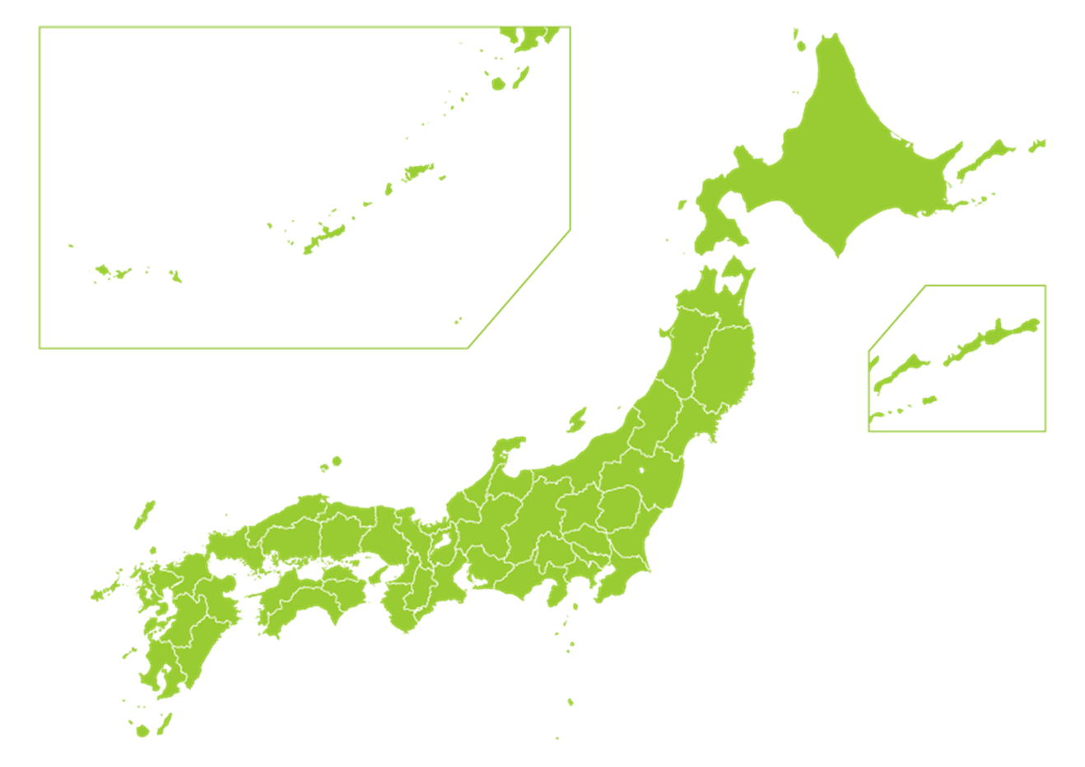
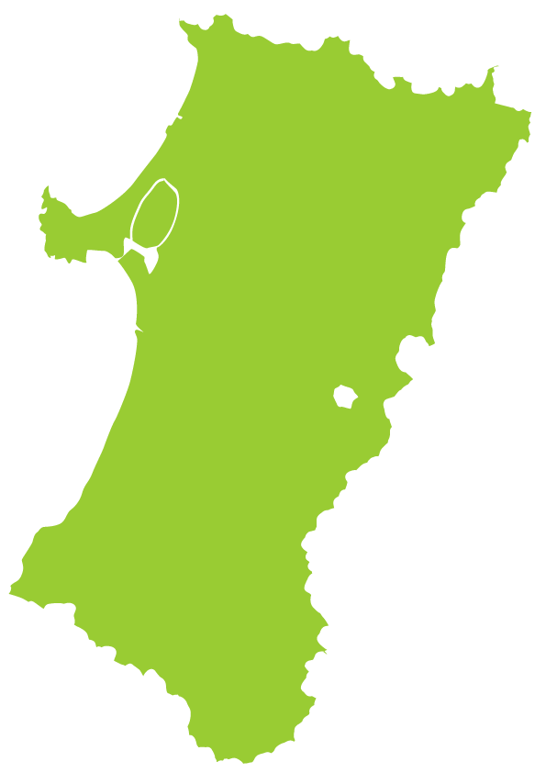
39°
Notes:
Let me introduce the region where I work.
I work in one of the centers located in the western region of Akita City. Akita City is situated in the northeastern part of Japan, 39 degrees north on the globe.

Slide 9

AKITA PREFECTURE
AKITA CITY
（2010；Akita City Office)
http://www.pref.akita.lg.jp/
Notes:
This particular district in Akita has a rapid ageing population and our center has recorded a variety of problems among the elderly population. The total population is about 37,000 and one quarter (1/4) of them are aged 65 and over, making up a total of approximately 9,000. Moreover, it is estimated that the population of elderly living alone is 1,200 with more than 700 of them with dementia. Problems such as missing persons, lonely death, abuse, murder crimes by family members are common and increasing.
9

Slide 10
Problems
Limitations of the Long-term Care Insurance System
Decrease in the number of Family Caregivers
General lack of Information and Understanding on Dementia
Notes:
Here are the major issues we have identified.
The Long-term Care Insurance System is not enough to cover care services for elderly with dementia which has given rise to several problems in the community.
Due to a great change in the family structure, family caregivers are on the decrease especially among the elderly with dementia. As I mentioned earlier, the average number of people per household is decreasing while population ageing rate in Akita is the highest in Japan. I assume that this is becoming a big challenge to us.
Lastly, family caregivers possess little or no experience and knowledge on how to care for the people with dementia.

Slide 11
Solutions
Create a Network System
2. Improve public awareness on Dementia
Notes:
We therefore came up with two solutions:
Create a network system that can link the available services, communities, families (family caregivers) as well as the elderly with dementia. This system will therefor help improve and encourage caregiving as well as reduce the level of isolation among the elderly with dementia.
Improving public awareness and disseminating (dɪśɛməǹeɪtɪŋ) knowledge about dementia by organizing seminars and conferences on caregiving and especially dementia.

Slide 12
Without the Network System
Educational Workshops
City Office
Medical, Care and Welfare Services
Care Manager
Home Helper
Home Visit Nurse
Day Service Center
Nursing Home
Hospital
Clinic
Pharmacy
Family
Missing Persons
Private Associations
Shoplifting
Public Organizations
Convenience Store
Police
Fire Station
Women’s association
Demand for money in banks
Senior sitizen’s club
Milkman
Judicial Clerk
Violence from families
Elderly Person
Caregiver’s Association
Bank
Gas Bureau
Water Bureau
Neighboorhood association
Lawyer
Public Health Nurse
Unchecked mail boxes
The need for trained professionals on dementia
Post office
Home Delivery
Supermarket
Paperboy
Notes:
These are the available service groups or associations in our community including the Long-term Care Insurance system which functions under the authority of the local municipality (mjuːnìsəpˈæləṭi). But there are other services in the communities such as ‘Senior Citizen’s Club’, ‘Neighborhood Association’, ‘Women’s Association, etc. It should be noted that all these service providers work independent from each other.
Our first step was to contact about thirty support service groups and associations to organize a conference.
As you can see on this slide, a lot of problems were raised at the conference. With little experience and knowledge on dementia, participants indicated the need for trained professionals to assist people in the communities.
This conference is held on a monthly basis in collaboration with service providers, families and the community to promote the sharing of knowledge and experience. As the coordinator of the network, we begin by collecting data on the needs of people who require services. We assess their needs to link them with the appropriate group or association offering support services for follow up.

Slide 13
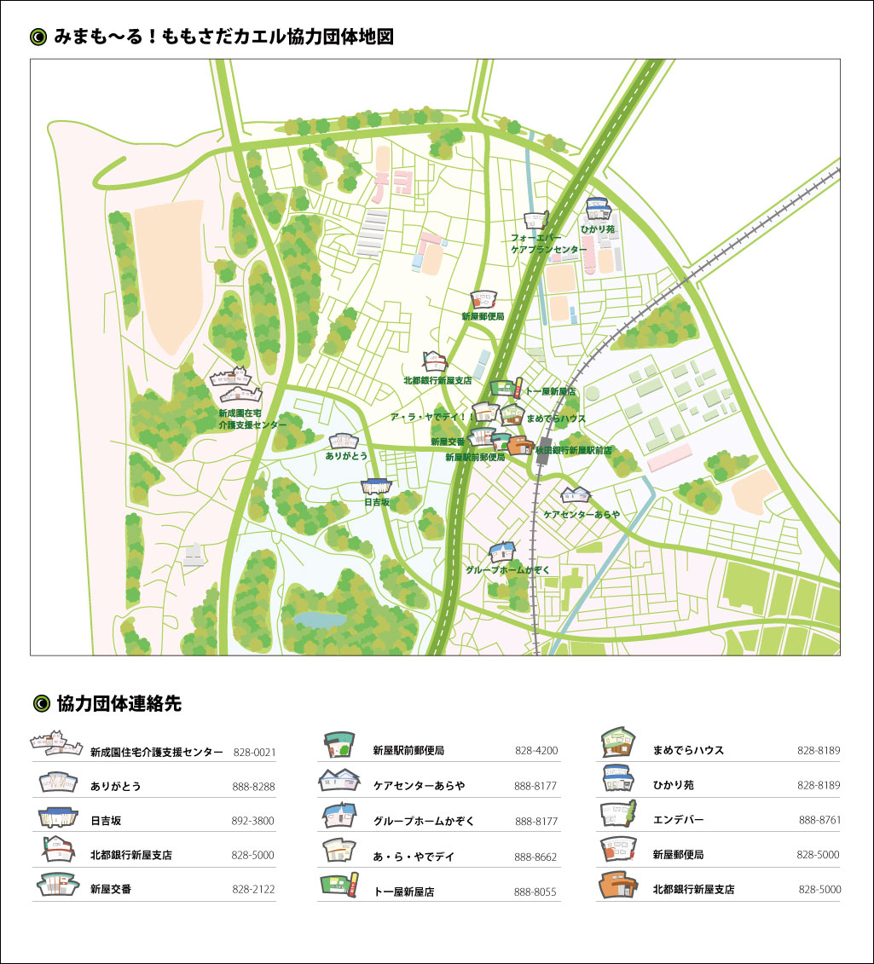

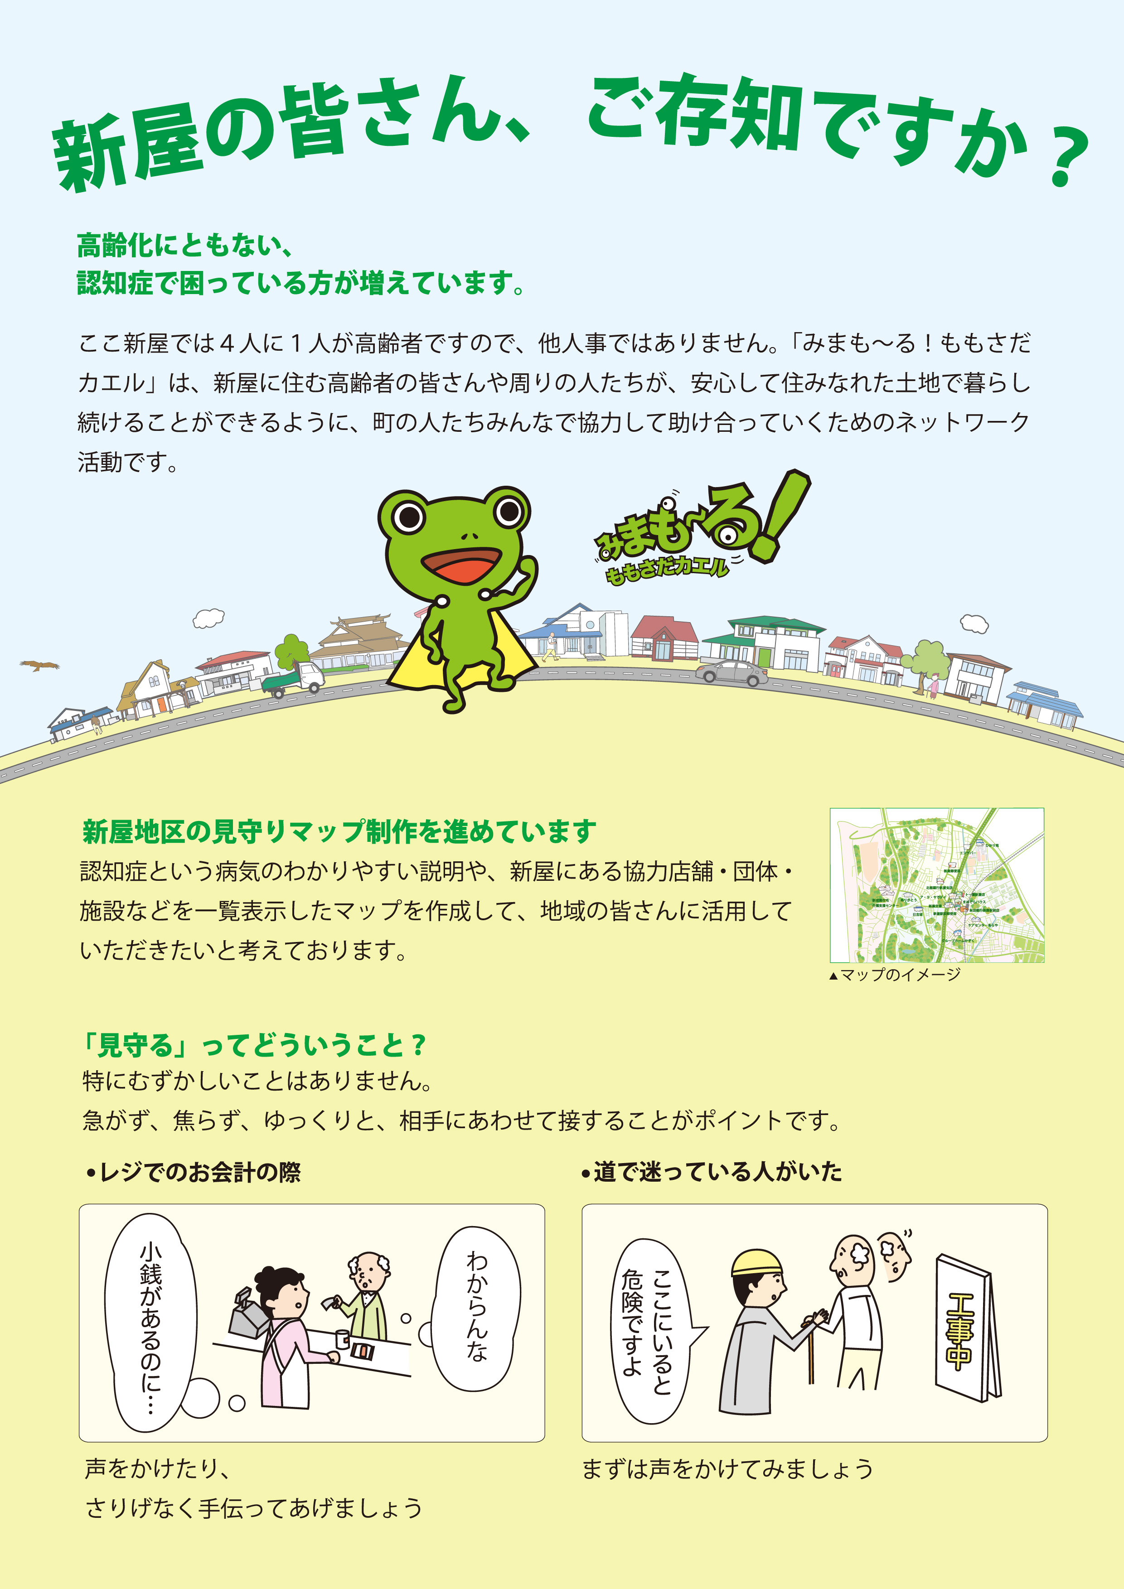
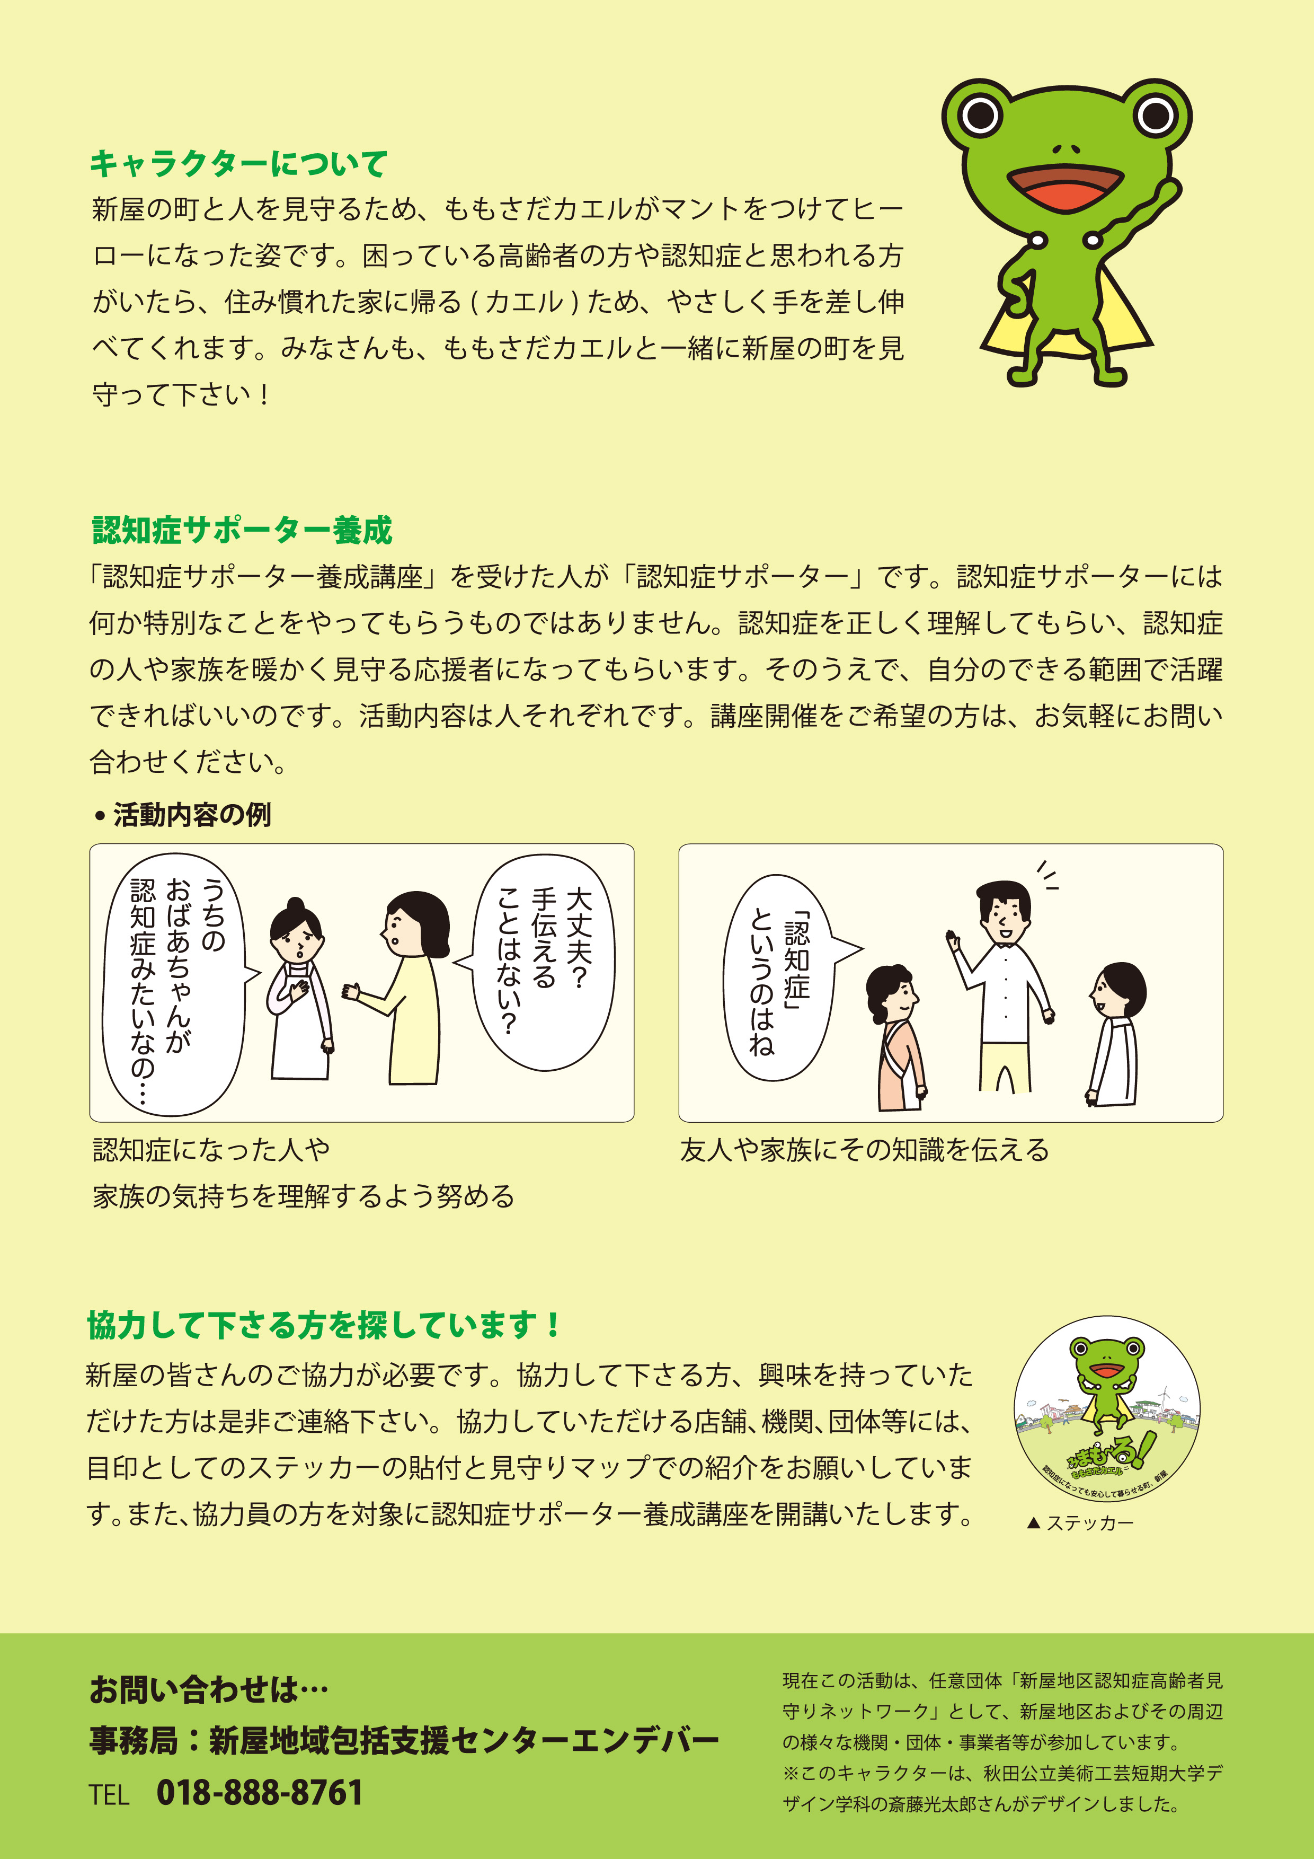

Promotional Materials
Map
Poster
Flyer(head)
Sticker
Flyer(tail)
Notes:
In order to promote and spread this network system in the communities, we designed an official mascot. We also made a map of community, posters, flyers and stickers so that people in the community would feel comfortable to contact each other to discuss on problems related to dementia.
13

Slide 14
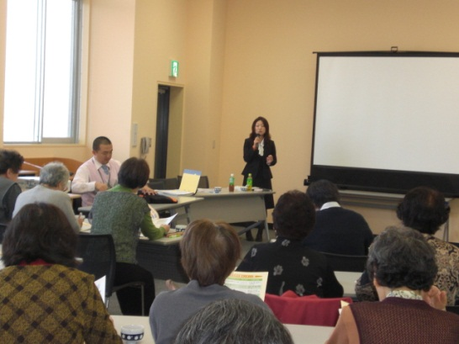
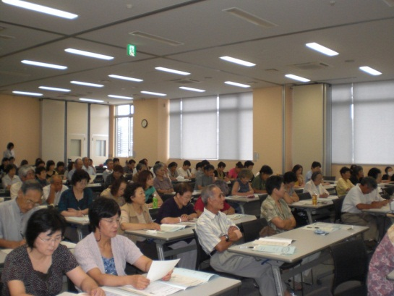
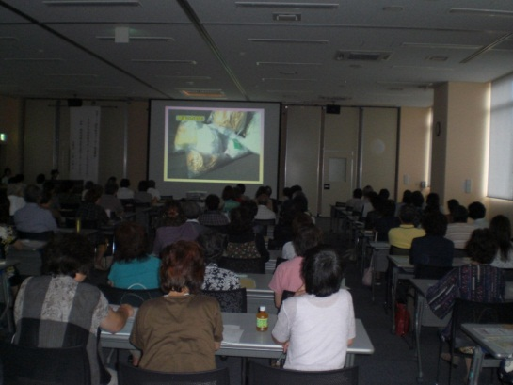
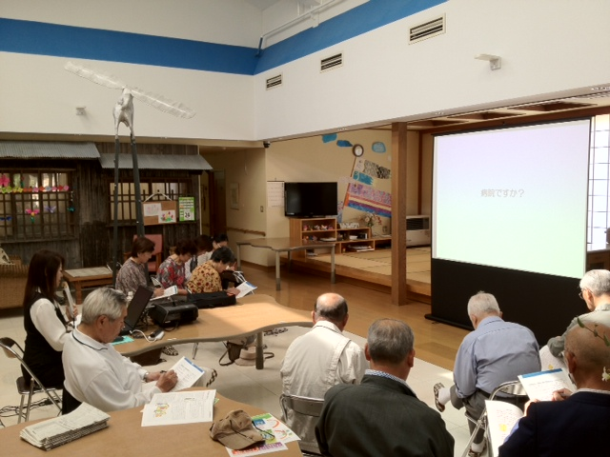
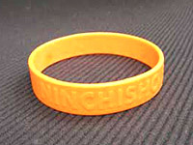

Seminars on Dementia
http://www.caravanmate.com/
At our nursing home on the day before yesterday.
Notes:
Part of what we have on our agenda is the education of families especially on dementia. With many reports on several problems faced by family caregivers taking care of their family members with dementia, we realized the necessity to organize informative seminars as a possible solution. At the end of each these seminars, we distributed wristbands (as shown in this picture on the slide) as a symbol of participation. We aim at expanding our network by increasing the number of people with wristbands in our community. Meetings of this nature are also organized in several cities across Japan and it is estimated that in the past seven years, there have been more than three million participants.

Slide 15
Outcomes
Improved collaboration among service providers
Growing relationships
The seminars influenced positive thinking among people in the community
Notes:
Thanks to all these activities above, the number of support groups as well as associations can easily contact each other. Furthermore, family caregivers including families with relatives suffering from dementia have benefited from this social support network system. They now voluntarily lead the system without much reliance on the Community General Support Center. We assume that this is a great change and enormous achievement in community. With developing strong ties among support groups and associations, relationships between elderly with dementia and family members within the community are growing strong.
We have had comments from some participants who attended our seminars and I quote “I have gained confidence to get along with someone suffering from dementia”, while another said “I would like to be of assistance to families or neighbors who are in need of support”. Some people realized that the problems regarding dementia could also be improved by organizing and take part in seminars. We foresee that knowledge can change our conscious mind, prevents problems and improve the quality of care services. Some participants in these seminars have also joined the social network system.
We have realized a big change in the communities since the start of the social network system. Support to the elderly with dementia and caregivers could easily be provided through the social network system without much reliance on the public service system.
Besides, there are challenges in managing the network system. One of which is that due to the Act on the Protection of Personal Information in Japan, it is getting more and more difficult to manage personal information of individuals. We are now taking steps to deal with this by seeking for legal advice.
We are also planning similar seminars not only for the elderly but for the younger population such as students and children. Since some cities in Japan have already had such seminars, we can learn from their experience.

Slide 16

Masaki Ishizuka
Thank you for your kind attention.
E-mail : araya-houkatsu@river.ocn.ne.jp
Web : http://www.jkk-sotohp.or.jp/endeavor/
Notes:
Thank you very much for your kind attention. If you have any questions, I will try to answer them as much as possible. But I if require further information please contact me using the e-mail address on the slide. Thank you again.

