Slide 1
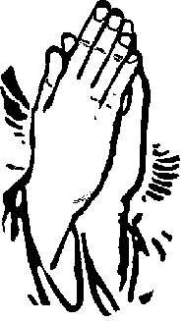
Prevalence of Diabetes Mellitus and Hypertension in the elderly group, in Rural community in Pune, India
12th Global Conference of IFA at Prague
May 28th to June 1st 2012
Janaseva Foundation, Pune
By,
Vinod Shah, M.D
Spandan Patel, M.B.B.S
Disha Mehta,M.B.B.S
Gautam Shah, M.B.B.S
Gururaj Mutalik, M.D

Slide 2
Increasing elderly population of India
In India approximately 9.5% of the population is aged 60 years and above.
The elderly population will increase to 12% of the total population by 2025, 10% of which would be bedridden, requiring utmost care. India will soon become home to the second largest number of older people in the world. The challenges are unique with this population. A majority (80%) of them reside in the rural areas thus making service delivery a challenge, feminization of the elderly population and 30% of the elderly are below poverty line.
According to WHO 2002, cardio vascular diseases(CVDs) will be the largest cause of death or disability by 2020. The contributing factors for growing burden of CVDS are increasing prevalence of Hypertension and Diabetes. Prevalence of Hypertension ranks 4th in the world. The Avg. prevalence of Hypertension in India is 25% in urban and 10% in rural population. It is directly responsible for 57% of all stroke deaths and 42% coronary heart deaths in India and also a leading cause of blindness, renal failure and congestive heart failure(13).

Slide 3
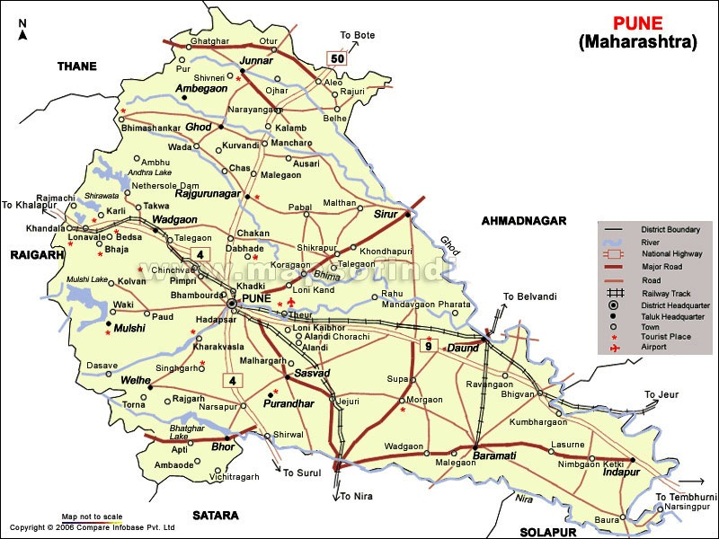
Janseva Foundation during the last 2 years conducted a Research study on aging in Rural areas, in 14 villages near Panseth. This study includes all aspects of aging including areas connected with the Human rights of the elderly.

Slide 4
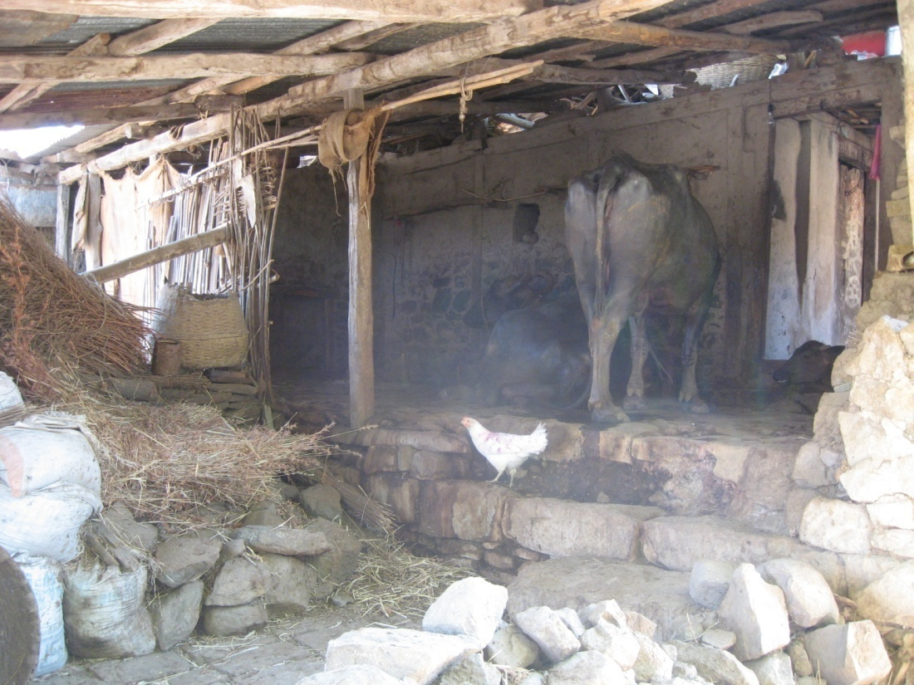
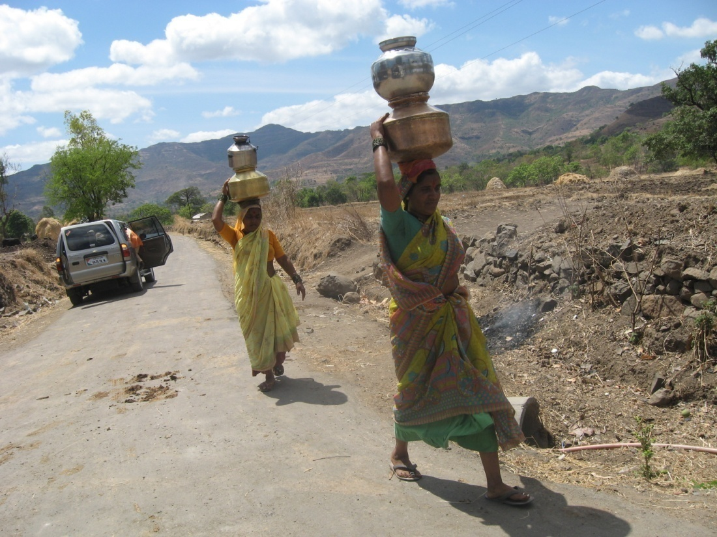
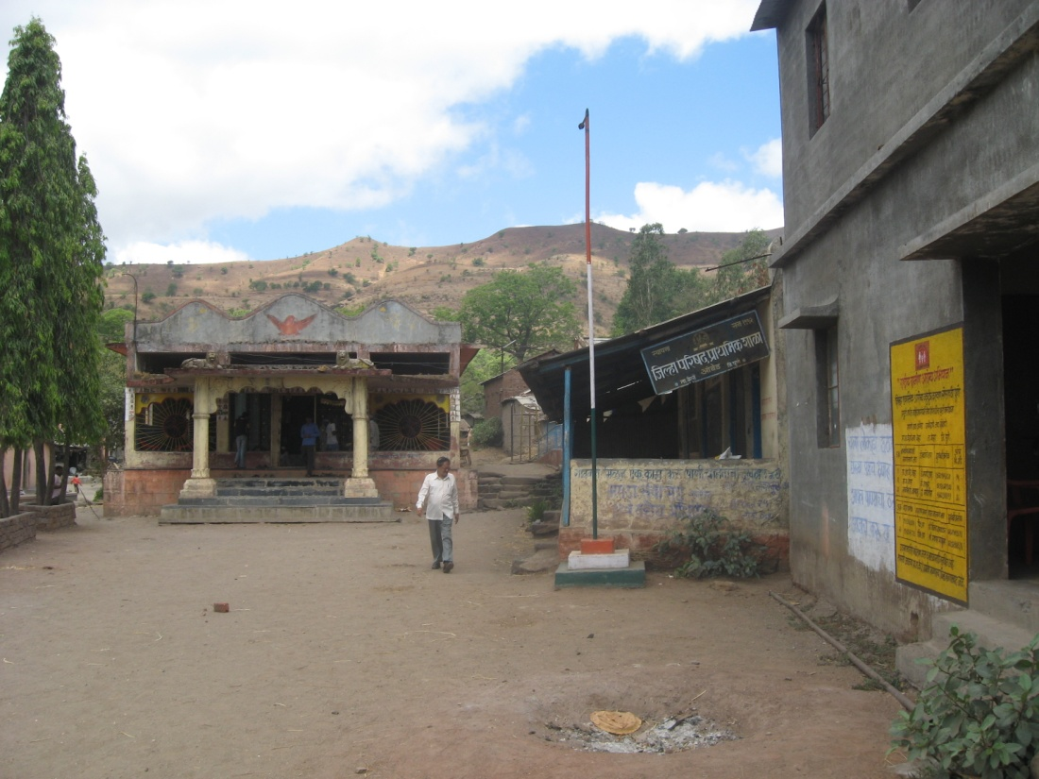
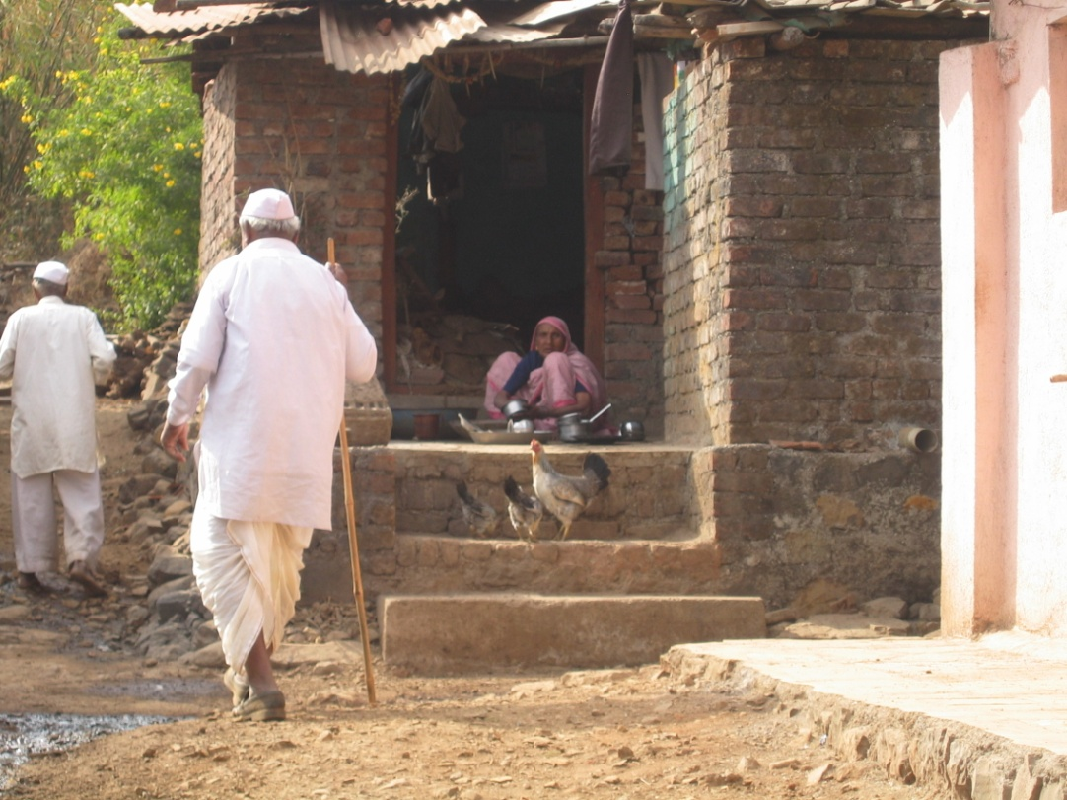

Slide 5
Objectives
A) Janaseva foundation has undertaken many research projects on morbidity pattern among the elderly (60+) in the rural region in the vicinity of Pune.
B) The present study is undertaken by Janaseva foundation as a part of larger research project on the elderly, to determine the prevalence of hypertension and Diabetes with/without dyslipidemia, ECG changes and renal functions in a sample of rural population above the age of 60 yrs.

Slide 6
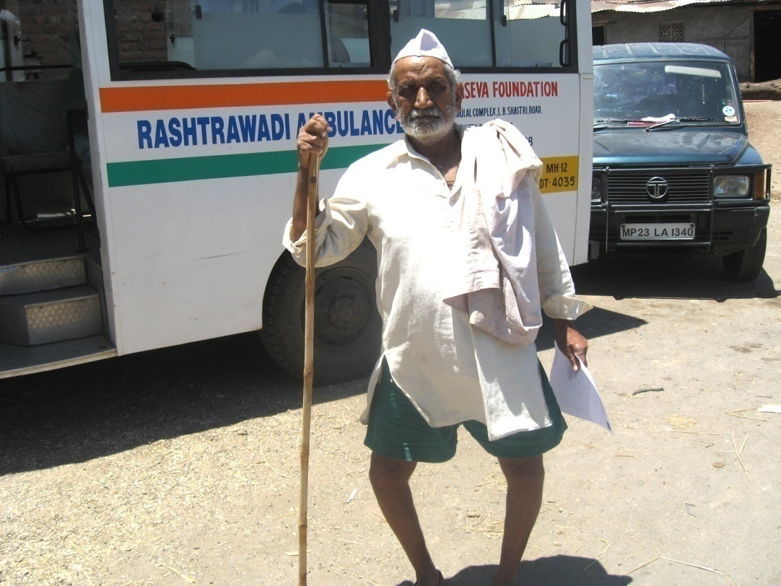
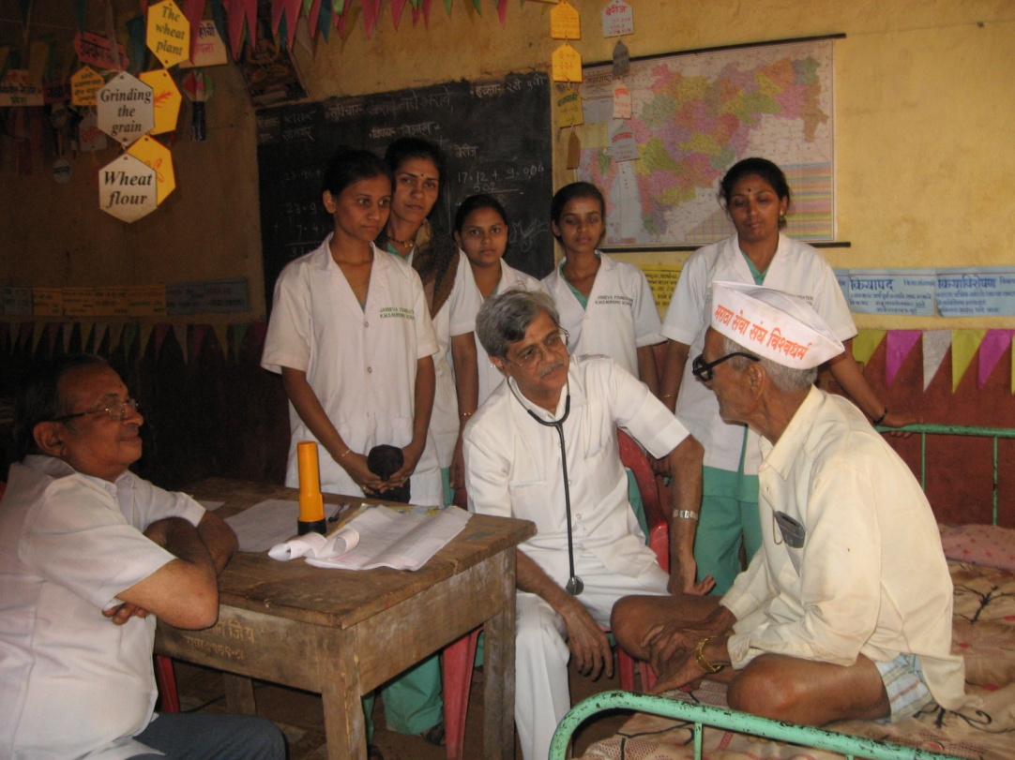
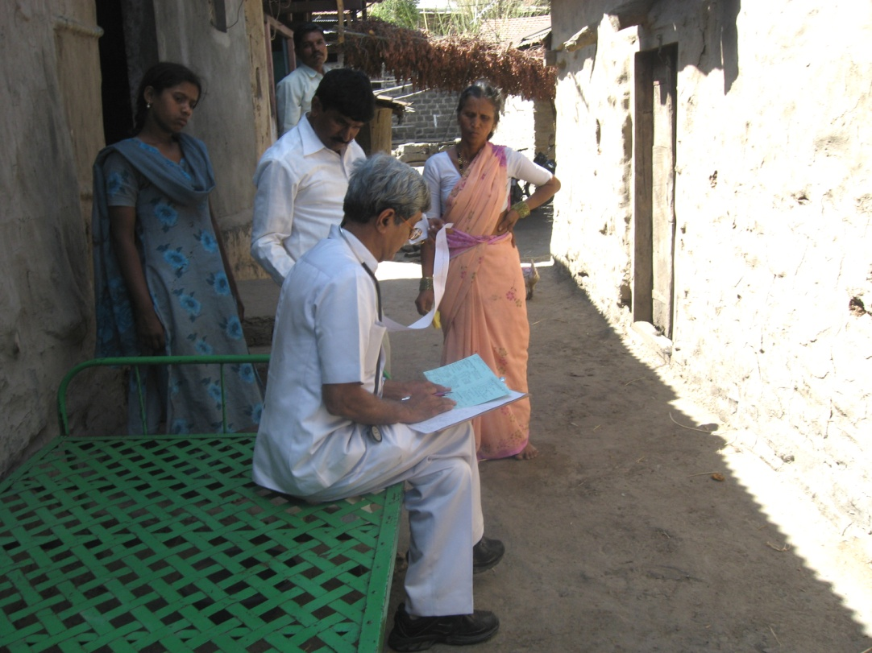
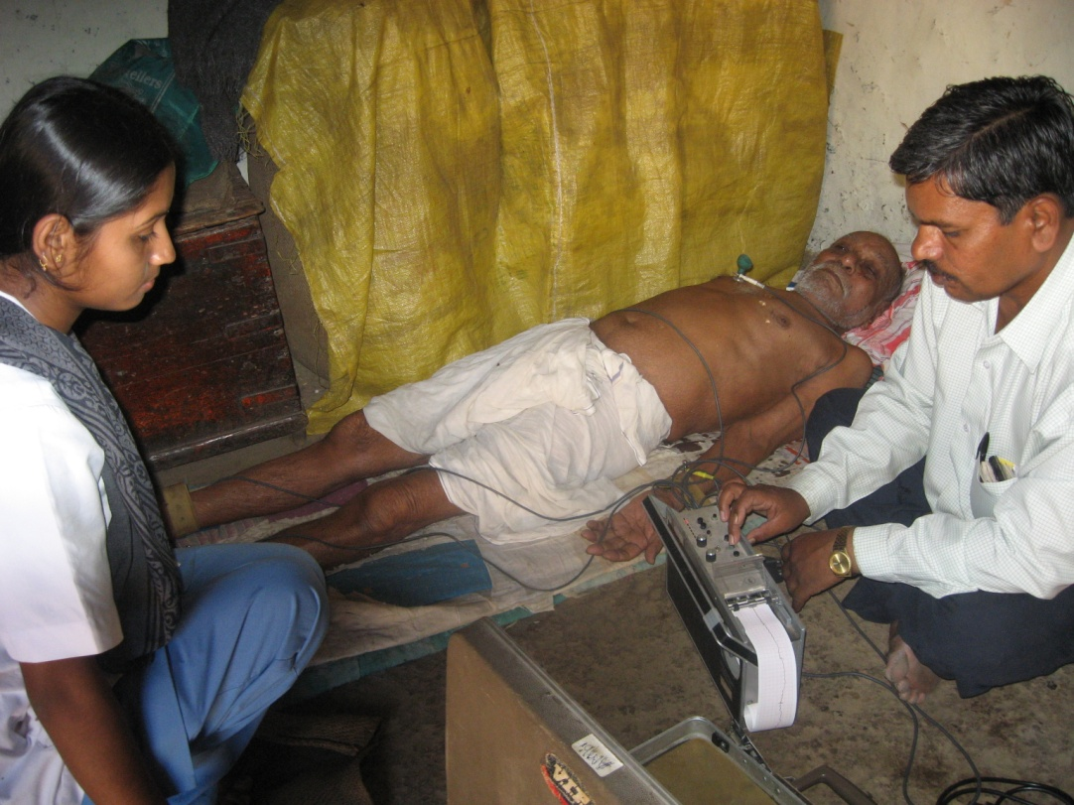

Slide 7
Methodology
This study was conducted for a period of 2 years from (2009) to (2011) in 14 villages near Panshet, Pune, India. These villages were 60-80 kms away from metropolitan city like Pune, India. The total numbers of subject studied were 636. In all the subjects, clinical history, family history and social history was recorded. All subjects underwent a thorough physical examination.
Basal, casual and periodical blood pressure was recorded in all subjects.

Slide 8
Fasting Blood Glucose using glucometer were taken in all subjects.
To assess lipid levels, laboratory lipid profile was done.
ECG charts of hypertensive patients were also done.
Renal Profile was also done.

Slide 9
1) Hypertension
28.14 % of the total female and 30.34 % of the males showed hypertension. Out of total 193 hypertensive population 83 (43%) subjects were having hypertension and abnormal lipid profile, 20 (10%) subjects were having hypertension and diabetes and 30 (16%) subjects were having all the three hypertension, diabetes and abnormal lipid profile.
Cases | >=140/90 mm/hg | Total Case | Prevalence
Male | 90 | 270 | 33.33%
Female | 103 | 366 | 28.14%
Total | 193 | 636 | 30.34%

Slide 10
Patients with Blood Pressure >=140/90 were included in this group as Hypertensive Patients.
Patients with Fasting Blood Sugar Level > 120mg/dl were included in this group as diabetic patients.
Lipid Levels:
1. Patients with only Hypertension, their LDL > 100, Total Cholesterol > 200 and Triglycerides > 180 were included in abnormal Lipid profile.
2. Patients with Hypertension and Diabetes, their LDL > 70, Total Cholesterol > 200 and Triglycerides > 180 were included in abnormal Lipid profile.

Slide 11
2) Diabetes
As shown in table 2 and diagram 2 out of (121) diabetics, (56) were males and (65) were females. Among diabetics patients (20) had hypertension, (37) had abnormal lipid profile and (30) had all three diabetes, hypertension and abnormal lipid profile.
Cases | >120mg/dl | Total Cases | Prevalence
Male | 56 | 270 | 20.74%
Female | 65 | 366 | 17.75%
Total | 121 | 636 | 19.02%

Slide 12
Patients with Blood Pressure >=140/90 were include in this group as Hypertensive Patients.
Patients with Fasting Blood Sugar Level > 120mg/dl were included in this group as diabetic patients.
Lipid Levels:
1. Patients with only Diabetes, their LDL > 100, Total Cholesterol > 200 and Triglycerides > 180 were included in abnormal Lipid profile.
2. Patients with Hypertension and Diabetes, their LDL > 70, Total Cholesterol > 200 and Triglycerides > 180 were included in abnormal Lipid profile.

Slide 14
3) Lipid profile
All elderly (636) were studied for abnormal lipid profile, excluding their associated hypertension and diabetes.
Total cholesterol was found above 200mg/dl in 145 (22.79%) out of which 34 (12.59%) were males and 111 (30.32%) females.
Triglycerides above 180 mg/dl was noted in 125 (19.65%) subjects in which 43 (15.92%) were males and 82 (22.40%) females.
LDL above 150 mg/dl was noted in 95 (14.77%) out of which 30 (11.11%) were males and 65 (17.75%) females

Slide 15
a) Total Cholesterol
Cases | >200 mg/dl | Total Cases | Prevalence
Male | 34 | 270 | 12.59%
Female | 111 | 366 | 30.32%
Total | 145 | 636 | 22.79%
b) Triglycerides
Cases | >180 mg/dl | Total Cases | Prevalence
Male | 43 | 270 | 15.92%
Female | 82 | 366 | 22.40%
Total | 125 | 636 | 19.65%

Slide 16
c) LDL
Cases | >150 mg/dl | Total Cases | Prevalence
Male | 30 | 270 | 11.11%
Female | 65 | 366 | 17.75%
Total | 95 | 636 | 14.77%

Slide 19
Abnormalities found in 636 SC
 | Females | Males | Total | Normal values
BUL | 26 | 47 | 73 | 15 – 35 mg %
 | 4.08% | 7.38% | 11.47%
S. Creatinine | 32 | 54 | 86 | 0.5 – 1.4 mg %
 | 5.03 % | 8.49 % | 13.52 %

Slide 20
Nutritional Status of Elderly in Detail in 139 SC
Male Female
Risk of malnutrition 32 50
Malnourished 16 34
Normal 3 3
Total 51 87
Body Mass Index
Male Female
Less than 19 19 55
19 to less than 21 19 24
21 to less than 23 9 5
23 or greater 5 2

Slide 21
Despite the vicinity of a metropolitan center, these villages were devoid of significant development with no safe water supply, lacked electric power, no transport facility and other infrastructure.
The majority of villagers including the elderly subsisted on agriculture and manual labor and are illiterate.
Their diet consist of mostly bread (bhakri) made up of wheat or jowar (sorghum) and vegetables if available.

Slide 22
Hypertension and diabetes are one of the major chronic conditions affecting elderly people (5). Only 25% of patients were aware of their diseases and 10% are taking treatment.
The association of hyperlipidemia in both groups in significant numbers (Hypertension 33%, Diabetes 19.02%) reflects on the high risk of potential CVS complications in both the groups.
In non obese, non diabetic hypertensive patients treating hypertension alone is one side of coin. The other side is dyslipidemia which should neither be ignored nor underestimated because it’s potentially reversible factor for coronary artery and development of vascular disease(3).

Slide 23
This finding reveals a counter trend that despite lower incidence of obesity, the rural elderly despite the simple lifestyle of austere living and adequate physical activities show a major trend of suffering from high incidence of diabetes and hypertension.
It can occur at any age but has higher prevalence in the elderly population. The prevalence of hypertension of 33% corresponds to Sample Registration System (SRS) report saying one in three among rural elderly have hypertension (1)

Slide 24
Rural Kerala (India) - DM is more frequently seen in rural than urban area. Therefore it’s a reverse trend similar to the West.
Since most rural areas in India and other developing countries have grossly inadequate health infrastructure and effective health services, the higher potential of the burden of cardiovascular and other chronic disease poses a serious challenge of alarming proportions to public health planning.
The growing trend in elderly age groups is even more alarming and demands high priority attention of nation and state health planners.

Slide 25
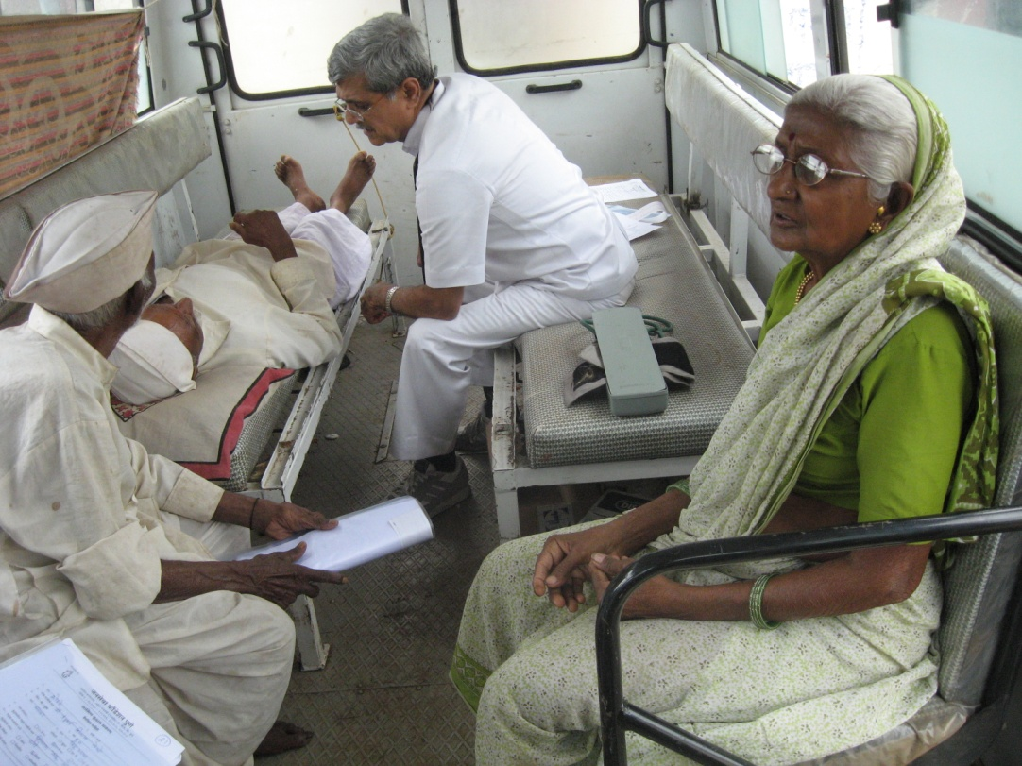
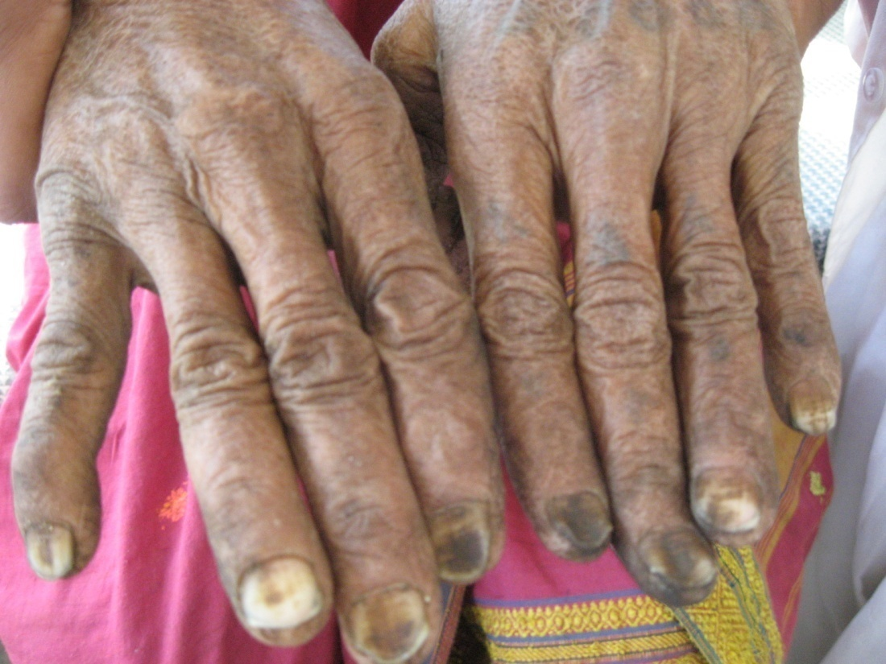
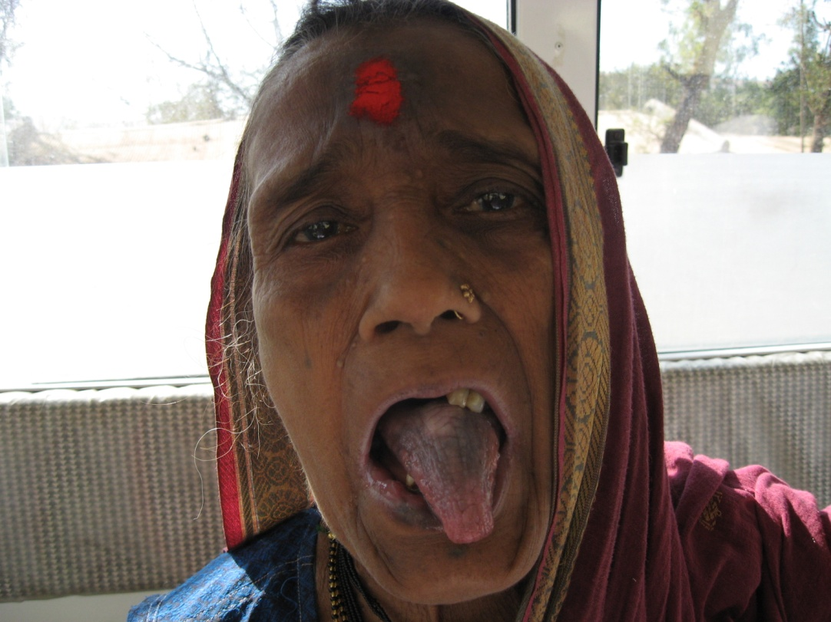
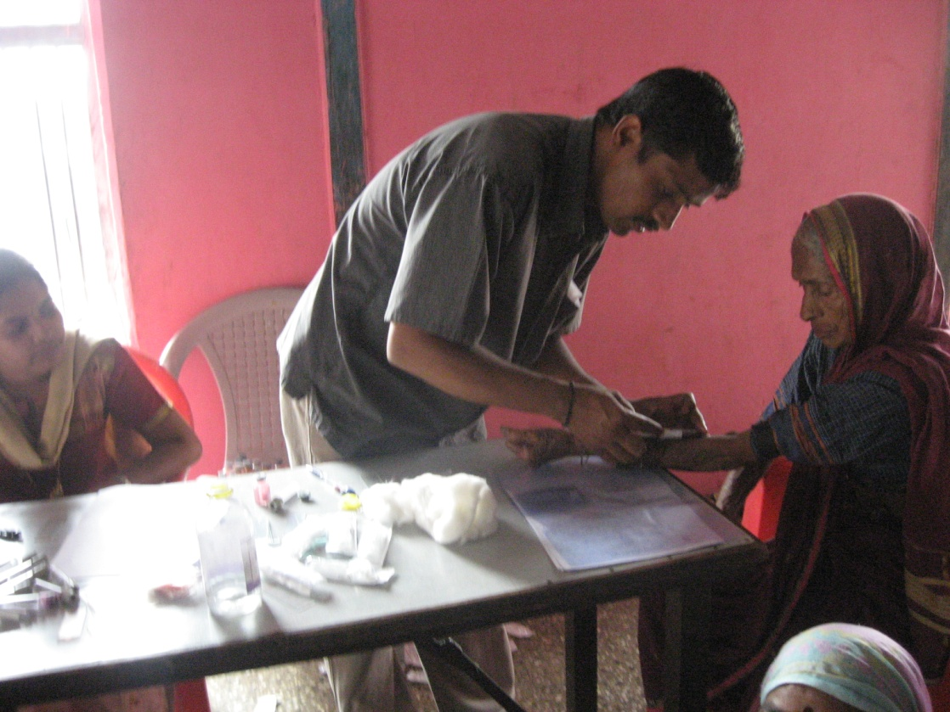

Slide 26
Conclusion
Inadequate health infrastructure and therefore health services is a challenge in India. Govt. under NRHM runs MMU and SNGO programmes and multiple other national health programmes but they have not reached the majority of the villages and hence there is a situation of ‘no doctor no drug’.
Therefore screening programme should be started all over, otherwise there will be a modern epidemic of chronic non communicable diseases e.g. HT and DM.
It is an enormous challenge of the alarming population to the public health planning and therefore ageing also needs high priority attention and therefore policy makers, doctors and NGOs should work together to achieve the goals.

Slide 27
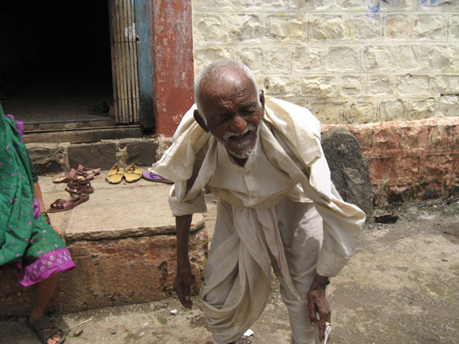
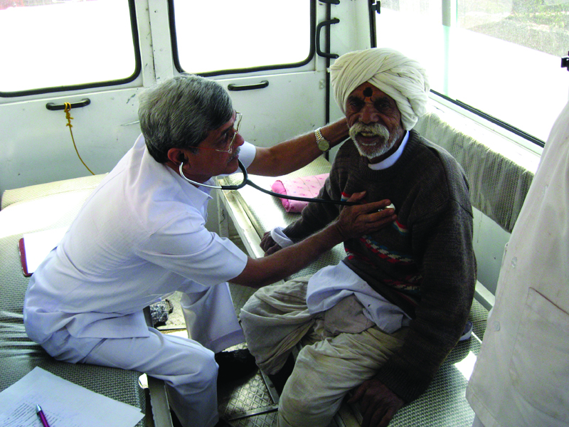
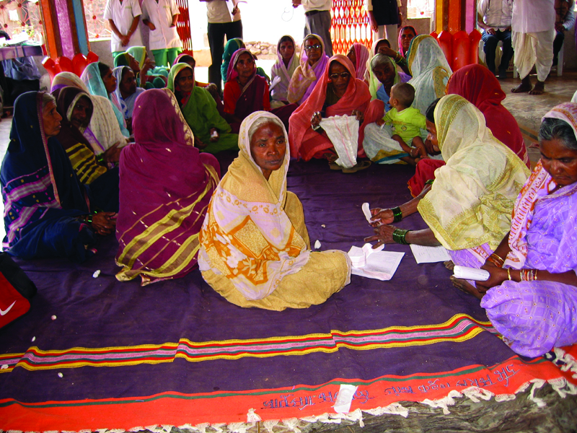
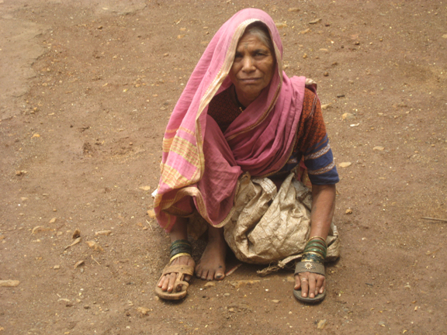

Slide 28
References:
1) The Registrar General of India's (RGI) latest data from the Sample Registration System (SRS), 2010.
2) Lipid Profile in non-obese and non-diabetic Hypertensive Patients
A) Shariq Sohail 2. Waseem Shafqat 3. Mahmood Nasir Malik 4. Abdul Hameed B)Asstt. Prof. of Cardiology 2 & 3. Assoc. Prof. of Medicine 4. PGR Medicine,
Allama Iqbal Medical College, Lahore
3) Howard BV, Magee MF, Diabetes and cardiovascular disease. Current Atherosclerosis
Rep 2:476-481,2000.

Slide 29
4) Morbidity Pattern among the elderly people living in a Southern Rural India –A cross sectional study.
Ashok kumar T, Sowmiya KR, Radhika G.
5) World Health Organization active Ageing: a policy framework Geneva Who Publications 2004;12-17.
6) Lipid management in type 2 diabetes. Maria p. Solano MD, Ronald B. Goldberg MD.
7) Type 2 Diabetes Mellitus in India. Vipin Gupta. South Asia Network For Chronic Diseases, New Delhi.

Slide 30
8) Leino M et al. Association of education with cardiovascular risk factors in young adults: the Cardiovascular Risk in Young Finns Study. International Journal of Epidemiology, 1999, 28: 667–675.
9) Sorel J et al. Educational Status and Blood Pressure: The Second National Health and Nutrition Examination Survey, 1976 – 1980, and the Hispanic Health and Nutrition Examination Survey, 1982–1984. American Journal of Epidemiology, 1992, 135: 1339–1348.
10) The association of hyperlipidemia in both groups in significant numbers (Hypertension 33%, Diabetes 19.02%) reflects on the high risk of potential CVS complications in both the groups.

Slide 31
Prevalence, awareness, treatment and control of hypertension among the elderly in Bangladesh and India: a multicentre study.
Pattern and Trend of Population Ageing in India. Suvalaxmi Chakrabarti, Prof. Ashis Sarkar.
Hypertension study group. Prevalence, awareness, treatment and control hypertension among the elderly in Bangladesh and India: A multicentre study. Bull World Health Organ 200179:490-500.

Slide 32
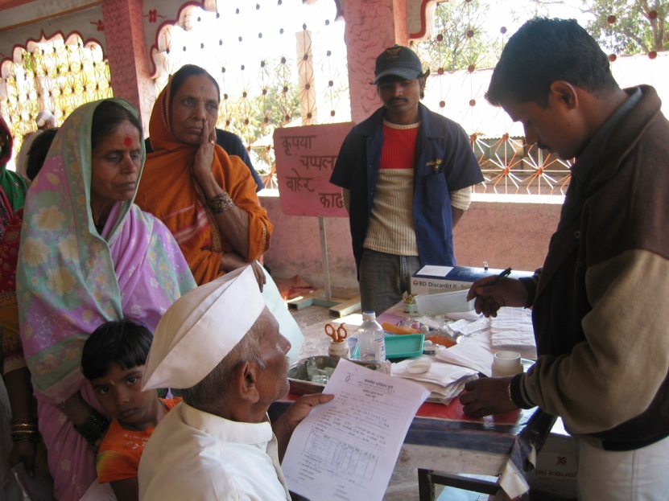
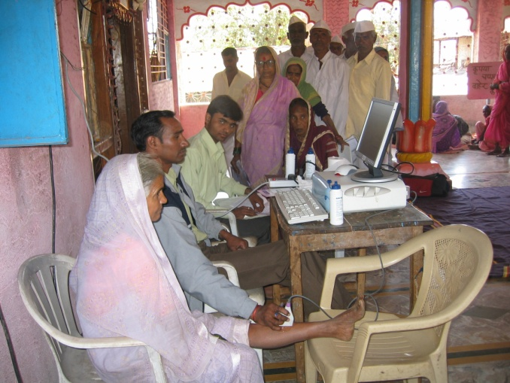
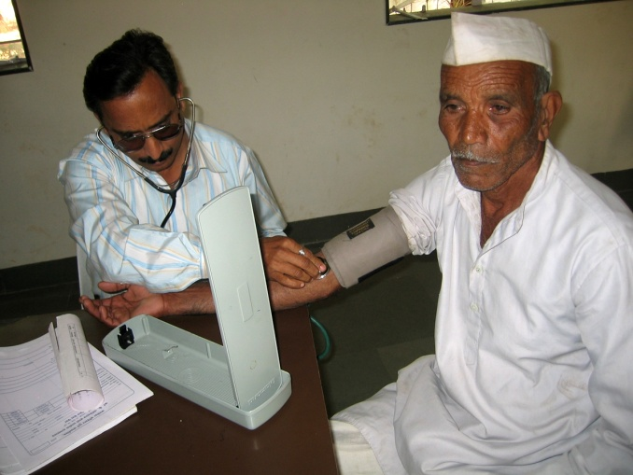
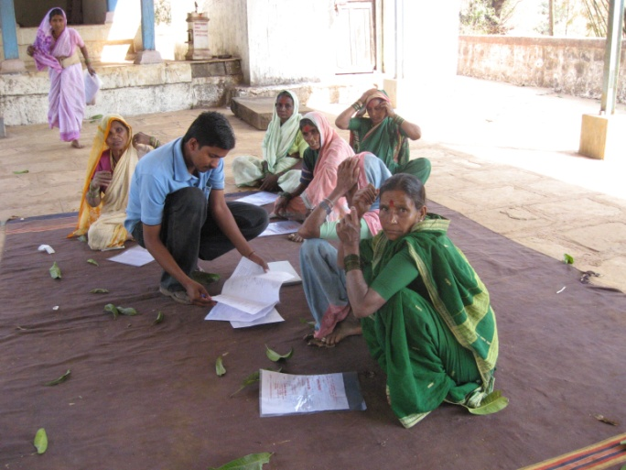
We are thankful to :
Maharashtra Foundation, USA
Share & Care, USA
Shri Narendra Lakhani, USA
Thank you

