Slide 1
The 11th Global Conference on Ageing 28 May – 1 June 2012 Prague
Research on usability for ICT system to improve the health of dependent elderly people with cardiovascular or osteoarticular disease
Stephanie Carretero
Jorge Garcés
Irene Monsonís-Paya
Mireia Ferri Sanz

Slide 2
Introduction
Methodology
Results
Conclusions
Index

Slide 3
Introduction
MAIN OBJECTIVE -> to design of a new technological social and health system to improve the prevention, control and self-management of chronic diseases and the autonomy of dependent elderly people affected by a cardiovascular or osteoarticular disease
The technological system will include:
a single solution a portable device for the control and communication of the health status and localization of the patient outwards
a control domotic system with movement detection at home

Slide 4
Introduction
Novelty of this technological system:
It sends medical and localization data in real time by the portable device and in the integration of an environment control system at home.
All the generated data will be sent to an information platform, processed and sent to the corresponding defined user.
The system will also include other services like video conference, video surveillance, cognitive stimulation for elderly people, etc.

Slide 5
Introduction
THE CONSORTIUM:

Slide 6
Introduction
PILOT STUDY:
to determine the way that the different users want to receive the information
PATIENT
CAREGIVER
GENERAL PRACTICIONER

Slide 7
Methodology
The sample was formed by:
13 Elderly people
3 Health professionals
6 Caregivers
Development of questionnaires
Evaluation of relevant variables in the design of the technological system.
As the study was an exploratory analysis, the collected data is small

Slide 8
Questionnaires design
ELDERS / PATIENTS:
General information: to collect sociodemographic data of the sample.
Home system: To identify the current measurement devices used by the patient and the difficulties found.
Data format: To identify the preferred format to receive data about their health status.
Record management system: To evaluate if it is interesting for elders to know their health conditions in a more or less long time period.
Outdoor system: To evaluate how user perceive the utility of the geolocalization and monitoring when outdoor.
Emergency system: To evaluate if elders would like that system will notify if there are some danger parameters.

Slide 9
Questionnaires design
GENERAL PRACTICIONERS:
General information: to collect sociodemographic data of the sample.
Health conditions of monitored users: To define the kind of test for daily and urgent monitoring; key information to the correct monitoring; how, when and where this information should be received; who must analyse it in first step, etc.
Emergency system: To define their preferred way to receive emergency warning and next steps.

Slide 10
Questionnaires design
INFORMAL CAREGIVERS:
Elder-caregiver relationship: To understand daily implications for the caregiver.
Health condition of elder: To identify needed measurements for monitor takes them.
Localization and health data format: To define the preferred way of receiving the information.
Data receiving mode: To define the preferred way of receiving formation in an emergency situation or progress data.
Management of data related to elder: To define the preferred way of access and manage the record.
General information: to collect sociodemographic data of the sample

Slide 11
Check and Validate Questionnaires
Validation in order to detect:
questions' ambiguity
Intelligible vocabulary according to user
if the compiled information is necessary
duration of the interview
others: awards, motivation, advice for doing questionnaire...
First validation:
Remove questions from which we don't obtain information,
Refuse question with the same objective,
Change writing and vocabulary to adapt to each kind of user.
Second validation: Approve questionnaires to use with final users.

Slide 12
Results
Elders
First group Second group
4 elders more than 71 years old living in their own homes.
Health condition: mobility problems and heart problems.
Averse to use technology because they have never used it.
Advantage: not depending on anyone.
9 elders between 61 and 71 years old living in their own homes.
Health condition: good.
Future users able to understand this technological system.
Don’t be averse to use it to improve their QL.

Slide 13
Results
Elders
99% of them don’t live alone
Responsibles of taking daily medication
Any of them is averse to press an alarm button
73% of them would like that this system minimizes medical visits and most of them prefer use a videoconference system
All of them use mobile phones, therefore they would have no problem in carry a biomedical monitoring device
Positive attitude for the idea of a system that make easier disease management and improves their Quality of Life.

Slide 14
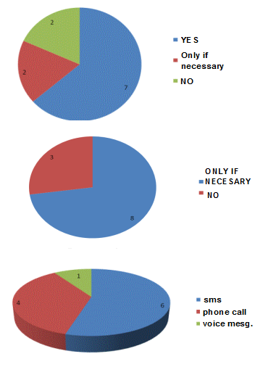
Results
Elders
Localization Sensors
64% accept localization sensors at home.
Video Cameras
73% accept video cameras under conditions.
Info when Outdoor
55% text message
36% phone call
the rest voice message.

Slide 15
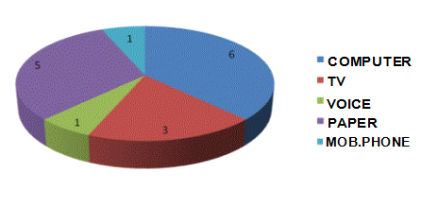
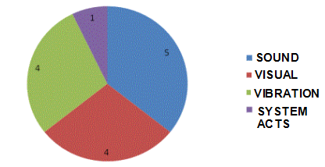
Results
Elders
Info in home
43% computer
36% paper
21% TV
Emergency alarm to user
36% resounding alarm
29% visual alert
29% mobile phone vibration

Slide 16
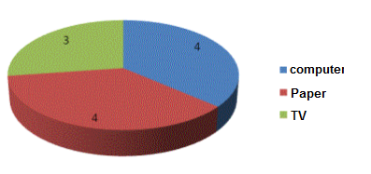
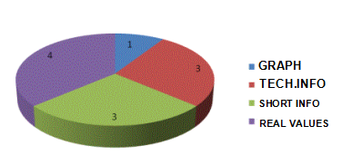
Results
Elders
Check Measurement Record
Option to monitor with retrospective vision.
37% computer
37% paper
26% TV
Format Measurement Record
37% real values
27% a short review
27% a technical review
9% graphical format

Slide 17
Results: General practicioners
THREE general practiCioners
Two of them 41-50 years old.
One of them 24-40 years old.
All of them can manage perfectly technological devices: computer, PDA, mobile phone.
Each doctor answered questions individually.
All of them have answered that a nurse must be who accesses to the compiled data.

Slide 18
Results
General practiCioners
Needed Information in case of emergency:
Clinic record
Value of the parameter
Contact data
Localization of elders and family
Home conditions
Warned by the system in an emergency situation: mobile message.
If he can’t visit or contact the elder, the system should contact the emergency services.
In non-emergency cases: e-mail.
It is necessary the pre-configuration of normal limits in parameters
Frequency to generate reports to the therapist: Once a week.
Therapist configures it depending on specific needs of elders This information is centralized in a data base.

Slide 19
Results: Informal caregivers
SIX CAREGIVERS
Women and direct family of the elders.
Three of them are more than 65 years old
Two of them are between 56 and 65 years old
One between 26 and 40
All of them can manage correctly a mobile phone.
Two of them can manage computer so well, three wrong and one regular.
They can't manage PDA because they had never used it.

Slide 20
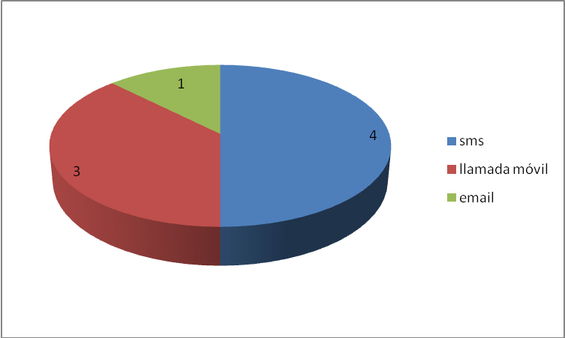
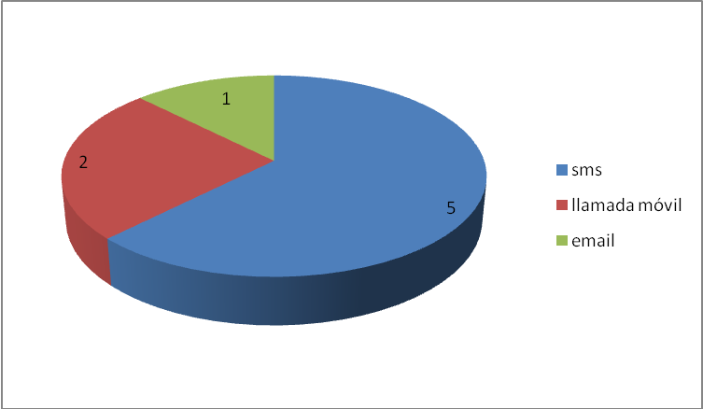
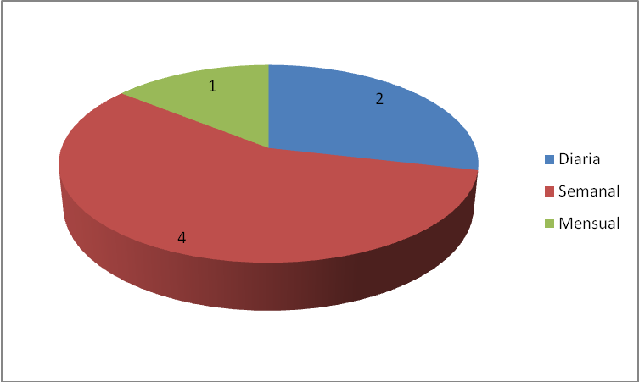
Results
CAREGIVERS
Monitoring Data
sms
phone
e-mail
50% prefer receive it by sms.
Progress Data
sms
65% prefer receive it by sms.
phone
e-mail
Frequency of Summaries
57% weekly
29% daily
14% monthly
day
week
month

Slide 21
Conclusions
Elderly people
Exact measurement in real time.
Detailed information of their status.
Graphic of the evolution: technical with all the possible details, showing them on a computer and these data should be printable
38% would use the panic situation button.
15% would like that system warns their families to check the situation
90% emergency service should be warned in emergencies.
Patients would prefer to obtain the information from the device itself and from a TV or computer monitor

Slide 22
Conclusions
GENERAL PRACTICIONERS
Key information: Cardiovascular (blood preasure, oxigen levels in blood, temperature) and osteoarticular (pain scale, activity scale and temperature) etc.
Initial training for medical staff, nurses, and doctors to use this system correctly.
Monitoring data will be evaluated, in a first step by trained nurses.
The format for registered and compiled monitoring information is web format.
Any change in elder's health conditions should be communicated to the doctor by e-mail.

Slide 23
Conclusions
INFORMAL CAREGIVERS
Outdoor portable system to know elders' localization warning when:
Detects a fall
Detects the elder remains quiet in a long period of time
Home system should have:
Sudden movement and fall sensors
Videoconference to communication with family and therapists to avoid uncomfortable visits.
Video-surveillance system if necessary.
SMS alarm to remember medicaments taking.
Value Chart to check control and progress data (63%).
Phone call to inform about getting worse and risk situation
Only one device to measure all vital parameters.

Slide 24
Thanks for your time and attention
jordi.garces@uv.es
irene.monsonis@uv,es

