Slide 1
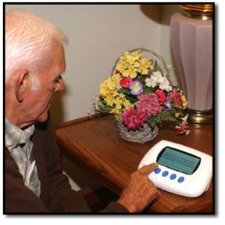
Gadgets, Gizmos, and Growing Old
Sandra P. Hirst RN, PhD, GNC(C)
Annette M. Lane RN, PhD
Brenda Strafford Centre for Excellence in Gerontological Nursing
Linda Shorting RN, MA
IFA 2012

Slide 2
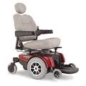
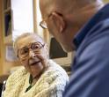
Outline
Laying the Context
Health promotive technology (HTP) specific to older adults aging in place
Definitions
Case examples
Literature Review
Our Study
Question
Method
Findings - Emerging Themes
Discussion of Findings
Conclusion

Slide 3
Aging in Place
Describes a senior living in the residence of their choice as they age, while being able to have any services they might need over time as their needs change, for as long as they are able.
The goal of a senior wanting to age in place should be to maintain and/or improve their quality of life.
Health promotive technology (HPT) is one service / product(s) that can facilitate aging in place.
Notes:
increasing demographic aging
physical functioning, defined as one’s ability to perform activities of daily living, instrumental activities of daily living , and mobility tasks necessary for independent living; impacts aging in place. ADLs (bathing, dressing, toileting, eating, moving around the house) and IADLs (preparing meals, shopping, managing money, using the telephone, doing housework, getting around outside, taking medications) are reference points for ascertaining an older adults person’s physical functioning
the inability to perform an ADL or an IADL alone or without assistance is the definition of a disability
majority of US / Canada’s older adult population requires some degree of informal & / or formal care due to loss of function as result of declining health
this change in demographics and its potential consequence s (e.g. for the health care system) has prompted active research in technology solutions for monitoring and assistance
growing recognition that the care & support of older adults can be enhanced through technology

Slide 4
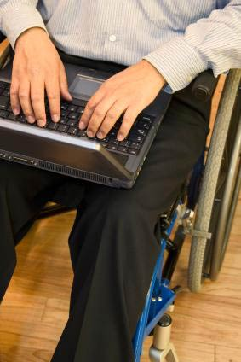
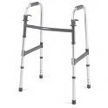
What is health promotive technology?
Technologies that can influence the aging process for older adults, including their quality of life, health outcomes, and satisfaction and / or the quality of care received.
Notes:
Technology and old age are not strangers to each other.
a long standing tradition of technology specific health care support; for example, assistive technologies ranging from communication tools to mobility aids to assist disabled older adults to have enhanced quality of life.
Technology is a potential enabler specific to aging in place.
To make technology useful to and usable creates challenges for key stakeholders including: the research and design community, older residents, and facility administration and staff.
It is hoped that this presentation will highlight some important challenges and in doing so help to build bridges between technology, aging in place, and the needs of older adults.

Slide 5
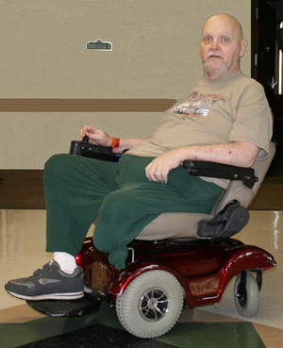
Case Examples
Richard:
Mrs. James:
is a 78 year old former teacher who was severely paralyzed in a motor vehicle incident. An eager volunteer, he wants to continue working at the local elementary school. He uses an electronic wheelchair. Richard can not write with a pen because of a weakness to his hand but a computer is adapted for his needs. He finds it difficult to manage the toilet but has been provided with some strategies to help him manage.
has just turned 88. She lives in a senior citizens residence. She makes her own meals despite having access to the dining facilities. She prefers her own cooking. Several years ago, Mrs. James complained of feeling unsteady on her feet and her daughter suggested the use of a cane. More recently, she has been using a walker.

Slide 6
Providing a perspective to health promotive technology and aging in place

Slide 7
Literature review
Retaining autonomy and quality of life
Smart homes
Intelligent phones
Supermarket shopping
Sources:
Altus, Mathews, Xaverius, Engelman & Nolan, 2000
Demiris, Oliver, Dickey, Skubic & Ranrz, 2008
Evans, Orpwood, Adlam & Chad, 2007
Notes:
High technology smart homes
Intelligent phones helping people with memory problems to remember who called last time or the name and relationship of the person calling
e.g. ThinkContacts is a mobile phone application being developed by Nokia which would allow a disabled person to select a contact from a list and place a phone call to that person using only their mind. The app, works with an accompanying headset that reads the user's brainwaves to measure attention levels. If the attention level is higher than 70%, the software scrolls to the next contact in the list. If the attention level is higher than 80%, the software makes a phone call to the selected contact.
Supermarket shopping - Older adults often find computer interfaces confusing. In Bristol, England, many housebound older shoppers found it difficult to use internet shopping. A Brunel University professor designed an easy to use barcode scanner that connects via email to a local supermarket. Shoppers scan bar codes from a catalogue or actual merchandise, receive verbal confirmation of the item, and then place their orders. The merchandise is delivered to the home.

Slide 8
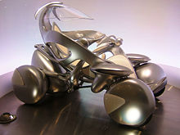
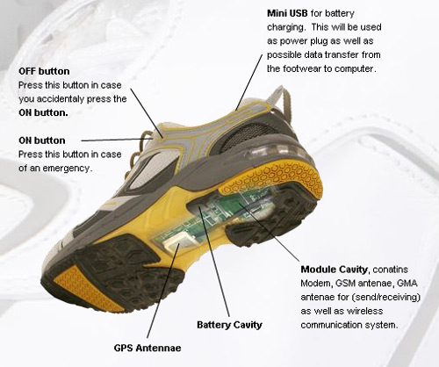
Diverse Applications
Health monitoring
connect monitoring devices, with web interface including: BP, glucometer
Home safety
passive motion monitoring
Transportation
I unit
walker
wanderer
Sources:
Chapman, 2001
Johnson et al., 2007
Notes:
Medication Monitoring
HTP designed to monitor, manage, dispense, adherence, & tracking
Generally of two types:
Stand alone – less complicated / single function e.g. talking pill bottle
Integrated – more complex, integrated
Medication Monitoring Systems that range from device; e.g. to the “smart” pill dispensers that work with sensors to alert them to missed dosages and give reminders of the appropriate time to take their medications.
Home Safety
PERS - Personal Emergency Response System is a system which allows individuals, including older adults, to summon help during an emergency. Although PERS vary in specifications, the most common configuration has three components:
(1) electronic hardware in the home that allows the client to request assistance,
(2) a centralized emergency response centre receiving client calls, and
(3) protocols and staff to assess and dispatch appropriate help.

Slide 9
Social Networking
60.8% of Canadians 55 to 64 accessed the Internet for personal reasons in 2007
Substantially smaller proportion (28.8 – 65 +)
Seniors use the Internet differently than younger Canadians
Sources:
CIUS (Canadian internet user survey)
Silver, 2001
Veenhof, 2006

Slide 10
Three points arising from the literature review
Older adults want to remain as active and independent as possible for as long as possible
Confounding factors to aging in place
Health promotive (enabling) technology has the potential to revolutionize health care services for older adults, promote independence, and enhance aging in place
Notes:
Large-scale surveys on individuals with an impairment, which include the National Health Interview Survey, National Long-term Care Surveys, and the Canadian Health Activity Limitation Survey have consistently demonstrated a trend toward an increase in assistive device use and a decline in the use of personal assistance by older people with varying levels of functional disability and impairment.
These surveys have also found that older people often cite the need for additional equipment and use products to help with a wide range of problems.

Slide 11
Our study
Question:
What is the lived experience of older adults who use health promotive technology to age in place?

Slide 12
Method
Meta-synthesis
specialized searches of Academic One File, Academic Search Complete, and Credo databases
free word texts
interlibrary loan
Internet search
Conversations with key stakeholders
Notes:
Studies were retrieved via computerized literature searches, cross referencing from original and review articles, and an examination of reference lists by members of the research team
specialized searches of Academic One File, Academic Search Complete, and Credo databases
used free text words, medical subject headings; search terms included: “older adults “, “technology”, “aging in place”, and “research”
articles obtained from on line sources, hard copies acquired when available from two university libraries and interlibrary loan,
duplicate articles removed from list as were technical reports / similar documents
Our primary goal was not to provide the most comprehensive or exhaustive survey of currently available assistive technologies, but rather to offer the reader an appreciation of the range of emerging devices that may find a role in supporting older adults to age in place

Slide 13
Inclusion criteria
Research article
Published 2000 – 2011
English language
Older adults were identified as participants / recipients
Technology was linked to aging in place
Notes:
Inclusion criteria were:
research (defined as containing a statement of the purpose and a description of methods and findings, regardless of whether such terms were used),
reporting on the health promotive technology experience of an older adult living in the community,
dementia / cognitive impairment excluded

Slide 14
Data (literature)
Total articles
Identified 3216
Obtained 2302
Excluded 2249
Reviewed 53
Notes:
Data Analysis
ongoing analysis was done using a matrix, and codes and categories were added, combined, or deleted
underlying the analysis process was a series of questions: What types of experiences are older adults obtaining? Are the findings of the different studies similar? What are the themes emerging from the findings?
Limitations
only English language articles were reviewed; reducing the richness of information from other language sources
some articles were not available

Slide 15
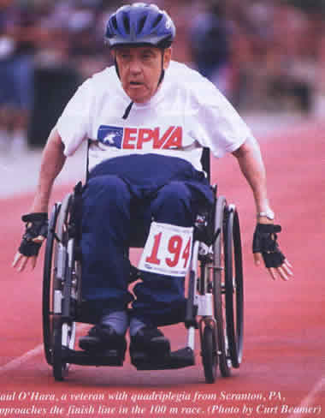
Findings: Who are the users?
Individuals caring for an older adult / HPT may decrease burden of care
Older adults / HPT may promote safety
Older adults / age related declines
Require assistance with ADLs
Aging / life long disability
Notes:
each of these groups may differ as to how they perceive assistive technology, define its benefits, obtain knowledge of the range of available assistive devices, and acquire devices.
systematic research involving comparisons across these five groups as well as within them would be necessary to fully comprehend the conditions under which older people become technology users and the circumstances under which they choose to abandon that particular approach to performing a daily activity.
Frequency of use:
studies, differ vastly in sample size, sampling procedures, population groups, and, not surprisingly, in findings, reported averages of 2 to 13.7 devices in the homes of older people.
frequency of use, which ranged among the studies from 35 percent to 82%, tended to vary by the type of device considered, the specific functional limitation, and the time of onset of the impairment.
e.g., people with visual impairments tend to report high use rates, while those with cognitive impairments report the least number of devices in use (Mann, Hurren, & Tomita, 1993).
those with a recent-onset condition appear to use devices less than those who have had an impairment for a longer period of time (Van Der Heide et al., 1993).

Slide 16
Themes
Is it for me?
The expression of feelings:
'It's not like before. I used to feel sorry for people who had wheelchairs.'
'I am the same person. I just can't walk.'
'I don't like to be dependent on these devices and others. I was very independent before my stroke.'
'My wheelchair makes me a cripple.'

Slide 17
Reasons for use
Reasons for abandonment
Tasks made easier to perform
Comfortable to use
Provides emotional security
increases safety
Improves function
Facilitates independence
(AARP, 2008; Charness & Boot, 2009; Coughlin, et al., 2006; Dermiris, et al., 2008; Li & Huang, 2009; Melenhorst, et al., 2009; Melenhorst, et al., 2006; Mitzner, 2010)
Functional ability improves
Use of one device contingent on use of another
Lack of knowledge about how to use device
Poor fit with environment or person's need
Device lost, forgotten, or never taken home from hospital
Device failure
Preference for personal assistance
Feelings of embarrassment
Denial of need
Notes:
It is recognized that the experience of illness and disability profoundly affects the ways people redefine themselves when their functional abilities become diminished or lost. How individuals proceed through the process of personal recovery and begin to reconstruct a sense of self shapes the ways prescribed therapies or techniques such as the use of a technological aid are accepted.
Some HTP devices, such as sensor networks that monitor the older adults, provide a detailed description of the person in the environment so that interventions can take place in a timely manner. - these networks do not empower the older adult. If older adults are not empowered, they may, in fact, become disempowered (Dewsbury et al. 2003). Preserving older adult’s identity and self-concept is a critical gap just as essential for independent living as meeting functional needs.
Identity and self-concept are related to the way older adults accept a disability. Heinemann and Pape (2001) suggested that the use of HTP devices may threaten the user’s identity because one’s identity is shaped by how people see themselves and their relationships with others. Stigmas, feelings of dishonor, disgrace and embarrassment may restrain older adults from using some devices.
The use of HTP occurs within a sociocultural context. Social attributes related to devices and cultural judgments concerning independence and dependence, having or not having a disability, seem to represent powerful influences on whether devices are accepted into an older adult’s daily public and private routines.

Slide 18
Embedded in the environment
systems that are designed to promote independence require varying degrees of privacy impairment (Bharucha et al., 2009; Birnholtz, et al., 2010)
use of cameras for monitoring purposes cause feelings of violation of privacy (Boissy et al., 2007)
1/3 abandon mobility aid devices within the first three months; 54% limit the use in social situations because of their appearance (Forlizzi, DiSalvo & Gemperle, 2004)
embarrassed if it made a noise when someone was visiting (Robinson et al., 2006)
Notes:
Forlizzi, DiSalvo, and Gemperle (2004) found that one third of older adults abandon mobility aid devices within the first three months, while as many as 54% limit the use in normal social situations because of their appearance. A wheelchair that looks more like a tank is not likely to be greeted with alacrity even though it can work autonomously.
Grab bars and wearable monitors are also noted as having been rejected because of their aesthetics (Forlizzi, DiSalvo, & Gemperle 2004). Forlizzi, DiSalvo, and Gemperle (2004) concluded that older adults people want devices that they find aesthetically pleasing and support their functional needs.
Aesthetics represents a critical gap. HTP may well be spurned if functionality without aesthetics is the norm.

Slide 19
An ounce of prevention
friendly eye in the sky versus big brother (Caine, 2011; Courtney, 2008; Essen, 2008; Melander-Wikman et al., 2007; Rantz, et al., 2008; Rowan, et al., 2005)
perception and receptivity regarding the introduction of an intelligent videomonitoring system at home – only if left alone (Turgeon Londei, 2009)
Notes:
Sophie Turgeon Londe^{i} et al. (2009) explored the perception and receptivity of elderly people regarding the introduction of an intelligent videomonitorin^{g} system (IVS) at home. Using a mixed methods design, 25 older people with a history of falls completed a structured intervie^{w} (two questionnaires). In the year preceding the interview, 72% of the participants fell as many as seven times. Open-ended questions were used to supplement the quantitative data.
Participants were 84% favourable or partially favourable to technologies which ensured home security and 96% favourable or partiallly favourable to the IVS. About half (48%) said that they would use it. The other participants did not wish to use it unless they had been left to live alone or if their health conditio^{n} worsened.

Slide 20
Staying in touch
loss of human contact (Bossy et al., 2007; Demiris et al., 2004)
long distance relationships (Robinson et al., 2006)
to create networks (Cheek et al., 2005; Pollack, 2005)
Where is the on switch?
ambivalence (Mitzner, et al., 2010; Selwyn, 2004)
attitudes towards computers (Czaja et al., 2006)

Slide 21
Discussion of the Findings
Not a homogenous group
Technology can promote aging in place
Structure of the home offers challenges
Need to create a clear profile of the older user
Level of knowledge – method of instruction
Social connectedness technologies can increase quality of life or decrease it
Review of payment processes
Role of informal care giver
Health technology versus aging services technology – the need to integrate these two fields
Notes:
The needs of the older adults are not homogenous.
Public policies, coupled with evidence-based research, must reflect the divergent needs of the majority and minority populations
Older adults’ homes often offer challenges because of their physical characteristics and location.
Housing designs that fail to adequately meet the needs of the older adults are a preventable problem. Thoughtful design and attention to the needs of all persons, including those of minority ethnic communities, can enhance the quality of life for older adults as they age-in-place.
Abandonment suggest that the method of instruction and the context in which it occurs need greater attention to ensure appropriate prescription and maximize proper use.
Older people appear to benefit from short training, periods with many, opportunities for practice, experimentation, re-evaluation, and modification of the assistive device or the environment, if necessary.
First-time device owners, may become more successful users if such strategies are introduced within the context of a valued activity and/or if instruction occurs in the home.
Instruction should include information as to where to obtain other technologies and how to repair or replace broken or lost devices.

Slide 22
How can I / we decide if HTP would facilitate aging in place?
Does it solve the problem?
Does it fulfill identified needs?
If not, can it be exchanged?
Is it well designed? Easy to use?
Does the older client like it?
Is it easy for the informal care giver to use?
Can the older client operate it by him/herself?
How is maintenance to be managed?
How will repairs be managed?
Are there instructions?
Is training on its use available?

Slide 23
Role of Gero / Aging Associations
Development of a clear technology -enabled care vision
Identify and learn from “best practices”
Advocacy efforts to bring these issues to policy makers and urge them to remove any impediment to aging in place
Notes:
Development of a clear technology-enabled care vision to increase awareness to the potential value that would be brought about by the implementation of such a vision.
A great opportunity exists to develop effective public policies that meet the challenges associated with aging-in-place. The issues surrounding aging are complex and interrelated; they require long-sighted decisions.
Aging-in-place involves individual, family and societal concerns. Governments are the mechanisms that link individual and family concerns with societal concerns. Family sensitive policies, as outputs of the political process, have the potential to construct policy solutions that address aging-in-place problems while enhancing older adults’ quality of life.
T o promote aging-in-place, housing policies need to address such issues as helping older adults people to maintain their independence through HTP and home adaptations. Housing designs that fail to adequately meet the needs of the older adults are a preventable problem.
Identify and learn from the “best practices” selected from among already ongoing efforts, as well as the need to continue to plan and execute additional outcome-oriented field pilots and larger-scale demonstration projects.
Advocacy efforts to bring these issues to policy makers and urge them to remove any impediments.

Slide 24
Further Research
Unanswered questions:
How do men and women differ in their use / acceptance of HTP?
What type of instruction will enhance HTP use?
How do robotics versus “live” animals compare in facilitating aging in place?
Notes:
Researchers need to be certain that the right questions are asked, the right research teams are employed to answer the questions, & findings are disseminated so that policy & practice can benefit.
Multiple research methodologies, including qualitative studies, need to address older adults’ physiological and psychological needs. Listening to the needs of the older adults is vital, even though the older adults are sometimes thought of as objects rather than key stakeholders.
Pilot studies need to test HTP to discern if the device is making life better for recipients. For example, testing levels of happiness before and after introduction of AT will help determine whether quality of life enhancement has been achieved.
Artificial intelligence. In 1966 Weizenbaum developed Eliza, a computer program that mimicked a therapist following the Rogerian approach. This was one of the early systems to pass the Turing test, that is, users could not tell whether they were interacting with a machine or person. This type of approach could be used with the older adults to give them “someone” with whom to talk when they feel lonely and no caregiver is available, thus helping to meet psychological needs.
when teddy bears were introduced to the bedrooms of a retirement community to monitor the residents, most formed a bond with their bear.

Slide 25
Thank you
Email
shirst@ucalgary.ca
alane@ucalgary.ca

