Slide 1
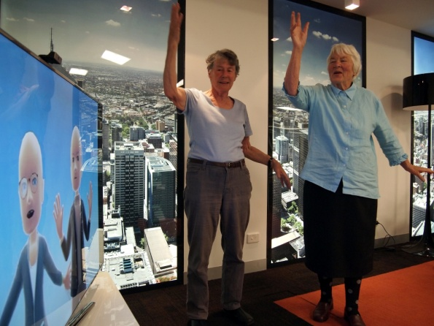
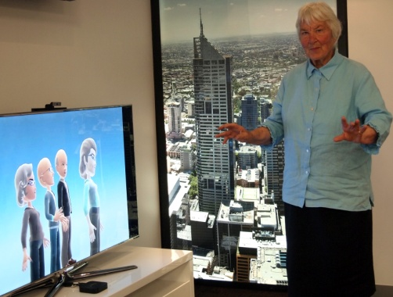
Ageing Well at Home with Broadband
Debra O’Connor
Elizabeth Cyarto
Rebecca Haarck
Frances Batchelor
Briony Dow
National Ageing Research Institute
Melbourne Australia
Notes:
Thank you for the opportunity to present our project Ageing well at home with broadband.
I am presenting on behalf of a research team led by senior research fellow at NARi Dr Liz Cyarto – I have been involved since the development and am on the advisory panel.
My position includes research management at NARI, I am on the management and advisory group

Slide 2
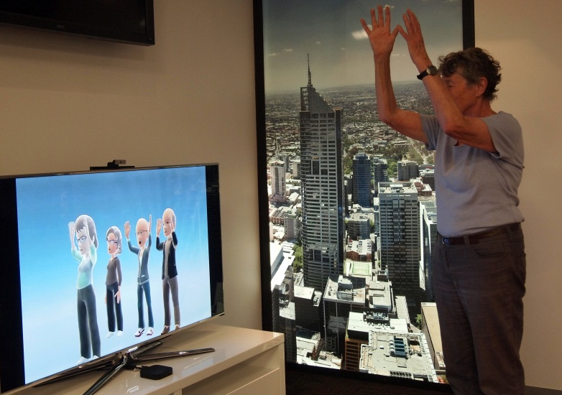
Presentation will cover:
The Australian context
Background research
The aims and methodology of the
AWAHWB project
Some challenges
Notes:
I will give some background and context and then describe the project and finish with a summary of the challenges so far

Slide 3
The National Ageing Research Institute:-
Based in Melbourne, Australia
Undertaken multi and interdisciplinary research into ageing for over 30 years. Research encompasses psychosocial, clinical, biomedical, aspects of ageing.
Stand alone, not for profit and is affiliated with various academic institutes. Mostly self funded.
Approximately 45 multidisciplinary researchers
International and local collaborators
Notes:
First some background about NARI and the context that provides the background for the research
NARI is based in Melbourne and has been undertaking research in ageing since 1975.
NFP and employs about 45 multidisciplinary researchers. Not basic benchtop research.

Slide 4
Focus of research:-
the provision and effectiveness of clinical care, health services and technologies provided for older people.
Health status and health needs of older people.
Highest academic standards of study and practice in medicine and allied health care
Provides and promotes education concerning ageing.
Translational research and evidence based practice
Notes:
The work is ‘holistic’ and interdisciplinary. Focus on translational research.

Slide 5
Background Context in Australia
Spending on aged care projected to grow
Care in home is preferred policy, preferred by older people but can be seen to increase risk of social isolation
Australia is rolling out a national high speed broadband network over the next 10 years to 93% of population
which is a major investment and governments are therefore funding applied research projects to demonstrate innovative applications and the community value
Lack of opportunities for physical activity
Notes:
Australia is rolling out a national high speed broadband network over the next 10 years to 93% of population
which is a major investment and are therefore funding applied research projects to demonstrate innovative applications. Australia is facing an aged care crisis. Over the next 45 years, the proportion of the population aged over 65 years is expected to double. Due to medical advances, people are living longer, but many are not ageing well.
Socially isolated individuals are at greater risk of losing their independence. There are 50,000+ socially isolated Victorians over 65 years with this number predicted to increase by 46% by 2020.
Only half Australia’s older adults engage in the recommended 150 minutes of moderate-intensity physical activity per week. Regular exercise and physical activity can reduce the risk of developing some chronic diseases and sustaining a fall. PA also delays functional limitations and mobility disability.
Older people are embracing interactive gaming. A study of older persons using Nintendo’s Wii demonstrated benefits of ‘exergaming’’. Participants perceived health benefits in terms of greater ease of movements and their psychosocial wellbeing. Participants also reported that the technology provided them with shared experiences and therefore greater connectedness with their family members, especially grandchildren.
Although there is a recognised demand and need for technology interventions to assist active ageing, the barriers and enablers for their use in practice and the effectiveness and acceptability of such technologies among older people has not been thoroughly assessed.
The Australian Government’s National Broadband Network initiative will provide high speed/high capacity broadband services to 93% of the country over the next 10 years.

Slide 6
NARI has a history of research into a number of areas in which technology has been an integral component:-
Carers on line – multidisciplinary project to support cares in rural areas through social connection and aiming to improve mental health outcomes (Dow et al)
Gaming technology to improve mental health and physical health outcomes for frail older people in residential care (Cyarto et al)
Delivery of Cognitive behavioural therapy to people living with chronic obstructive pulmonary disease to reduce depression (Doyle)

Slide 7
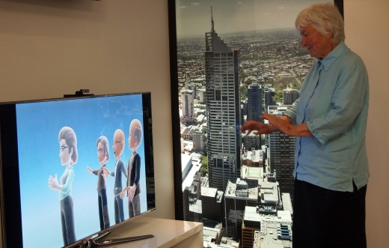
This project builds on several streams of research at NARI
Physical activity, falls prevention, mental health projects:-
Some findings:
Supervised group exercise projects have higher adherence rates
Prevention of cognitive decline and falls through exercise
Exercise improved mental health
Notes:
Make point about the life expectancy gap – over 10 years for both men and women

Slide 8
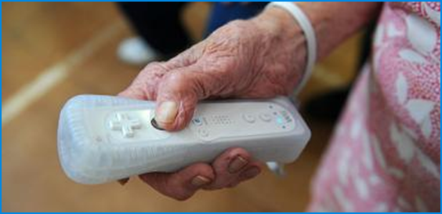
Problems with existing gaming technology for older people
lack of rigorous evaluation
Issues fine motor and co-ordination skills with navigation and hand held controls
Relies on intensive staff support
Notes:
Interesting in the inclusive design presentation on Tuesday by Ian Hoskin from …

Slide 9
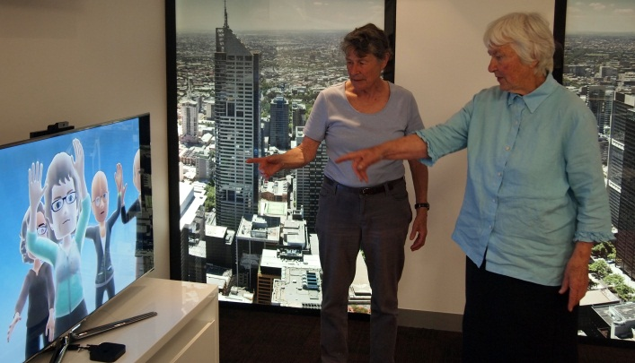
Opportunities Provided by Gaming Technology:-
Wii – “exergaming” in residential care, active gaming, games for health
New generation of wireless gaming technology
No need for hand held and operated controls
Accessible virtual environments
NBN provides opportunity for more sophisticated models of care
Notes:
The new generation of wireless gaming consoles brings low-cost easily accessible virtual enviornemnts to lounge rooms phsiotherapy clinics and aged care faciliteis
Active gaming technology offers older peop;le anew and enternating way to becoming more active or participating in activities the once enjoyed.
Ageing well at home with broadband has been funded to investigate the feasibility of using Microsoft Kinect technology to deliver home baesd exercise

Slide 10
Ageing Well at Home with Broadband (AWAWHB)
Aim
Use interactive gaming technology to assist older adults to remain active at home and promote social inclusion
Objectives
Develop a ‘virtual’ exercise class using Microsoft’s Kinect for Xbox 360 and Avatar Kinect
Evaluate the feasibility and acceptability
Assess adherence and changes in physical function, social connectedness and quality of life
Notes:
18-month project
Physical function – balance, upper/lower body strength, flexibility
Focus groups or interviews with participants
Other objectives: determine whether this approach has potential for wider application such as younger populations and remote/regional areas; reduce need for healthcare services

Slide 11
Ageing Well at Home with Broadband
Led by a local government organisation
Moreland City Council
One of the first NBN trial sites
Project partners
NARI, Institute for a Broadband Enabled Society (IBES), Microsoft, Infoxchange, AARNet, NBNCo, Council on the Ageing, Merri Community Health Services

Slide 12
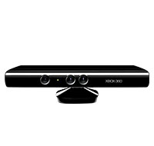
Methodology
Each participant provided with Kinect Xbox360™ console
Pre and post physiotherapist assessment
Instructor at remote site (peer facilitator)
Real time interaction with each other via tv screens – avatars
Also prescribed exercise program out of class
Notes:
Re outcomes, we were planning on measuring some aspects of functional fitness (upper/lower body strength, balance, mobility), physical activity, and number of falls. For QoL, either SF-36 or AQOL plus the UCLA loneliness scale, Zarit burden scale (if caring). We'll also find out what home support services they receive from MCC, ED visits, hospital admissions and GP visits. You've mentioned focus groups/interviews - the process evaluation will be very important for the proof of concept. Here's the reference for my paper on Wii: 15. Cyarto E, Kuys S, Henwood T, Blackberry I. (2011) Can Will work it out? Telecommunications Journal of Australia, 61(3) 37.1-37.12.
Microsoft’s Kinect for Xbox 360 uses a motion-sensing camera with high resolution tracking
It is possible to have two-way interaction between remotely located devices

Slide 13
PILOT TESTING PHASE
20 older adults aged over 60 years
Each provided with Kinect system and access to the NBN for 6 months
Will log in at a set time for the ‘virtual’ class
Instructor located at Merri Community Health Services
Participants and instructor will appear as avatars
Will be able to see each other on screen; participants will follow exercises performed by instructor
Evaluation will encompass, psychosocial, technological, physical, acceptability (quantitative and qualitative), economic
Notes:
MeasuLiving in their own home in the Brunswick trial area – recruitment begins July-August 2012
Not all 20 at once; groups of 4 participants and the instructor
Before commencing trial the NBN equipment will be installed and connected, they will be shown how to use the Kinect, they will have an assessment of their physical abilities and complete questionnaires on quality of life etc
First a home visit to go through the exercises one-on-one with a member of the research team, then an online session one-on-one using Video Kinect (can see actual person on screen), then they will be ready for Avatar Kinect
The NBN will allow real-time interaction, both voice and video data, between participants and the instructor. The instructor can provide immediate feedback to participants. Each session can be recorded by the instructor.
Participants will be encouraged to connect with each other outside of class times to do the exercises (an illustrated booklet will be provided) or socialise (skype feature). They could also use it with other family members eg grandkids.
rements are the QOL 10, ….., primary health care usage

Slide 14
Development Phase
Development phase
IBES software engineer
use of test bed
NARI volunteers
Notes:
Where we are at right now
Refine the Microsoft Kinect software that will be used to underpin the exercise program, identify any problems older people may have with the technology and test the exercise program that we will implement in the next phase of this project.
This phase will also help us determine the effectiveness and limitations of the hardware and software and make sure that the Kinect for Xbox 360 is user-friendly for older people

Slide 15
Anticipated benefits
Functional fitness
Falls prevention
Maintenance of physical and mental wellness
Decreasing social isolation

Slide 16
Challenges
Software development and modification
Avatar (not video conferencing)
Using current software
Upper body only
Health economic measures

Slide 17
Acknowledgements
Dr Elizabeth Cyarto
Victorian Dept of Business and Innovation
NARI Volunteers
Contact: .E.Cyarto@nari.unimelb.edu.au;
www.nari.unimelb.edu.au
Ref:Cyarto E, Kuys S, Henwood T, Blackberry I. (2011) Can Will work it out? Telecommunications Journal of Australia, 61(3) 37.1-37.12.

