Slide 1
PROMOTING PROPER EXERCISE FOR THE ELDERLY THROUGH A HEALTH PROMOTION PROGRAMME IN RURAL THAILAND
W. Boonchalaksi, P. Muensakda
Institute for Population and Social Research,
Mahidol University,Thailand prwbc@mahidol.ac.th

Slide 2
Why we study?
⧫ Proper exercise can help the body maintain
its good health and good looks.
⧫ Good health does not occur automatically.
⧫ It requires good preparation and
the right form of promotion.

Slide 3
Why we study?
⧫ Different types of exercise offer
different benefits.
⧫ Proper exercise can improves health
and increases longevitiy.
⧫ The elderly should select kind of exercise
suitable for the physical condition and
have no danger.

Slide 4
The objectives of the study
1) to prolong elderly life with a good physical
and mental health through a proper exercise .
2) to research and develop a health promotion
program for the elderly through
collaboration with health-center staffs
at sub-district level.

Slide 5
Methodology of the Study
๏ The participatory action research (PAR)
was used to assess the effectiveness of
community-based interventions
in implementing a health promotion program
for the elderly.
๏ Two health centers at sub-district level
were selected

Slide 6
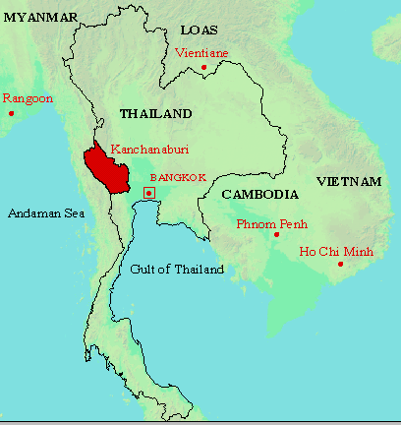
Kanchanaburi province
is the study areas

Slide 7
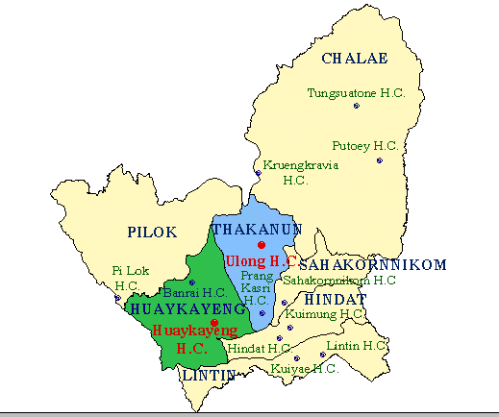
There are 13 Health Centers (H.C.)
in Thongpapum District,
only 2 centers were selected.

Slide 8
Results of the Study
๏ There are many kinds of exercise implementing
in the program.
๏ But the results from the evaluation at the end of
the project covered 300 elderly samples
indicated that more than half of the elderly
were satisfied with the health promotion
activities, especially the activity on
physical exercise with bamboo stick.

Slide 9
Results of the Study
๏ This kinds of exercise was designed by
local Thai women, Aunty Boon - Mee.
๏ It comprised of 12 positions
and can be easily applied with body exercise.

Slide 10
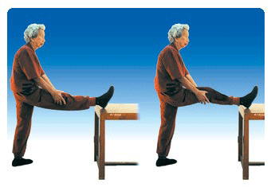
1. Shaking Legs
Pictures of 12 positions came from Department of Health, Ministry of Public Health, Thailand

Slide 11
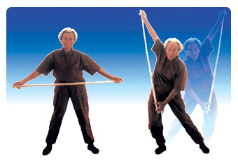
2. Throwing left and right
Pictures of 12 positions came from Department of Health, Ministry of Public Health, Thailand

Slide 12
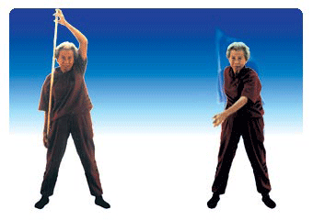
3. Paddling a boat
Pictures of 12 positions came from Department of Health, Ministry of Public Health, Thailand

Slide 13
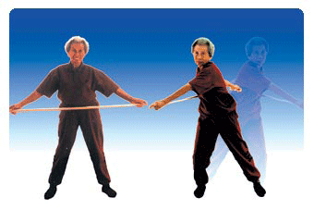
4. Twisting body and waist
Pictures of 12 positions came from Department of Health, Ministry of Public Health, Thailand

Slide 14
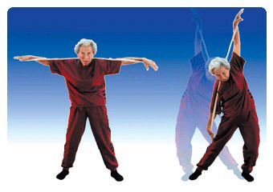
5. Steelyard
Pictures of 12 positions came from Department of Health, Ministry of Public Health, Thailand

Slide 15
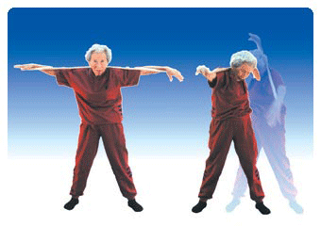
6. Swimming in free style
Pictures of 12 positions came from Department of Health, Ministry of Public Health, Thailand

Slide 16
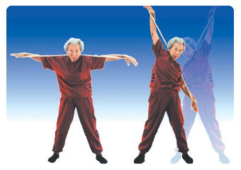
7. Swimming in backstroke style
Pictures of 12 positions came from Department of Health, Ministry of Public Health, Thailand

Slide 17
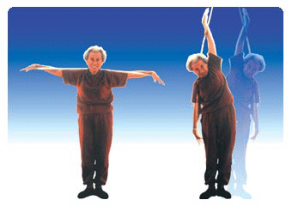
8. Go to Heaven
Pictures of 12 positions came from Department of Health, Ministry of Public Health, Thailand

Slide 18
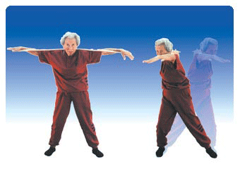
9. Flying Bird
Pictures of 12 positions came from Department of Health, Ministry of Public Health, Thailand

Slide 19
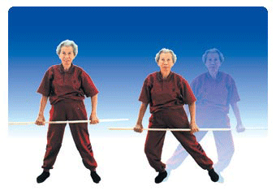
10. Waggling the body
Pictures of 12 positions came from Department of Health, Ministry of Public Health, Thailand

Slide 20
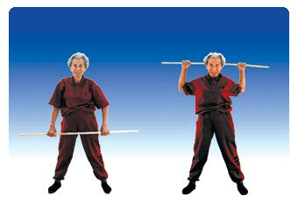
11. Weight lifting
Pictures of 12 positions came from Department of Health, Ministry of Public Health, Thailand

Slide 21
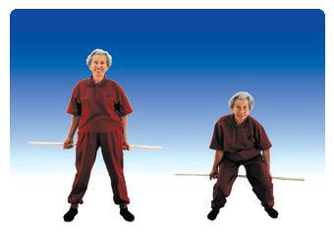
12. Body Massage
Pictures of 12 positions came from Department of Health, Ministry of Public Health, Thailand

Slide 22
There are 4 principles of this exercise
1) use appropriate size and length of stick
by measuring arm stretching
while holding the stick
2) should perform the right position
of straight back, not too tight,
then easily make natural movement,

Slide 23
There are 4 principles of this exercise
3) should perform 99 times at least 10 minutes,
and for the beginner should start
each position with 20 times.
4) should regularly and continuously perform
in order to make most effective.

Slide 24
Cautious of this exercise
๏ It should be avoid exercise position
that make pain as much as possible
and then simultaneously add until
feel comfortable.
๏One who get diseases such as heart disease
or others should consult physicians
before exercise.

Slide 25
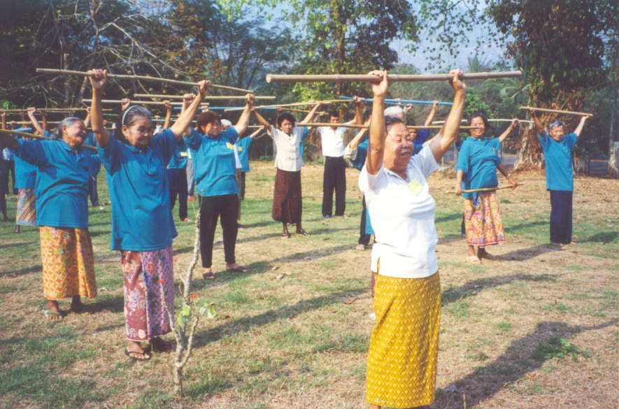
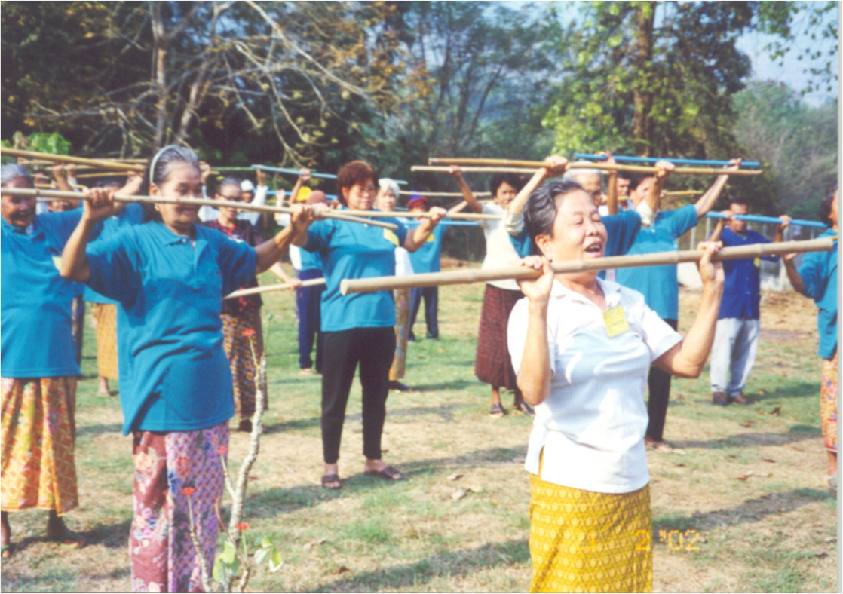
Results of the Study

Slide 26
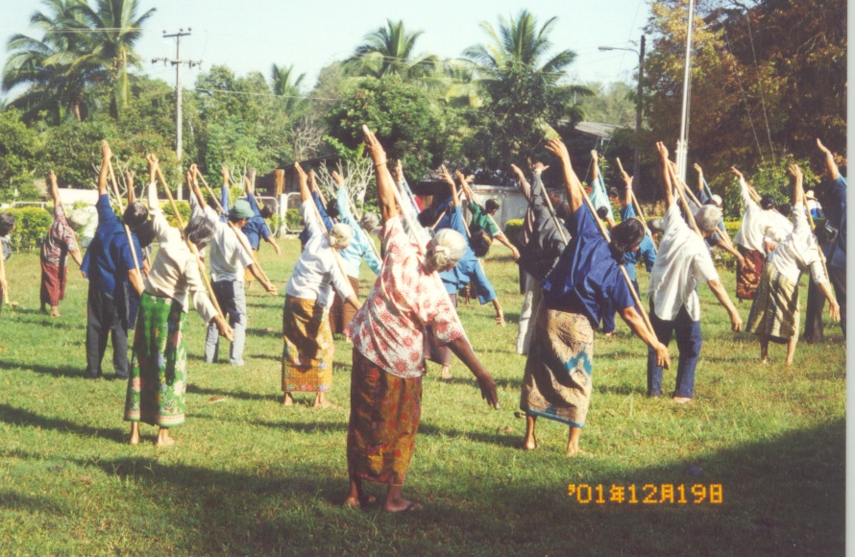
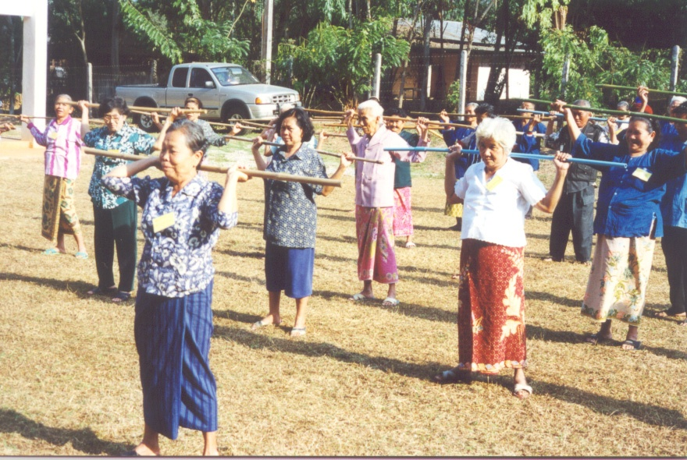
Results of the Study

Slide 27
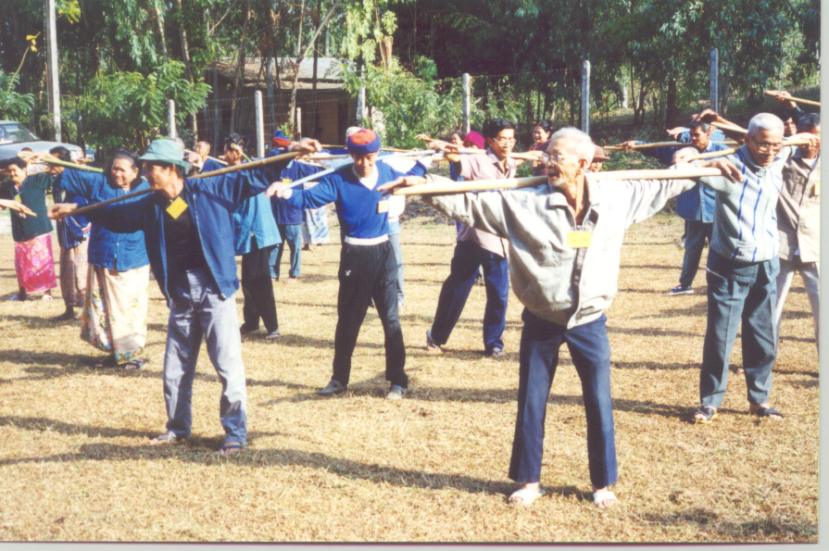
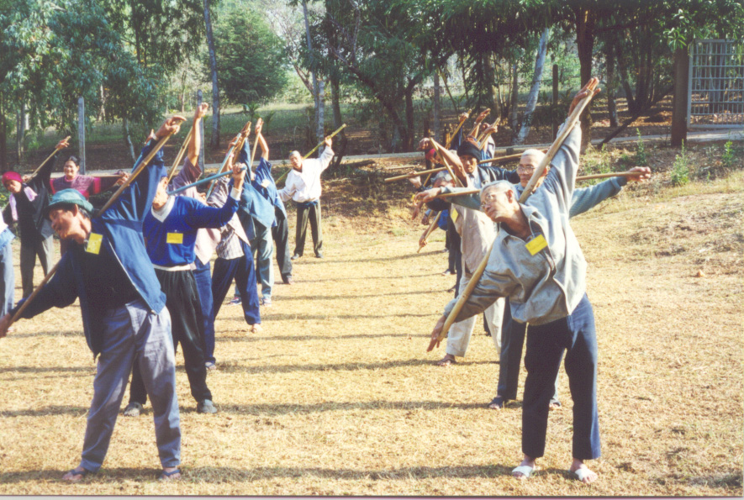
Results of the Study

Slide 28
Results of the Study
๏ The elderly satisfied and perceived of
this kind of exercise about 69% and 76%.
๏ After participating in the activity,
they said that it can be helped them
to decrease back and hip pain.

Slide 29
Results of the Study
๏ It was also found that
most of the elderly who performed exercise
with bamboo stick regularly at least 3 times
a week and who performed it regularly
got sick twice a year and the percentage of
illness was not so high.

Slide 30
Conclusion
๏ This study try to indicate the health benefits
of the proper exercise
because there are many kinds of exercises.
๏ The elderly should select kind or method of
exercise suitable for the physical condition
and have no danger that can make good
and continuous exercise resulting benefit to
the body.

Slide 31
Conclusion
๏ The lesson learned from the study is
proper exercise would reduce the expenses
to be paid for the medical treatment
because good health would bring happy life
which in turn resulted in the happiness of
the family and the community as well.

Slide 32
Thanks for Attention

