Slide 1
Nordic Walking in Wales
Engaging older people in physical
activity through peer learning
Notes:
NORDIC WALKING IN WALES – ENGAGING OLDER PEOPLE IN PHYSICAL ACTIVITY THROUGH PEER LEARNING

Slide 2
Nordic Walking programme
Notes:
Nordic Walking is suitable for people of all ages
Nordic Walking is one of Europe’s fastest growing forms of
exercise and is particularly suited for people aged 50+
You walk using a pair of lightweight, specially designed poles
that provide great support while also increasing the
effectiveness of the exercise
Irrespective of age or physical condition, Nordic Walking
provides many benefits

Slide 3
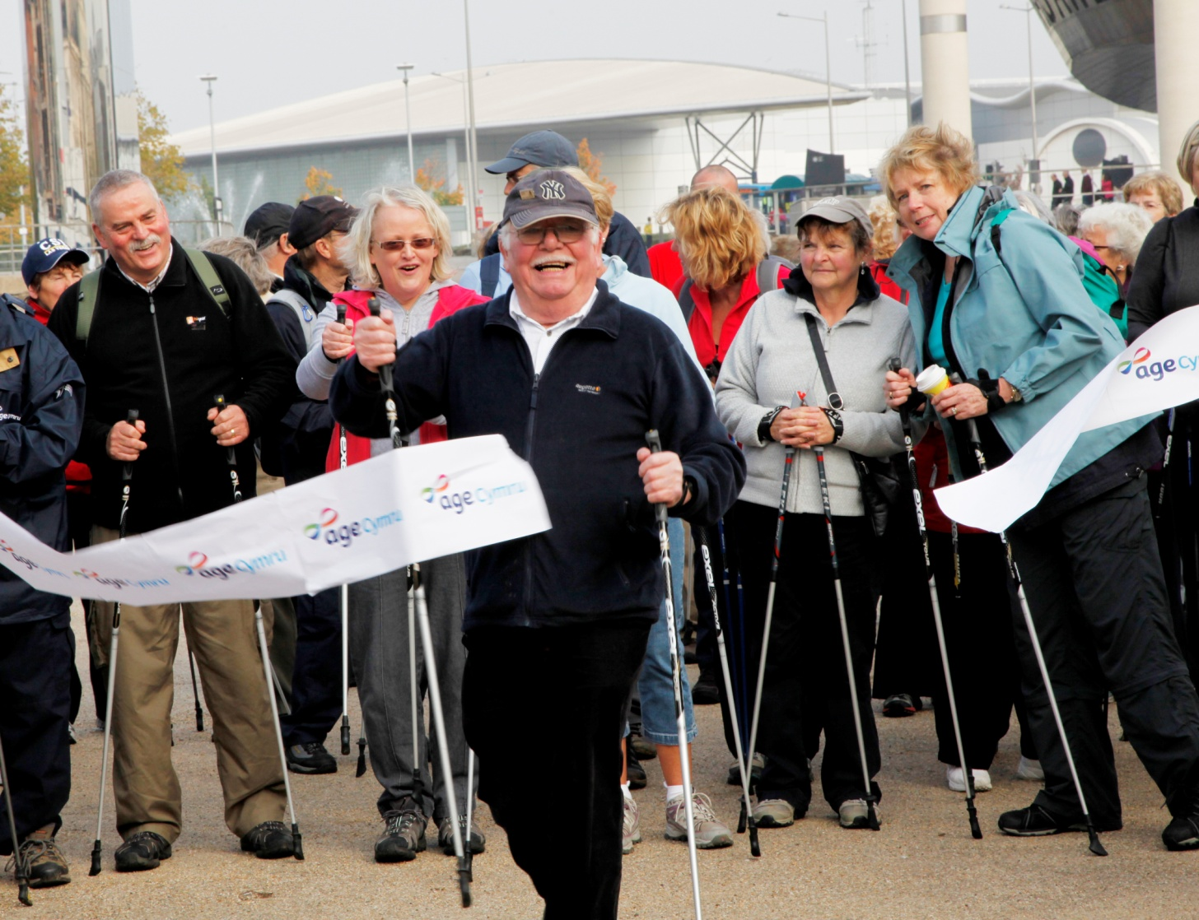
Nordic Walking programme
In 2007 Age Cymru started its Nordic Walking programme
funded through the Welsh Government
We have grown from having four volunteers to sixty
volunteers delivering the programme across Wales
Notes:
The programme is managed by the Physical Activity Development Officer
part of role
Supported by the Healthy Ageing Team Administrator part of role
Initially part funded by Countryside Council for Wales (£8k per annum, 2 years)
Total Budget for Physical activity programme in 2012 – 13 is £56K
It started with four Nordic Walking Volunteers

Slide 4
Nordic Walking programme
it is a community based peer led Nordic Walking programme aimed at people who are 50+
we recruit and train older adults to become Nordic Walking Instructors and Nordic Walking Leaders
we provide courses, taster sessions and ongoing led walks to members of the public and community groups across Wales
Notes:
The NW Instructor training is for 2 days and the Walk Leader training (£30) is for 1 day. Individuals learning NW technique attend a 5 to 6 week course, depending upon their ability. The cost of this course is £10, covering volunteer costs and generating approx £2k income back into the programme
We provide NW poles at cost to walkers
All qualified Nordic Walking Instructors and Leader volunteers are registered with British Nordic Walking and the International Nordic Walking Federation.

Slide 5
Nordic Walking programme
the Physical Activity Development Officer is a qualified Nordic Walking Coach and delivers update training to volunteers and cascade trains the Nordic Walk Leader qualification
We provide for the volunteers:
all training, equipment, publicity materials, certificates, pin badges, identification cards, risk assessments and registration forms for them to use locally
Notes:
Glenn’s coaching qualification means that we can cascade training at significant cost savings
Volunteers are managed by the Physical Activity Development Officer through local meetings and an annual conference at which we update volunteers on technique / programme administration and gather evaluation evidence

Slide 6
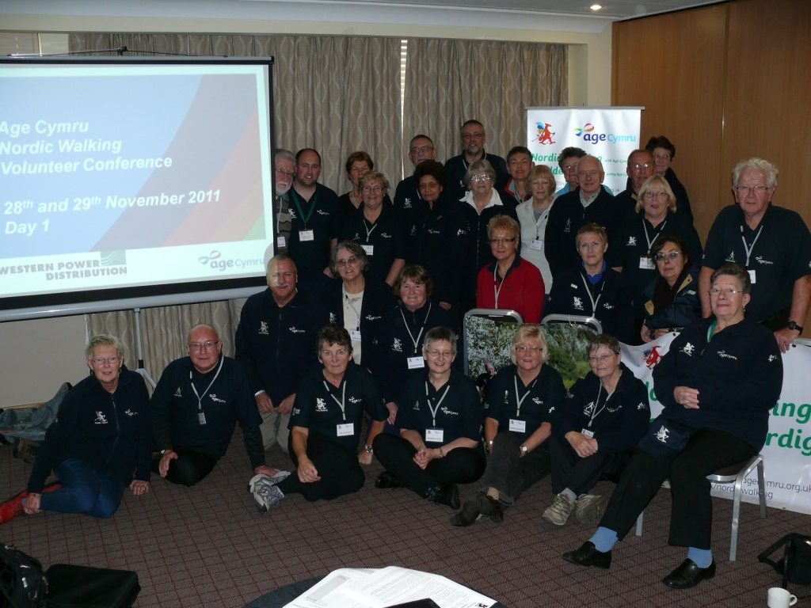
Nordic Walking programme
Notes:
Nordic Walking annual volunteer conference

Slide 7
Nordic Walking programme
We teach Nordic Walking through the Internationally
recognised 10 steps:
Posture 6. Extend Fully
Walk 7. Release Actively
Drag 8. Swing Forward
Plant 9. Lean Forward
Push 10. Rotate

Slide 8
Nordic Walking programme
Challenges and considerations:
paying volunteer expenses as the numbers of volunteers expands
cost of Nordic Walking poles
cost of volunteer conference
providing Leaders with a poles to loan out on a library scheme for people who cant afford to purchase poles
charging for Nordic Walking courses, currently the fee is £10
taster sessions and led walks are currently free
Notes:
The programme is growing to a point where it requires more financial support and more dedicated staff time
Volunteer expenses cost £5k pa
We are aware that the cost of poles (approx £45 upwards) can be a barrier to people continuing to Nordic walk after completion of training, so we endeavour to source good quality, cheaper poles.
We provide poles free to volunteers

Slide 9
Nordic Walking programme
What we have achieved so far:
recruited and trained 60 volunteers
take out 200 people each week
some people form their own groups and still Nordic Walk more than four years after they completed their Nordic Walking course
we are working with large number of public, private and voluntary organisations to run the programme
Notes:
Age range of volunteers is 50 – 70 yrs
We are exploring the potential for NW as an exit route for the National Exercise on Referral programme in Wales

Slide 10
Nordic Walking programme
What we have achieved so far (cont’d):
receive invitations to attend large shows to deliver taster/demonstration sessions e.g. Royal Welsh Agricultural Show
invited to present at the International Nordic Walking Federation annual conference
presenting at the World Congress of Active Ageing 2012 which is being held in Scotland, United Kingdom
Notes:
RWAS – attending for the third year in 2012 – the second of which is free as invited by RWAS to attend – can take 700 enquiries over the week

Slide 11
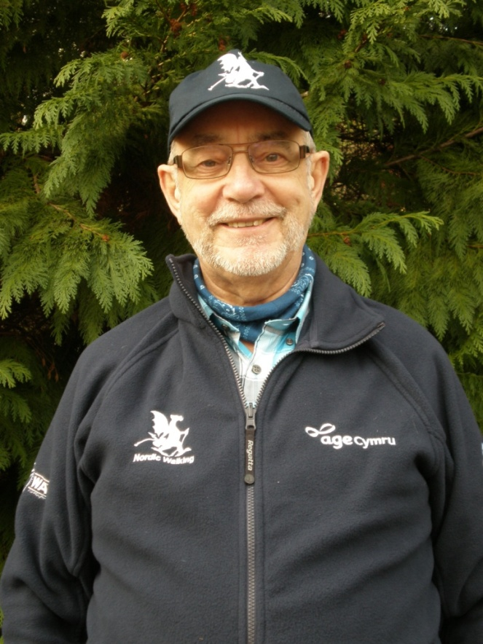
Nordic Walking programme
Branding our programme

Slide 12
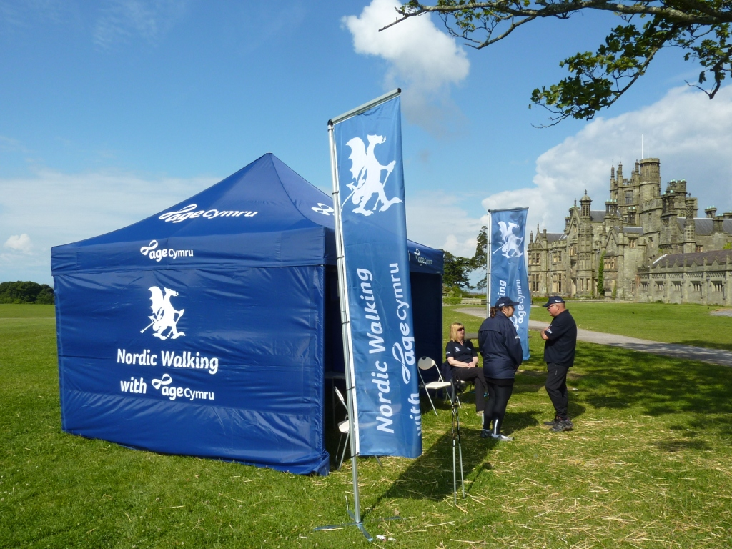
Nordic Walking programme
Branding our programme

Slide 13
Nordic Walking programme
Claire Bottomley
Healthy Ageing Manager
Age Cymru
email: nordicwalking@agecymru.org.uk
website: www.agecymru.org.uk
tel: 0044 2920 431555

