Slide 1
The 11th Global Conference on Ageing 28 May – 1 June 2012 Prague
Social Tourism as Strategy for promoting personal Autonomy of elderly people
Dr. Stephanie Carretero
Mireia Ferri
Dr. Jorge Garcés

Slide 2
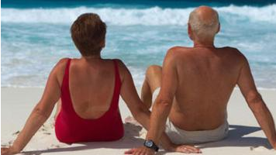
Introduction
Methodology
Results
Conclusions
Index

Slide 3
Introduction
Europe is living an ageing process that represents a long term trend: People who have 65 years or more will represent more than 30% in 2060 (Eurostat, 2010).
Ageing process + prevalence of chronic diseases related with disability: Dependent and disabled people will also augment (WHO, 2011).
Now
2060

Slide 4
Introduction
In 2010 -> 17% of the European population self-perceived some limitation to carry out their daily activities and the 8% self-perceived a severe limitation (Eurostat, 2012).
Projections-> the number of dependent people is going to increase (OECD, 2007).
Impact:
Increasing needs of long-term care
Families burden
Dependent person

Slide 5
Introduction
This trend = challenge for the European Governments
Initiatives that try to prevent dependency situations and enhance the elderly’s quality of life -> reduce social and health spending and the burden of informal caregivers.
Some initiatives:
European Innovation Partnership on Active and Healthy Ageing

Slide 6
Introduction
Tourism = potential strategy to prevent dependency situations
Because of health and wellbeing positive effects that some studies have linked with holidaying in other vulnerable groups.
In fact, European and national organisms are displaying a growing interest in promoting tourism accessible for all.

Slide 7
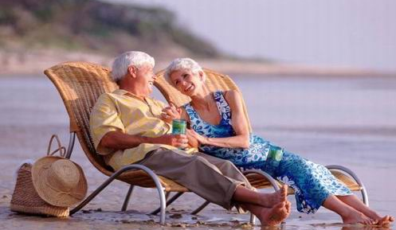
Our research
“Pilot research of tourism benefits in elderly people”
Objective:
To study the tourism relationship with the functional health of older adults

Slide 8
Our research
Sample:
43 older people from six leisure centres that organise leisure activities for elderly in the city of Valencia (Spain) and surroundings
Variables measured and instruments used:
Tourism habits -> self- designed instrument
Self-perceived health -> Spanish version of SF-36 (Alonso et al, 1995)
Capacity to carry out Instrumental Activities of Daily Life -> Lawton & Brody Index (1969)
Cognitive status) -> Short Portable Mental Status Questionnaire (Pfeiffer, 1975)
Social integration -> Berkman-Syme Social Network Index (Berkman & Syme, 1979)
Use of social and health services -> self- designed instrument
Socio-demographic data -> self- designed instrument

Slide 9
Our research
Methodology:
Statistical analysis was carried out:
Descriptive analysis: to know the demographic characteristics of the sample and to define the tourism habits of older people and their travelling experiences and attitude.
Bivariate comparative test between two groups (elderly people who travelled during the previous year and elderly people who did not travel during the previous year): to detect significant differences on their functional health and use of social and health services (t-Student and Chi-Squared at 0.05 significant level).

Slide 10
Our research
Results show:
Positive relationship between tourism and older adults self-perceived health.
Positive relationship between tourism and elderly woman capacity to carry out Instrumental Activities of Daily Life.
Small proportion of older travellers in the lowest grade of social integration compared to elderly non-travellers.
Elderly travellers use less social and health services than elderly non-travellers.

Slide 11
Our research
Results show:
54% of elderly people who did not travel affirm that they enjoy holidaying.
Some characteristics of their travels:
One night long
Accommodation in hotels
Promotion trough travel agencies and leisure centres for elderly
Focus on leisure and holidaying
During autumn and spring time
By coach

Slide 12
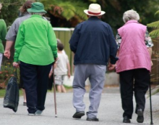
Conclusions
Implications of the positive relationship between tourism and elderly’s functional health ->
Accessible Social Tourism
It could be used as a tool in social and health policies in order to provide a better quality of life for elderly and to reduce their associated costs for governments

Slide 13
mireia.ferri@uv.es jordi.garces@uv.es
Thanks for your time and attention

