Slide 1
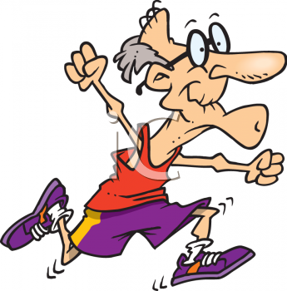
On your marks, get set, go... An active ageing programme connecting people throughout the country
Femada Shamam
femada@tafta.org.za

Slide 2
The National Golden Games
From Durban South to Bloemfontein
Frustrations
The accomplishments
The friendships
Fun
Indirect benefits of participation

Slide 3
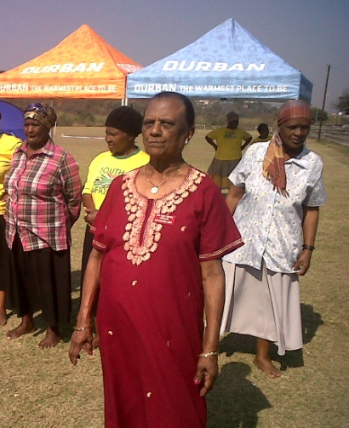
Contextualising South Africa
Population: 50.59 million
3.9 million older people

Slide 4
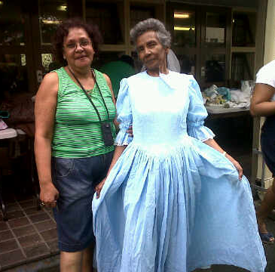
3 tier Government system
9 provinces
11 official languages
National
Provincial
Local

Slide 5
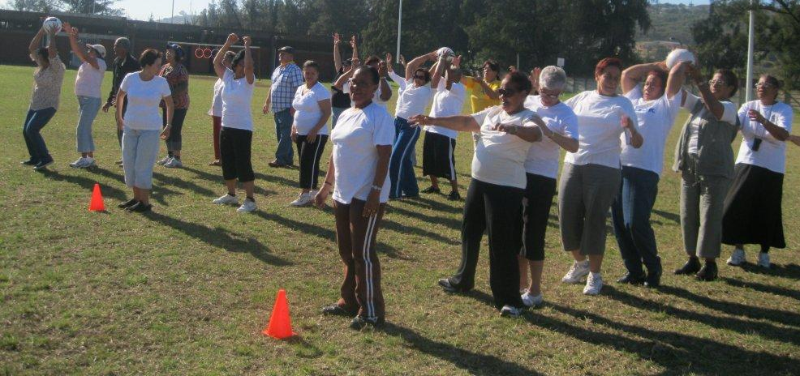
History of the Golden Games
Began in 2005 in the Western Province
Objectives:
Promoting intergenerational bonding
Embracing active ageing
Creating awareness of abilities and capabilities of older people
Creating awareness of the socio-cultural needs of older people
Expand the horizons of older people

Slide 6
The Association For the Aged
Service Centres and Clubs
Advocacy and Lobbying
Accommodation
Community based services
Reach out to 7000 older people annually
70 000 meals produced and delivered

Slide 7
2010 – The call for participation

Slide 8
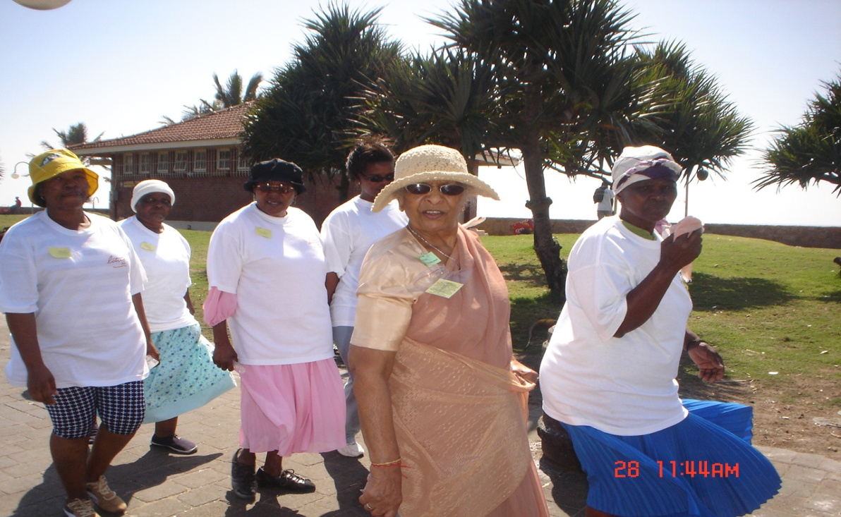
The Durban South area
Historically a “coloured “community
Bordered by major industry – one of the most polluted areas in the world
High unemployment in the area
Most of the older people had participated in unskilled work in the textile industry

Slide 9
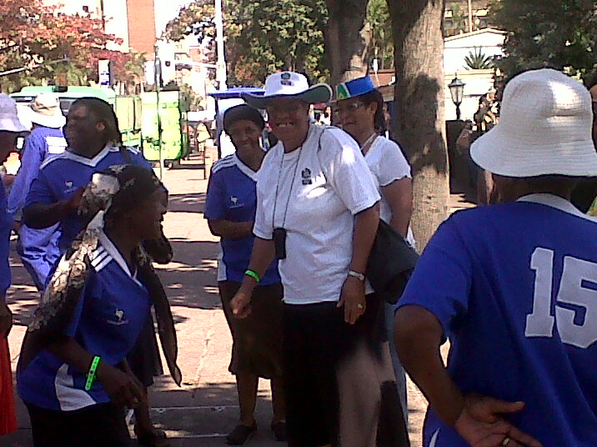
Our approach
Targeted an informal leader
She was a volunteer
Was involved in the “struggle” and in the “trade unions movement”

Slide 10
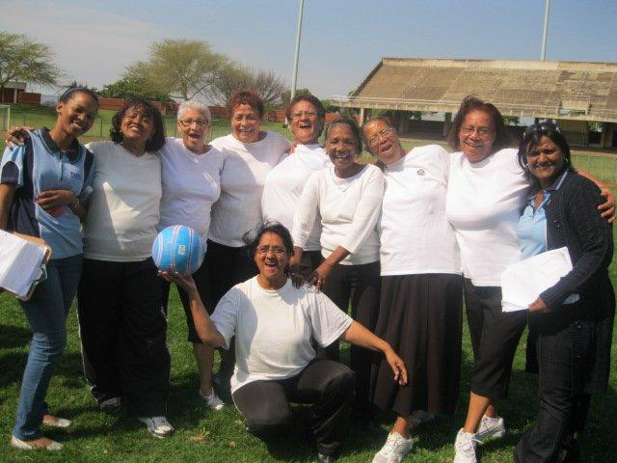
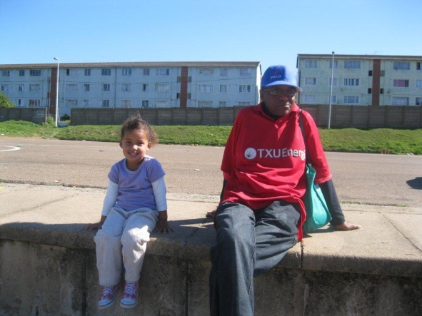
Intergenerational cooperation and collaboration
Interaction with younger people was on two levels:
School learners from a nearby primary school
Youth at the district, local and provincial games

Slide 11
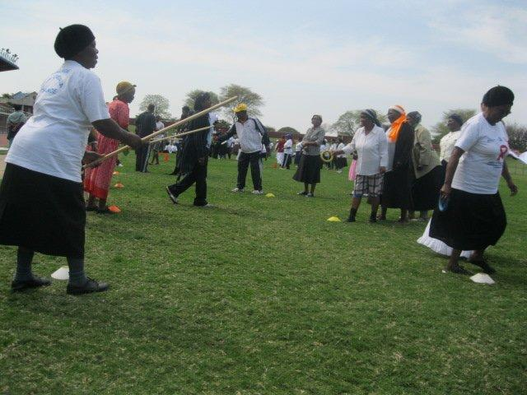
The challenges
Coordination by the different government departments and the NGO sector
Family commitments of the older people
Unfair selection – “representativity”
Financial support

Slide 12
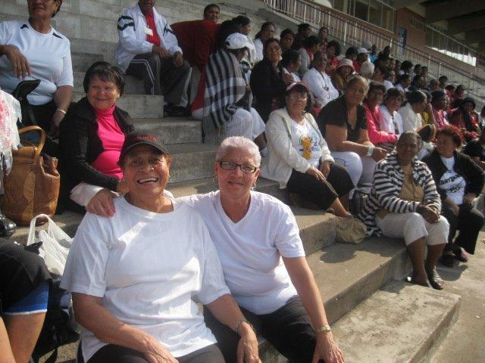
Benefits and Achievements
Number of beneficiaries
Started with 12,
109 participated in the local district games
38 were chosen for the provincials
16 progressed to the National Games
Indirectly 350 older people benefitted
Friendships
Communities
Ethnic groups
Generations

Slide 13
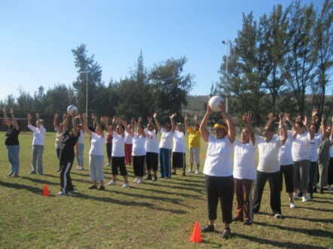
Strategies for engaging people in an active ageing programme
Mix of competition and social items
Minimise costs
Market and promote the “pioneers and the participants
Market the fun and social benefits rather than the image of being fit
Use a “train the trainer” approach
Take the programme seriously

Slide 14
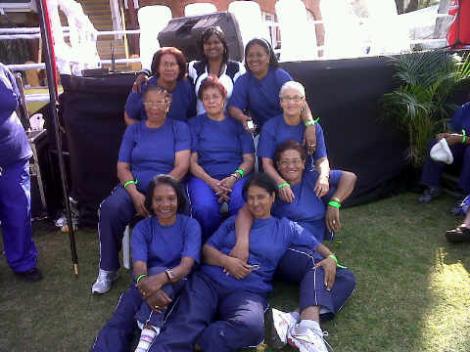

Slide 15
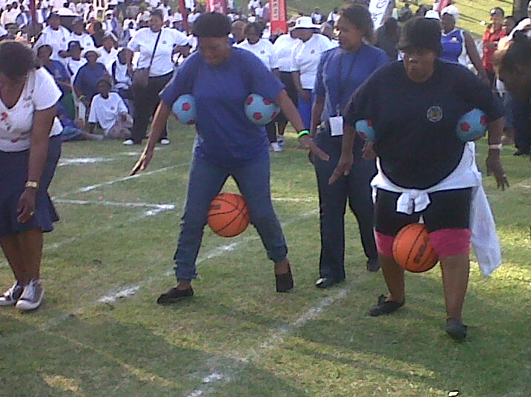

Slide 16
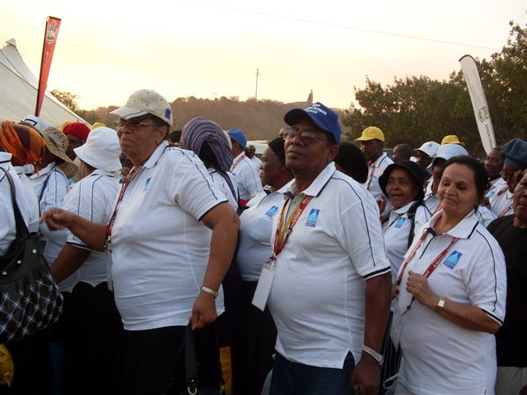

Slide 17
Femada shamam
femada@tafta.org.za
Thank you

