Slide 1
An Intercultural Gerontology Curriculum
Presentation by Prof. Lorraine Mercer
May 31, 2012
International Federation on Aging

Slide 2
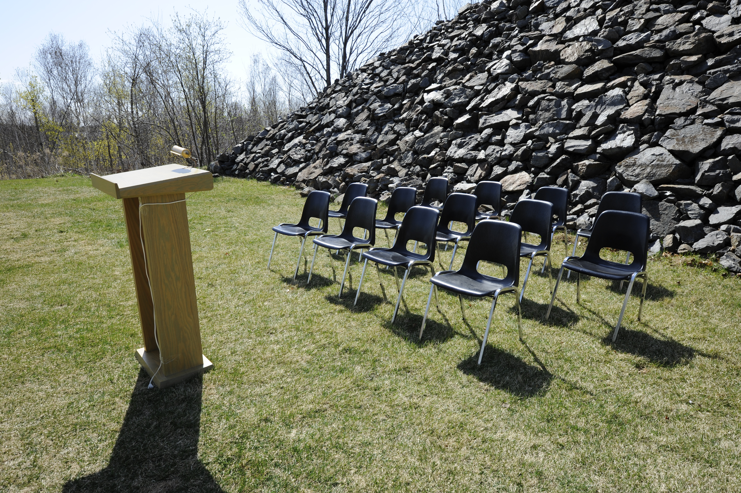
What Brought Me to My Studies

Slide 3
Perspectives for Teaching
Ethnocentric Keeping it “normal”
Multicultural A.G.H.E.’s guidelines
Intercultural Finding common ground and synergies amongst cultures

Slide 4
Culture is…
…fluid and dynamic rather than essentialized and as a process of hybridization (Grant, 2011)
“Culture is the sum total of ways of living adopted by a people. Cultures offer meaning structures for interpreting events, judging the qualities of services, making decisions, and implementing life plans.” (Capitman, 2002, p. 11)

Slide 5
Curriculum Goals
Progression in Transformation
Cultural Awareness
Cultural Sensitivity
Cultural Competence
Cultural Safety
Crichton & Scarino, 2007; Hart-Wasekeesikaw 2009

Slide 6
Hidden Curriculum
Anything that is not of the main stream is understood to be “other” and therefore is viewed as separate, not necessarily relevant and, ultimately it is marginalized. (Jones and Young, 1997; Rosenfelt, 1997)
Assumptions of Normal vs. Exotic
Transparency reveals the hidden
Opportunity for transformation

Slide 7
Gerontology’s Visible Curriculum
Heterogeneity of aging and the aged
Critical Gerontology
Life Course Perspective
  In texts
  In research
  In global agendas: WHO’s Active Aging Framework; Age Friendly Cities.

Slide 8
Context for Intercultural Curriculum: Contemporary Trends
Internationalization (Nincic, 2007)
Glocalization (Grant & Brueck, 2011)
Global Citizenship (Harlap & Fyer, 2011)
Cosmopolitanism (Grant & Brueck, 2011)

Slide 9
Modernism and Post-Modernism
The Telescopic and the Kaleidoscopic*
Learning about Cultural Diversity or
Synergistic Learning**
*Slattery, 1995
** Smith, 1983

Slide 10
Curriculum Reform by Faculty
Review and analyze programs and courses to determine how cultural pluralism is evident.
Provide faculty development to overcome barriers and support the work of program renewal.
Provide support to learn new content; review and select new texts; develop competence in comparative studies; develop skills in interdisciplinary studies; and develop new skills in active learning. (Olguin, 1997)

Slide 11
References
Capitman, J. (2002). Defining diversity: A primer and a review. Generations, 26(3). 8-24.
Crichton, J. & Scarino, A. (2007). How are we to understand the 'intercultural dimension'?: An examination of the intercultural dimension of internationalisation in the context of higher education in Australia. Australian Review of Applied Linguistics, 30(1), n.p
Grant, C. A. & Brueck, S. (2011). A global invitation: Toward the expansion of dialogue, reflection, and creative engagement for intercultural and multicultural education. In C. A. Grant & A. Oortera (Eds.), Intercultural and multicultural education: Enhancing global interconnectedness (pp. 3-11). New York: Routledge.
Harlap, Y. & Fryer, M. (2011). Global citizenship in teaching and learning. (Green Guide No. 12). London, ON: Society for Teaching and Learning in
Hart-Wasekeesikaw, J.(2009). Cultural competence and cultural safety in the First Nations, Inuit and Métis Nursing Education: An integrated review of the literature. Ottawa: Aboriginal Nurses Association of Canada.

Slide 12
References (continued)
Jones, T. & Young, G. S. A. (1997). Classroom dynamics: Disclosing the hidden curriculum. In A. I. Morey & M. K. Kitano (Eds.). Multicultural course transformation in higher education. (pp. 89-103). Toronto: Allyn and Bacon.
Nincic, V. (2007). Academic spaces, computer technologies, and difference: Toward a multidisciplinary approach to academic participation of nonnative English speaking students. Learning Inquiry, 1, 189-202. DOI 10.1007/s11519-007-0021-1
Olguin, E. & Schmitz, B. (1997). Transforming the curriculum through diversity. In J. G. Gaff, J. L Ratcliff and Associates (Eds.). Handbook of the undergraduate curriculum: A comprehensive guide to purposes, structures, practices, and changes. (pp. 436-456). San Francisco, CA: Jossey-Bass.
Rosenfelt, D. S. (1997). Doing multiculturalism: conceptualizing curricular change. In A. I. Morey & M. K. Kitano (Eds.). Multicultural course transformation in higher education. (pp. 35-55). Toronto: Allyn and Bacon.
Slattery, P. (1995). Curriculum development in the postmodern era. New York: Garland Publishing, Inc. Critical Education Practice, Vol.1 Shirley R. Steinberg and Joe L. Kincheloe Series Editors.

