Slide 1
Older men’s re-entry to labor force in Singapore: Does health status play a role? 31 May 2012 • Prague, Czech Republic
Young Kyung Do, Treena Wu, Angelique Chan
Program in Health Services and Systems Research, Duke-NUS Graduate Medical School, Singapore
Notes:
Opening Slide

Slide 2
The Question
What is the role of health in intention to re-enter the labor force among older retired Singaporean men?

Slide 3
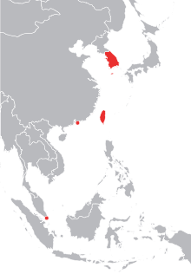
Singapore, one of the four Asian Tigers Young Country, Ageing Population: Singapore’s age group composition, 1965-2045
1965
2005
2015
2045
(Unit: 1000)
Source: United Nations World Population Prospects (2008)
The “demographic dividend” accounts for 1/4 ~ 2/5 of the economic “miracle” in the Asian Tigers. (Bloom and Williamson, 1998)

Slide 4
Benefits both at individual & societal levels: Well-matched employment in old age could…
lead to better psychological and physical health, thereby reducing care burden by family and society
result in more active/productive/successful ageing, thus creating more economic opportunities by and for the elderly
provide better protection against poverty and catastrophic out-of-pocket spending, thus relieving burden on public financing

Slide 5
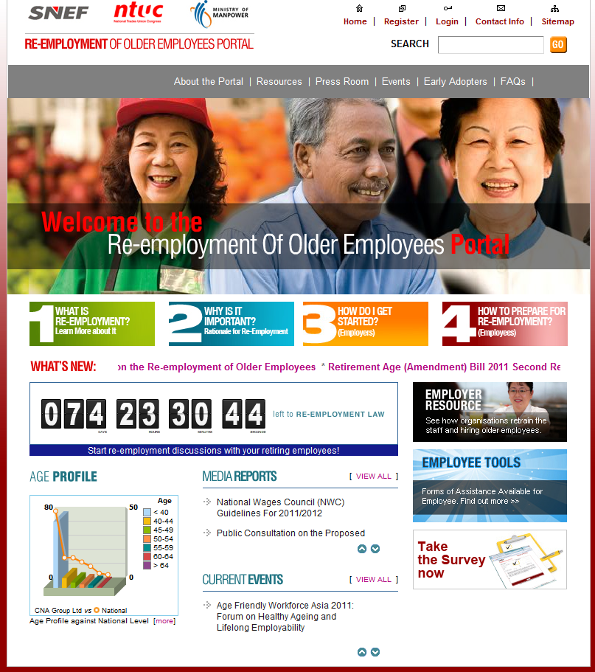
Re-employment of Older Employees
“…workers should be given the option to stay on their jobs if they are medically fit and show satisfactory job performance…”
Enactment of the
Re-employment Legislation
Full implementation as a law in 2012
Employers will be required to re-employ eligible employees who attain the statutory minimum retirement age of 62 years* on or after 1 January 2012
*or contractual retirement age, whichever is higher
http://www.re-employment.sg/

Slide 6
Theoretical framework (1): Why health might matter and in what direction?
Better health may increase intention to re-enter
It’s simply less difficult to work in better health
Longer subjective life expectancy, more income required
Poorer health may increase intention to re-enter
Leisure would be less enjoyable in poorer health
Greater medical expenditures, more income required
Direction is not unambiguous
Depends on which direction is dominant
Empirical question

Slide 7
Theoretical framework (2)
Income (perceived adequacy, transfer from children, …)
Health
Intention to work again
Other factors (demographic, education, etc)
Retirement
(vs. Still working)

Slide 8
Empirical issues
Sample selection: Re-entry can only be asked among retirees
→ Probit model with sample selection estimated
“Justification bias”: Poorer (self-reported) health to “justify” not intending to work (& not working currently)
→ Separate analysis by subjective health measure and objective health measures

Slide 9
Data & Variables
Data: Social Isolation, Health, and Lifestyles Survey (2009)
Nationally representative sample of elderly Singaporeans (≥ 60 y) (N=5,000)
Analysis restricted to males aged 60+ but <80, no missing var. (N=1,745)
Dependent variable
Intention to re-enter labor force: 1 if yes to “Would you like to be working?
Selection indicator (retirement): 1 if “retired and not working”
Two types of health measure
Subjective: Self-reported health status (Very healthy/Healthier than average/Of average health/Somewhat unhealthy/Very unhealthy)
Objective: 1) three categories of # difficulties in physical ability, 2) cognition score, 3) depressive symptom score, and 4) any hospital admission in the past year
Control variables: Age, ethnicity, education, years of working, perceived income adequacy, marital status, coresidence with child, and transfer from children

Slide 10
Distribution of outcome variables (M, 60-79)
Still in labor force (38%) | Retired (62%)
 | “Would you like to be working?” Yes (17%)
 | No (83%)

Slide 11
Distribution of self-reported health

Slide 12
Self-reported overall health and intention to work
“Would you like to be working?”
Self-reported Health | Re-entry | Retirement
Very Healthy | 0.28 Reference | 0.51 Reference
Healthier than Average | −0.09 (0.08) | 0.09* (0.04)
Of Average Health | −0.16* (0.08) | 0.11* (0.04)
Somewhat Unhealthy | −0.21* (0.09) | 0.21** (0.05)
Very Unhealthy | −0.22* (0.10) | 0.20* (0.10)
Self-reported health
* p<0.05 , ** p<0.01, marginal effects (average pred prob) with SE in parentheses

Slide 13
Objective measures of health and intention to work
“Would you like to be working?”
# of items with difficulty in physical ability | Re-entry | Retirement
0-1 | 0.15 Reference | 0.61 Reference
2-3 | 0.03 (0.05) | 0.07 (0.05)
4+ | −0.12** (0.05) | 0.21** (0.07)
# of items with difficulty in physical ability
* p<0.05 , ** p<0.01, marginal effects (average pred prob) with SE in parentheses
- Hospital admission: (−) & stat. sig.
- Cognitive/depressive sx. score: n.s.

Slide 14
Other variables
 | Re-entry | Retirement
Older age group | − | +
More education | Not significant | −
Greater difficulty to meet expenses | + | Not significant
Kin members as first source of income support | Not significant | +
Married | Not significant | Not significant

Slide 15
Summary and Policy implications
Health status may matter substantially in older workers’ labor force participation decisions (not only on retirement but also on re-employment).
Special policy considerations are required for poor older adults in poorer health status.
Investment in public health can have positive long-term economic effects.

Slide 16
Correspondence:
Young Kyung Do, M.D., M.P.H., Ph.D.
Program in Health Services and Systems Research
Duke-NUS Graduate Medical School Singapore
8 College Road, Singapore 169857
young.do@duke-nus.edu.sg
Thank you!
Notes:
End Page Option 1

