Slide 1
AWARE PROJECT – AGEING WORKFORCE TOWARDS AN ACTIVE RETIREMENT
Alberto Ferreras-Remesal
Institute of Biomechanics of Valencia
IFA 2012 – Prague – May 31th 2012

Slide 2
Contents
Project overview
Work done
Results: the SEN+ platform
Current status and future tasks
Conclusions

Slide 3
Project overview

Slide 4
The project
AAL funded project
Project team
IBV – Instituto de Biomecánica de Valencia
CVA –CV&A Consulting
AYG – Gandia City Council
UDP – Unión Democrática de Pensionistas y Jubilados de España
MDT – MediaTouch 2000 S.r.l.
IAD - Institute of Ergonomics - Darmstadt University of Technology

Slide 5
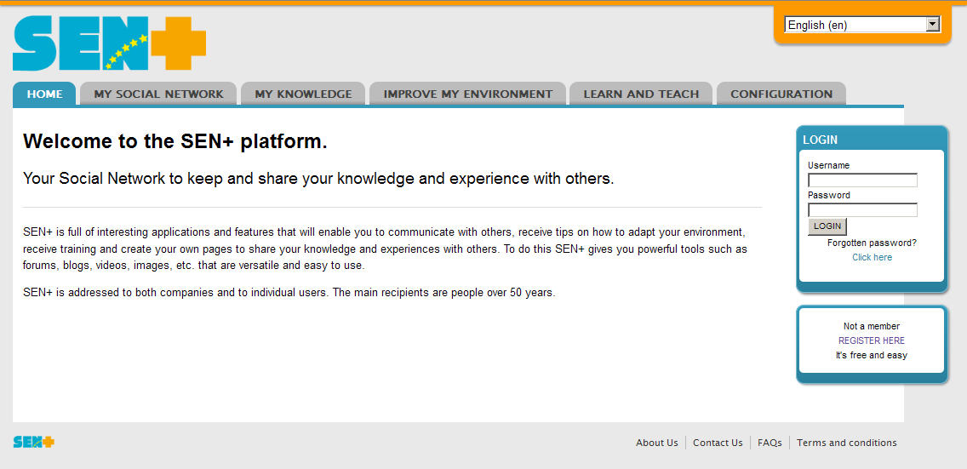
Primary Objective
To develop a Social Network and a Knowledge Management system to provide services to both the older workers and retired elderly people that helps them in being active and that contributes to support companies’ in the management of the needs of their ageing workforce

Slide 6
Sub-objectives
Promote an active ageing.
Create web communities to share experience, skills and expertise.
Advice workers and retirees about how to adapt their environment
Maintain mentally and economically active the elder person.
Support the companies during the whole retirement process.
Help companies to retain the knowledge of their workers.
Bridge the gap between young workers, elder workers and retired people.

Slide 7
Potential users
Older workers
Retired elderly people
Companies
Other users
Associations
Municipalities
…
Young workers…

Slide 8
Main results
Accessible user oriented Social Network
Environment adaptation module
Knowledge Management and Knowledge Sharing module
ICT Approach / training module
Web platform

Slide 9
Work Packages
Management
Definition of requirements and specification
Environment adaptation module
Knowledge sharing module
ICT approach module
Toolbox development and integration of modules
Pilot implementation, verification and validation
Dissemination and exploitation

Slide 10
Work done

Slide 11
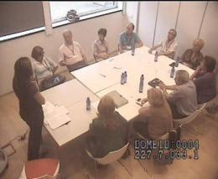
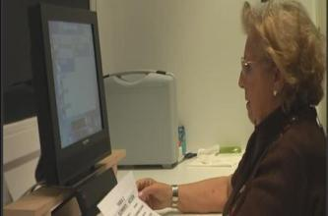
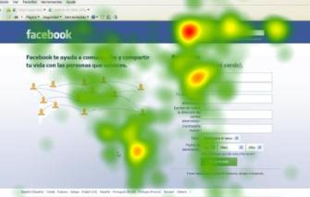
Work done
Definition of requirements and needs
Discussion groups with older workers (3), retired and companies (2).
Questionnaires (206) addressed to elderly people.
Literature review:
Relation between elderly people and software.
Knowledge transfer and SN methodologies.
Laboratory tests with elderly people using different SN and web platforms (eye tracking, functional and emotional analysis).
Integration of these results: Definition of technical guidelines for the social network and the entire system.
Development of the system: Social Network, Knowledge Management, ICT training, Environment adaptation module.

Slide 12
Pilot result: The SEN+ Platfform

Slide 13
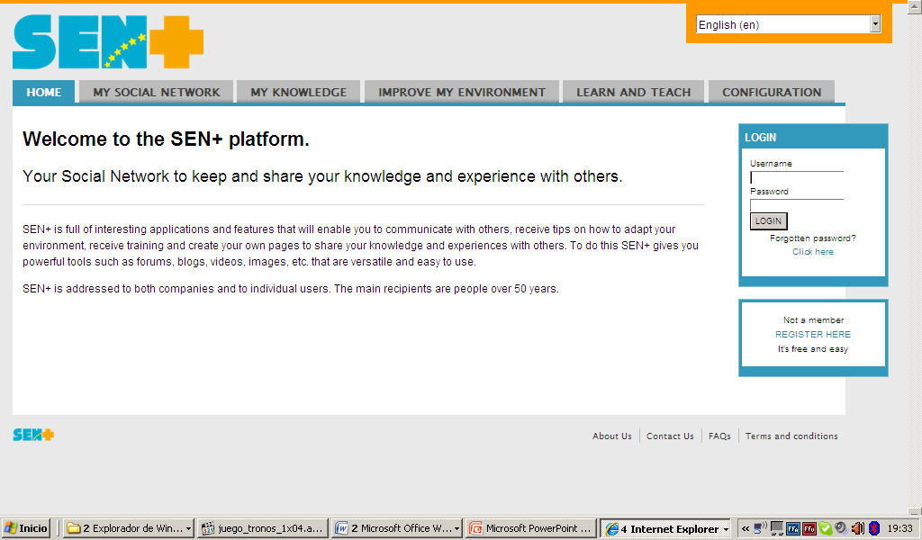
The SEN+ platform
SEN: Seniors Experience Network
General features:
Free access (registration required)
Possible “private” access (for companies)
In four languages: English, German, Spanish, Italian

Slide 14
Features / Modules
Create, organize, store and share knowledge
Join courses and create new ones
Introduction, news, access to contents
Define system and user parameters
Social Network: contact and communication with colleagues, friends and experts through messages, groups, forums, etc.
Find recommendations to improve work and home environments

Slide 15
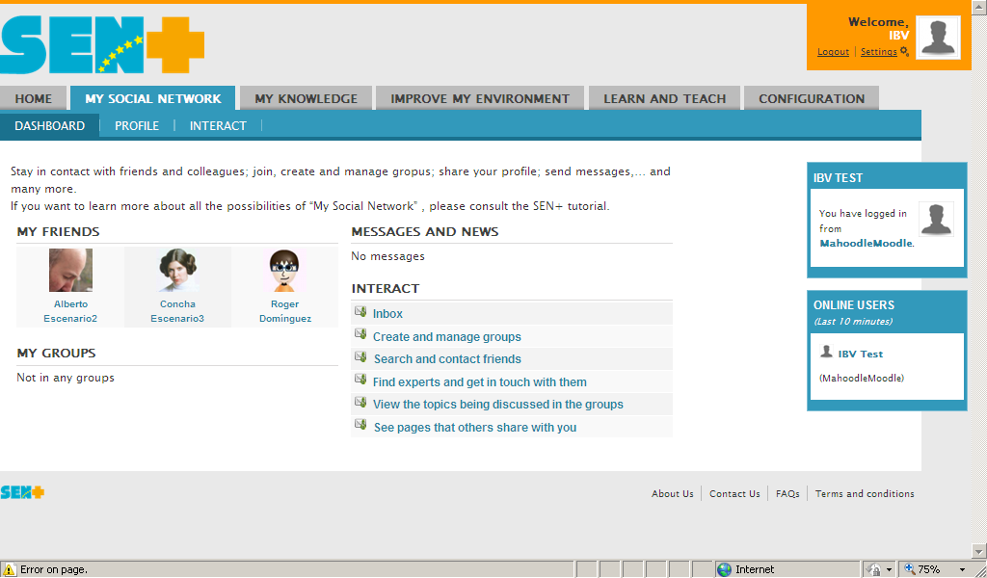
My Social Network
The Social Network is the area for contacting with friends, experts and groups.
The Social Network allows to contact with others, search and find friends, join groups, communicate with individuals and groups (messages, forums, chat), search for experts, etc.

Slide 16
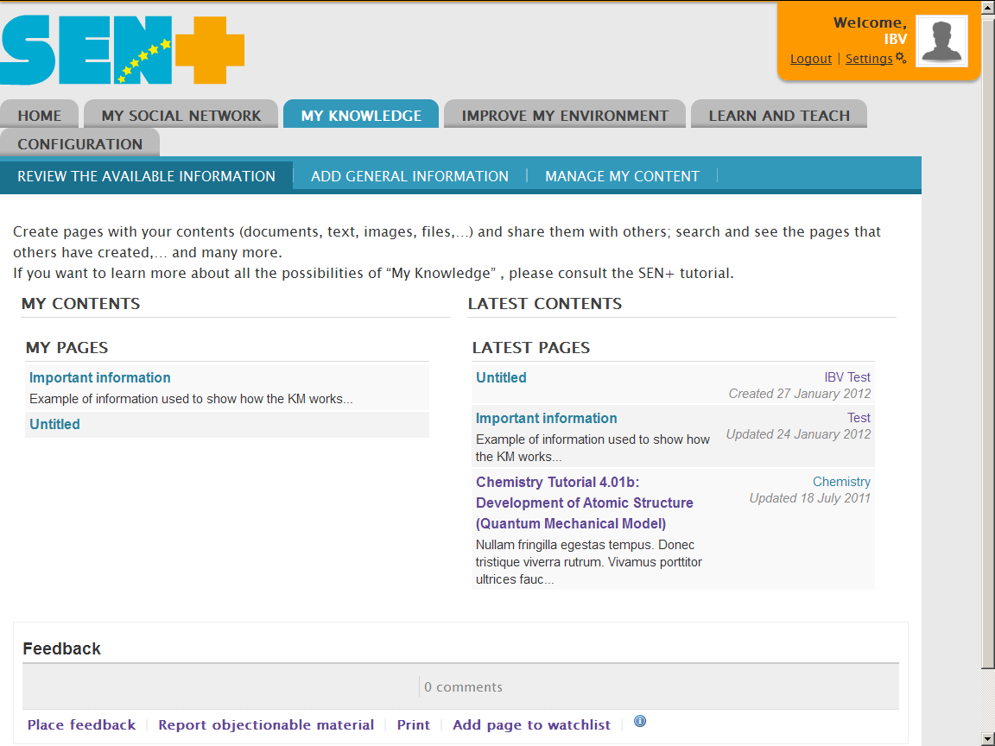
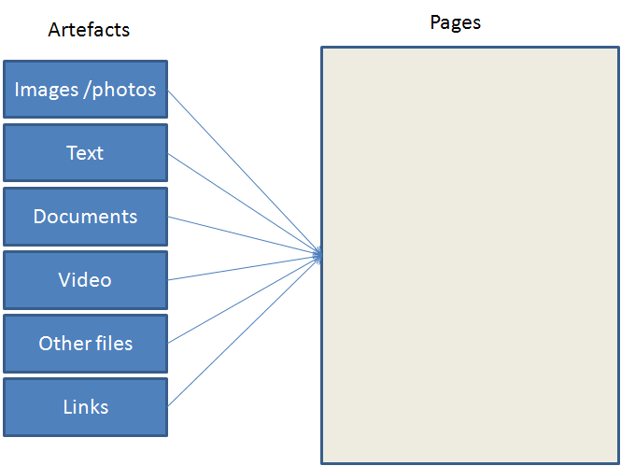
My Knowledge
MY KNOWLEDGE is the area where users organize and store their knowledge.
The knowledge can be stored in many different objects or artefacts: text, documents, images, video, etc.
Users can organize their artefacts in pages. This way they can build their portfolio of knowledge.

Slide 17
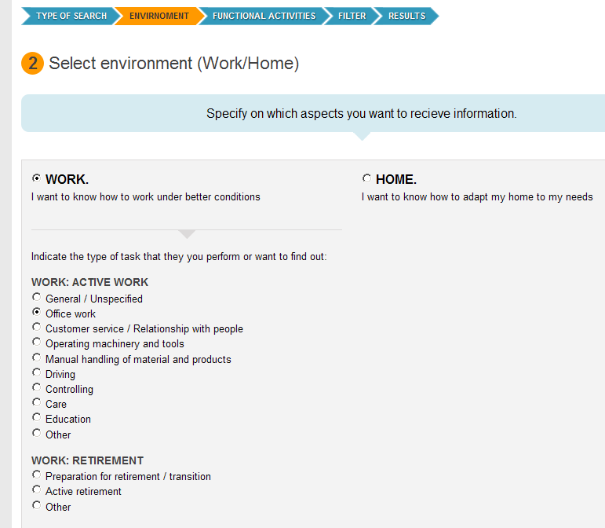
Improve my Environment
In this area users can search for recommendations in order to adapt their working place or home.
There are two searching modes.
Open search. The open search allows searching by keywords.
Guided search. The system guides the user through a step-by-step interactive search.

Slide 18
Learn and Teach
User can:
Participate in SEN+ courses.
Check the courses that others have developed and participate in them (under the conditions proposed by the creators of the course).
Create their own courses.
If the user has a lot of information about a subject, perhaps the tools from the other modules (My Social Network and My Knowledge) are not enough. In this case, he can organize them as a course and invite others to participate.

Slide 19
Current status and future tasks

Slide 20
Current status
The first prototype of the platform is almost finished.
Tasks being developed actually:
Accessibility and usability internal tests.
Experts evaluation
Translation from English to Spanish / Italian / German
Privacy policy / Terms and conditions

Slide 21
Future tasks
Pilot test with users (companies, older workers and retired)
From June 2012 to February 2013
Different groups of users and companies (with common themes) in Germany and Spain.
Pilot test in real conditions with periodic feedback and reports.
Usability and accessibility tests in laboratory
Application of the improvements into the platform
License agreement between the partners for the continuation and the exploitation of the results.
End of the project: September 2013

Slide 22
Conclussions

Slide 23
Conclusions
The AWARE project aims at developing solution for social inclusion of retired people and at preparing older workers for transition to retirement.
This objective will be achieved by providing an platform that can enable social interaction of both groups in order to promote an active aging.
Companies have a good chance with this tool to keep the and manage the knowledge and experience of their workers.
The platform (SEN+) has been developed accordingly to the needs, demands and capabilities of the users and it is now in the pilot testing that will ensure that it is usable and useful for them.

Slide 24
Thank you for your attention

