Slide 1
Will you still love me, will you still need me when I’m 64? Sustaining and supporting an ageing workforce and an ageing population
Rosemary Hogan Executive General Manager – Service Delivery

Slide 2
Overview of RDNS
How and where we work
Who we care for
Defining the issue
Increasingly aged population driving demand
Future workforce shortages
Addressing the challenges
Better utilisation of staff time
Adopting telehealth technology
Broadening our skill base
Anticipating and planning for the future
Notes:
In this presentation I am going to provide you with a brief overview of RDNS including how and where we work, who we care for.
I am also going to define the issues that we are confronting in Australia.
Namely an increasingly aged population driving demand and current and future workforce shortages
I will then discuss some of the measures we at RDNS have and are taking to prepare for the future.
Finally I will talk about what else we are anticipating and trying to prepare for

Slide 3
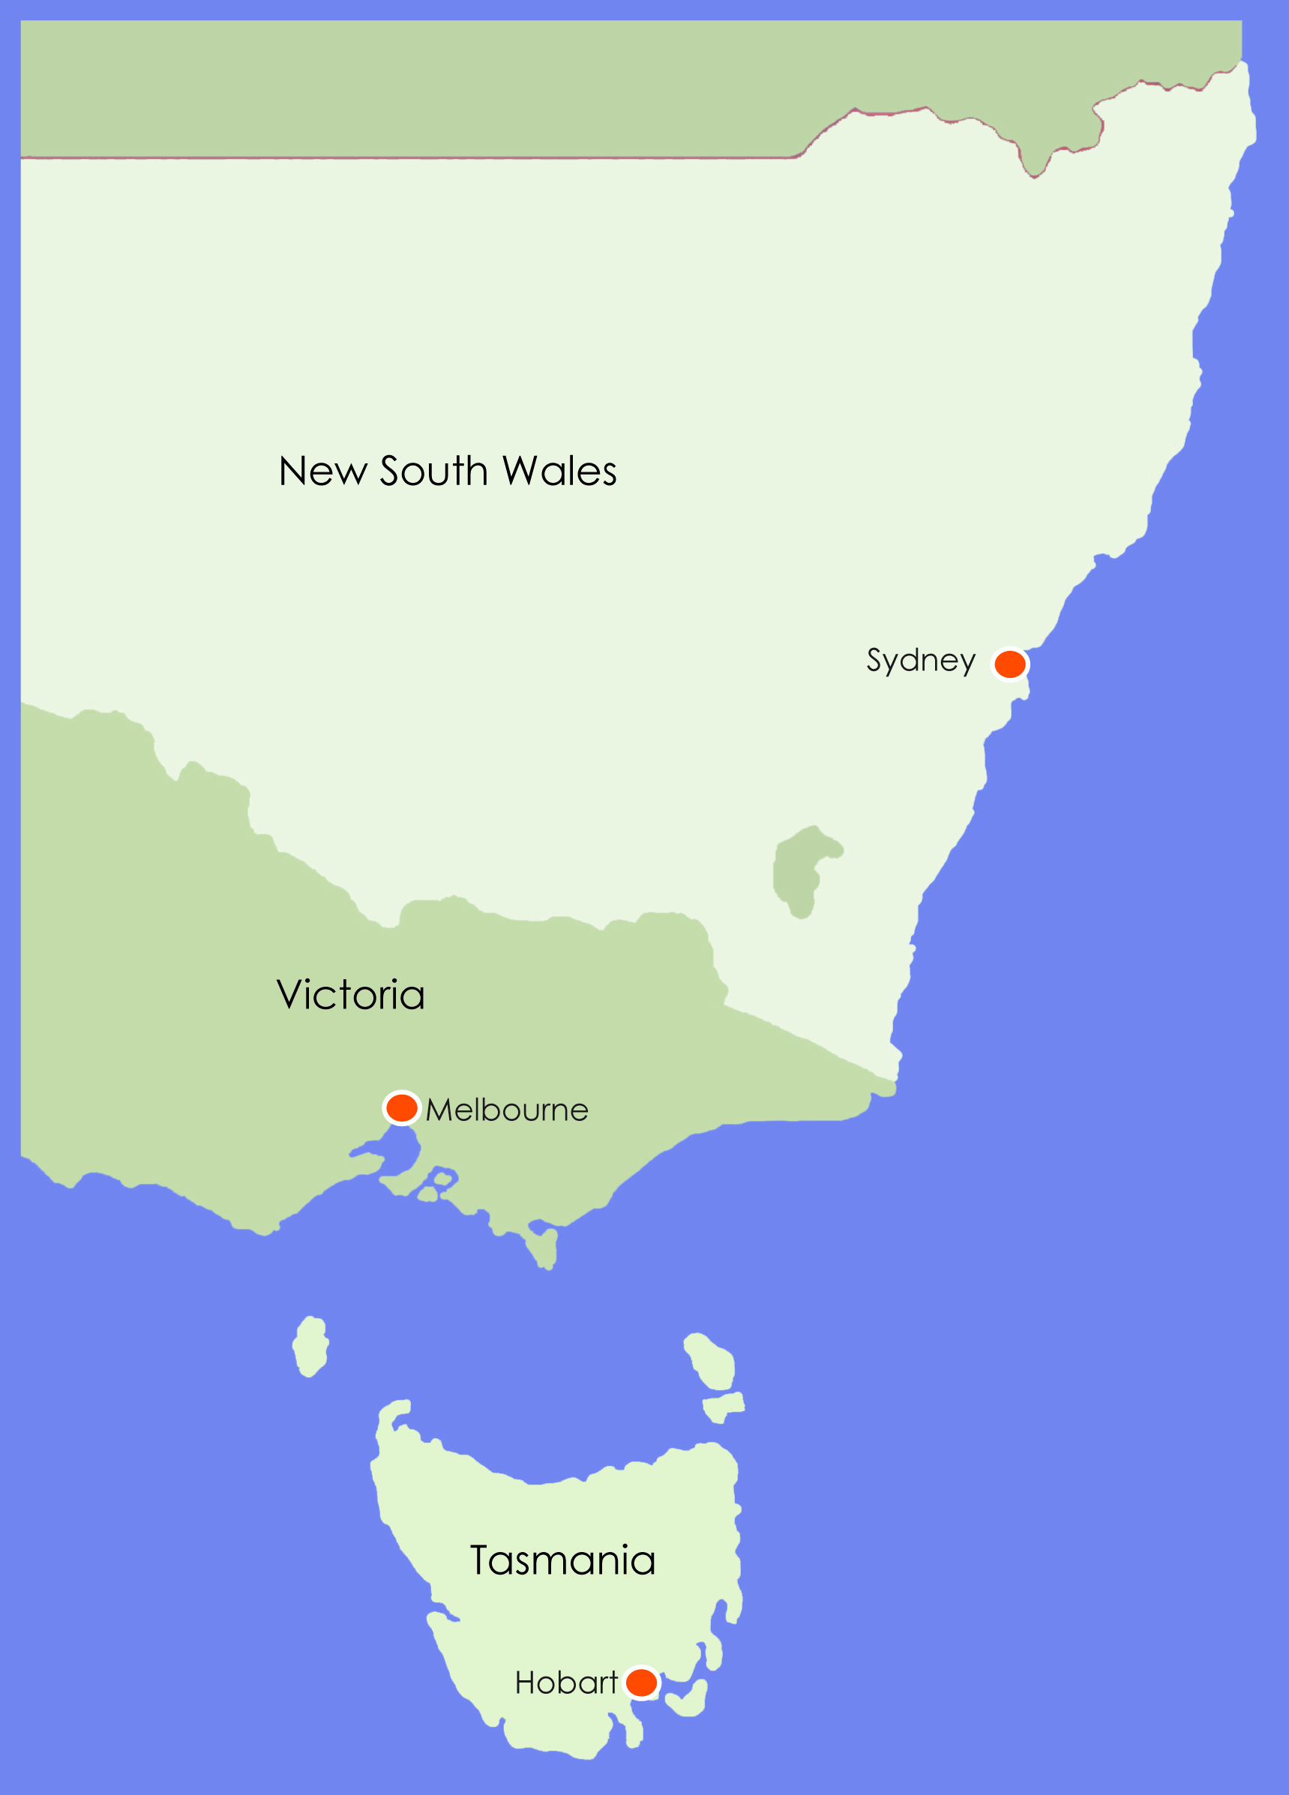
Overview of RDNS
Established 1885
>1,700 Employees
Operates 24hrs a day, 365 days year
1.8M client visits
34,000 clients
9M km’s driven
Private, not-for-profit organisation
No Gov’t financial safety net
Notes:
RDNS is Australia’s largest not-for-profit charitable organisation
Provide a 24-hour home nursing and community care services, seven days a week from twenty two sites located throughout the Melbourne metropolitan area, Regional Victoria and New South Wales. With over 1700 employees (over 1,100 registered nurses),
RDNS staff travelled in excess of 9 million kilometres last year to deliver professional nursing and healthcare to more than 7,000 people on a daily basis in their own homes.

Slide 4
The ageing population current (ABS projections 2006)
Notes:
The ageing population
Australia’s population is ageing.
By 2041, the Australian Bureau of Statistics predicts that one in five people will be over 65 and 7% of the population will be aged over 80 (the fastest growing group in Australia). With the improvement of medical technology and health awareness, we are living longer and while many see this as a triumph of a civilised and caring society, some see it as a major issue facing the community, because to support the elderly will require a vast workforce (Wesley Mission, 2009).

Slide 5
Age of RDNS client
Notes:
63% of Clients are 70+
76% of Clients are 60+
55% of all Clients are female
45% of all Clients are male

Slide 6
Future workforce shortages
nursing is becoming increasingly central to the delivery of primary health care (Eggert 2005)
ageing nursing workforce
nurses leaving the profession soon after they have completed their training (AIHW 2010)
aver. age of the RDNS nurse - 48 years
Notes:
Future Nursing workforce shortages
With the expected rise in chronic health conditions and the changing health care needs of an ageing Australian population, the demand for nursing to meet these needs will continue to grow, because nursing is becoming increasingly central to the delivery of primary health care (Eggert, 2005).
Some of the workforce issues emerging are from an ageing nursing workforce, with the average age of nurses being 44.1 years in 2008, the predicted decline in new entrants to the profession and nurses leaving the profession soon after they have completed their training (Australian Institute of Health and Welfare, 2010).
So not only are nurses likely to become more important especially in the home and primary care setting the supply will struggle to keep up so while there is much work to be done on strategies for recruitment and the retention of nurses, it will be critical to improve the efficiency and effectiveness of the workforce that is left.
The RDNS workforce is also ageing and the average age of nurses is currently 48 years.
The two scenarios I have here seek to capture the outcomes for the future health workforce arising from a range of innovations and reform which could include changing models of care, changes to scope of practice, reduced demand through improved preventative health measures and retaining existing employees in the workforce through improved practice and workplace environments.

Slide 7
Future workforce shortages (low demand scenario)
Notes:
Low demand scenario.
This scenario models the impact of a reduction in demand that may stem from the effects of health reform measures or other systemic changes that would lower the use of health services by the general population, or a reduction in the demand for particular categories of health worker.
A notional value of decreasing demand by two percentage points was selected for modelling by Health Workforce Australia (with a minimum value of one percent). In this the most optimistic scenario there a requirement for approximately 46,000 nurses and a supply of just over 41,000 nurses with a shortfall of 4,000 + nurses.

Slide 8
Future workforce shortages (productivity scenario)
Notes:
Productivity scenario.
This scenario presents the impact on workforce supply and demand projections of a five percent productivity gain over the projection period. In this scenario, the productivity gain is not attributed to any particular measure, but could include gains achieved through workforce reforms such as changing models of care, adjustments to skill mix, health professionals working to their full or expanded scope of practice, and technology changes (such as eHealth or Telehealth).
Of concern to us is that given the history of relatively low increases in health workforce productivity, a five percent productivity improvement is probably ambitious.
In this scenario there is a requirement for 54,000 nurses against a predicted availability of 41,000 giving rise to a shortage of 13,000 + nurses.
two percentage points was selected for modelling by Health Workforce Australia (with a minimum value of one percent).
At RDNS we are not immune to the ageing workforce and of course contemplate a future of significant nursing shortages. We are now working on how we will meet these future challenges and this next part of my talk is going to focus on our efforts.

Slide 9
Addressing the challenges
More effective utilisation of staff time
Adopting telehealth technology
Broadening our skill base
Notes:
Addressing the challenges
More effective utilisation of staff time
The first part of our focus over a number of years has been more effectively utilise staff time this has included enhancements in the way we admit people to our service schedule and reschedule our client interactions and include the provision of other services such as telephone support in addition to face to face visits.
To do this we found we had to establish a centralised telephone contact centre.
The CSC as it is known RDNS CSC provides a consistent and more flexible response to callers, it has improved our scheduling efficiency and it underpins the work of our field staff it has now also enabled us to have a platform for the more systematic adoption of other tele-health services and technology
As well we are broadening our skill base by expanding the skill sets of existing staff and introducing staff categories and roles that are new to RDNS.
This next slide although busy shows how we connect to clients

Slide 10
Connecting our clients to care
Notes:
More effective utilisation of staff time
By equipping our staff with mobile computing devices we enable nursing staff to have the information they need in their work place at all times. Staff do not need to come to sites to gather information about their clients.
We are about to provide them with online ordering of wound dressings and other products which will be able to be done whilst in the persons home.
The CSC provides 24/7 telephone support to clients, that means that clients with concerns or worries can call and talk them through.
In our model the staff at the CSC have an electronic record of the callers history which includes medication charts, visit details and medical history and are skilled practitioners and are able to address most issues. The sorts of things our clients ring about include catheter concerns, blood sugar levels, missed medications or symptom management in the case of palliative care.
As well carers can also ring and assuming the client has given permission can talk to our staff about the family member. If necessary we can arrange for a nearby nurse to visit including after hours.
The effect of this telephone support has been to reduce or prevent many of our clients needing to either have a visit from a nurse, attend their local hospital emergency department or visit their GP.

Slide 11
Adopting Tele-health technology
Home tele-health
“is the use of information, communications, measurement and monitoring technologies to evaluate health status and deliver healthcare from a distance to patients at home”
Notes:
Telehealth
Workforce shortages such as those noted above are also being overcome partly through the use of new technologies.
Home telehealth is part of this new health service landscape.
Home tele-health is the use of information, communications, measurement and monitoring technologies to evaluate health status and deliver healthcare from a distance to patients at home” [Celler, 1999 (in Kai-Wen Kan, 2007)].
In the UK, the United States and to a lesser extent in Australia, the benefits of home telehealth are well documented. Researchers have found that telehealth provides quality care and improved clinical outcomes for patients living with chronic obstructive pulmonary disease (COPD) and heart failure, while increasing patient participation and decreasing home nursing visits and rehospitalisation rates (Schneider, 2004).
At RDNS we are trialling or using a variety of telehealth products.
Three recent projects that are either underway or completed are the telehealth monitoring at home, the BEIP project and the medido medicines management trial.

Slide 12
Using “tele-health” recent projects
Tele-health monitoring of clients with chronic disease
Main focus on understanding the workforce impact
Notes:
The first project was Tele-health monitoring of clients with chronic disease
Main focus on understanding the workforce impact
What education worked best, what concerns did nurses have, where there any unintended impacts on the workforce?
What we found was that in our setting the role for district nurses did alter but perhaps not as much as we had anticipated while district nurses continued to undertake patient assessments, develop care plans and provide education and care to the patient in line with the care plan they no longer needed to do vital sign measurement as this was now done by the patient using TMC equipment.
However nurses who participated did have to become even more technically competent in trouble shooting machine and IT issues.
For the patients there was a greater role in taking vital signs measurements themselves and in identifying their own clinical changes that might occasion a visit with a health professional.

Slide 13
Using “telehealth” recent projects
Broadband Enabled Innovation Project (BEIP)
Uses video conferencing to facilitate medicines management
Notes:
This second project is currently underway
And uses video conferencing to facilitate medicines management we support enormous numbers of clients with their medicines management and if this trial is successful in assisting a larger number of clients to manage their medicines at home it could be an extremely useful tool into the future.

Slide 14
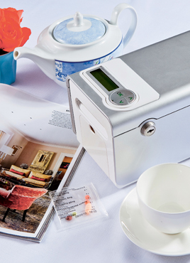
Using “telehealth” recent projects
Medido Medicines Administration device
Notes:
The third project is using a series of different medicines administration devices
We kicked off with the Medido Medicines Administration Device
This device is a sachet delivery system backed up by a secure Internet website to monitor medicines self administration.
Essentially sachets with the clients medicines loaded into them are delivered at the predetermined time from administration system
An alarm goes off to remind the person to take their medicine
If the person doesn’t press OK to eject their medicines within a certain period, say 1 hour from the time their dose was due, an email and SMS is sent to a nominated care giver or care.
At this stage it is proving to be challenging with the proof of concept in our setting. These challenges have arisen from mostly IT issues such as changes in the clock timing s in daylight saving ceases, power interruptions.

Slide 15
Broadening the skill base
Introducing new categories of worker
Enrolled nurses
Improving the health literacy and involvement of our clients
Development of evidence based education material
Active Service model
Notes:
New categories of workers
At RDNS we have introduced a new to us at least category of nurse the enrolled nurse, these nurses undertake a nursing course over a single year of full time or two years part time study as compared to the registered nurse with a three year tertiary qualification and apart from some relatively minor issues such as RDNS experiencing more complexity on scheduling arising from restriction in these nurses practice and supervision in practice irequirements they are proving to be valuable staff members
Improving the health literacy and involvement of our clients
Two initiatives we have undertaken in this arena have included the development of an evidence based education package for clients with lower leg ulcers this included 6 health care guides for individuals and use a multi media approach -
Healthy eating for healing
Care of your high risk feet
Skin care and you
Activity and healing for venous leg wounds
Footwear for high risk feet
Care of your compression garments
Whilst a lot of information material has been produced for consumers of health care not a lot has been produced for older people aged 75 and tested for its efficacy. Following research on these tools in 2010/11 we have expanded to include the whole of RDNS and collaborated with the Department of health to introduce more broadly across the home health care sector.
Our clients have become increasingly involved in their care since the introduction of the Active Service Model this is an approach that has at its core the principle that the promotion of clients capacity to live as independently as possible by improving functional independence, quality of life and social participation will help to achieve greater efficiency by reducing the need for other service providers to support them in maintaining their health status (DH, 2009). This reduced demand on health professionals will contribute to addressing problems associated with the shortage of nursing and GP workforces.

Slide 16
Anticipating and planning for the future
What we have learnt
Productivity gains
Client support
Workforce support
Notes:
What we have learnt - Is it possible to make sustainable productivity gains to the workforce using technology, well yes
Where do productivity gains come from?
Our experience has been that productivity gains have come with improved scheduling and use of the CSC has been the principal driver in this area.
Our experience in the first project I described allowed the research team to model potential productivity gains associated with shifting from a direct care service delivery model to a virtual team approach. When the typical direct care hours for district nurses, GPs and Outreach Nurses per week for 9 in-home patients were compared with the same care delivered via a mix of self and remote monitoring using a virtual team, a saving of 10 hours per week across these health professionals was identified. This would translate into a saving of 1.25 days per week, assuming an 8 hour day
As yet we are still studying what productivity benefits will be derived from the 2 and 3 projects.
It is however easy to see productivity gains slip away if lengthy waits are experienced by services waiting for technology connections to made or equipment to arrive or technical issues to resolve.
Client support
Overall, patients/clients experienced no real barriers to their use of the tele-health monitoring unit their comfort level with the use of computers was not a barrier to their participation in tele-health monitoring or health professionals and this is consistent with other trials however there are issues that need to be considered.
We had one elderly client that disconnected the equipment when thunderstorms were predicted this was a lifetime habit to protect her electrical goods from electricity surges
Workforce support
With the average age of our nurses about 48 years we are looking at how we support this older worker and this has included
Increasing the technology in the workplace be it for improving the utilisation or staff, substituting video visits or telephone calls does not reduce training or education requirements if anything it increases it. Technology nursing or tele-nursing roles could permit longer workforce participation by nurses who have considerable knowledge and skills but reduced endurance the technology does open the door to flexible practice opportunities.
But it won’t be only technology nurses have a key role to play in improving client health through health literacy and re-enablement strategies. Employers also are key RDNS expends a lot of time and effort on improving the equipment and materials that staff use to better protect them from workplace injury as they age as well as develop employment practices that assist staff in staying at work because they can.
However when one thinks back to the two slides on future workforce we will need all these measures and more to support our ageing population be they worker or client.

Slide 17
Acknowledgements
Home and Community Care (HACC) services provided by RDNS are jointly funded by the Victorian and Australian Governments
Victorian Government, Department of Business & Innovation
Health Workforce Australia funded by the Australian Government

Slide 18
Bibliography
Australia Bureau of Statistics Population Projections Australia 2004 onwards Canberra
AIHW 2010. Australia's health 2010. Australia's health no. 12. Cat. no. AUS 122, Canberra: AIHW
Health Workforce Australia 2012: Health Workforce 2025 – Doctors Nurses and Midwives – Volume 1
The Active Service Model: a conceptual and empirical review of recent Australian and International Literature (1996-2007)
Schneider, N M (2004) Managing congestive cardiac heart failure using tele-health. Home Healthcare Nurse, 22, 719-722

