Slide 1
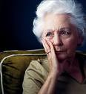
Moving From Elder Abuse to Elder Rights Les Mauvais Traitements Envers les Aines et la Justices pour les Aines
Elder Rights as a Social Movement

Slide 2
The Point Le Point

Slide 3
This Morning… Ce Matin…
1. Social Movement of Elder Rights Mouvements Sociaux des “Droits des Aines”
2. Issi and Alex – the context “le context”
3. What is all Means/ Discussion Ca Va Dire Quoi? / Discussion

Slide 4
Social Movement Mouvement Social
Expansion
Attenuation
Repetition
Fluid Growth Croissance Fluide

Slide 5
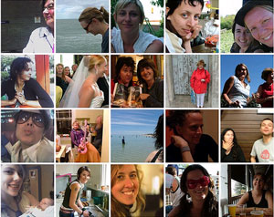
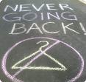
Women’s Rights Droits des Femmes
30 Years Ago…

Slide 6
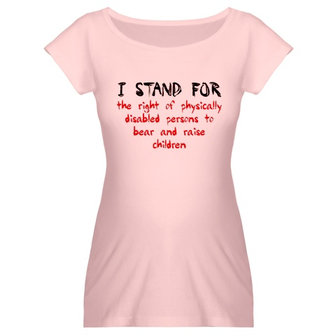
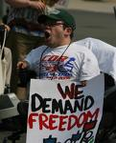
Disability Rights Droits Lies a L’incapacite
20 years ago…

Slide 7
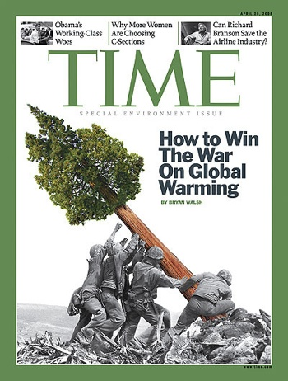
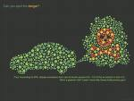
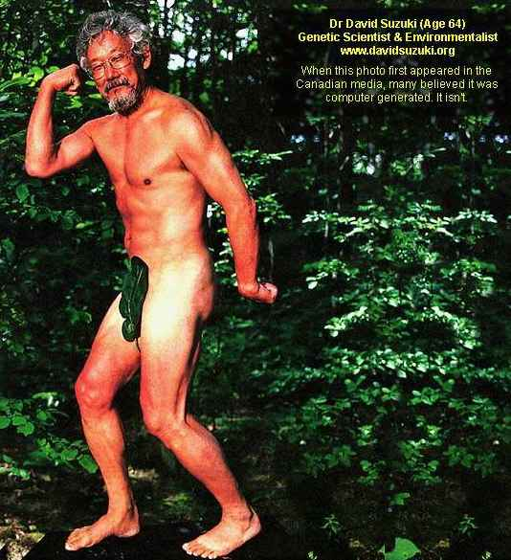
Green / Eco Vert / Eco
10 years ago…

Slide 8
Our Path La Route a Suivre
1927 then 1952 Old Age Security Pension de Viellesse
1960s US Legislation – Great Society Grande Société
1970s Grassroots Local Development Les Racines du Développement Local
1980s Literature, Leaders, Organizations La Literature, Les Leaders, Les Organismes
1990s Broad Network Development (INPEA etc), New Adult Guardianship / Protection Laws Les Développements a Grande Escelle des Reseaux, Curateur pours les adultes
2000s Research, Inter-disciplinary Networks, Consciousness Raising La Recherche, L’interdisciplinarite, La Conscienitsation

Slide 9
Areas of Growth La Progression
Legislation / Législation
Case law / Jurisprudence Civil and Criminal Civile et Criminelle
Policies / Les Politiques

Slide 10
Important Considerations for Expansion Les Considerants Importants
Contexte / Context
Capacité / Capacity
Culture
Contenu / Continuity

Slide 11
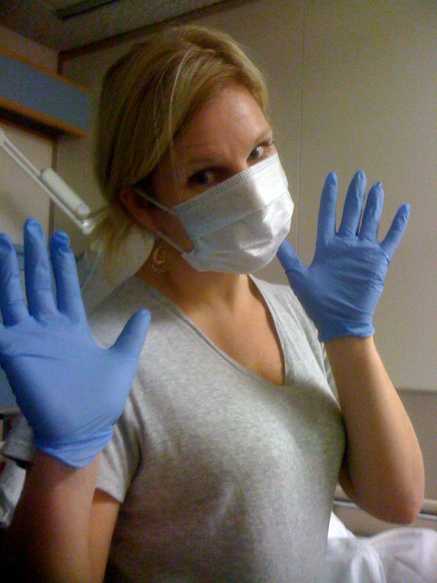
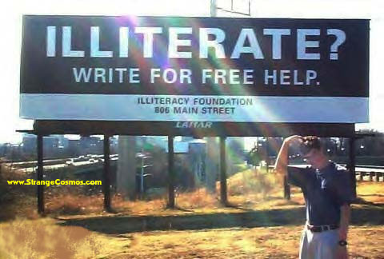
Appropriate Intervention Intervention Appropriée
Analphabete?
Ecrivez pour de l’aide.
123 Rue Principale
Nulpart

Slide 12
3. What it all Means? Ca va dire Quoi?
Working Together Travailler Ensemble
Many Contributions, Many Talents Nombreuses Contributations, Plusieurs Talents
Respecting our Past, Celebrating our Current, Visioning our Future Respecter notre passe, Celebrer notre present, Imaginer notre avenir.

Slide 13
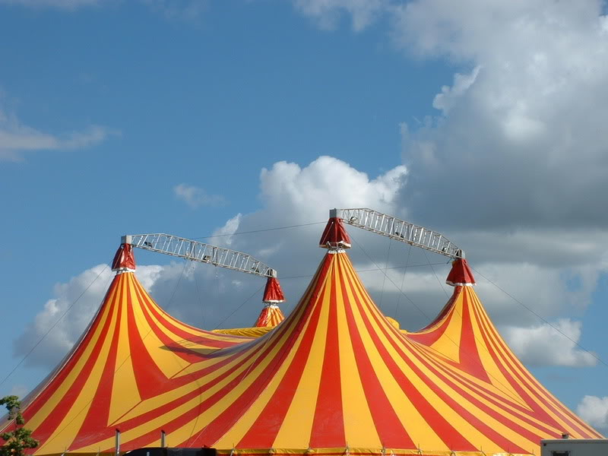
Big Tent Le Grand Chapiteau

Slide 14
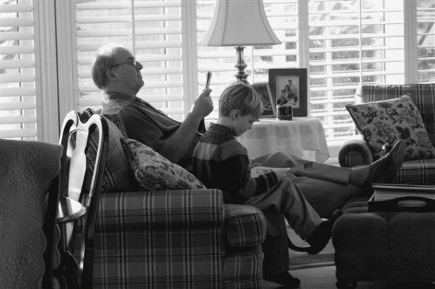
The Answer La Reponse

Slide 15
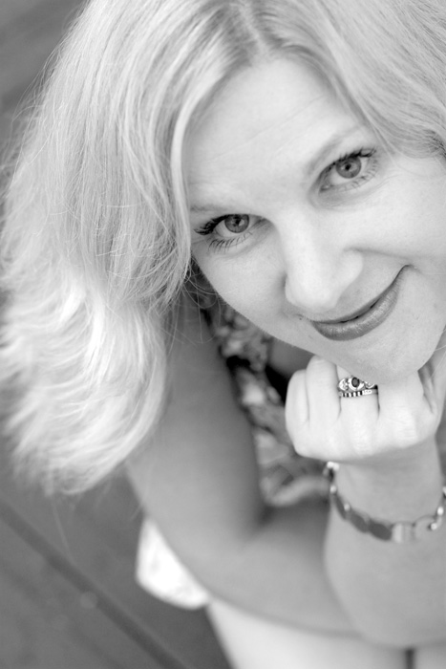
Laura Watts
Canadian Centre for Elder Law 1822 East Mall, UBC Faculty of Law, Annex 1 Vancouver, BC V6T 1Z1 www.bcli.org/ccel lwatts@bcli.org
604-822-0142 - Vancouver 647-969-6793 - Toronto

Slide 16
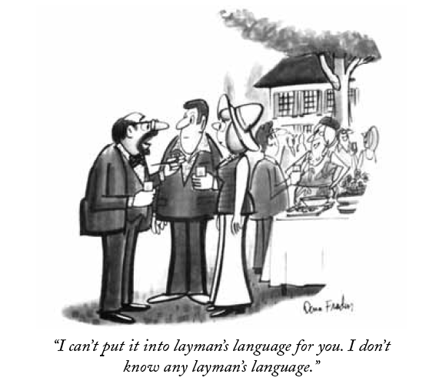
2. Alex and Issi – Setting the Context Le Context 3. Discussion
“I can’t put it into layman’s language for you. I don’t know any layman’s language”
“Je ne peux pas dire dans la language de M. Tout le Monde. Je ne connais pas ce language la!”

