Slide 1
Men, Women and Ageing
Gender differences in the impact of gastrointestinal problems and their association with frailty
Derrick Lopez¹, Leon Flicker¹ & Annette Dobson²
¹University of Western Australia, Australia
²University of Queensland, Australia
NHMRC/ARC Ageing Well, Ageing Productively Grant

Slide 2
Men, Women and Ageing
GI problems in the elderly
Common in old people
GERD in 80-84 yo: 190/100,000 men, 169/100,000 women¹
Dyspepsia in 80-84 yo: 84/100,000 men 79/100,000 women ¹
Adverse effects due to their multiple co-morbidities and low physiological reserves
(GERD=gastroesophageal reflux disease)
¹Goldacre Best Pract Res Clin Gastroenterol (2009), 23(6): 793-804

Slide 3
Men, Women and Ageing
GI symptoms and their impact on quality of life (QoL)
Physical functioning – eating, walking, bending (e.g. dyspepsia associated with reduction in lower limb mobility)¹
Social functioning – relationships, embarrassing symptoms
Body pain – abdominal pain/discomfort, chest pain
Mental health – anxiety, frustration, depression
Lack of vitality, sleeping problems

Slide 4
Men, Women and Ageing
Gender differences GI symptoms and outcomes
Men and women with GI problems may differ in their pattern of symptoms and pain perception
Heartburn more frequent in men (49% vs 40%)¹
Heartburn associated with poor physical health in men
Among dyspeptics, women (PCS=46.4; MCS=44.7) had poorer physical and mental well-being than men (PCS=47.9, MCS=47.5) - p < 0.05 ¹
¹ Westbrook et al Qual Life Res 2002, 11: 283-91
Notes:
Heartburn is more frequent in men than women, ie 49% vs 40%)

Slide 5
Men, Women and Ageing
Frailty
State where there is increased vulnerability to stressors
Increasing levels of frailty associated with disability and mortality
Markers of frailty include low activity, declines in strength, endurance, lean body mass
Many of these may be associated with GI problems

Slide 6
Men, Women and Ageing
Aims
To determine the prevalence and frequency of indigestion/heartburn in old adults.
To determine if there is an association between indigestion/heartburn and frailty, and if there is any gender differences in this association.

Slide 7
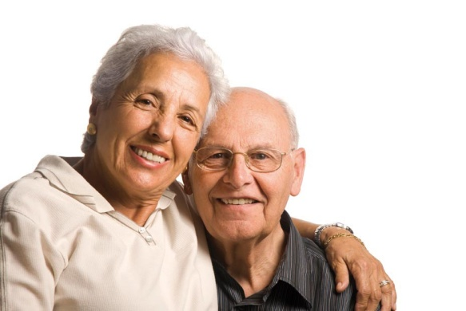
Men, Women and Ageing
METHODS

Slide 8
Men, Women and Ageing
Study participants
Limit to age 82-87 years and urban residents
1085 men who responded to HIMS 3 survey (2008)
1916 women from ALSWH old cohort Survey 5 (2008)

Slide 9
Men, Women and Ageing
Exposure variable: indigestion/heartburn
Question:
Have you had indigestion/heartburn in the LAST 12 MONTHS?
Choice of responses:
Never, Rarely, Sometimes, Often

Slide 10
Men, Women and Ageing
Elements of the FRAIL scale^{1,2}
Fatigue - feel worn out, feel tired, have a lot of energy
Resistance - ability to climb a flight of stairs
Ambulation - ability to walk 100m
Illness > 5
Loss of weight >5%
1. Hyde et al Endocrinol Metab 2010;95:3165-72
2. Lopez et al J Am Geriatr Soc 2012; 60:171-3
Notes:
The frailty elements, are fatigue, resistance and ambulation, which we have validated in our centre. Fatigue is based on feeling worn out, feeling tired or not having a lot of energy. Resistance is ability to climb a flight of stairs, ambulation is ability to walk 100m.

Slide 11
Men, Women and Ageing
FRAIL scale^{1,2}
Accumulation of deficits
Scored 0 (not frail) to 5 (most frail)
0-2: not frail; 3-5 frail
1. Hyde et al Endocrinol Metab 2010;95:3165-72
2. Lopez et al J Am Geriatr Soc 2012; 60:171-3

Slide 12
Men, Women and Ageing
RESULTS

Slide 13
Men, Women and Ageing
Demographics
 | Men (n=1085) | Women (n=1916)
Age years | 83.9 | 84.2*
Living alone % | 23.9 | 57.7*
Educational level %
Primary school | 14.3 | 25.2
Some high school | 35.6 | 36.9
Completed high school/tertiary | 50.1 | 34.6
*
* p<0.05
Notes:
The average participant age was 84 years with women being slightly older than men
More women lived alone
Ed is higher in women than in men

Slide 14
Men, Women and Ageing
Self-reported medical conditions
 | Men % (n=1085) | Women % (n=1916)
Alzheimer’s disease/dementia | 4.6 | 2.5*
COPD | 29.1 | 25.0*
Diabetes | 17.1 | 14.8*
Heart attack/angina | 35.4 | 27.3*
Stroke | 16.1 | 10.8*
Arthritis | 58.2 | 73.0*
Osteoporosis | 11.2 | 77.5*
* p<0.05

Slide 15
Men, Women and Ageing
Frequency of indigestion/heartburn
 | Men % (n=1085) | Women % (n=1916)
Never | 392 (36%) | 906 (47%)
Rarely | 281 (26%) | 383 (20%)
Sometimes | 274 (25%) | 405 (21%)
Often | 53 (5%) | 126 (7%)
p<0.05
Notes:
Indigestion/heartburn more common in men, 36% of men reported “Never” having indigestion/heartburn compared to 47% of women

Slide 16
Men, Women and Ageing
FRAIL scale
 | Men % (n=1085) | Women % (n=1916)
Fatigue | 49.2 | 65.3*
Resistance | 48.8 | 53.5*
Ambulation | 29.7 | 37.7*
Illness > 5 | 7.9 | 18.3*
Loss of weight >5% | 22.7 | 27.5*
Frail (FRAIL scale > 2) | 27.4 | 38.6*
* p<0.05
Notes:
Frailty and its elements are higher in women than in men.

Slide 17
Men, Women and Ageing
Association between GI symptoms and frailty
 | OR (95% CI) |  | M:W
 | Men | Women
Never | 1.00 | 1.00 | -
Rarely | 2.09 (1.45-3.01)* | 2.05 (1.59-2.65)* | 1.02 (0.65-1.59)
Sometimes | 1.96 (1.35-2.84)* | 1.55 (1.20-2.01)* | 1.26 (0.80-1.98)
Often | 2.01 (1.05-3.87)* | 3.96 (2.60-6.03)* | 0.51 (0.23-1.11)
* p<0.05

Slide 18
Men, Women and Ageing
DISCUSSION

Slide 19
Men, Women and Ageing
Indigestion/heartburn and frailty
29% of old adults reported sometimes/often had indigestion/heartburn in the last 12 months
Associated with frailty in both men and women
More specifically associated with fatigue, resistance, ambulation and illness > 5
Not associated with loss of weight > %5

Slide 20
Men, Women and Ageing
Indigestion/heartburn and frailty
Resistance, ambulation possibly indicative of muscle weakness and/or low physiological reserves
Fatigue may be due to poor sleep
Patients with indigestion/heartburn are more likely to have multiple co-morbidities

Slide 21
Men, Women and Ageing
Conclusion
In addition to common investigations for indigestion/heartburn in older adults, healthcare professionals should consider assessing for frailty in patients who present with these symptoms.

Slide 22
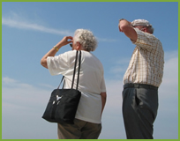
Men, Women and Ageing
Please visit our website for more details
http://www.wacha.org.au
Notes:
Thank you.

