Slide 1
Adult Immunization: Prevention and Wellness Across the Life Course
Jane Barratt
Secretary General, International Federation on Ageing
31 May 2012

Slide 2
Linear Lifeplan
0
10
20
30
40
50
60
70
80
85
Age
Education
Work
Leisure
_{Thanks to Ken Dychtwald}
2

Slide 3
Linear Lifeplan
“Longevity Bonus”
0
10
20
30
40
50
60
70
80
85
Age
Education
Work
Leisure
_{Thanks to Ken Dychtwald}
3

Slide 4
Cyclic Lifeplan
“Longevity Bonus”
“Longevity Bonus”
“Longevity Bonus”
“Longevity Bonus”
0
10
20
30
40
50
60
70
80
85
Age
Education
Work
Leisure
_{Thanks to Ken Dychtwald}
4

Slide 5
Cyclic Lifeplan
0
10
20
30
40
50
60
70
80
85
Age
Education
Work
Leisure
_{Thanks to Ken Dychtwald}
5

Slide 6
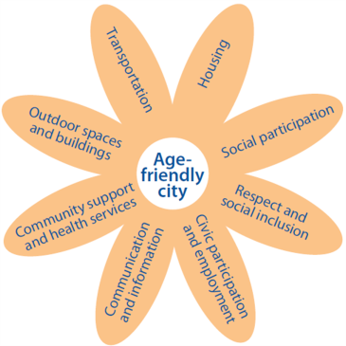
WHO Global Network of Age-friendly Cities and Communities
6

Slide 7
New Outlets to Highlight Healthy Ageing
www.AgeFriendlyWorld.org
7

