Slide 1
The Older People’s Commissioner for Wales’ Review of Advocacy Arrangements in Care Homes
Sarah Stone
Deputy Older People’s Commissioner for Wales
Christian Beech
Swansea University

Slide 5
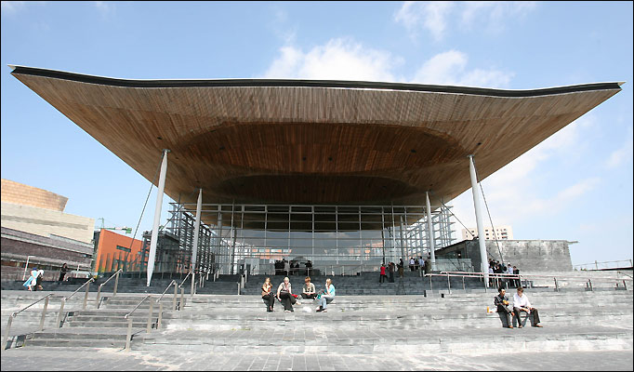

Slide 6
Older people in Wales
Population of all ages: 3m
Over 700,000 people aged over 60
Nearly one in four people are aged over sixty, higher than in England, Scotland or Northern Ireland
Life expectancy is 77 for men, 81 for women

Slide 7
Basis for the Review
The Commissioner protects the rights and promotes the interests of older people
The Commissioner supports the vital role of advocacy services in supporting and safeguarding older people
Older people brought cases concerning their experiences of care home to the attention of the Commission
Preliminary findings of research undertaken on behalf of the Commission:
Inconsistent advocacy provision throughout Wales
Lack of awareness and understanding of the importance, benefits and availability of advocacy

Slide 8
Methods
The Commissioner for Older People (Wales) Act 2006
Section 5 allows the Commissioner to Review the arrangements for advocacy
The Commissioner for Older People in Wales Regulations 2007
With respect to issuing guidance
Notes:
Subject to this review were the advocacy arrangements of the Welsh Government (Minister for Health and Social Services & Deputy Minister for Social Services and Children; Local Authorities and Local Health Boards in Wales)

Slide 9
Methods
Obtained information about advocacy arrangements:
22 local authorities
7 local health boards
143 care homes
Notes:
The OPCW notified regulated bodies, services and persons (who may be subject to the review), of her intention to conduct a review of advocacy arrangements for older people in care homes in Wales.
These included all 22 local authorities; 7 Local Health Boards (where joint commissioning arrangements may exist) in Wales; the Care and Social Services Inspectorate for Wales (CSSIW); the Deputy Minister for Social Services and Children and all registered care homes for older people (N=703) in Wales.
The OPCW issued further notice requiring information from all 22 local authorities and 7 local health boards and a random selection of 5 care homes per local authority area (N=110) in relation to their advocacy arrangements.
16 care homes were selected for inclusion in the study including an independent care home chosen as a pilot site after having been brought to the attention of the OPCW via the Information and Enquiry team as an example of good practice with regard to the provision of independent advocacy services for older residents.

Slide 10
Methods
Selecting the sample sites:
Five local authority areas were selected for review which as far as reasonably possible represented the diverse cultural and demographic context of Wales.
Sixteen care homes were selected
Notes:
One local authority area was selected on the basis that it had a proportionately high population of first language Welsh speakers and that it included both rural areas but also pockets of former industrial areas.
A neighbouring local authority area was selected to consider referrals to specialist provision across county borders and look at advocacy in the round.
The third local authority area was a county which classically includes a mix of rural and urban communities and has been used in the past for pilots on digital inclusion and the census for this very reason.
A fourth local authority area represented an inner city location with by far the greatest proportion of its citizens with minority ethnic backgrounds other than English or Welsh, and where the diversity of intake of care home residents was likely to be most varied.
The final area selected was adjacent to the previous local authority but with the characteristics of an urban area with some of the most economically deprived communities in Wales.

Slide 11
Methods
Obtaining views and experiences:
Interviews with older residents; relatives; care home providers, managers and staff.
Focus groups with Care and Social Services Inspectorate for Wales inspectors
Focus groups with independent advocacy providers

Slide 12
Methods
Sample and Response Rates
Of the 16 care homes selected for inclusion in this review, none of the care home providers and managers refused entry to the research team.
The research team also visited 2 specialist care homes for older people with advanced dementia.
Additionally, 3 of the care homes selected were in the process or under threat of closure.
Notes:
Some managers and providers contacted the OPCW to seek reassurance that the visits were not part of a formal inspection process and conducted independently of the local authority or CSSIW.
Within these care homes, interviews were conducted with care home management and staff and relatives.

Slide 13
What we found…
Older residents are at risk of institutional ageism and viewed as homogeneous
Advocacy has been ‘problematised’ within care homes
The ‘gatekeeping’ role of care home providers and managers
Older people are not receiving the right support at the right time to manage transitions into care settings
Notes:
Older residents within care homes are experiencing implicit and institutional ageism. Older residents are at risk of being viewed as a homogeneous group; whose aspirations are to receive only basic comfort and care in their later life; and the constant physical presence of other older people at all times.
A narrow view of advocacy has emerged which sees it synonymous with safeguarding, dispute resolution and complaints. There is an implicit fear amongst care home managers that its presence may be perceived as poor care standards within the care home and potentially impact upon the commercial interests of the home. This has resulted in gatekeeping practices amongst care home managers who determine the ‘need’ for advocacy in a way that lacks transparency and accountability. This may be partially addressed by training for care home managers and staff; Inspectors and commissioners but also requires a more comprehensive approach to assert advocacy as a basic right for older people.
There is an explicit assumption amongst care home managers that they are best placed to determine the need for advocacy yet are engaging in gatekeeping practices which lack transparency and accountability and often more geared to the commercial interests of the home than the older person.

Slide 14
What next?
Publication of Review findings – 9th June
Follow up recommendations and work in partnership to monitor implementations
Identify ongoing work and further research

Slide 15
For more information…
Older People’s Commissioner for Wales
www.olderpeoplewales.com
Email us
ask@olderpeoplewales.com

