Slide 1
Opening doors: generating new connections to foster Social inclusion
Ronda Held
Inner East Social Inclusion Initiative
Notes:
I would like to tell you a story about our journey in thinking about the issue of social isolation in our local community, and how we discovered new ways of taking a strengths-based approach to building a more inclusive community.
I want to begin by introducing you to two older people who have been involved in this program. Given their age and potential health issues, they could be considered as part of the group of older people who may be “at risk” of isolation. However, drawing on their passion and strengths, they have been part of grass roots initiatives to build community and make connections between people.

Slide 2
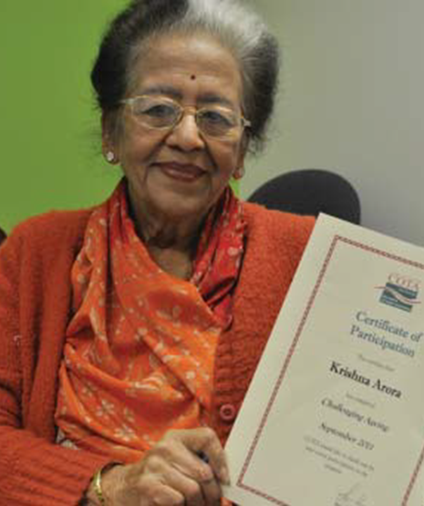
Krishna
Notes:
To summarise the life of Krishna Arora in one, short article is no mean feat, but one thing is for sure: at 83 years young, she has a tremendous appetite for life and working with her community.
Having studied both at home in Dehli, and abroad in the UK, one of Krishna’s first jobs was teaching at a finishing school in Mumbai (then known as Bombay). Quickly finding her passion in life, Krishna turned her eye to hospitality. In 1986 she moved to Madras and opened the Institute of Hotel Management, which she ran for six years.
Arriving in Australia in 1992 to help care for her grandchildren, Krishna initially found herself feeling isolated.
“When I came to Melbourne I found lots of seniors who were very lonely. Money was a factor, but some of them didn’t even know English, which was another barrier for them. They were effectively excluded from the community,” she said. Since then, she has worked tirelessly within the Indian community to bring about change in this area. She has been writing recipes for a local Indian paper for 18 years, has published two cookery books (which remain in print to this day), has been President of the Indian Senior Citizens Association and still works with the Federation of
Indian Associations of Victoria.

Slide 3
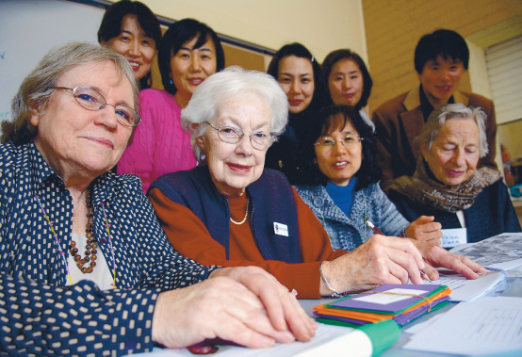
Joan and Sadie
Notes:
In both years of the program, participants were drawn from across the four local government areas and from a range of ethnicities, backgrounds, ages and abilities. Ages have ranged ranging from the 20’s to the 80’s and from 10 different ethnic groups.
These two woman in their late 70’s and late 80’s passionate about life long learning set up a new University of the Third Age (U3A) and to help young Korean mothers to learn English.
The diversity of the group has been a key strength of the program, fostering strong, supportive relationships between people who may not have otherwise had the opportunity to meet.

Slide 4
Social Isolation and Social Inclusion
How do we engage with people who are at risk of isolation in our community?
How can we build sustainable initiatives that will foster community inclusion?
If you were socially isolated, what would it take for you to take a risk and become more engaged in your community?
Notes:
A partnership of agencies working in the area of health and aged care in the inner east of Melbourne, Australia, identified the potential health impact of social isolation on our community, particularly on vulnerable groups such as older people, people with disabilities, and people from diverse cultural backgrounds. In making an assessment of the current responses to isolation, the group noticed that human service agencies were struggling to engage with people who were potentially isolated and connect them with the vast resources available in the community. Research has shown that potentially isolated people are less likely to access relevant health and community services.
This project then started on a journey to address these 3 key questions :
How do we engage with people who are at risk of isolation in our community?
How can we build sustainable initiatives that will foster community inclusion?
If you were socially isolated, what would it take for you to take a risk and become more engaged in your community?
For example, a group of Cambodian elders in our local community had come to Australia as refugees and experienced torture and trauma in their own country. As this violence was aimed at dismantling the social connections between families and the wider community, such refugee communities may be divided, with little sense of community beyond a shared national identity. This experience also leads to a distrust of government and formal services. Community leaders were concerned about the isolation of this group, but were unsure of how to address it.

Slide 5
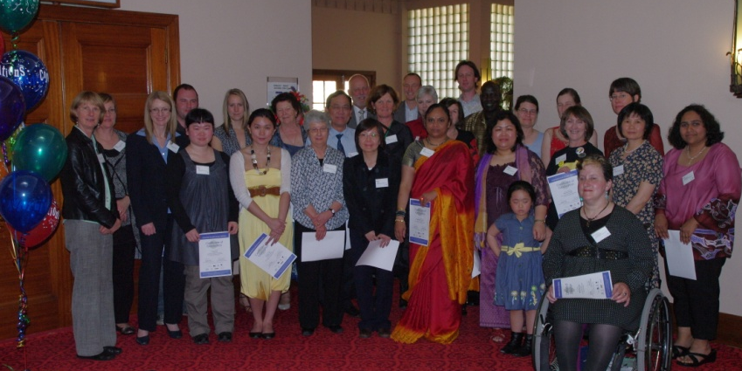
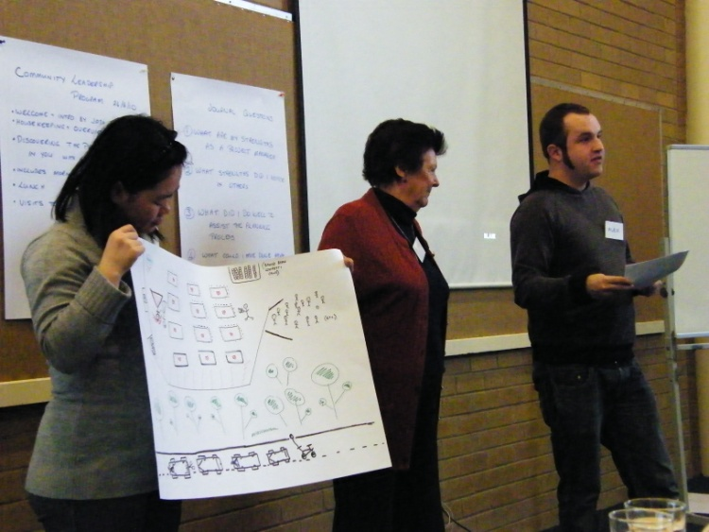
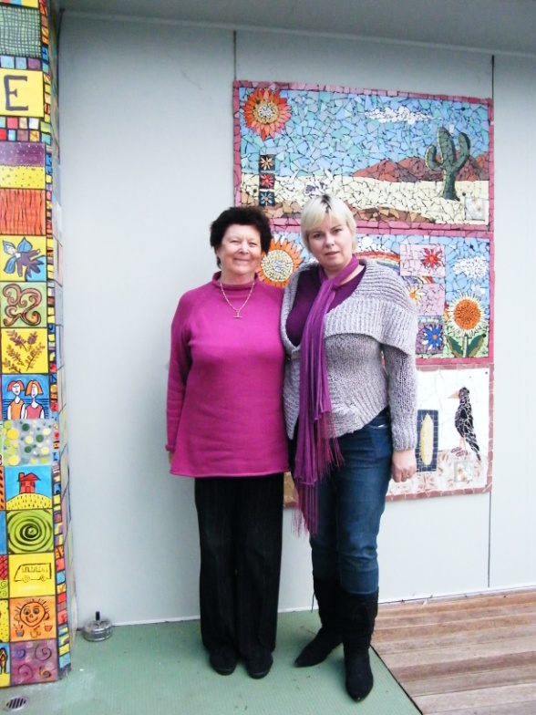
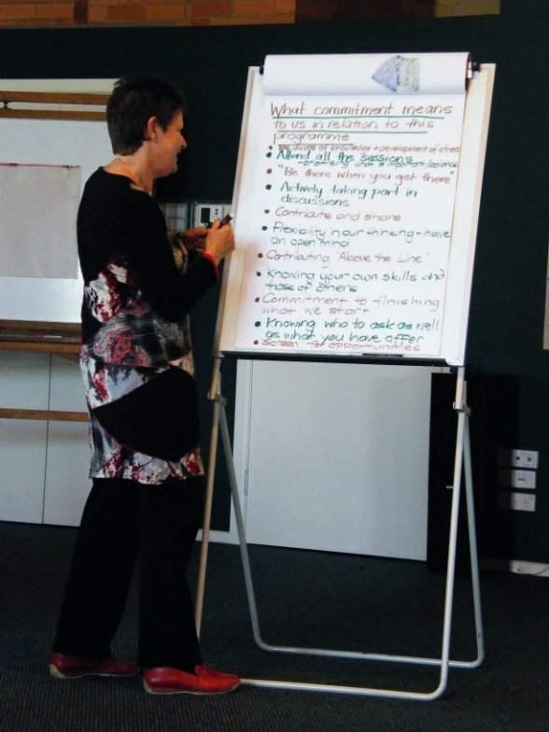
Opening Doors
into Community
Are you willing to take
the lead in making your
community more
inclusive?
A community
leadership program for
SOCIAL INCLUSION
Notes:
Instead of looking to more “service” solutions, the partnership chose to use a community building approach, identifying grass roots community leaders who are passionate about everyone having the opportunity to participate in their community. These community members were invited to participate in the Opening Doors Community Leadership Program for Social Inclusion . The program provides these existing and emerging leaders the opportunity to build their capabilities to develop local responses to increase social inclusion. The Program is now in its 4th year in the inner east, and has since been replicated in the south, running for the second year there this year.
Each year around 20 community members participate in a 6 month leadership development program where they develop their personal leadership skills, learn about community development and how to develop a local project, and then use their ideas and new found skills to start or support a local project that promotes connectedness.
The core approach of the program is to build on the strengths of the participants and their local communities. Asset Based Community Development (ABCD) approaches (based on Appreciative Inquiry) are shared with participants and are utilized in developing the local projects that are worked up during the program and continue to foster social inclusion in local communities.

Slide 6
Appreciative Inquiry
…begins by identifying what is positive and connecting to it in ways that heighten energy, vision and action for change.
Cooperrider (2008)
Notes:
Paper will describe the program, the partnership and outcomes for participants and the community.
The use of Appreciative Inquiry and strengths based approaches such as Asset Based Community Development was prompted by the realization that traditional “problem solving” approaches were not working to address social isolation, and that our efforts were likely to be much more productive using a strengths-based approach.

Slide 7
Social Isolation
Significant risk factor for morbidity and mortality
Risk comparable to cigarette smoking
Risk factor for depression and suicide
Socially isolated people are less likely to access health and support services and engage in positive behaviours that can improve their health and well-being
The debate about social isolation focusses on deficits.
Notes:
Agencies in the Inner East of Melbourne are engaged in a coalition called the “Primary Care Partnership” (PCP) to proactively address the health issues affecting the population in the catchment of four local government areas. Social isolation was identified as a key issue for a number of groups in the community, with an initial focus on older people. The research confirms that social isolation has a major impact on the health and well-being of those who experience it.
Research shows:
Social isolation is a signiﬁcant risk factor for morbidity (illness) and mortality (death);
The size of this risk has been described as ‘comparable to cigarette smoking and other major biomedical and psychosocial risk factors’, although our understanding of the underlying causal mechanisms remains limited;
Social isolation is also recognised as a risk factor for depression and suicide;
Socially isolated people are less likely to access health and support services and to engage in behaviours that can have a positive impact on their health and wellbeing.
The dilemma with the social isolation debate is that it focusses on people’s deficits. Older people who are frail, living alone, have cognitive impairments, limited mobility or come from diverse cultural backgrounds are seen as “at risk”. Communities are seen as excluding people due to their perceived deficiencies. The initial research for this project was with community and health services who identified that their primary response to social isolation was to refer people to another service, but their ability to link people back into ordinary community activities was limited. Thus in attempting to use the traditional “problem solving” approach, services were further stigmatising people as “in need” of human services.
The Partnership discussed possible responses, including establishing various projects to address these “disadvantaged groups”. After some discussion and input from Asset Based Community Development (ABCD) practitioners such as Mike Green, the group decided to pursue a capacity building initiative that would seek out grass roots community leaders who were passionate about inclusion and interested in taking action at a local level.

Slide 8
Two paths – two solutions
Needs Assets
(What is not there) (What is there)
⇩ 
Services to meet Connections &
needs contributions
⇩ 
Consumers Citizens
⇩ 
Programs are the People are the
answer answer
Notes:
However, the group was still learning about the ABCD approach as we attempted to identify areas of “high need” or social disadvantage to recruit our community leaders. This strategy did not prove particularly successful, and at first we thought we would not find enough people to commence the program. We then realised we were using a “glass half empty” approach.

Slide 9
Community Needs Map
Unemployment
Social Housing
Child Abuse
Crime
Teenage Mothers
Elderly
Illiteracy
Poverty
School Dropouts
Mentally Ill
Homeless
Truancy Addiction
Social isolation
Delinquency
Notes:
We went looking for a map like this that indicated where people might be more isolated, e.g. due to poor public transport, larger percentage of older people living alone, public housing etc. In fact we obtained copies of government maps that were essentially “deficit maps”.

Slide 10
Looking to the community not services…
Found people passionate about inclusion
People raised the issues that were important to them
OPEN SPACE PRINCIPLES
Passion
Responsibility
Notes:
However, opening up the opportunity more widely and moving to an approach based more on “Open Space” principles proved far more effective. These principles include:
“All of the issues that are MOST important to the participants will be raised.
All of the issues raised will be addressed by those participants most qualified and capable of getting something done on each of them.

Slide 11
Community Assets
Businesses
Local Institutions
Schools
Associations
Churches
Clubs
Gifts of Residents
Parks
Income
Artists
Libraries
Youth
Elderly
Labelled/Marginalized
Social Groups Self-Help Groups
Hospitals
Nonprofits
Notes:
When we stopped looking for “needs” or for services to “meet needs” we found a map that looks more like this one.
People came forward who were passionate about inclusion and willing to act on the things they cared about. Some of these people came from human services but many came from other walks of life. In four years there has not been an issue with filling the program and people are often on a waiting list for the next year.

Slide 12
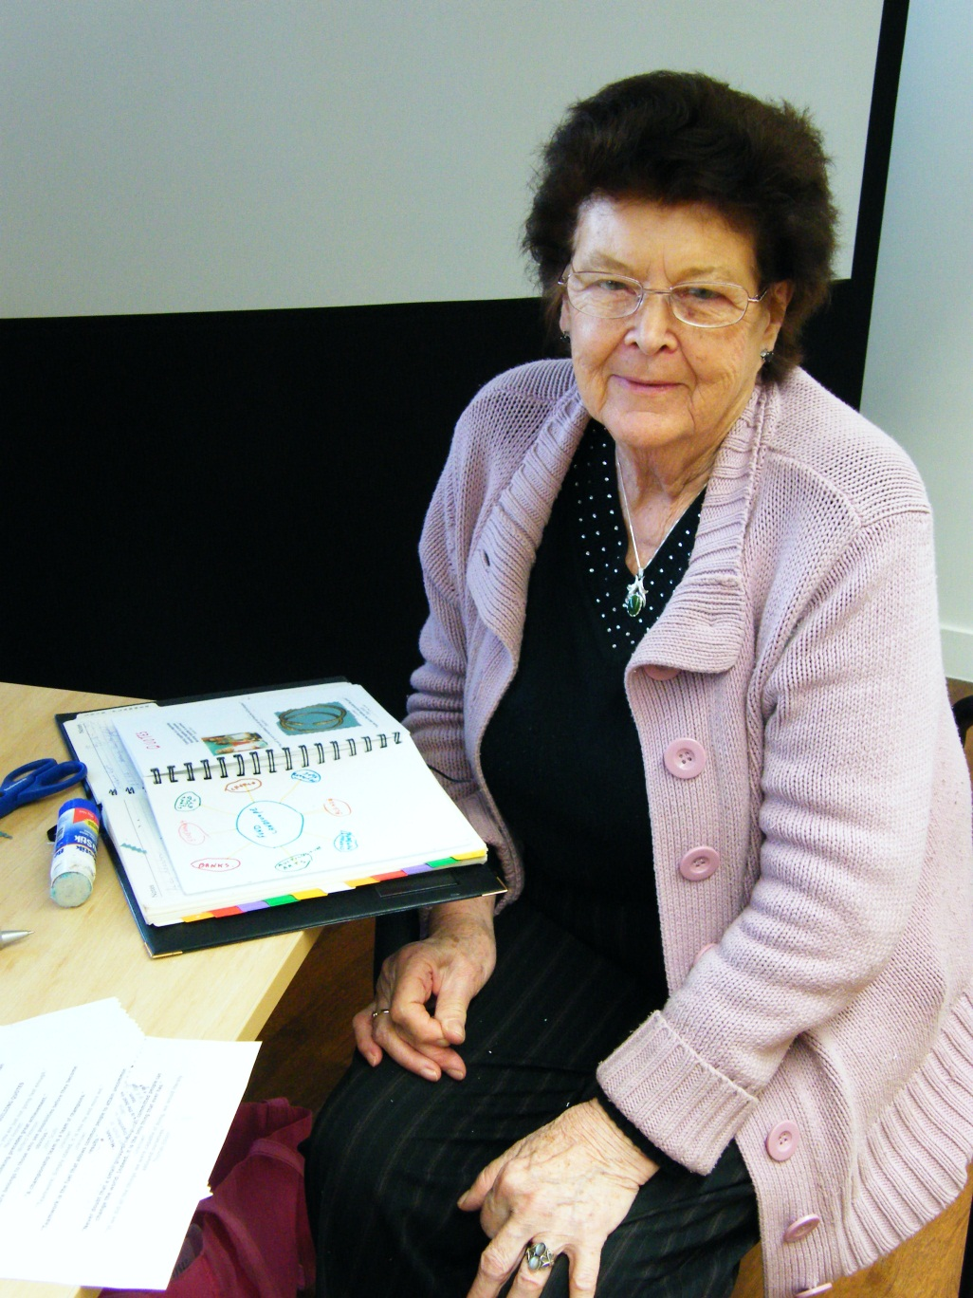

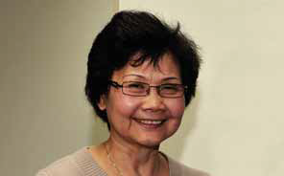
Notes:
In the initial year the focus was on the social isolation of older people. In subsequent years the focus has broadened to other groups but older people are still an important focus. In one LGA 24% of people live alone, many of these are older people. Participants each year have been extremely diverse in age, cultural background and life experiences. In 2010 43% of participants were 50 and over.
Applicants who demonstrated leadership capabilities and/or who were well connected in their community were selected to undertake the interview process, as it was viewed that these attributes would assist participants to establish responses within their local community aimed at reducing social isolation. Three to four applicants participated in each interview which was structured as a 2 hour workshop with the project manager, a steering committee representative and an independent person where possible. The workshops were constructed to promote conversations as opposed to strict question and answer format. Relevant topics such as: team work, leadership and personal strengths were explored and this provided opportunity for applicants to demonstrate their ability to engage with others and to meet with potential fellow group participants.

Slide 13

Program Process
Group Interview:
Promote conversation
Vision for community
Notes:
A visioning exercise was also included using Jeannie Baker’s picture book `Belonging’ as an example of how a socially inclusive community can develop over time. Applicants were encouraged to “dream” by drawing or describing the transformation of their own local community to a socially inclusive one and then to explore the commonalities of their vision with the other group members. People were finally selected based on their passion and ability to work with others in the program.

Slide 14
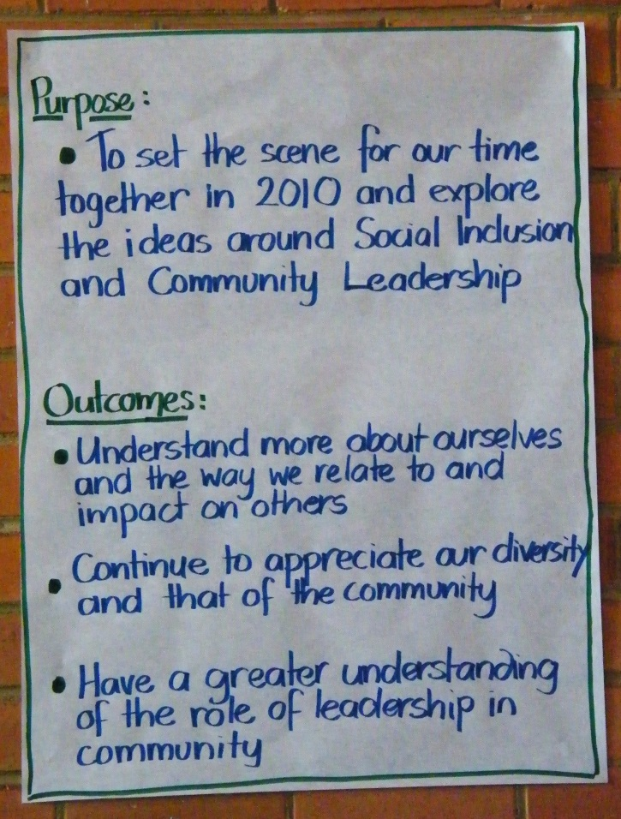
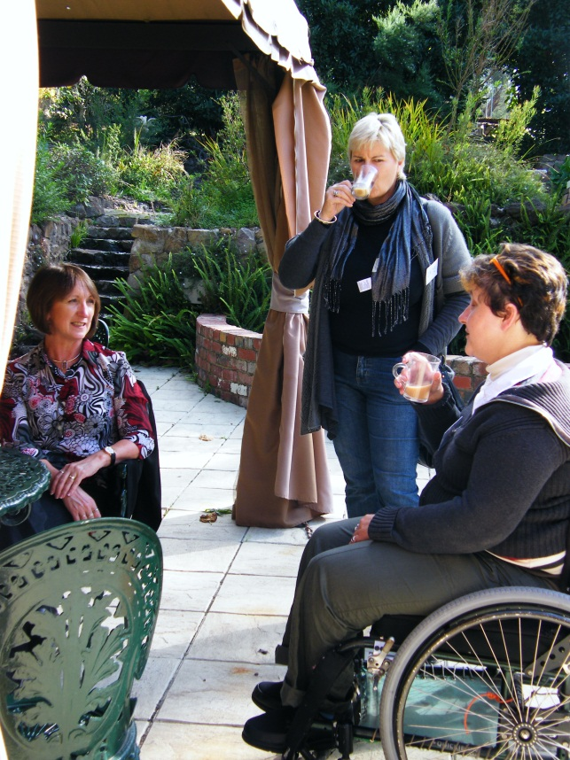
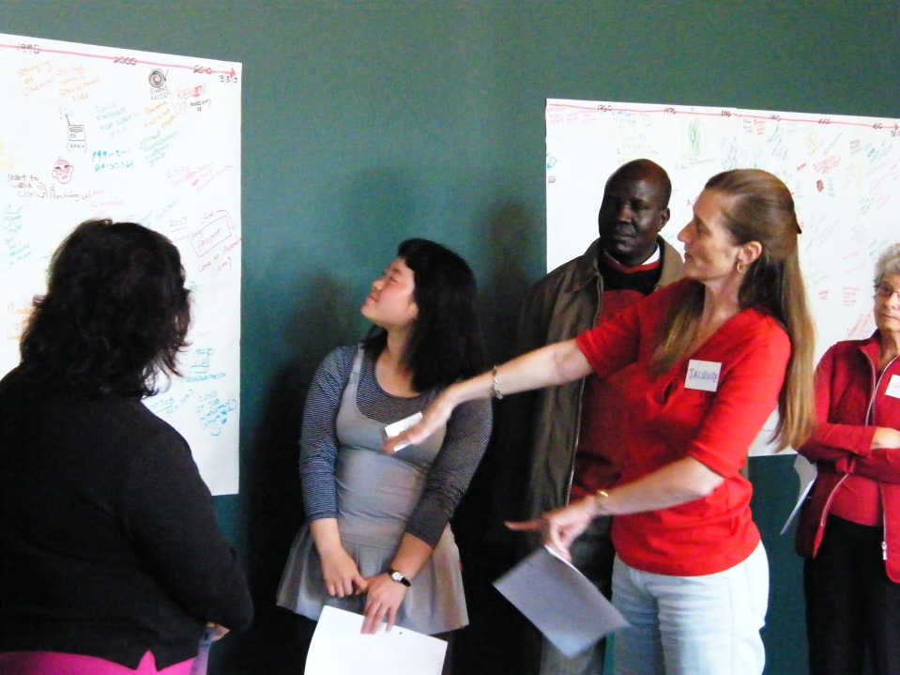
Opening Retreat
Explore leadership
Discover leadership strengths
Notes:
The Opening Doors Community Leadership Program offers participants (the future leaders) opportunities to develop their natural leadership skills and become aware of the many assets in their community.
The program commences with a two day retreat, where participants explore the concept of leadership and discover their own leadership strengths.

Slide 15
Twelve Principles of ABCD
Everyone has gifts.
Relationships build a community.
Citizens are at the centre.
Leaders involve others as active members of the community.
People care about something.
Identify what motivates people to act.
Notes:
During the program they are introduced to the Asset Based Community Development Approach which is based on Appreciative Inquiry Principles.
Asset-Based Community Development (ABCD) is a growing movement that considers local assets as the primary building blocks of sustainable community development. Building on the skills of local residents, the power of local associations, and the supportive functions of local institutions, asset-based community development draws upon existing community strengths to build stronger, more sustainable communities for the future.
Participants are encouraged and supported to engage in community conversations to help them to understand the kind of local community initiative that will engage potentially isolated people and help them to generate new sense of connectedness and belonging.

Slide 16
Twelve Principles of ABCD (cont.)
7. A listening conversation is the way to discover motivation and invite participation.
8. Ask, ask and ask.
9. Asking questions rather than giving answers invites stronger participation.
10. A citizen-centred ‘inside-out’ organisation is the key to community engagement.
11. Institutions have reached their problem solving limits.
12. Institutions are servants.

Slide 17
ABCD – three steps
Discover strengths
Connect with each other and our community
Come together to build on knowledge and skills

Slide 18
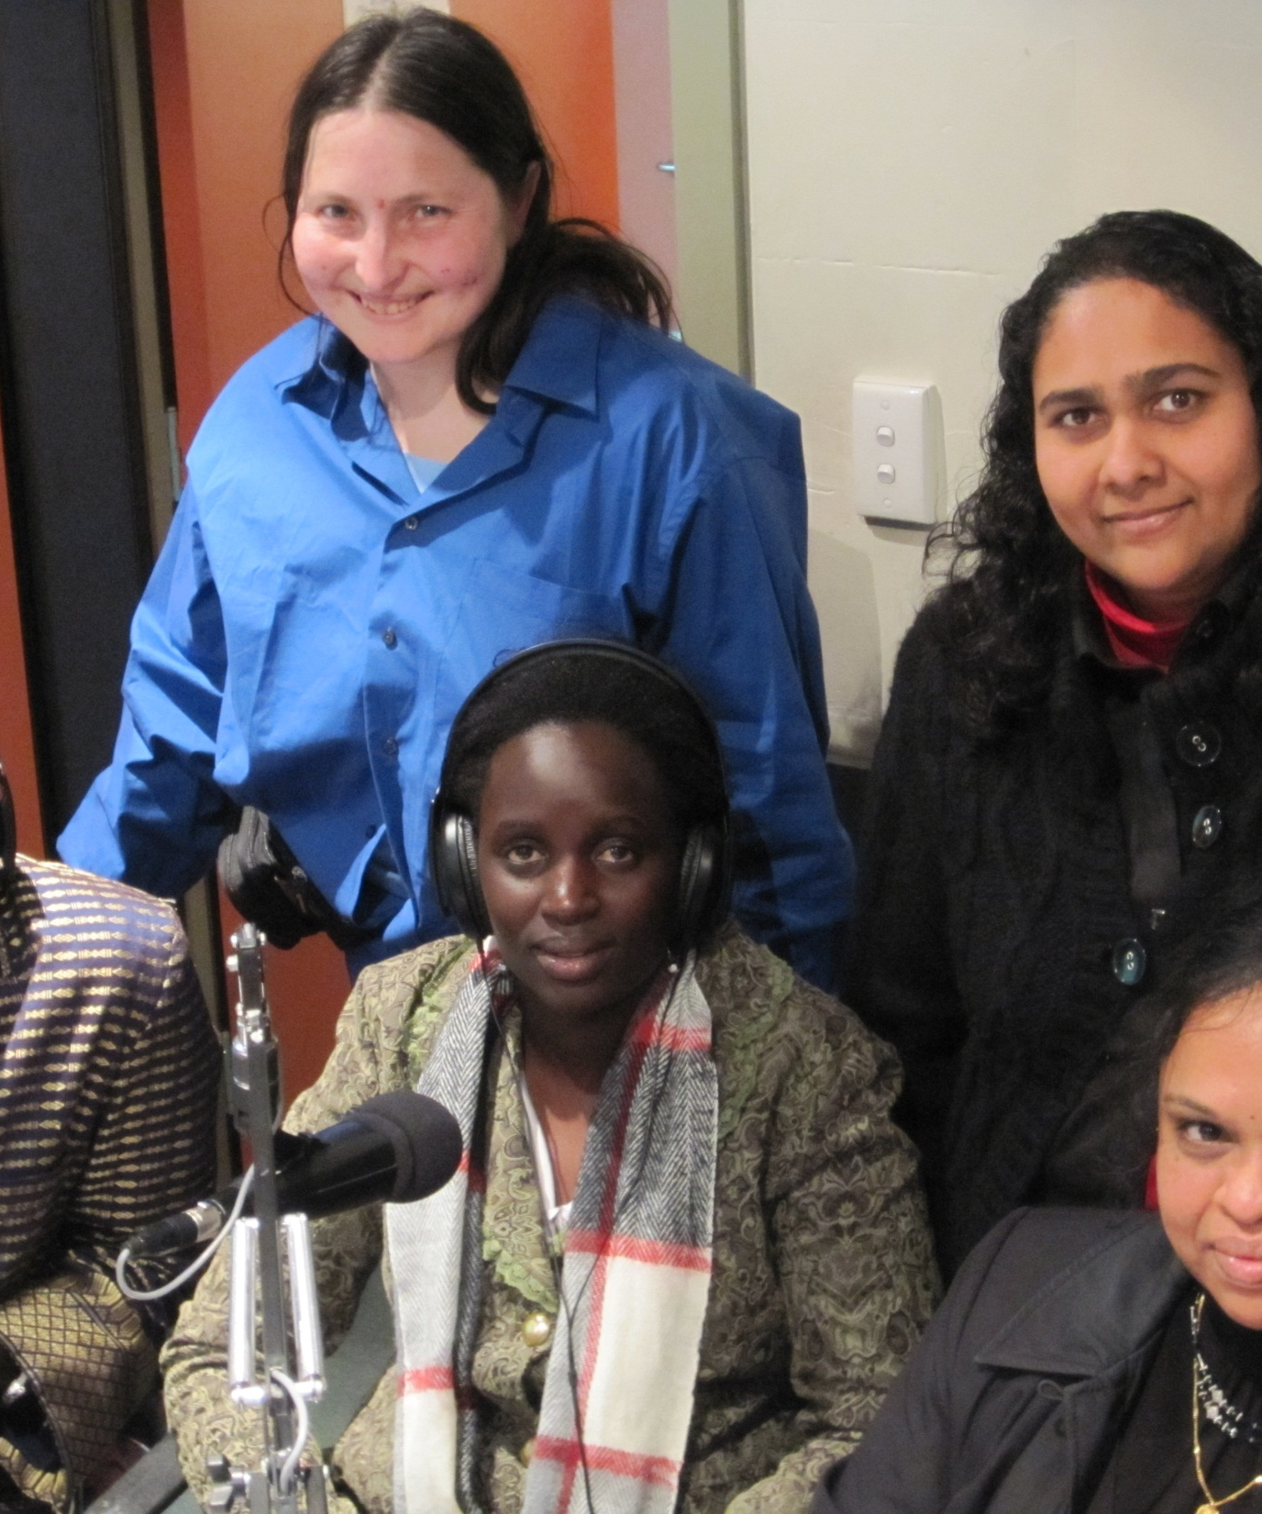
Regular sessions
12 sessions over 6 months
Meet in a variety of community venues to discover local assets
Develop a community project
Notes:
Following the retreat, participants attend workshops twice a month for six months in a variety of community venues. These visits help them to become more familiar with the resources in their local communities. Adult education principles underpin the program delivery and the content of workshops includes: community engagement training, case study presentations, group facilitation by experienced guest ‘leaders’ and participant reflection. A key component of the program is participants designing and implementing projects aimed at enhancing social inclusion in local neighbourhoods. In most instances this required significant networking and linking with community groups and organizations.
A Co-ordinator was appointed to facilitate the program who came with extensive experience in working within communities in a variety of roles. When a second program was started in the Southern Region, an Opening Doors graduate was appointed to assist with facilitating the Inner East program.

Slide 19
Margaret Wheatley
“There is no power for change like a community discovering what it cares about.”
Notes:
The outcomes of the program bear witness to Margaret Wheatley’s quote
“There is no power for change like a community discovering what it cares about”

Slide 20
Opening Doors has led to…
58 graduates strengthening their knowledge, skills and confidence to make a difference in their communities
45 grass roots community projects that are working to increase social inclusion
Over 4000 community members who are engaged with their communities in new and positive ways as a result of these projects
A network of 50 different organisations, businesses and groups collaborating to promote social inclusion through their support of the program.
Notes:
The Program is now in its fourth year, and between 2009 and 2011, The Opening Doors Program in the Inner East has assisted in fostering:
58 graduates who have the knowledge, skills and confidence to make a difference in their community;
45 grass-roots community projects that aim to address social isolation and make communities more inclusive;
Over 4000 community members who are engaged with their communities in new and positive ways as a result of these projects;
A network of over 50 different organisations, businesses and groups collaborating to promote social inclusion through their support of The Opening Doors Program.
Two evaluations of the program have been conducted showing significant benefits to the participants and the community through the projects established.

Slide 21
Mike Green
“The deepest dream of ABCD is that more and more people can come to see truly that ‘there is no one we don’t need’ and that a community without a place for everyone is a community really with a place for no one.”
Notes:
The groups were united through their passion for social inclusion and desire to see their communities move towards their vision of inclusive communities.

Slide 22
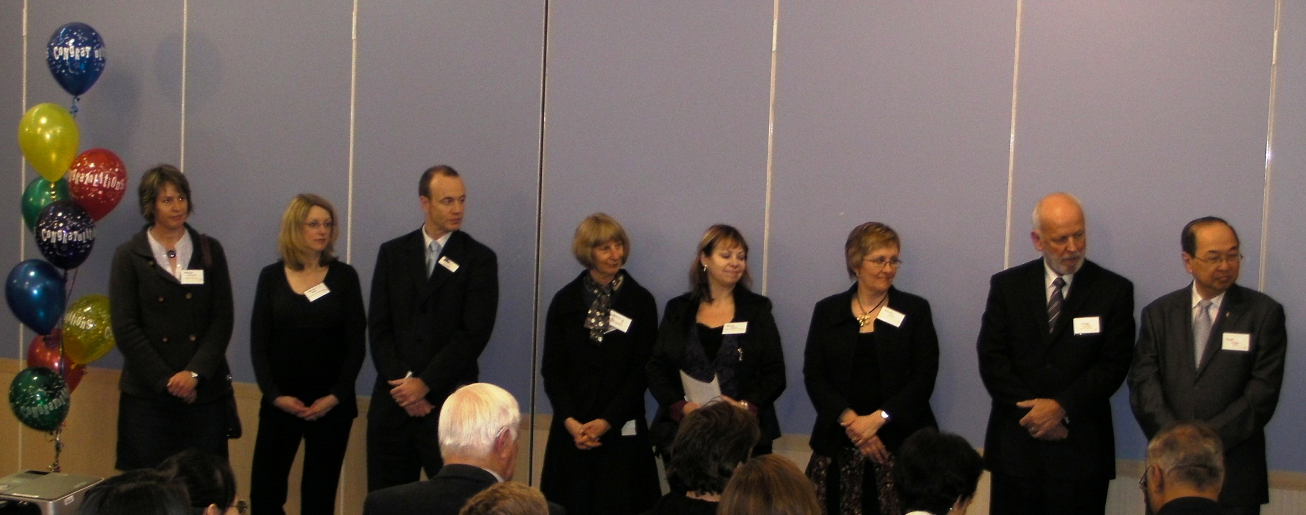
Strength in Partnership
Partners at the Opening Doors Graduation 2009
Notes:
An analysis was also conducted on the partnership itself to determine the factors that led to its success in getting the program off the ground and continuing over three years with uncertain funding from year to year. The strong relationships formed within the group, and the ability to draw on the strengths of each of the partners were identified as key success factors. Partners came from a range of agencies and community groups and government, with people in a variety of roles including community development, health promotion and agency management. Initially agencies were brought together under the auspice of the Inner East Primary Care Partnership, but as the Inner East Social inclusions Initiative (IESII) partnership matured, high levels of co-operation, trust and shared accountability were established and the partnership gained an identity of its own.
Primary Care Partnerships aim to improve their local service system and to support better health and wellbeing outcomes.

Slide 23
Partners involved in Opening Doors
Inner East Primary Care Partnership
MonashLink Community Health Service
Whitehorse Community Health
Manningham Community Health
Uniting Care Community Options
Ashburton Support Services
City of Boroondara
Department of Health, Eastern Region
Women's Health East
Department of Planning and Community Development

Slide 24
Key success factors
Perceived social value of the initiative
Common vision and goals
Diverse contributions
Structures to manage the partnership
Relationships
Roles
Time
Notes:
1. The perceived social value of what the partnership aimed to achieve, and the commitment and passion of those partners who chose to be involved to address the issue of social isolation by building community capacity to promote social inclusion.
2. The common vision and goals that were agreed, and the time invested in planning an approach to achieve those goals, while retaining flexibility to respond to changing circumstances.
3. The diverse contributions brought by the partners and the respect and value placed on everyone’s contribution, including the significant input of time.
4. The structures put in place to manage the partnership including the Steering Committee, working groups and auspice arrangements to manage the resources and staff.
5. The relationships between the partners, and the partnership and Project managers, that were based on trust and mutual respect.
6. The roles played by all of the partners, which were not necessarily fixed but drew on people’s strengths and networks, and a willingness to step forward when something needed to get done. Leadership roles were important but shared amongst partners, and the resourcing roles were also crucial.

Slide 25
Quotes from partners
“Partners were prepared to work together and change direction when they could see that the project would benefit from this”
“Be prepared for the long haul”
“A diversity of views leads to a better outcome”

Slide 26
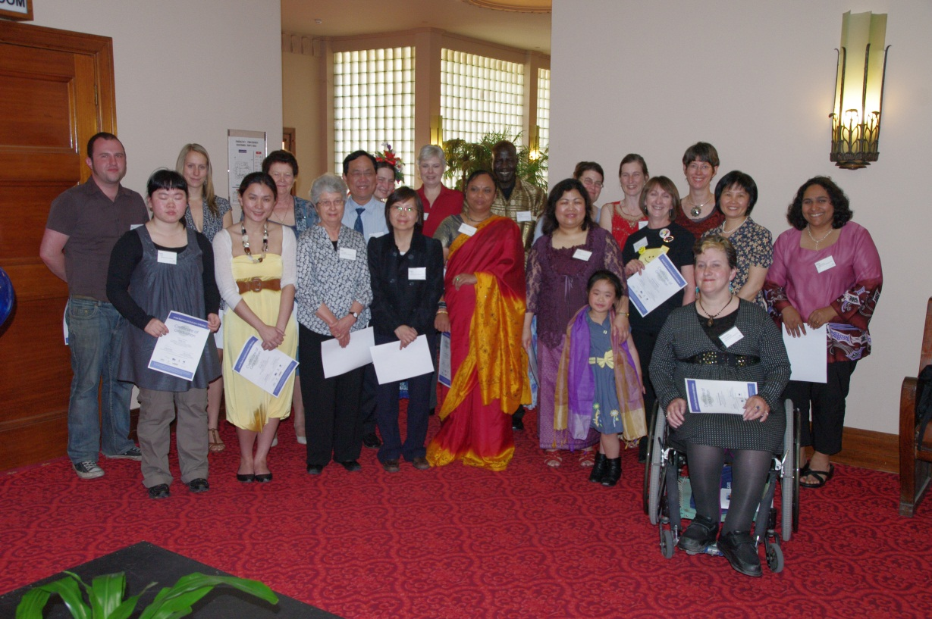
Greatest Achievement
The Graduation “…confidence building of the students who will continue to contribute. They have been skilled up on a long-term basis and empowered to use these skills. Fantastic model!”
Graduation 2010
Notes:
The generative competence was reflected in the pride of the partners when attending the graduations each year.
At the graduation participants also set up a display that describes the projects they are working on.

Slide 27
Community Benefit
Participants
Increased leadership knowledge, skills and confidence to engage with communities.
Community Projects
Actively working to strengthen community connectedness and reduce social isolation in local neighbourhoods.
Notes:
The two evaluations of the program have also quantified a positive impact on individual’s leadership skills and their knowledge of Asset Based Community Development and approached to community building.

Slide 28
Quote from an Opening Doors Participant
“Opening Doors has challenged many of my belief systems. Through its many unique experiences I now see and experience our world and myself differently. Where I saw hopelessness, weakness, deficiencies and indifference I now see beauty, strengths, potential and passion. I step forward now, empowered and hopeful.”

Slide 29
Krishna
“I’m already telling people they should join. It was a fantastic course. There is a time when I didn’t want to tell anyone my age, but I am not ashamed of that any more… You’re never too old to learn and never too old to try something new.”
Notes:
Krishna believes that food is one of the great uniters in our society. “Food is a thing that no one can avoid… It brings people together because it’s the one thing that each and every one of us need.”
For her Opening Doors project, Krishna is developing a community kitchen where Indian
seniors come together, share recipes and cook delicious meals so anyone in the community can attend and enjoy some lunch at a nominal cost. Krishna believes this is a great way to bring people together through a shared passion, and
give back to the community in the process.
When asked how she has found Opening Doors this year, Krishna replies: “I’m already telling people they should join. It was a fantastic course. There is a time when I didn’t want to tell anyone my age, but I am not ashamed of that any more… You’re never too old to learn and never too old to try something new.”

Slide 30
Quotes from participants
“Honestly, it’s made a huge difference in my life…in fact life changing. I think doing this course has opened my eyes to what’s possible and given me renewed faith in others…especially myself. I have more confidence and faith in my abilities and that’s a big shift.” Mike
Opening Doors gave me insight into how I can contribute. It helped me to focus on my strengths and see a different way to attract people to become involved. Bunnary
I learnt a lot from that program, most importantly how to listen. Margaret
I have learnt that a lot can be achieved with a small beginning. If we have a simple idea, a clear vision, along with persistence and determination, anything is possible. Linda

Slide 31

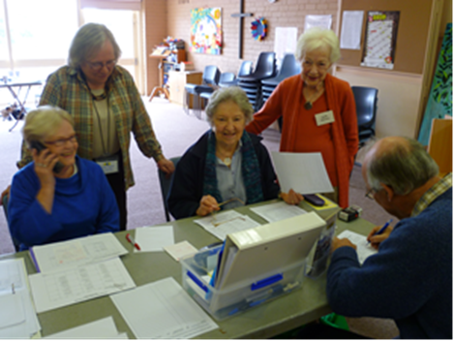
PROJECTS
Notes:
What is life-giving for communities? What helps people to connect?
The projects developed by participants during their participation in the Opening Doors Program have been many and varied. The common theme has been to find what is life-giving for members of the community who may be at risk of social isolation. For some, this may mean meeting people in the same position, but for many it is about sharing a common interest, being able to contribute, finding out about the resources already available in the community, and having the confidence and skills to utilise them. The following are some examples of projects that have been initiated as a result of the program.
The ladies who I mentioned earlier established the Deepdene U3A commenced with their Term 1 program in February 2010. At this time there were 26 paid up members, all friends of the participants, Joan and Sadie. In Term 4 2010, they had 228 paid up members. Their membership is now at 430 – their volunteer hours for last year 5642.
The Cambodian elders expressed a wish to remain fit and by linking with a local community health service and the pool facility established a regular aqua-aerobics class which is now self-sufficient.
Other projects include a soccer club for Sudanese young people and community gardens in areas with social housing, a knitting group linking people in the community with residents in a nursing home with dementia, neighbourhood BBQs on a public housing estate, and a community residents group and community newsletter.

Slide 32

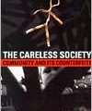
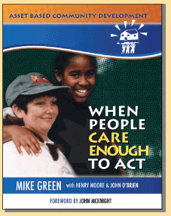

Resources
\

Slide 33
Questions?
Find us on facebook
Email: ronda.held@rondaheld.com.au

Slide 34






Sponsors
of the
Manningham Community Health Service

