Slide 1
Ageing and development Unfinished Business
Sylvia Beales Head of Strategic Alliances HelpAge International sbeales@helpage.org 1st June 2012
IFA 11th Global Conference on Ageing Prague Czech Republic

Slide 2
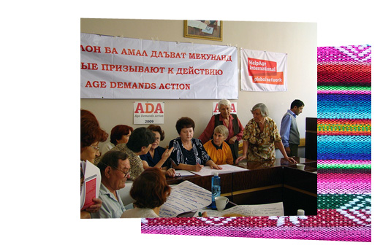
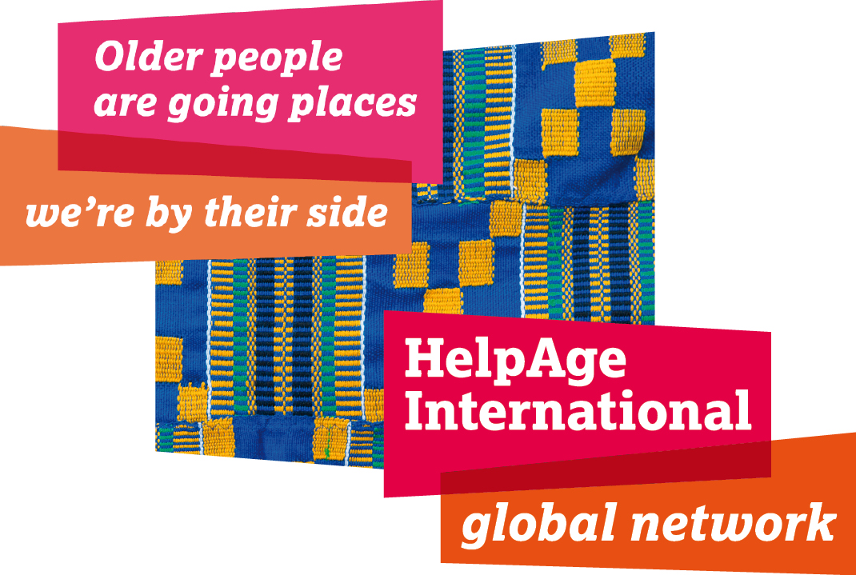

Slide 3
Topic to answer
"What is the (sole) most important action for harmonizing the population ageing and societal development?"
"The ultimate goal of social development is to improve and enhance the quality of life of all people"
(para 7 of the Programme of Action of the World Summit for Social Development 1995)
Older persons must be full participants in the development process and share in its benefits...
Action is to
Reduce the proportion of (older) persons living in extreme poverty by one half by 2015
And
Include older persons in policies and programmes to reach the poverty reduction target
(Para 16 and 48(a) and (b) Madrid International Plan of Action on Ageing 2002)

Slide 4
Global ageing – against the odds?
Older people in 2012 report
– poverty - hunger - indecent work - unmet health needs - persistent exclusion - importance of care and care givers - discrimination - abuse - patchy evidence – lack of data denial – stigma – importance of secure pension, participation and health
“Despite the weight of scientific evidence, the significance of population aging and its global implications have yet to be fully appreciated” U.S. Department of State March 2007
Current paradigm not fit for purpose

Slide 5
The challenges
Ageing seen as stigma - we fear ageing
Old age treated as a time of dependence and vulnerability
Toleration of human rights abuse in old age
Absence of old age specific rights instruments
Persistent policy focus on children, the young and able-bodied obscures need for lifecourse and age-inclusive interventions
Development ignores ageing and older people are on its margins

Slide 6
Challenging stereotypes

Slide 7
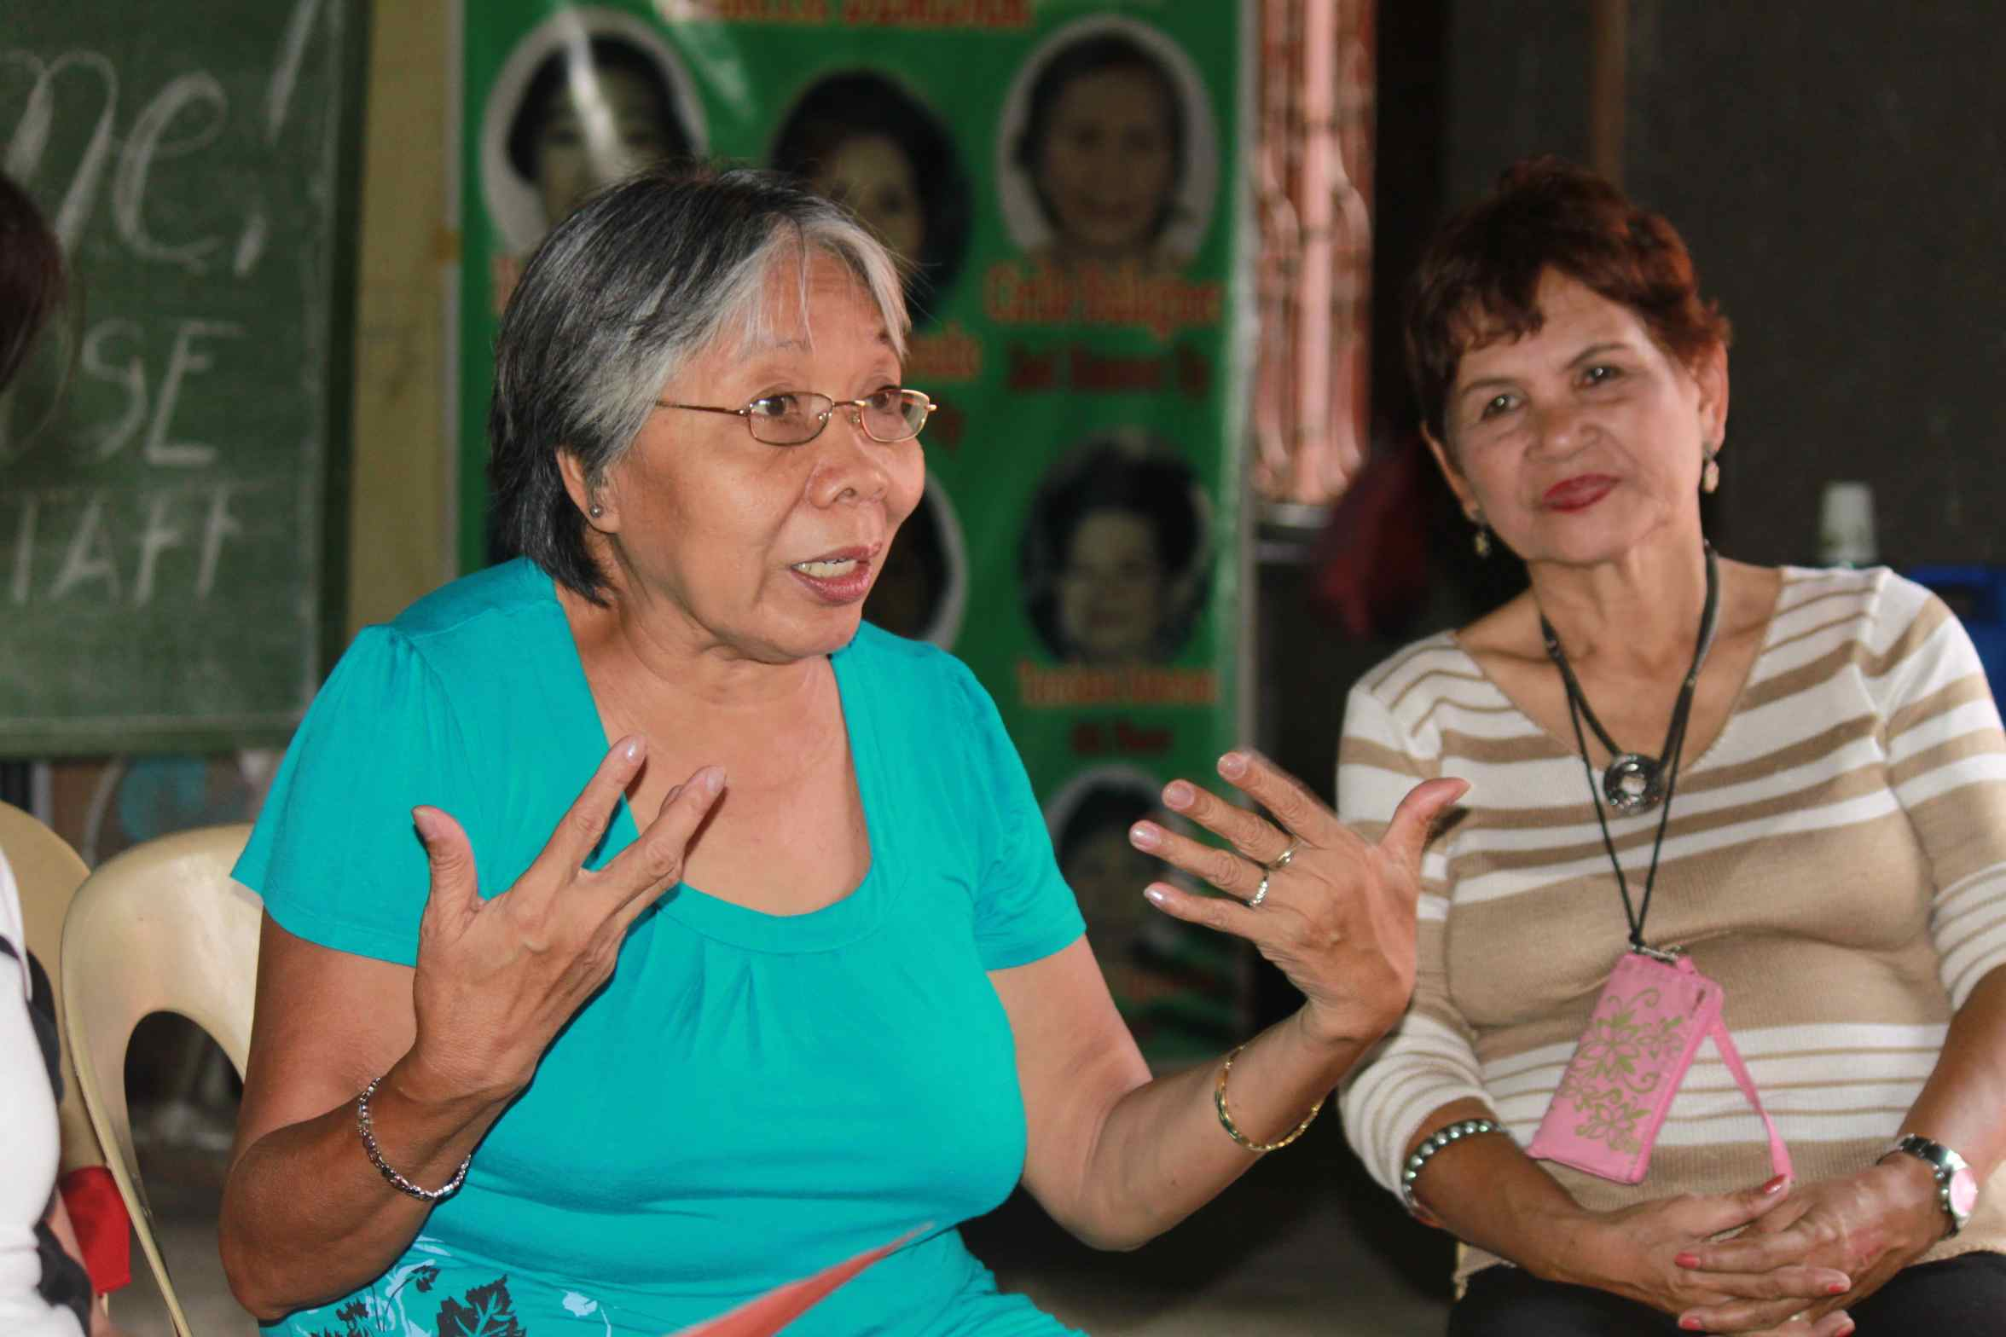
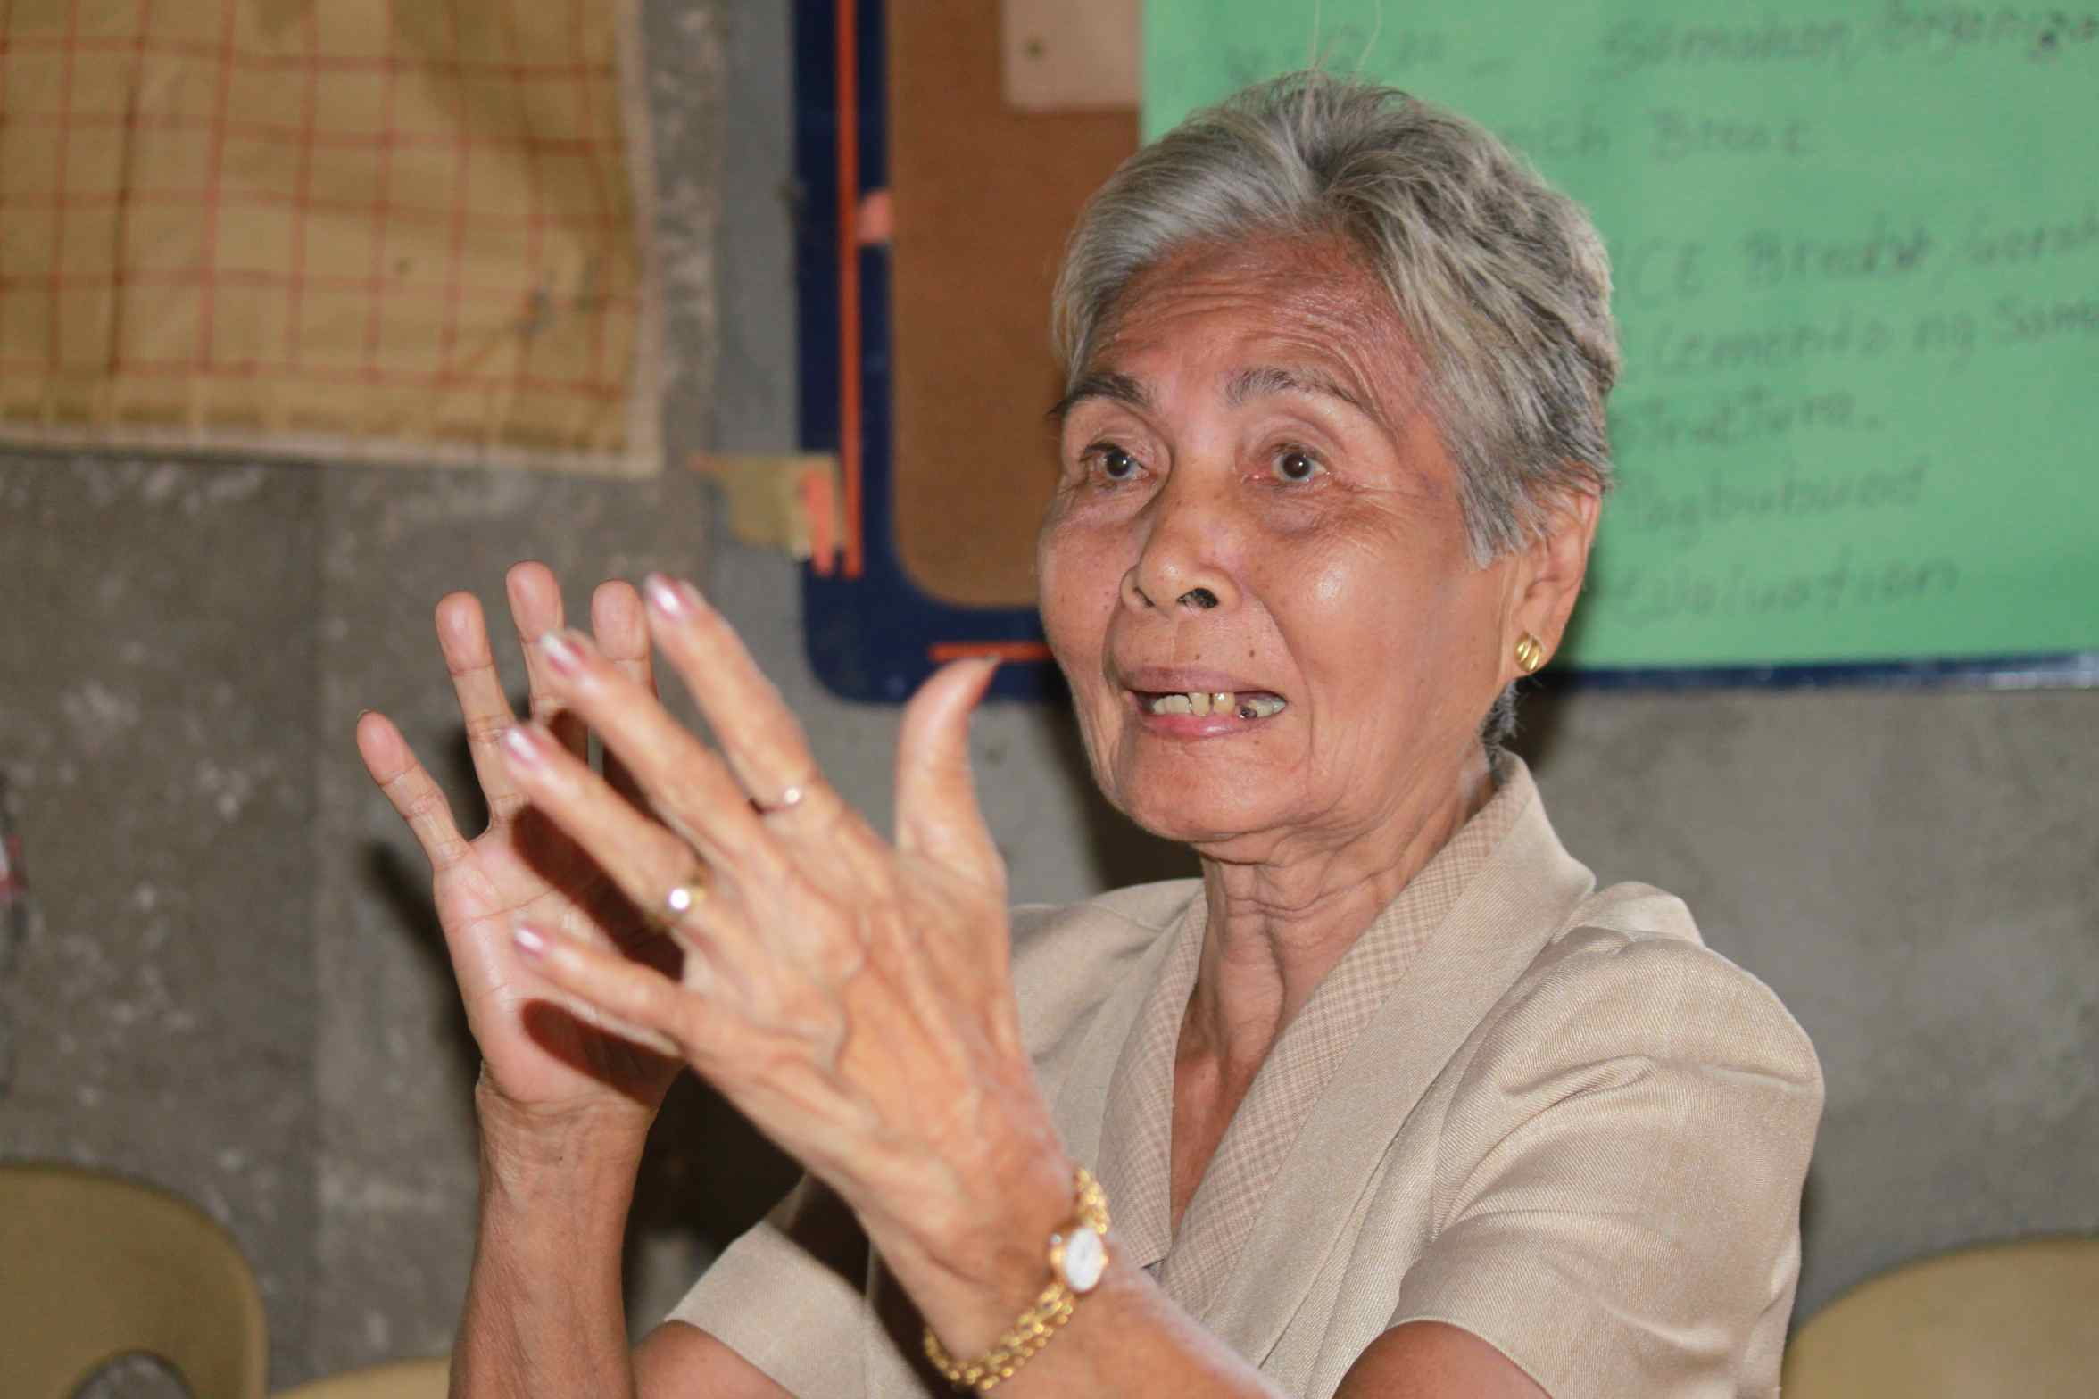
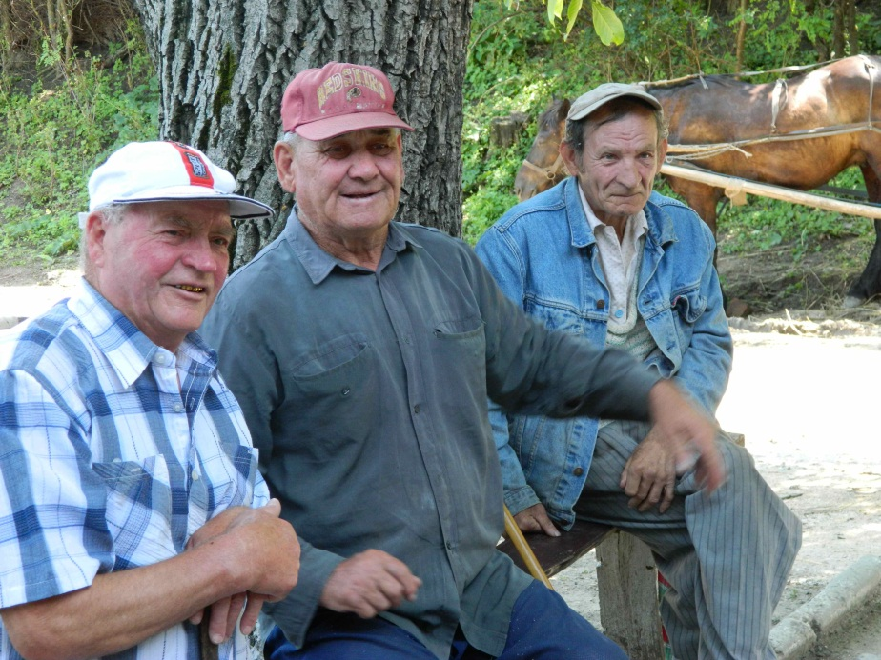
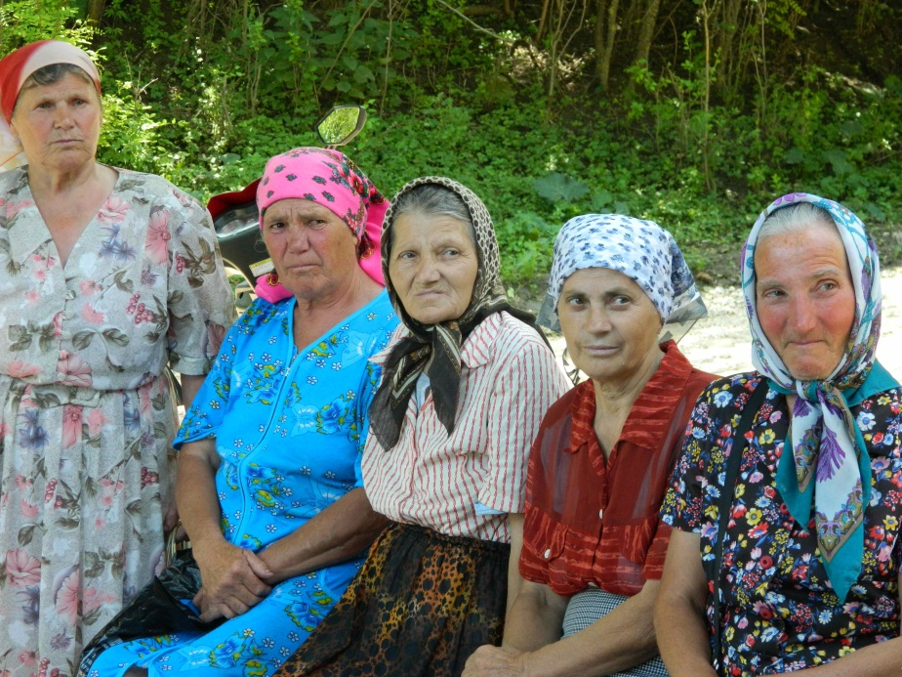
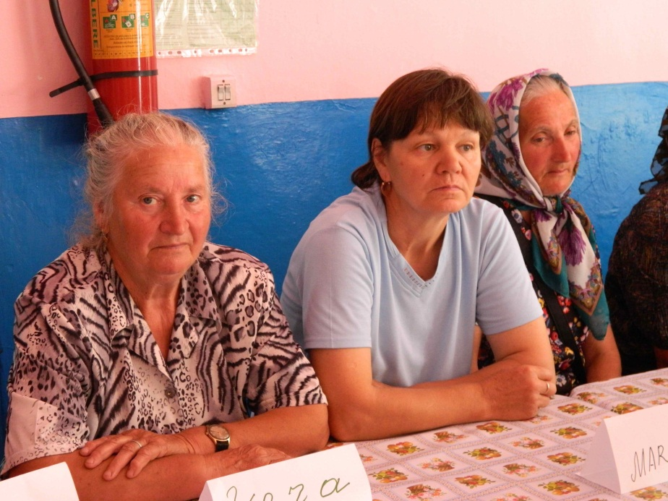
Active, articulate, organised, informed

Slide 8
Reminders of age trends by region

Slide 9
The future that’s here already

Slide 10
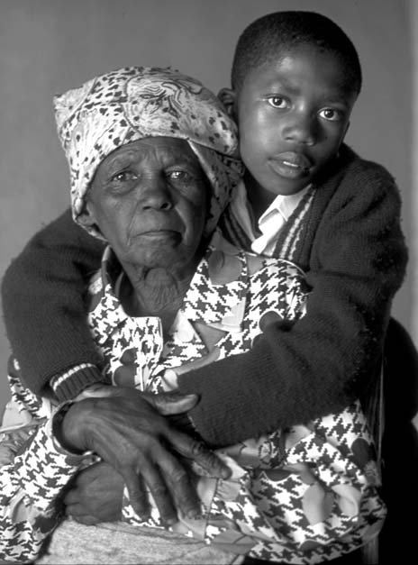
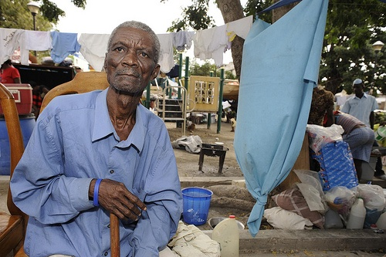
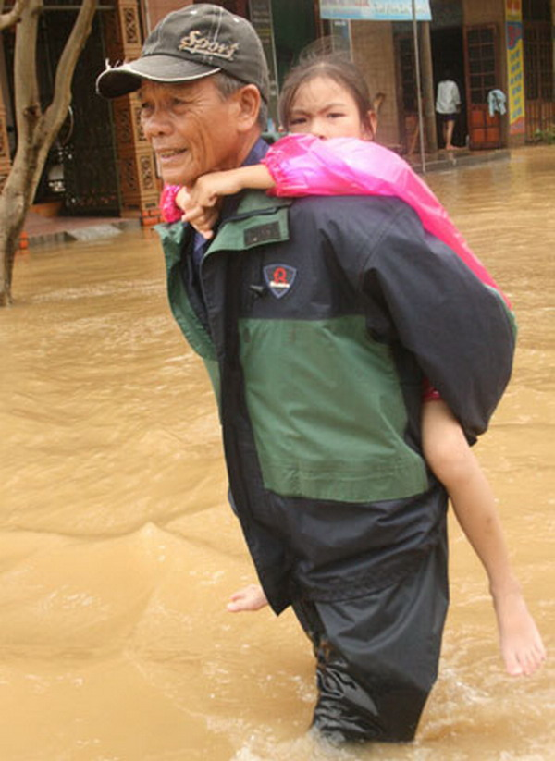
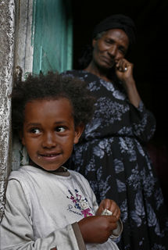
Generational interdependence is the norm

Slide 11
Why ageing is a development priority
Predicted and actual demographic transition
Gender and age - 80+ fastest growing population group globally
Growing inequalities across age groups as well as within and between countries
Generalised insecurity; environment, income, work, health
Skipped-generation households and intergenerational interdependence
50% of men and women continue to work past the age of 60
Three-quarters of the world’s older population live in areas affected by natural disasters and conflict
Two thirds of the of the world’s older people who have chronic illnesses live in low and middle income countries
Across Africa, older people are the main carers of more than 40% of people living with HIV and AIDS
Globally only one fifth of over 60s have regular income
Notes:
Based

Slide 12
Work in older age (Source: HelpAge International)

Slide 13
Greater health spend in old age (Source: WHO/GTZ)

Slide 14
Poverty data compared to other age groups in selected countries (Source: HelpAge International)

Slide 15
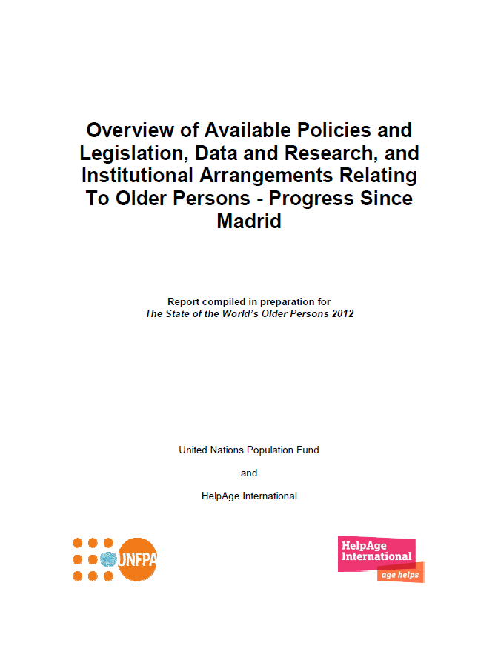
MIPAA plus 10 - opportunities
Goal: assess progress and gaps on MIPAA’s three priority directions
Information was collected from 133 countries and 32 country case studies
Review of status/availability of
Data and research
Policies and legislation
Institutional arrangements
Living document (work in progress)
Available on UNFPA and HelpAge websites
Notes:
As mentioned by the previous speakers this project entailed data gathering from the project over five months by regional consultants and a range of researchers. The global report includes data received from 133 countries, regional overviews and 32 country case studies. The intention was to gather data from all countries but for some no information could be found. It is work in progress and the data bank still needs completion.
Dissemination of global report at 2nd session of OEWG in NY. On our website under “resources”. The information presented in this report is intended to provide the international community with an indepth understanding of the progressive realization of the objectives and recommendations of the Madrid Plan. The challenges in obtaining accurate and easily available information necessary to build this understanding and inform policy making on ageing suggest that data analysis and reporting on ageing is an area for considerable improvement. We hope that this report serves to promote progress in this field, especially relevant to the upcoming ten-year review and appraisal of the Madrid Plan. We invite all stakeholders to come forward with additional information as it becomes available to make this a living document that can be shared by all in our mutual quest to fulfil the goal of the Madrid Plan, that of achieving a “Society for All Ages”.
Build on this review for SOTWOP 2012 (this review will provide the necessary information to analyse the impact of these governmental actions on the QoL and well-being of older people). The impact on OP will be assessed through consultations in form of group discussions with older people.

Slide 16
World of Older People 2012 (working title)
Rationale
“You are talking of a Second World Assembly on Ageing. What happened to the first? We were never consulted, yet you tell us a Plan of Action to address our situation emerged. Who made it?”
Older woman, Zimbabwe (State of the World’s Older People, HelpAge International 2002
Focus groups in 38 countries to assess
Older people’s awareness of MIPAA
Lived experience now; impact of national actions due to MIPAA
Older persons recommendations and priority actions
-

Slide 17
Review Findings
Between 2002 and 2010
48 countries approved and published national policies on ageing
10 countries brought into force overarching legislation on ageing
51 produced research or surveys on ageing,
64 countries set up official bodies and institutions to respond to ageing with at least one ministry responsible for ageing or older people
Big variations across regions – limited or no policy coverage in:
Mainstreaming of ageing into poverty reduction programmes
Emergency programmes
Migration/rural development
HIV/AIDS, NCDs, mental health, disabilities
Violence and human rights
Little evidence on budgets to implement policies

Slide 18
Focus group findings
Lack of knowledge of MIPAA and other policies, rights and entitlements
Government policies not known by service providers
Better water, roads, health clinics, income gives tangible results
Interdependence on family and community; caring, livelihoods (work)
Marked differences between urban and rural in relation to poverty, inclusion, participation, basic service provision
Worries about being costly to families (health, frailty)
Disputes over land and housing – family, official and police abuse
Abuse a source of shame and anguish
Increasing cost of food, medicines, consultations, care and transport
Short sighted policies – free consultations but expensive medicines
Value placed on caring for others – neighbours , grandchildren
Value of being organised – many benefits including sense of worth and political recognition

Slide 19
Priority Actions
Global target for life expectancy of 80 years for all
Universal income security in old age
Access to affordable and appropriate health services and care services across the life course
Legislation on age discrimination
Accountable investments in older people and their associations
Age auditing of development policies and public services
Post 2015 framework to be accountable, rights based and age inclusive to support all people across the lifecourse and across social economic cultural and environmental domains
All poverty data to be disaggregated by age as well as by sex

Slide 20
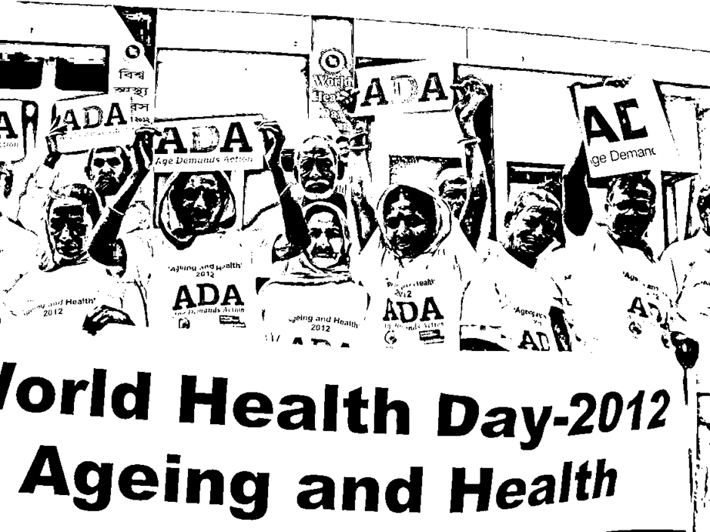
Enhance organisation and voice
on Health

Slide 21
Age group: 18-30 years old
Build awareness what it is like to be older
Show solidarity with older people in developing countries
Join Age Demands Action campaign, become champions, build relationships with MEPs
To find out more: www.makeitageless.org

Slide 22
Agenda for Action
Support and build up contributions of older people
Secure participation, visibility and voice
Deliver income security and affordable and appropriate health care
Ensure decent work and opportunities to extend working life
Focus on quality of life – well being, expansion of capacity, education, accessible and affordable health and other basic services
Support for caregivers and independent living
Innovation – services, policies to support contributions, life course approaches – smart economics
Determined action on age discrimination and abuse

