Slide 1
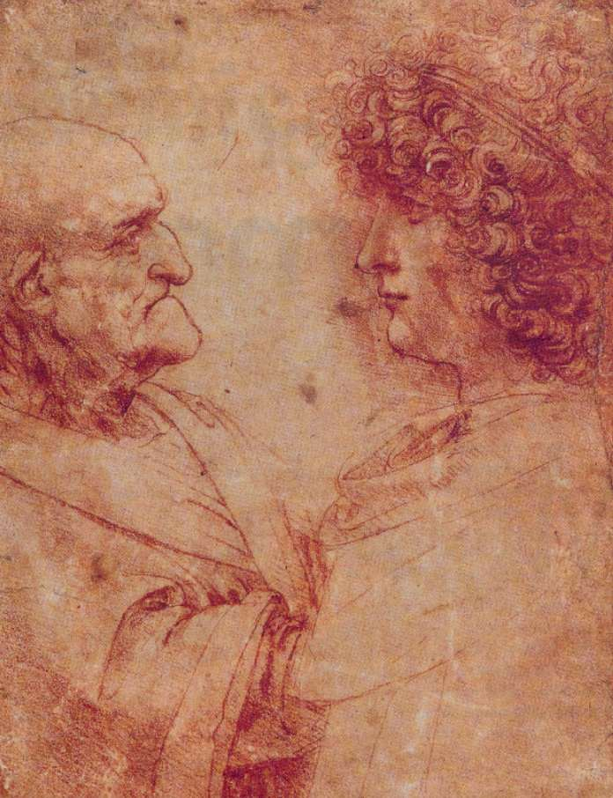
Why I could not Sleep After Prof’ Walkers Presentation or From “Active” Aging to “Activism” in Old Age
Dr. Israel (Issi) Doron
Head of the Department of Gerontology
University of Haifa, Haifa, ISRAEL

Slide 2
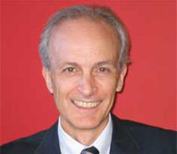
?Every body is talking about a revolution
Thank you: Jan & Jane
What can be said?
My “personal” starting point.
My “practical” starting point: Prof. Alan Walker’s analysis of “active aging”
Why I didn’t get any sleep: SOME THING IS MISSING
In this presentation I would like to try an answer this question.

Slide 3
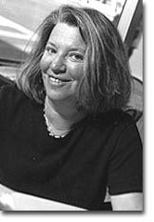
Social Justice and Prof. Nancy Fraser’s Alternative model
The “classical” political discussion around “social justice”: distribution
The “alternative” political discussion around “social justice”: recognition
From Redistribution to Recognition? Dilemmas of Justice in a “Postsocialist” Age. Justice Interruptus. Routledge 1997;
How to be “original”?

Slide 4
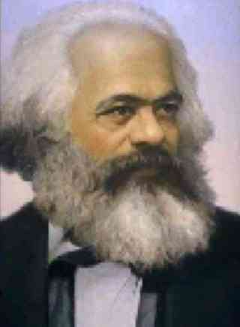
Part 1: The distinction between “different” kinds of injustice
Prof. Fraser distinguishes between two different kinds of social injustices:
The first is the “Socio-Economic” injustice
Examples are:
Exploitation (having the fruits of one’s labour appropriated for the benefit of others).
Marginalisation (being confined to undesirable or poorly paid work or being denied access to income-generating labour altogether),
Deprivation (being denied an adequate material standard of living).

Slide 5
Part 1 – cont.: The Second Kind of Injustice
The second type of injustice is cultural or symbolic.
Here injustice is rooted in social patterns of representation, interpretation, and communication.
Examples include:
Cultural domination (being subjected to patterns of interpretation and communication that are associated with another culture and are alien and/or hostile to one’s own);
Nonrecognition (being rendered invisible by means of the authoritative representational, communicative, and interpretative practices of one’s culture);
Humiliation & Disrespect (being routinely maligned or disparaged in stereotypic public cultural representations and/or in everyday life interactions).

Slide 6
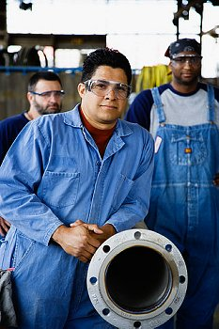
Part 2: The Different Kinds of Social Collectivities
Prof. Fraser now moves from the injustice spectrum to the social collectivities spectrum
On the socio-economic injustice side one can find “Exploited Collectives”
The classic example: The Working Class
The body of persons in a capitalist society who must sell their labour power under arrangements that authorise the capitalist class to appropriate surplus productivity for its private benefit.
.

Slide 7
Part 2 – cont.: Despised Collectives
As opposed to “exploited collectivities” there are Despised Collectivities.
The sources of this status stems not from economic distribution , but rather from cultural misrecognition
Example: Homosexuals. Their mode of collectivity is that of a despised sexuality, rooted in the cultural-valuational structure of society. From this perspective, the injustice they suffer is quintessentially a matter of recognition.

Slide 8
Part 2 – cont.: On Bivalent Collectivities
While some groups are “exploited” and other are “despised” some social groups are subject to both kinds of injustice. They are the “Bivalent Collectivities”.
They are differentiated as collectivities by virtue of both the political-economic structure and the cultural-valuational structure of society.
Examples: Gender
Gender structures the fundamental division between paid “productive” labour and unpaid “reproductive” and domestic labour, assigning women primary responsibility for the latter.
A major feature of gender injustice is androcentrism: the authoritative construction of norms that privilege traits associated with masculinity.

Slide 9
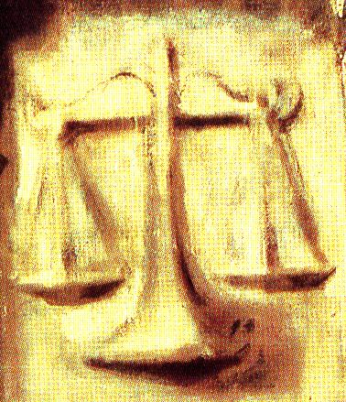
Part 3: The Question of “Remedy”
Prof. Fraser moves now and distinguishes between two broad approaches to remedying injustice that cut across the redistribution-recognition divide.
Affirmation:
Affirmative remedies for injustice mean remedies aimed at correcting inequitable outcomes of social arrangements without disturbing the underlying framework that generates them.
Transformation:
transformative remedies, in contrast, mean remedies aimed at correcting inequitable outcomes precisely by restructuring the underlying generative framework.

Slide 10
The Model: Combining Conceptual Injustices with Conceptual Remedies
Affirmation | Transformation
The liberal welfare state surface reallocations of existing goods to existing groups; supports group differentiation; can generate misrecognition | Socialism deep restructuring of relations of production; blurs group differentiation; can help remedy some forms of misrecognition | Distribution
Mainstream multiculturalism surface reallocations of respect to existing identities of existing groups; supports group differentiations | Deconstruction deep restructuring of relations of recognition; destabilises group differentiation | Recognition

Slide 11
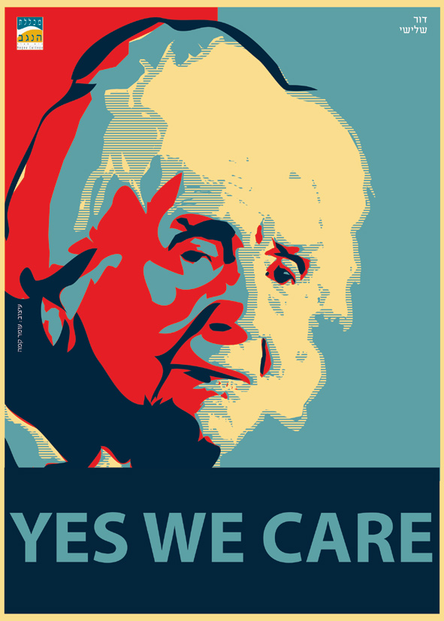
Applying Fraser’s Model on Older Persons
Are older persons subject to socio economic injustice ?
I would like to argue: Yes.
Currently, over half of older people worldwide - 342 million - lack income security and, unless action is taken to improve the situation, it is estimated that, by 2050, more than 1.2 billion older people will be without access to secure incomes (UNDESA, 2007).

Slide 12
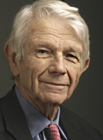
Do older persons suffer from recognition injustice?
Are older persons subject to cultural or symbolic injustice?
Once again, I would argue: Yes.
Ageism can be seen as a process of systematic stereotyping of and discrimination against people because they are old, just as racism and sexism accomplish this for skin color and gender. Old people are categorized as senile, rigid in thought and manner, old-fashioned in morality and skills [...] Ageism allows the younger generations to see older people as different from themselves, thus they subtly cease to identify with their elders as human beings

Slide 13
What is the “type” of “remedy” that is embedded in “active aging”?
It is clear that older persons are a “bivalent group” which needs remedies both on the re-distribution and the recognition fields of justice.
I would argue that conceptually, the “ideal” remedy embedded in “active aging” is what Prof. Fraser would categorize as mainly “Affirmation” + “Recognition” = Mainstreaming anti-ageism through cultural change;
I would argue that within this model, one can understand Prof. Walker’s critique as a fear of “reducing” active aging to the “Affirmation” + “Redistribution” = i.e. minimal welfare state regime.

Slide 14
Back to my original question: What is missing????
I would argue that what is missing is the “Transformation” element;
What is missing is the understanding that “active aging” is “playing by the rules” of the dominant culture: a culture based on “age”.
I would like to argue that it is time for NGOs to be more critical in understanding that may be “active aging” is re-affirming exiting age-group divisions?

Slide 15
If we really care for older persons we need to start thinking in terms of adopting a political-identity discourse that de-constructs the whole notion of “age” and “old age”;
Or in other words, we need not only be “active” we need to be “social activists.”
This is why I did not get any sleep last night: the fear is not only of the “reduction” of active ageing, but the fear of its surrender to dominant and hegemonic social construction of ‘old age”, which will mean the death of the older persons social movement.

Slide 16
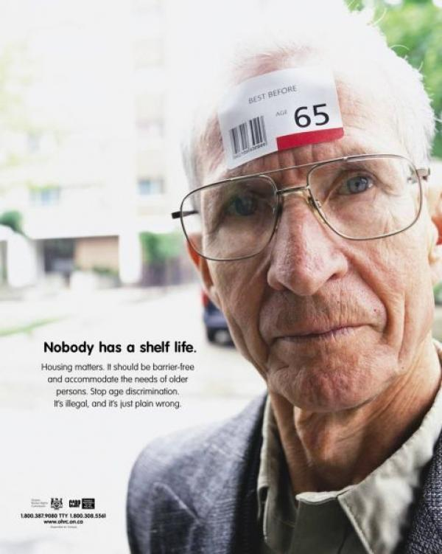
Final Thoughts
I believe that Prof. Nancy Fraser’s model, allows us to better understand the essence of current ‘active aging” discourse.
It also allows us to better understand that true social change does not occur without social struggle for structural change.
Hence, the true meaning of active aging should transform the “affirmative” nature to a transformative “activist” social movement

Slide 18
Example 1

Slide 20
Example 2

