Slide 1
www.pwc.com/ageing
IFA Results SOM
Ageing Connects
Long term care & technology
28 May 2012, Prague

Slide 2
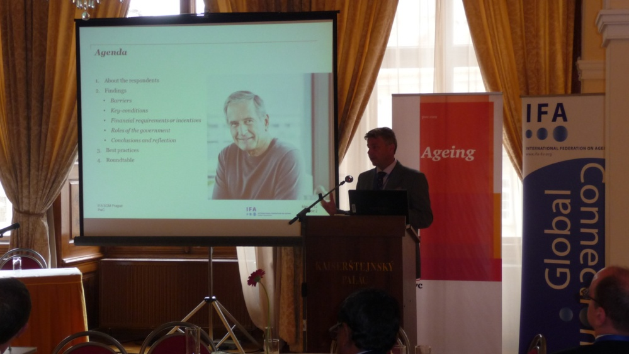
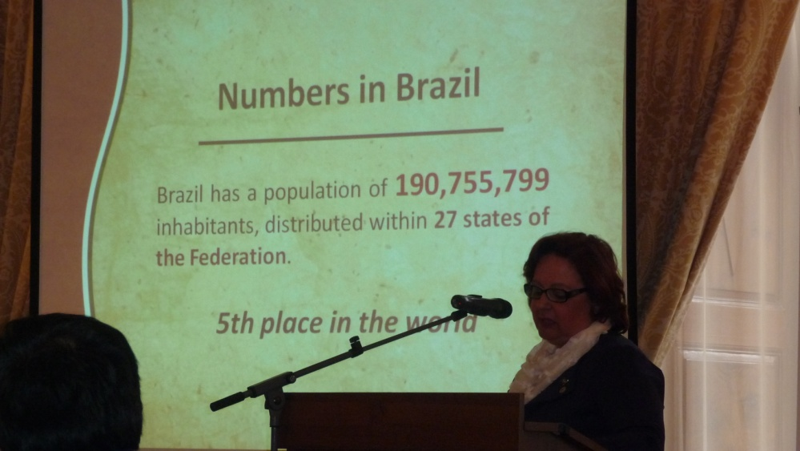
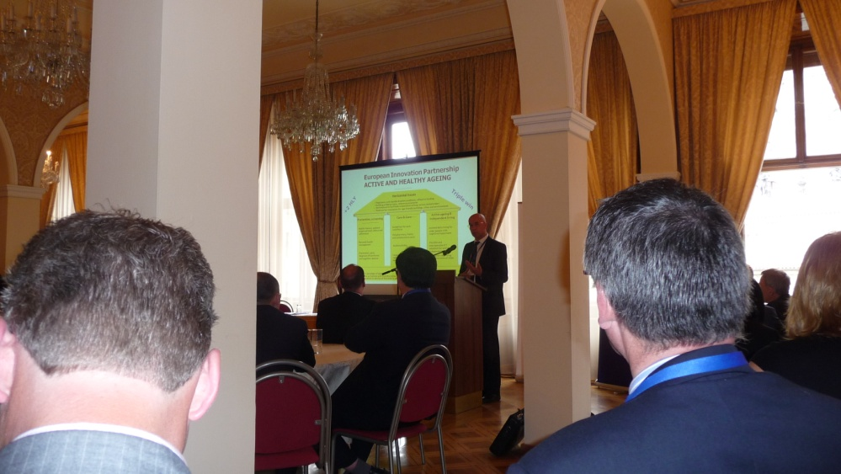
Agenda
Attendants at Senior Officials Meeting
Inspiring presentations
Key-findings from survey
Key-take aways round tables

Slide 3
Attendants at Senior Officials From 30 countries

Slide 4
Inspiring Presentations: Ageing meets Science
Population ageing is a global trend
Human needs of an Ageing population are the same whether you are in a developing country or not
Urbanization leads to differences in ageing between regions
People get old before they get rich
System crisis asks EU for mind-shift
First generation solutions where ICT- pushed, too complex and rejected
Effectivity = Quality * Acceptance
Co-creation with client and partnership between organizations are fundamental
Patient/client always centric
Technology as katalyst
Overcome social isolation
Collaborate globally - Act locally

Slide 5
Inspiring Presentations: Ageing meets Science
Population ageing is a global trend
Human needs of an Ageing population are the same whether you are in a developing country or not
Urbanization leads to differences in ageing between regions
People get old before they get rich
System crisis asks EU for mind-shift
First generation solutions where ICT- pushed, too complex and rejected
Effectivity = Quality * Acceptance
Co-creation with client and partnership between organizations are fundamental
Patient/client always centric
Technology as katalyst
Overcome social isolation
Collaborate globally - Act locally
Key-elements in approach:
Keep technology simple
Tailor the solution
High volume, low cost
Enhance human contact in systems
Build relationships between vendors and suppliers
Opportunities are:
Security & Safety
Diagnoses and treatment
Assistive Technology
From low to high profile jobs
From red tape to hands free for care

Slide 6
Inspiring Presentations: Ageing meets Best-Practices
China:
Goalsetting next 5 yrs: 90% of the elderly (185 mln) will be living at home, 7% in communities and 3 % in institutions
Age-Friendly cities & China’s family support plan: government and family
Virtual Home for older people: living, development and emotions
Expansion: in 5 years roll-out of coordination centers (1-20-whole country)

Slide 7
Inspiring Presentations: Ageing meets Best-Practices
China:
Goalsetting next 5 yrs: 90% of the elderly (185 mln) will be living at home, 7% in communities and 3 % in institutions
Age-Friendly cities & China’s family support plan: government and family
Virtual Home for older people: living, development and emotions
Expansion: in 5 years roll-out of coordination centers (1-20-whole country)
Brasil:
Constitution:“ The Family, the Society and the Government have the duty to assist the elderly, assuring their participation wthin the community, defending their dignity and welfare, as well as guaranteeing them the right to life”
The Maturity college: Provide self esteem, fight the idleness and opens ways to a completely new world and friendships

Slide 8
Inspiring Presentations: Ageing meets Best-Practices
China:
Goalsetting next 5 yrs: 90% of the elderly (185 mln) will be living at home, 7% in communities and 3 % in institutions
Age-Friendly cities & China’s family support plan: government and family
Virtual Home for older people: living, development and emotions
Expansion: in 5 years roll-out of coordination centers (1-20-whole country)
Brasil:
Constitution:“ The Family, the Society and the Government have the duty to assist the elderly, assuring their participation wthin the community, defending their dignity and welfare, as well as guaranteeing them the right to life”
The Maturity college: Provide self esteem, fight the idleness and opens ways to a completely new world and friendships
Netherlands-Brabantzorg:
Dare to let go: Trust in professional autonomy leads to better quality and cost efficiency
Reversed proces of social innovation, involvement of Family in planning and care, bottom up, organisational pull
Netherlands-Brainport:
Triple helix cooperation between government, knowledge institutes, and private companies Incubation programs helps young entrepreneurs to succeed, then let go, but maintain local presence

Slide 9
Key-findings survey: Best-practices plotted
Top-down
Telemedicine (IT)
Interfacing (HK)
Telehealth (Aus)
Elderly watch (Mau)
GPS (Can)
Silver alert (Greece)
Tech for elderly (Swe)
BHP (Taiwan)
PACE (USA)
Television lectures (SA)
Technology driven
Ambient Ass Living (NL)
Organization driven
Brainport (NL)
Maturity college (Brazil)
Diabetes care (Iran)
Brabantzorg (NL)
Aging in Place (Can)
Bottom-up

Slide 10
Key-findings from survey 23 countries filled in questionnaire
Financing is indicated as most crucial for innovation. However, solutions are still sought in classical approaches, such as public-private funds.
Little attention for new financing & businessmodels such as pay per use/case, crowd funding or well-defined business-models with attention for ROI for participants.
→ The risk of this perspective is that innovations fully rely on one time only financial support and are not sustainable in the market if the funding stops.

Slide 11
Key-findings from survey 23 countries filled in questionnaire
Financing is indicated as most crucial for innovation. However, solutions are still sought in classical approaches, such as public-private funds.
Little attention for new financing & businessmodels such as pay per use/case, crowd funding or well-defined business-models with attention for ROI for participants.
→ The risk of this perspective is that innovations fully rely on one time only financial support and are not sustainable in the market if the funding stops.
Respondents indicate that for successful implementation attention should be given to placing users, clients and their needs/satisfaction in a central position. Co-creation between user and supplier and cooperation between suppliers are indicated to be crucial. So in line with scientific studies and practical experiences.

Slide 12
Key-findings from survey 23 countries filled in questionnaire
Financing is indicated as most crucial for innovation. However, solutions are still sought in classical approaches, such as public-private funds.
Little attention for new financing & businessmodels such as pay per use/case, crowd funding or well-defined business-models with attention for ROI for participants.
→ The risk of this perspective is that innovations fully rely on one time only financial support and are not sustainable in the market if the funding stops.
Respondents indicate that for successful implementation attention should be given to placing users, clients and their needs/satisfaction in a central position. Co-creation between user and supplier and cooperation between suppliers are indicated to be crucial. So in line with scientific studies and practical experiences.
Respondents predominantly see a supportive role for the government in terms of financing, regulating and providing ‘good conditions’. However incorporation in law and privacy issues are not found to be as important.

Slide 13
Key take-aways round tables: Barriers to overcome
Impact of Ageing
We still have blind spots on the actual impact of Ageing in society

Slide 14
Key take-aways round tables: Barriers to overcome
Impact of Ageing
We still have blind spots on the actual impact of Ageing in society
Understanding differences
Differentiation developed-non developed countries (e.g. social structures)
Developing countries being left alone (no legislation, nu human rights, being on your own, survival)

Slide 15
Key take-aways round tables: Barriers to overcome
Impact of Ageing
We still have blind spots on the actual impact of Ageing in society
Understanding differences
Differentiation developed-non developed countries (e.g. social structures)
Developing countries being left alone (no legislation, nu human rights, being on your own, survival)
Funding and Government
Lack of funding, shattered pattern of funds within Governmental structures and competing funds
Focus Governments on where to save money and not to increase quality or to be prepared for bigger volumes
Relatively low political will to make changes (responsibilities on different tiers, disperity)
Focus R&D on technology, not developing new business models or control costs
Time to market is very long for governmental organizations. (10-15 years to act)
Poor standards or the technological infrastructure is partially absent

Slide 16
Key take-aways round tables: Barriers to overcome
Impact of Ageing
We still have blind spots on the actual impact of Ageing in society
Understanding differences
Differentiation developed-non developed countries (e.g. social structures)
Developing countries being left alone (no legislation, nu human rights, being on your own, survival)
Funding and Government
Lack of funding, shattered pattern of funds within Governmental structures and competing funds
Focus Governments on where to save money and not to increase quality or to be prepared for bigger volumes
Relatively low political will to make changes (responsibilities on different tiers, disperity)
Focus R&D on technology, not developing new business models or control costs
Time to market is very long for governmental organizations. (10-15 years to act)
Poor standards or the technological infrastructure is partially absent
Private organizations
Competition between stakeholders, pharmacy, consumer companies etc.
Small providers work individually, not together

Slide 17
Key take-aways round tables: Barriers to overcome
Impact of Ageing
We still have blind spots on the actual impact of Ageing in society
Understanding differences
Differentiation developed-non developed countries (e.g. social structures)
Developing countries being left alone (no legislation, nu human rights, being on your own, survival)
Funding and Government
Lack of funding, shattered pattern of funds within Governmental structures and competing funds
Focus Governments on where to save money and not to increase quality or to be prepared for bigger volumes
Relatively low political will to make changes (responsibilities on different tiers, disperity)
Focus R&D on technology, not developing new business models or control costs
Time to market is very long for governmental organizations. (10-15 years to act)
Poor standards or the technological infrastructure is partially absent
Private organizations
Competition between stakeholders, pharmacy, consumer companies etc.
Small providers work individually, not together
Workforce
Employers not much involved or interested yet in effects of ageing on their workforce

Slide 18
Key take-aways round tables: Barriers to overcome
Increasing amount of countries ‘borrowing’ ? workforce from each-other
Workforce discrimination as of 50 yrs
Education HC last only for several years (permanent education)
No adequate knowledge care givers

Slide 19
Key take-aways round tables: Barriers to overcome
Increasing amount of countries ‘borrowing’ ? workforce from each-other
Workforce discrimination as of 50 yrs
Education HC last only for several years (permanent education)
No adequate knowledge care givers
Adding complexity?
Introducing families in dealing with Ageing can make the problem more complex ? (how to manage both sides ?)
Limited capacity seniors to use technology

Slide 20
Key take-aways round tables: Solution-areas
Use standards and proven technology
Standardize for example the Continua Alliance (also for Small and Medium sized companies)
Use of mobile device
Joining up international evidence

Slide 21
Key take-aways round tables: Solution-areas
Use standards and proven technology
Standardize for example the Continua Alliance (also for Small and Medium sized companies)
Use of mobile device
Joining up international evidence
Sustainable finance
Funding: venture capital, low risk area, new financing models, stock market
Privatize companies

Slide 22
Key take-aways round tables: Solution-areas
Use standards and proven technology
Standardize for example the Continua Alliance (also for Small and Medium sized companies)
Use of mobile device
Joining up international evidence
Sustainable finance
Funding: venture capital, low risk area, new financing models, stock market
Privatize companies
New ways of looking at Ageing
Mind-shift from Calender age to Functional- , Social or Mental Age (how to change the current systems). This is also a cultural problem
Involve close family and relatives, friends first to reduce first demand for supply on government and be ready from a Government point of view for more volume (circle-model)

Slide 23
Key take-aways round tables: Solution-areas
Use standards and proven technology
Standardize for example the Continua Alliance (also for Small and Medium sized companies)
Use of mobile device
Joining up international evidence
Sustainable finance
Funding: venture capital, low risk area, new financing models, stock market
Privatize companies
New ways of looking at Ageing
Mind-shift from Calender age to Functional- , Social or Mental Age (how to change the current systems). This is also a cultural problem
Involve close family and relatives, friends first to reduce first demand for supply on government and be ready from a Government point of view for more volume (circle-model)
Professional and client driven innovation
Use ‘Living lab concept’ (600.000 inhabitants as a lab)
Motivate people/create champions and work solutions they can relate to
Use the power of social groups in countries (using social structures)
Training and education

Slide 24
Key take-aways round tables: Solution-areas
Help the developing countries:
Some countries are crying for help !
Developing countries have multiple issues at the same time (economical, cultural etc.)
Basic legislation (Age-friendly policy is first step instead of Age-friendly cities) and usage of existing first generation solutions
Influence political will and create more awareness for the older people (change of governments ?)
Create more relationships between countries and governments of developed and developing countries to exchange experience (lobbying and showing best practices)
Bring people at the table to start awareness, more than government alone because they cannot do it alone

Slide 25
Key take-aways round tables: Results and implementation
Role of Government
If Government does not provide collective goods (necessary, not profitable) like infrastructure, than business will falter/back off.
Reduce the amount of rules by the government –keep it simple ! (shorter time to market)
Businesses are more important than government
Countries are not able to implement changes in systems quick enough (new-elections i.e)
Costs institutional care higher than community care
Involve private sector and start small and grow organic (bottom up), and find a few partners (prevent dependency on too many stakeholders)
Define financial triggers: use the Corporate Social Responsibility or tax reduction for all companies that invest/ act upon social projects

Slide 26
Key take-aways round tables: Results and implementation
Role of Government
If Government does not provide collective goods (necessary, not profitable) like infrastructure, than business will falter/back off.
Reduce the amount of rules by the government –keep it simple ! (shorter time to market)
Businesses are more important than government
Countries are not able to implement changes in systems quick enough (new-elections i.e)
Costs institutional care higher than community care
Involve private sector and start small and grow organic (bottom up), and find a few partners (prevent dependency on too many stakeholders)
Define financial triggers: use the Corporate Social Responsibility or tax reduction for all companies that invest/ act upon social projects
Incubation and diffusion of innovation
Generate ideas and than stay in the region
As technology grows, expectations grow
Young and mid-aged people don’t realise that they need long-term care and are not planning for that (suddenly it is there ?), stimulate saving
Developing countries will skip fases towards a higher level (cells with apps)
Top down roll-out must fit culture

Slide 27
Key take-aways round tables: Results and implementation
New market opportunities
Corporate sector acts upon market need (e.g. young generation has a problem of taking care of their parents)
Create new financial and care products (chances for insurance companies) in an open international market (stimulate competition)
Create, monitor sustainable business cases pilots
Develop new public Private Partnerships (insurance, care providers and government).

Slide 28
www.pwc.com/ageing
IFA Results SOM
Ageing Connects
Long term care & technology
28 May 2012, Prague
Have a good event !

