Slide 1
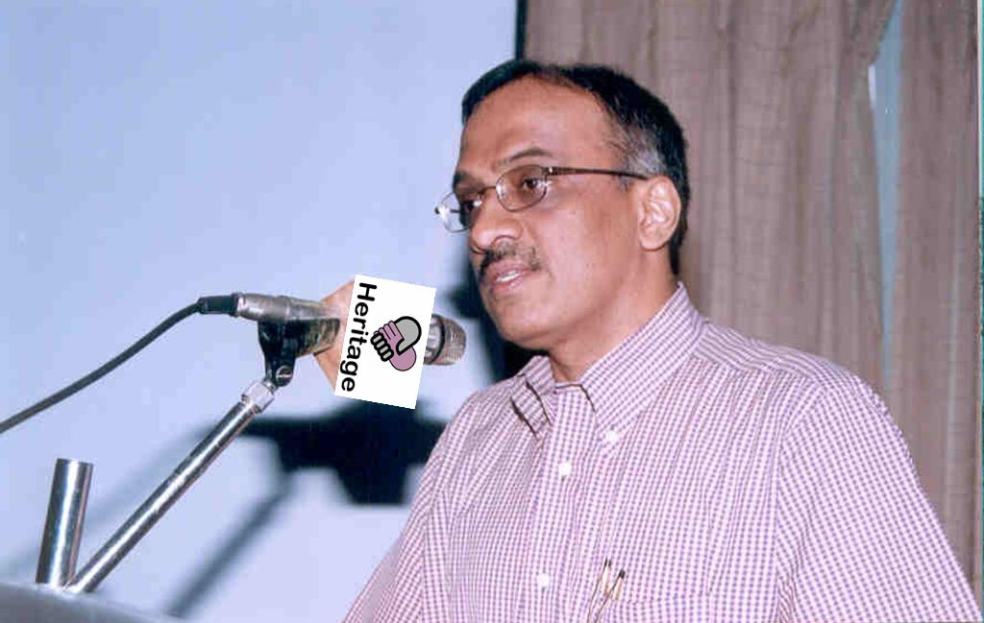
Dr. K.R Gangadharan President

Slide 2
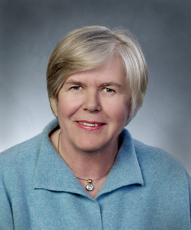
Ms. Irene Hoskins Immediate Past President

Slide 3
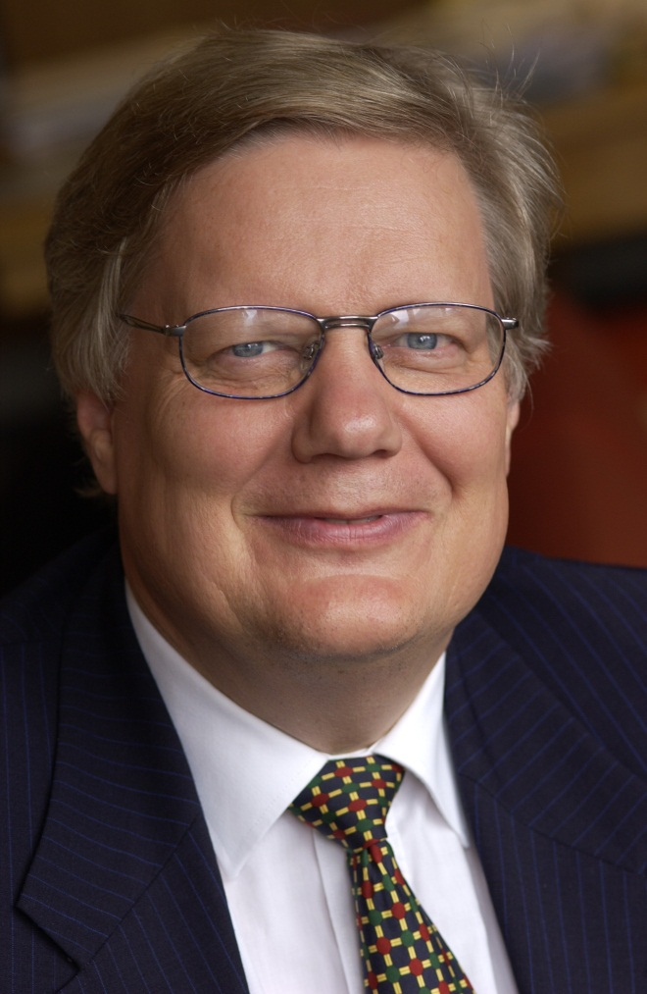
Prof. Bjarne Hastrup International Vice-President

Slide 4
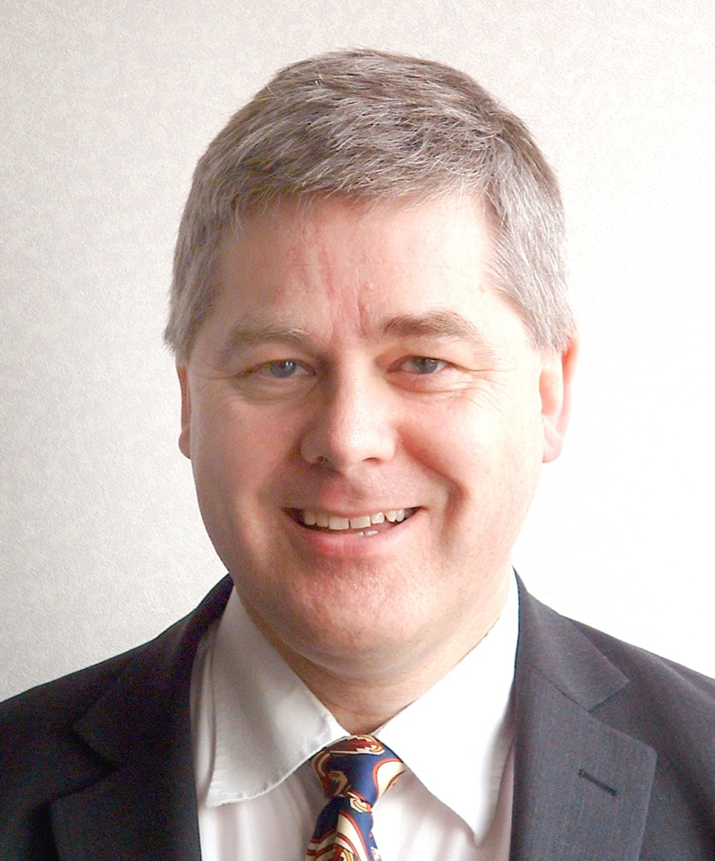
Mr. Alan How Treasurer

Slide 5
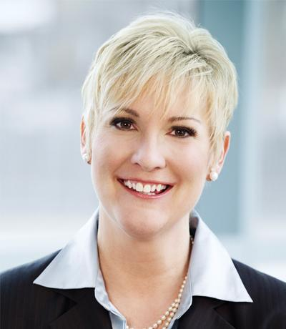
Dr. Amy D’Aprix Regional Vice President (North America)

Slide 6
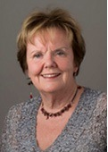
Prof. Elizabeth Mestheneos Regional Vice President (Europe)

Slide 7
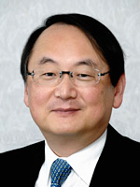
Dr. Hisashi Hozumi Regional Vice President (Asia)

Slide 8
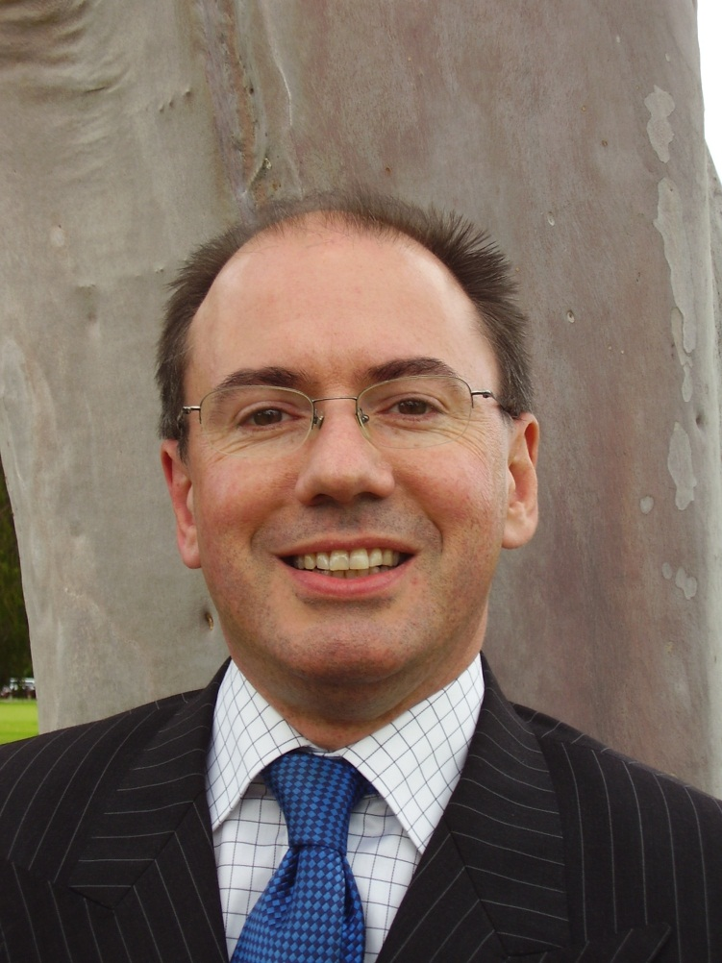
Mr. Robert Reid Regional Vice President (Oceania)

Slide 9
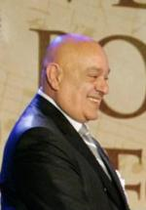
Mr. Mete Bora Director

Slide 10
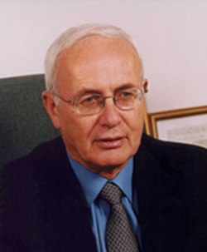
Prof. Yitzhak Brick Past President

Slide 11
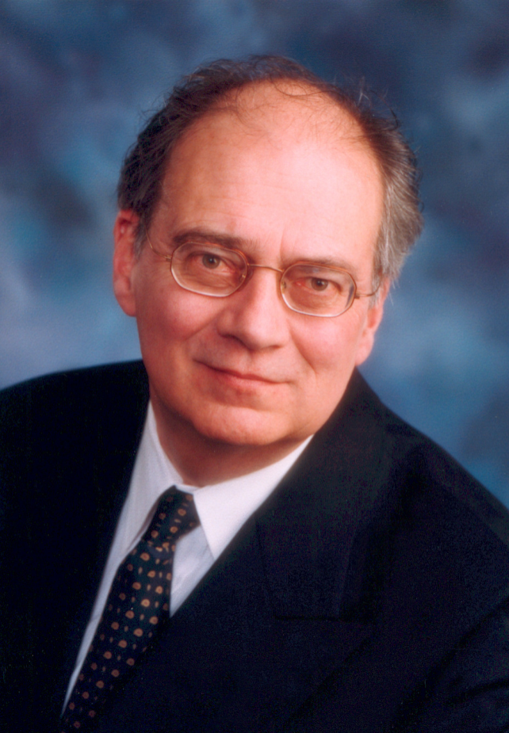
Mr. Robert Chagnon Director

Slide 12
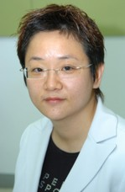
Ms. Grace Chan Director

Slide 13
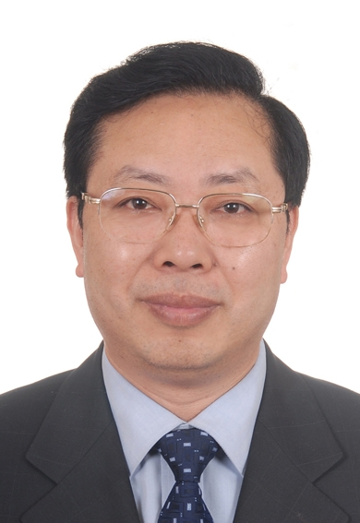
Mr. Chen Chuanshu Director

Slide 14
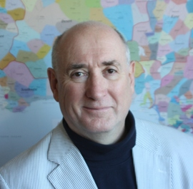
Mr. Denys Correll Honorary Director

Slide 15
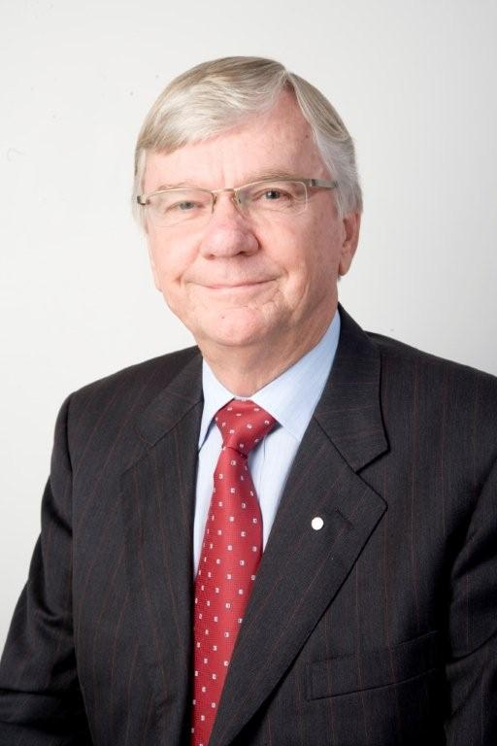
Mr. David Deans Director

Slide 16
Ms. Kaye Fallick Director

Slide 17
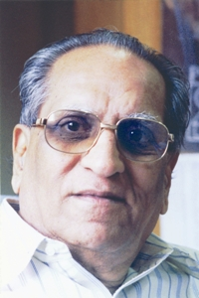
Dr. Sharad Gokhale Honorary Director

Slide 18
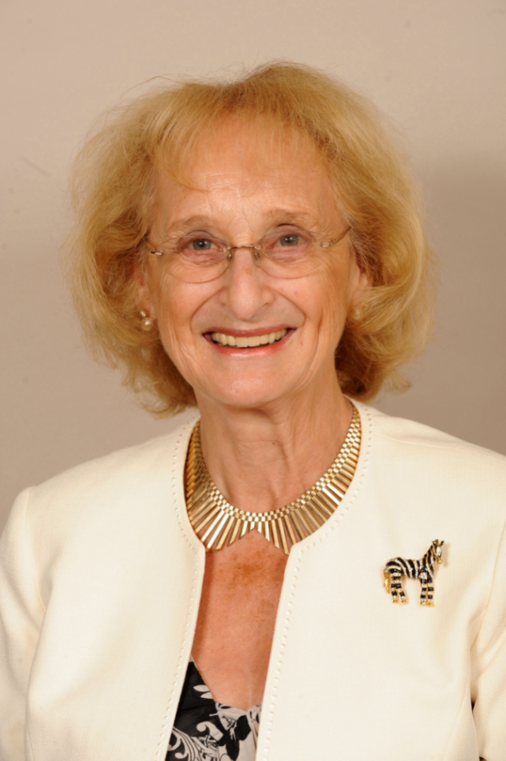
Baroness Sally Greengross Honorary Director

Slide 19
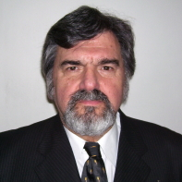
Dr. Ramón M. Gutmann Honorary Director

Slide 20
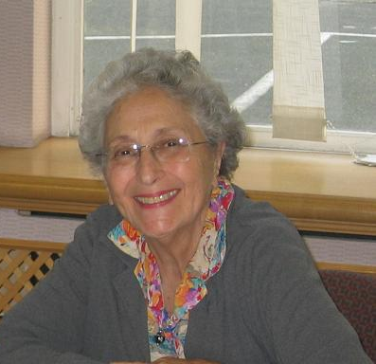
Ms. Helen Hamlin Director

Slide 21
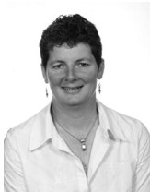
Ms. Sue Hendy Director at large

Slide 22
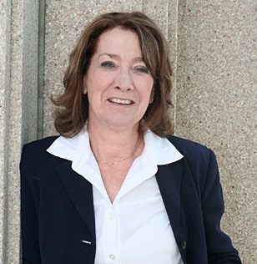
Dr. Sandra Hirst Director

Slide 23
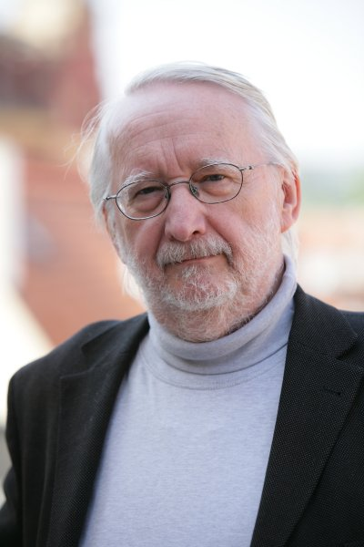
Mr. Jan Lorman Director

Slide 24
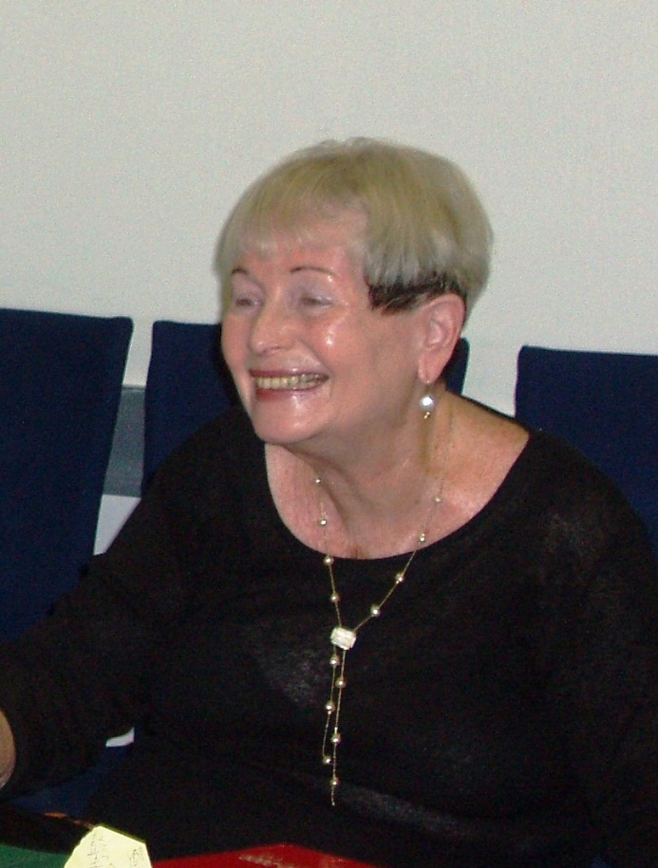
Dr. Ariela Lowenstein Director

Slide 25
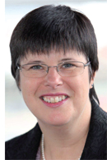
Ms. Ruth Marks Director

Slide 26
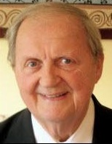
Mr. Clarence E Pearson Director at large

Slide 27
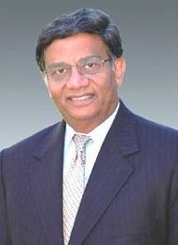
Dr. Vinod Gajanan Shah Director

Slide 28
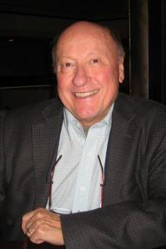
Prof. James T. Sykes Director

Slide 29
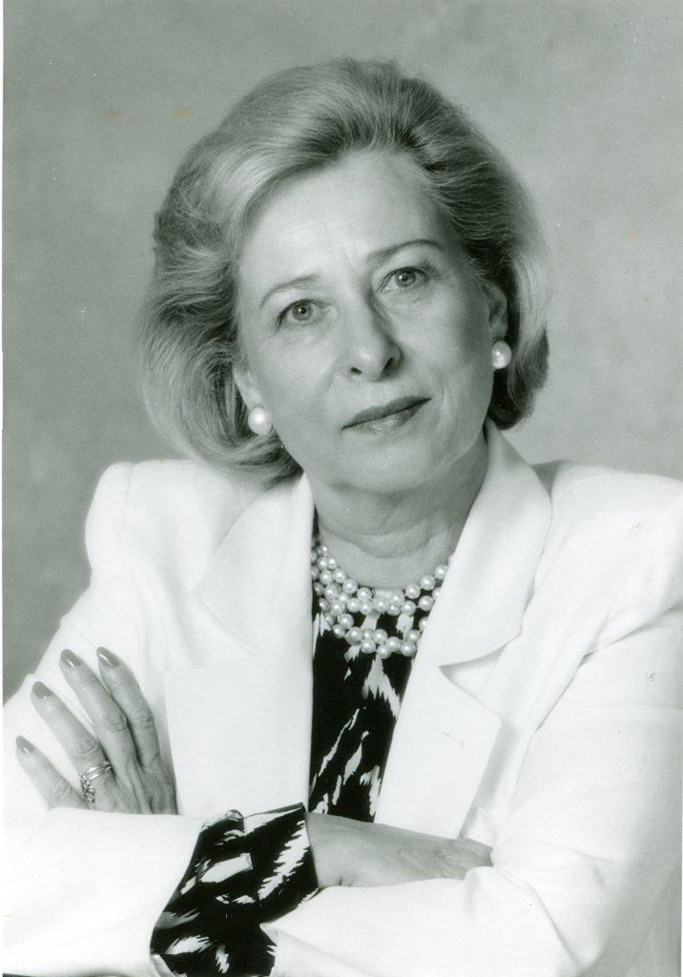
Dr. Blossom Wigdor Honorary Director

