Slide 1
Winter Experiences IFA 11th GLOBAL Conference on Ageing Prague, Czech Republic May 28 – June 1, 2012
Gulnara Minnigaleeva, PhD
CEO, Organization of Retired Persons “Wisdom Ripening”
(“My years are my treasure”)
Research Fellow, National Research University Higher School of Economics

Slide 2
Russian Winter
Canvas by V. Polenov, 1880
Photo by G.Minnigaleeva, 2011

Slide 3
Challenges
Winter challenges
Russia’s challenges
COLD
SNOW
SHORT DAY LIGHT TIME
Size
Roads
Climate

Slide 4
Winter Pedestrian Challenges
Moscow metro entrance
Moscow streets
Photos from the Internet

Slide 5
Winter Pedestrian Challenges
Photos from the Internet

Slide 6
Winter Transport Challenges: On the Snow
Photos from the Internet

Slide 7
Winter Transport Challenges: Under the snow
Photos from the Internet

Slide 8
Winter Transport Challenges
Photos from the Internet

Slide 9
“We sell snow. Self pick up”
Photos from the Internet

Slide 10
Winter Public Transport Challenges
Photos from the Internet

Slide 11
Winter Commuter Challenges
Photos from the Internet

Slide 12
Bad for people, dogs, tires and shoes
chemicals
Photos from the Internet

Slide 13
Beautiful and dangerous
Photos from the Internet

Slide 14
Heating in rural communities
Photos from the Internet

Slide 15
More winter challenges in rural communities
Photos from the Internet

Slide 16
When electricity lines fail…
Photos from the Internet

Slide 17
Cold
Photos from the Internet

Slide 18
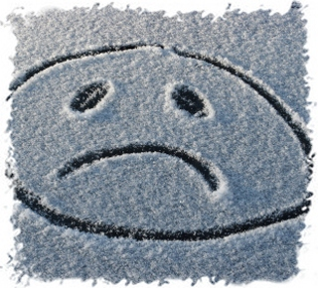
Daylight is Short
Photos from the Internet

Slide 19
Winter fun
Photos from the Internet

Slide 20
Winter fun
Photos by members of “Wisdom Ripening”

Slide 21
Winter fun
Photos by members of “Wisdom Ripening”

Slide 22
Winter fun
Photos by members of “Wisdom Ripening”

Slide 23
Winter’s fun!!!
“The Twelfth Day”
Photos from the Internet

Slide 24
Gulnara Minnigaleeva
Email: gminnigaleeva@gmail.com
Tel.: +79166296264

