Slide 1
Technology-mediated services for older in outlying villages
Arja Kilpeläinen, Prague 2012

Slide 2
Main lines of this presentation
As a context Northern Finland
Viewpoint of social work
Couple of examples
Social work, information technology and education

Slide 3
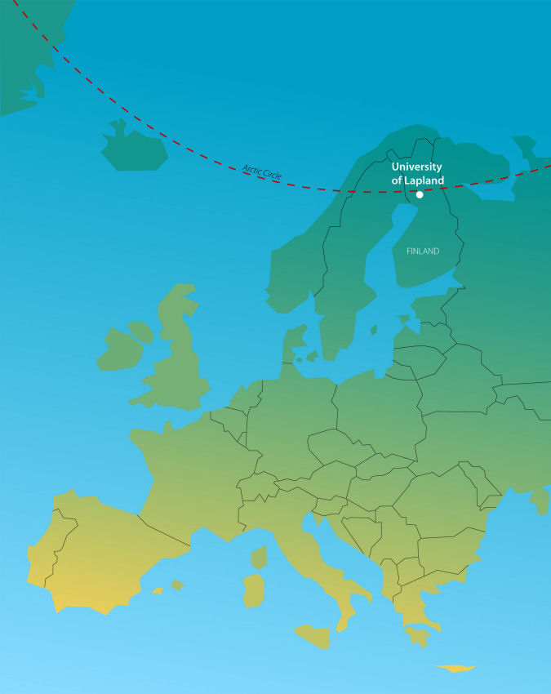
I’m coming from..

Slide 4
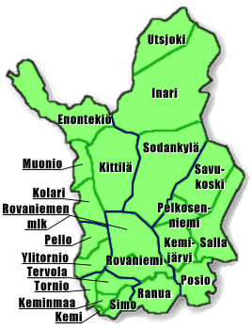
Where do people live in Lapland?
Population:
183 488 (2010)
Density 2,0 inhabitants / km²
about 40% of people
about 60% of people
Notes:
In four cities live 110 000 inhabitants
In Lapland there are 175 000 reindeers

Slide 5
Technology-mediated services
advantages
same services to everybody
the best know-how to every area
but
the knowlegde of local circumstances
facelessness → responsibility?
demands
decent infrastructure
user-friendly interface
education (workers and clients)
new way to work / act (digi-native generation versus earlier)
courage to think and try something new
Notes:
education for the professionals but also for the citizens
digi-native generation force also older generations to plan, produce and apply technology-mediatated services

Slide 6
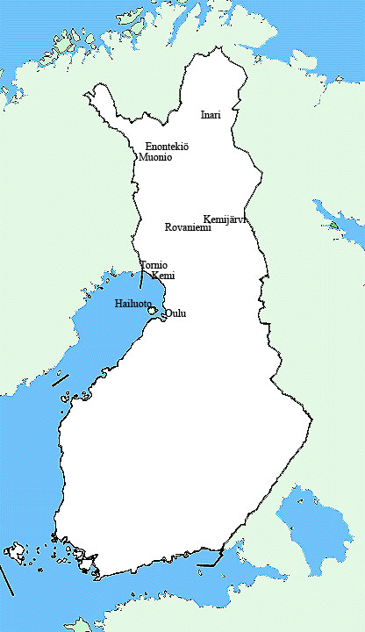
Online counseling
started in Kemijärvi 2006; expanded to Rovaniemi and Tornio 2007, at this moment also in Enontekiö, Inari, Kemi, Muonio, Hailuoto, Haukipudas, Kempele, Kiiminki, Liminka, Lumijoki, Muhos, Oulu, Oulunsalo, Tyrnävä
citizens have possibilities to ask
authorities answer in secure environment
Notes:
So, if you have map of Finland here, you would see that advice via net -services has started from Lapland and is expanding to the south.

Slide 7
Calculator for social assistance
citizens are able to calculate do they get sosial assistance
approximately, not final desicion
quite popular and widely used
many municipalities have this calculator in web-pages
is this technology-mediated service?

Slide 8
Information technology and social work
at the national level the utilisation of ICT in the production of social services is still relatively low
mostly forms to print or to fill out online
some portals to get information (both professionals and citizens)
virtual self-help groups
professional helping via internet
Notes:
Finland has been said to be the leading country in using information technology, mostly thanks to Nokia.
Because of these facts the department of Social work in the university of Lapland has started the second master program focused on IT and social work.

Slide 9
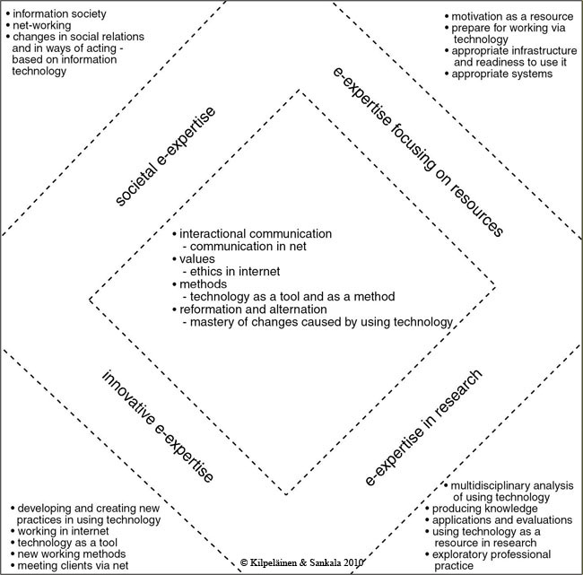
Areas
of e-expertise
in social work

Slide 10
Master’s Degree Program of e-Competence in Social Work
25 students (studying in addition to the work)
Operating time 1.5.2011-31.12.2013
Students get dual competence:
1) qualification of social worker
2) how to use applied IT in social work
Notes:
Funded by
European Social Fund
Municipalities: Hailuoto, Haukipudas, Kempele, Kiiminki, Liminka, Lumijoki, Muhos, Oulu, Oulunsalo, Tyrnävä
Oulunkaari, including Ii, Pudasjärvi, Simo, Utajärvi, Vaala
Friends of the Young
Operating time 1.5.2011-31.12.2013
Organized by University of Lapland, Faculty of Social Sciences, Social Work
Situated in Oulu
25 students
Combines the disciplines of social work and applied information technology
The aim of the program is to
Understand and develope different ways to do social work
Utilize IT in social work practice
Students get dual competence: both in social work and how to use applied IT in social work

Slide 11
Thank you! Kiitos!
Arja Kilpeläinen
arja.kilpelainen@ulapland.fi

