Slide 1
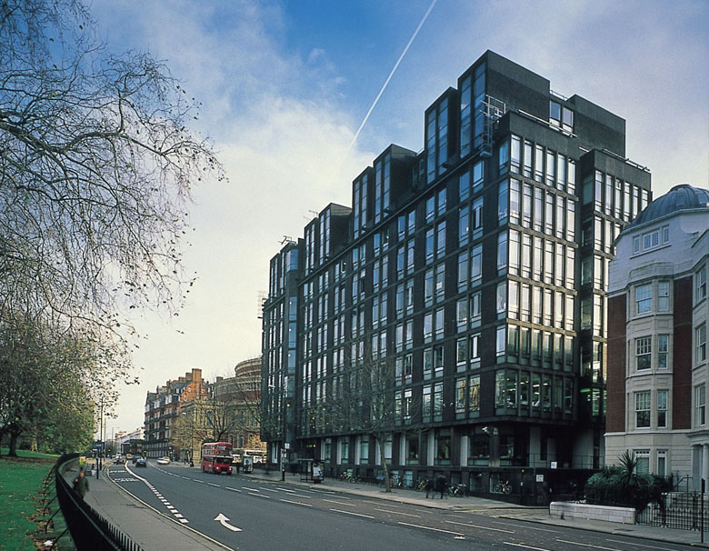

Living environments
Housing and products for all
Rama Gheerawo
Deputy Director,
Helen Hamlyn Centre for Design
Royal College of Art
Notes:
Based in London, the Royal College of Art is the world’s only entirely postgraduate community of innovators in art and design

Slide 2

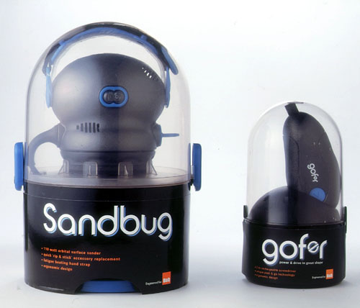
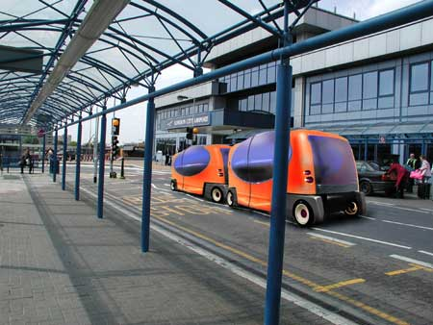
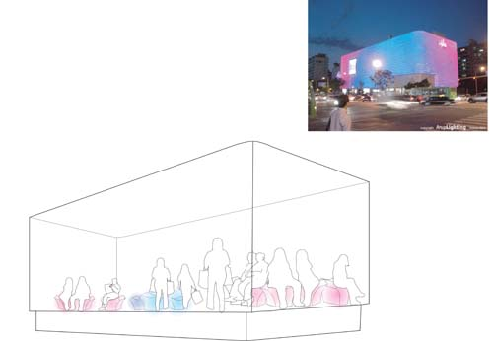
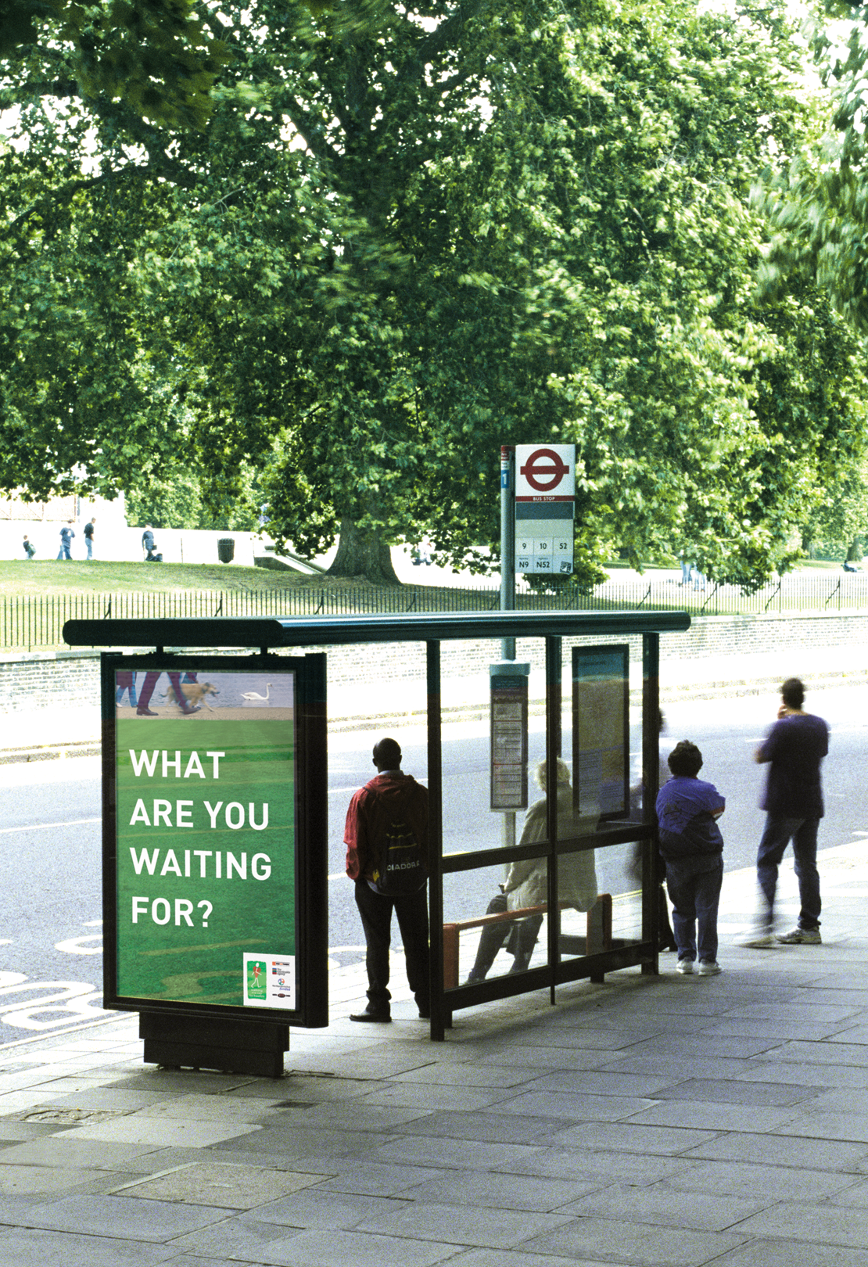







Notes:
The Centre has a number of programmes, working with academics, students and professional designers, but today I will talk about our work with business, an important part of Universal Design

Slide 3
IMPROVING LIFE

Slide 4
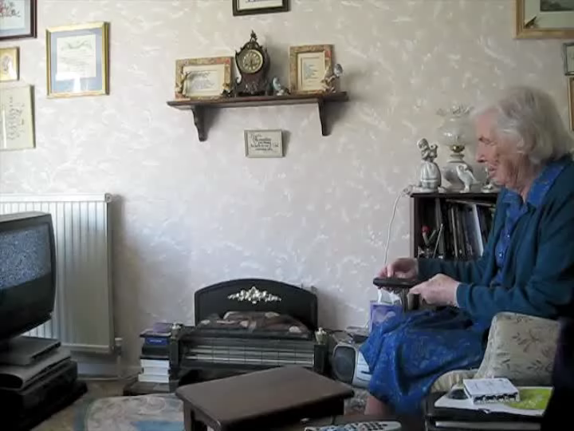

Slide 5


Slide 6
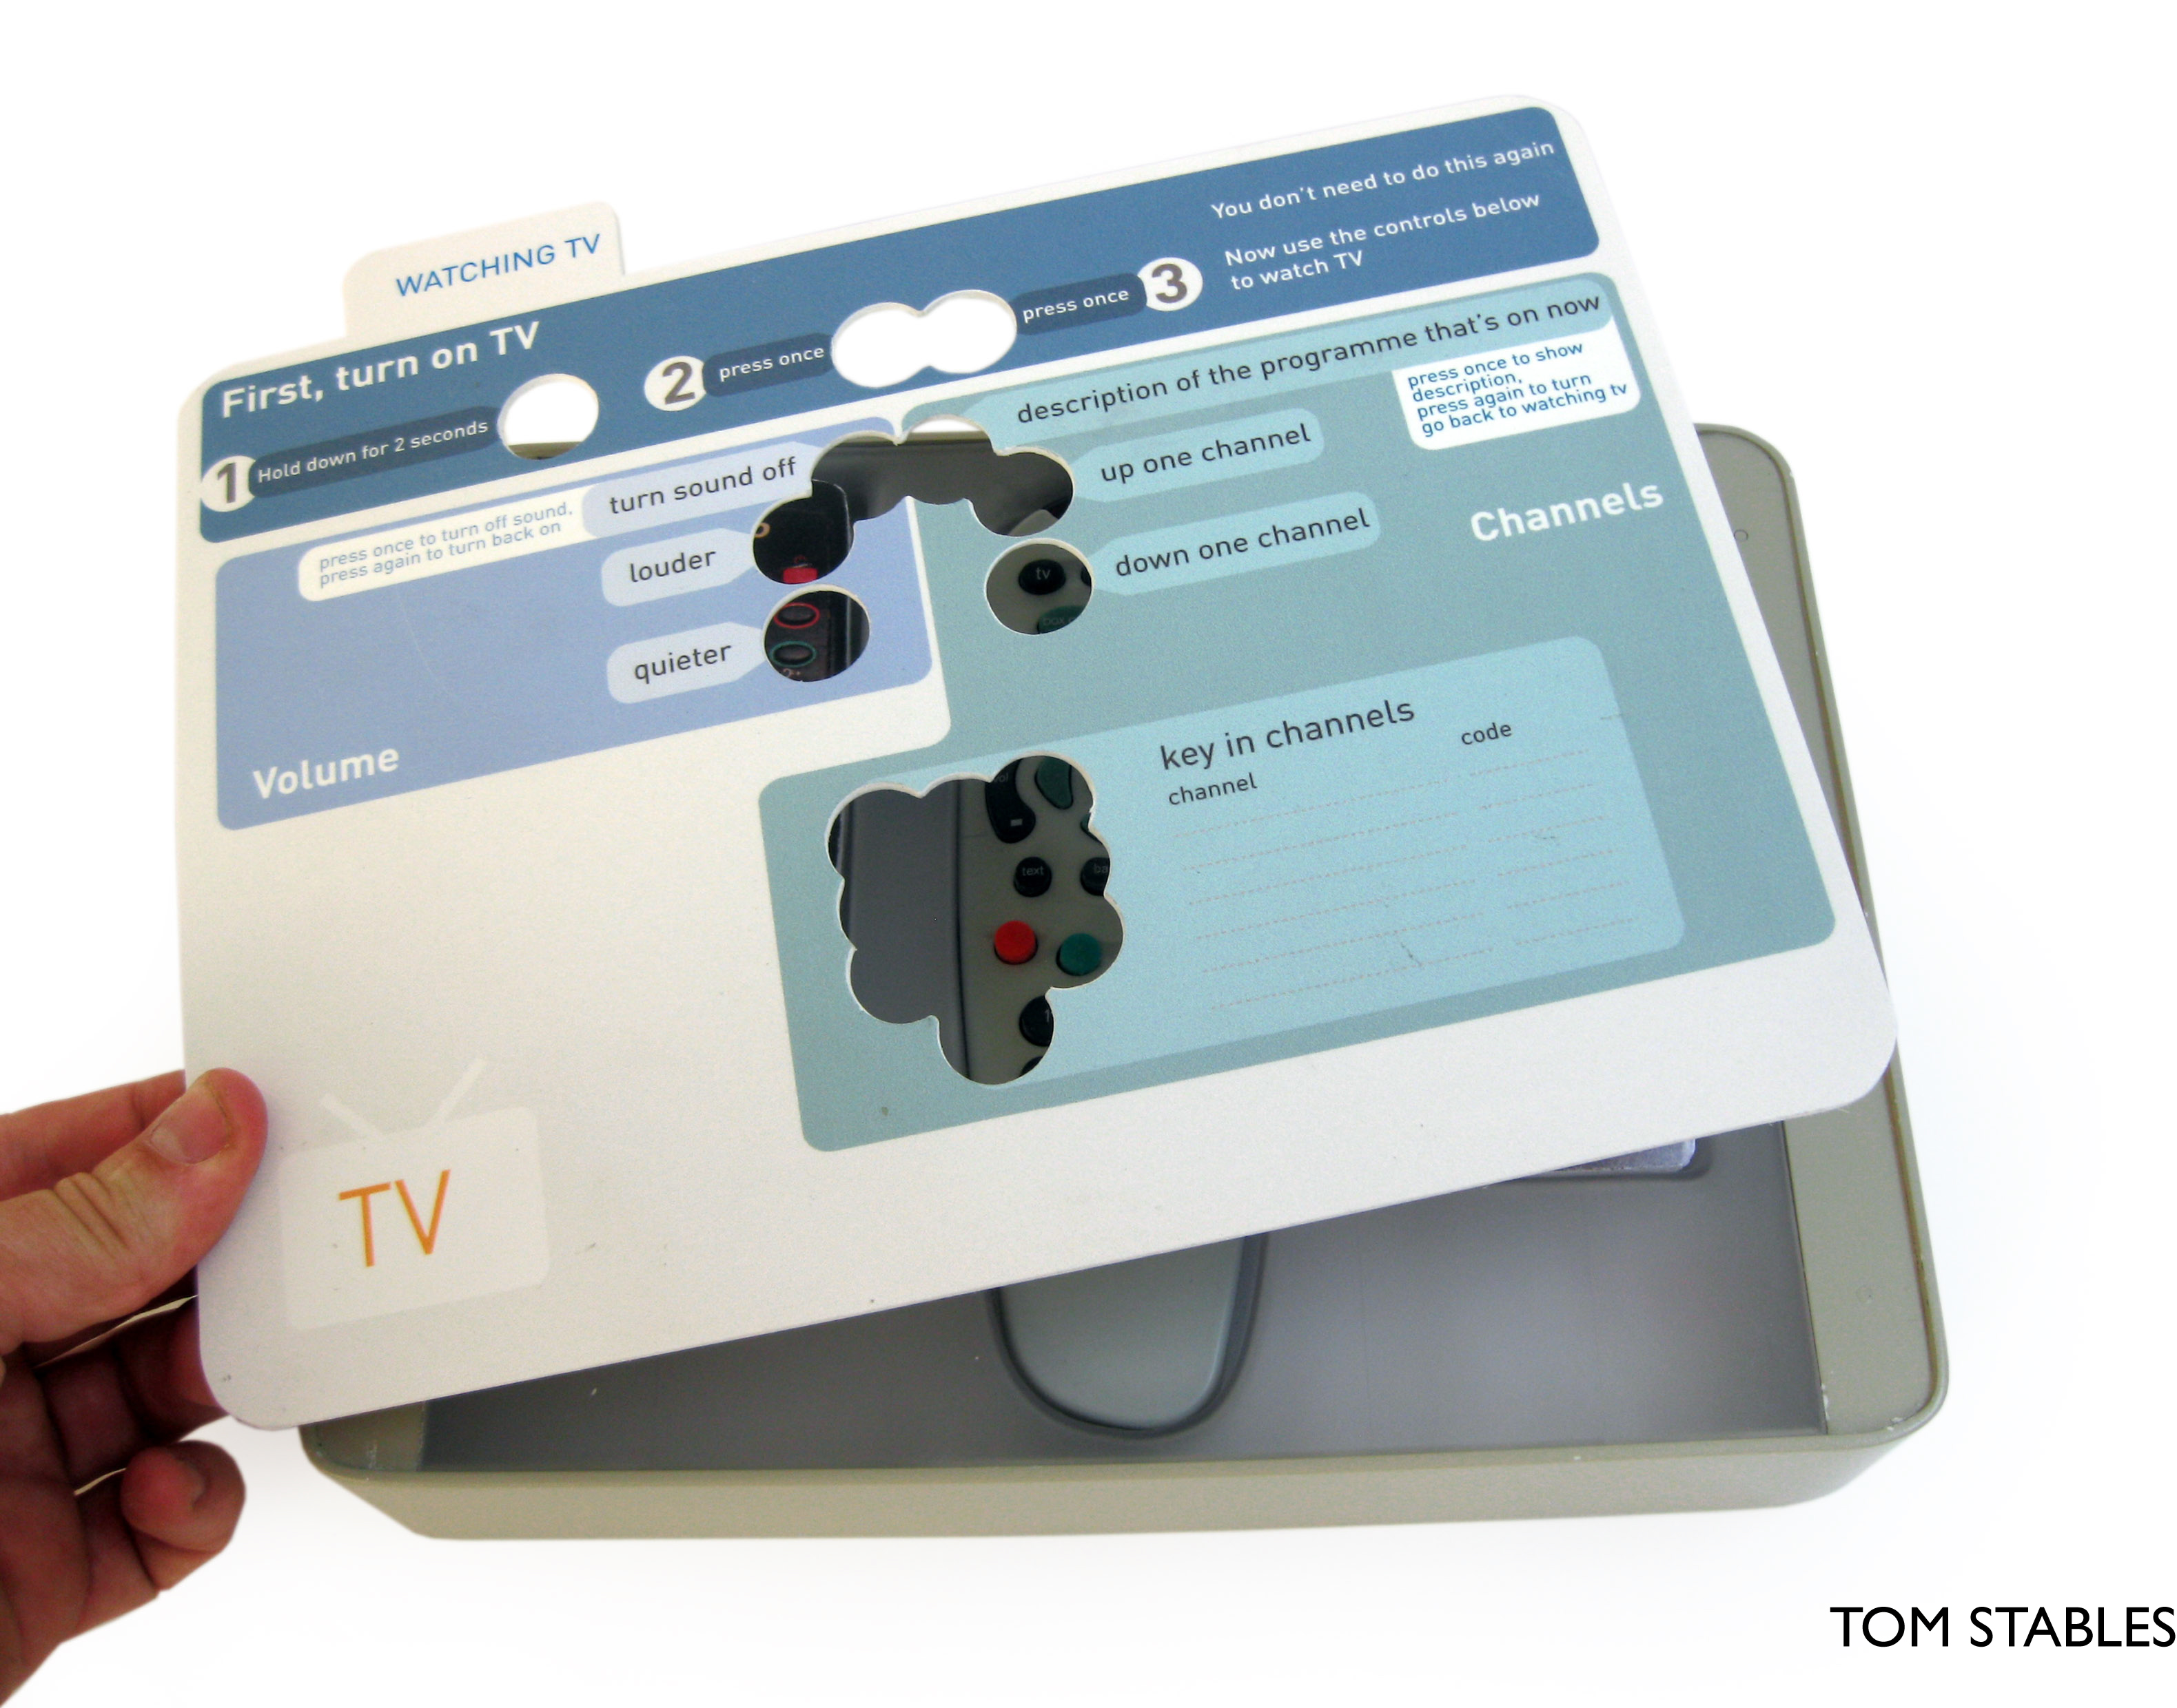

Slide 7
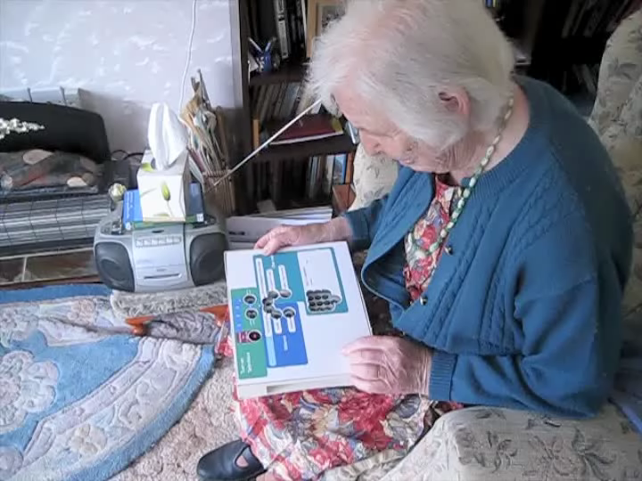

Slide 8
WHO IS DESIGN FOR?

Slide 9

Notes:
Well, most design is done for people, aimed at people, or affects people. Everything in this room has been designed –it is ever-present in our daily lives

Slide 10
DESIGN CENTRED around PEOPLE
Notes:
So why is more design processes and activities not centred around people, the consumers, the users who we are designing for.

Slide 11
PEOPLE CENTRED DESIGN
Notes:
We look to put people at the centre of design, not just as passive recipients, but as active contributors to the process. We call this people-centred design … and this can be really smart business practice.

Slide 12
OUR METHODS DESIGN ETHNOGRAPHY

Slide 13
SEE
ASK
INTERPRET

Slide 14
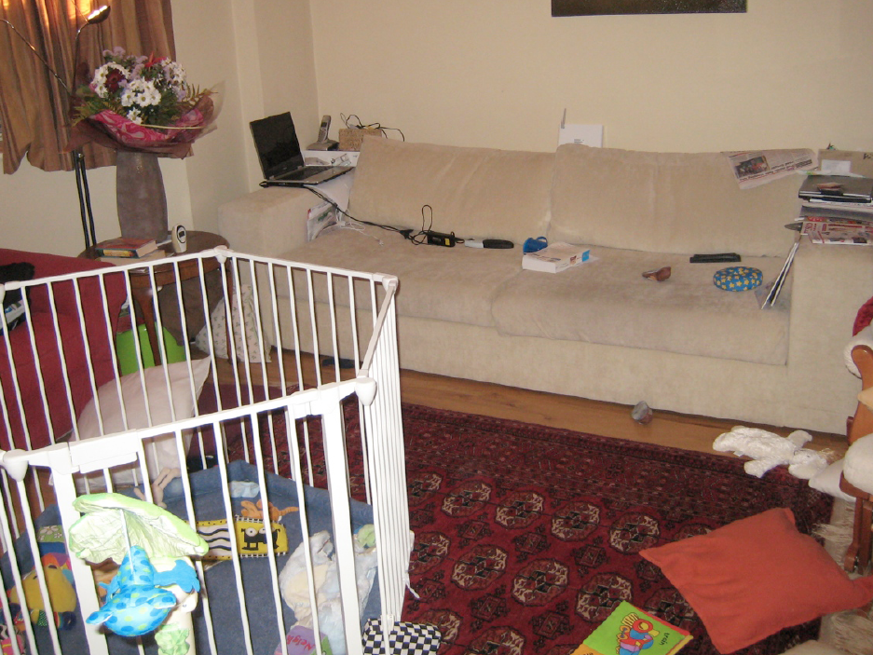
See how people live

Slide 15
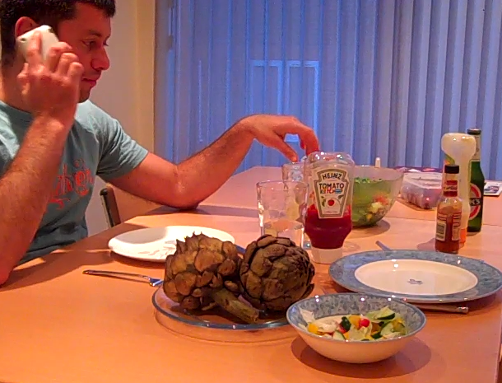
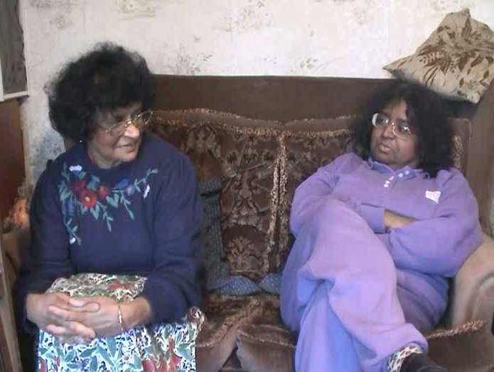

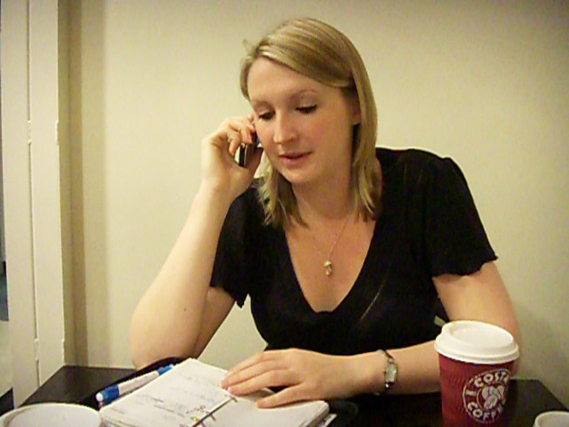
Ask them what they actually do

Slide 16
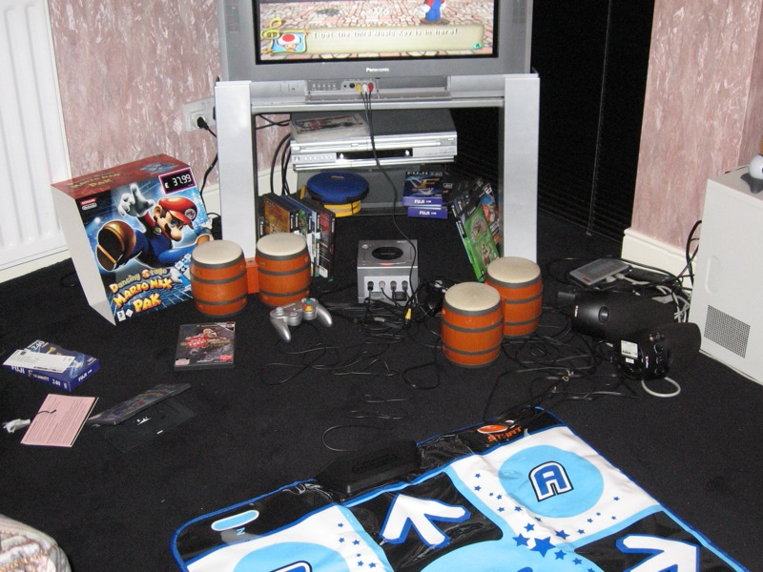
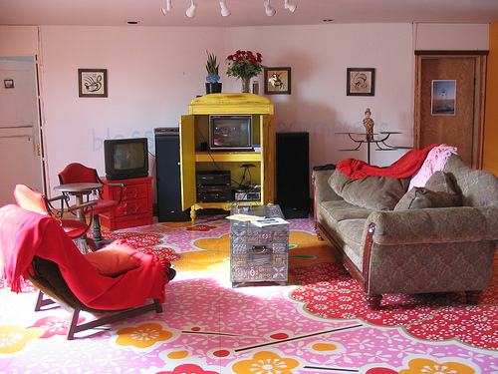
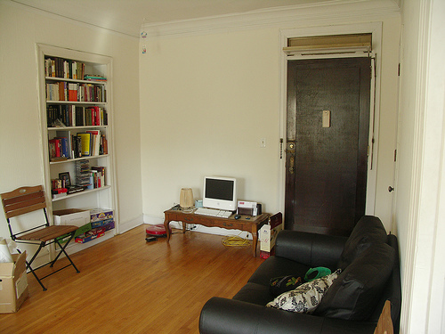
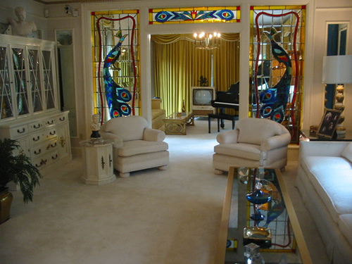
Make interpretations

Slide 17
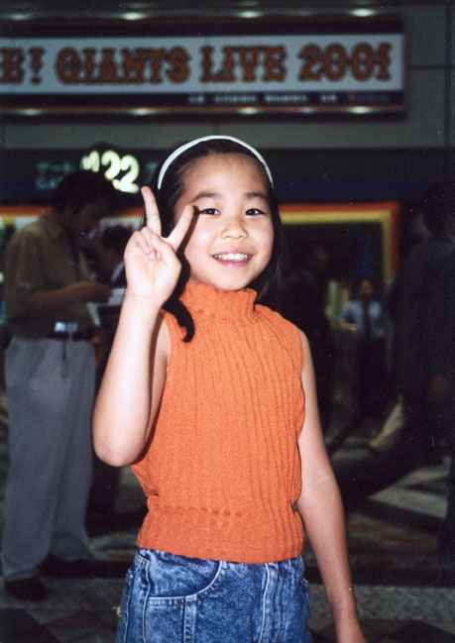
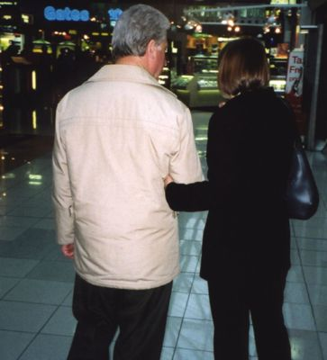
Follow people around

Slide 18

Set people tasks

Slide 19
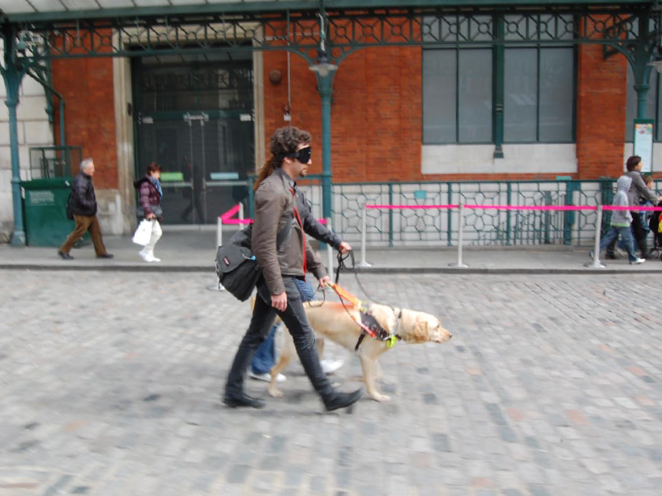
Experience their world

Slide 20
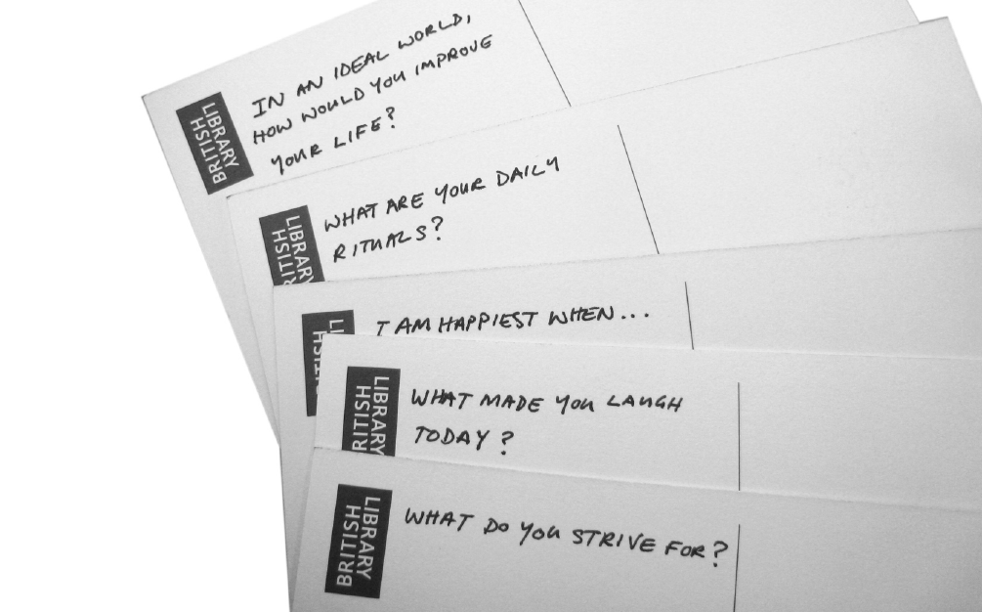
Capture emotions as well

Slide 21
THE PROJECTS

Slide 22

Indulgent bathroom
beauty and ageing in the bathroom

Slide 23
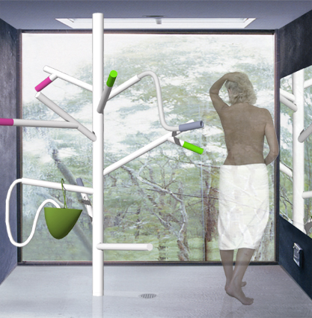
Concept_tree
Notes:
Insert images of 24 users of diferent ages and sizes

Slide 24
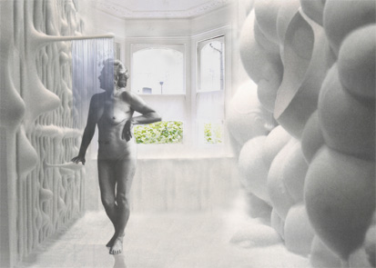
Concept_waterdrop
Notes:
Insert images of 24 users of diferent ages and sizes

Slide 25
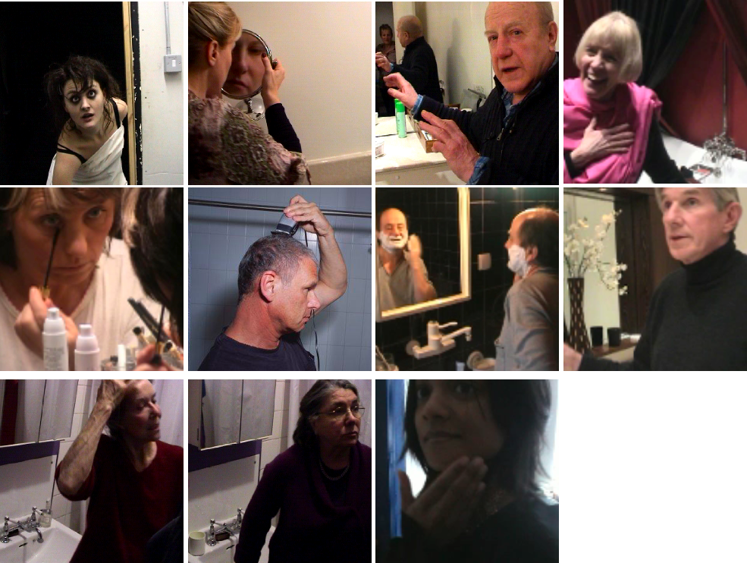
Notes:
Insert images of 24 users of diferent ages and sizes

Slide 26
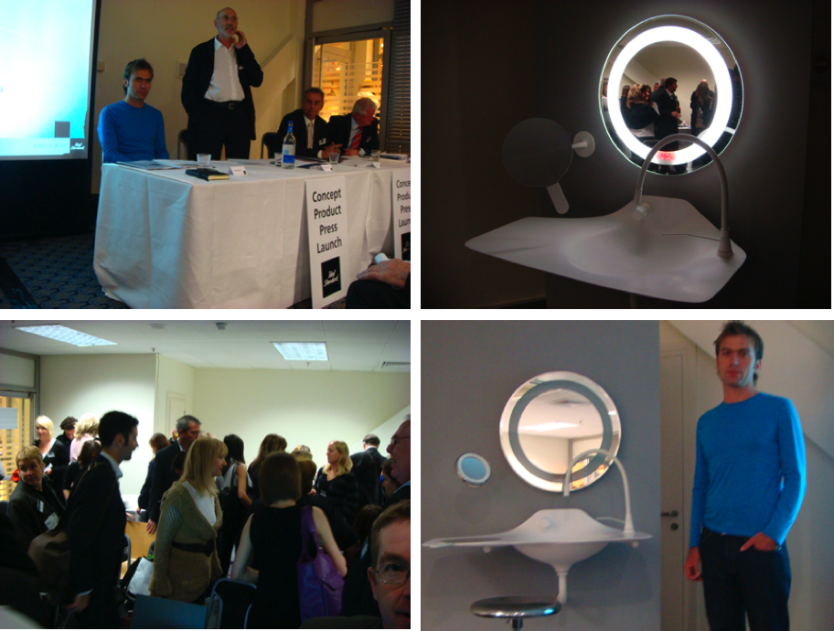
Notes:
Insert images of 24 users of diferent ages and sizes

Slide 27

Kitchen Tales
Redefining single living

Slide 28
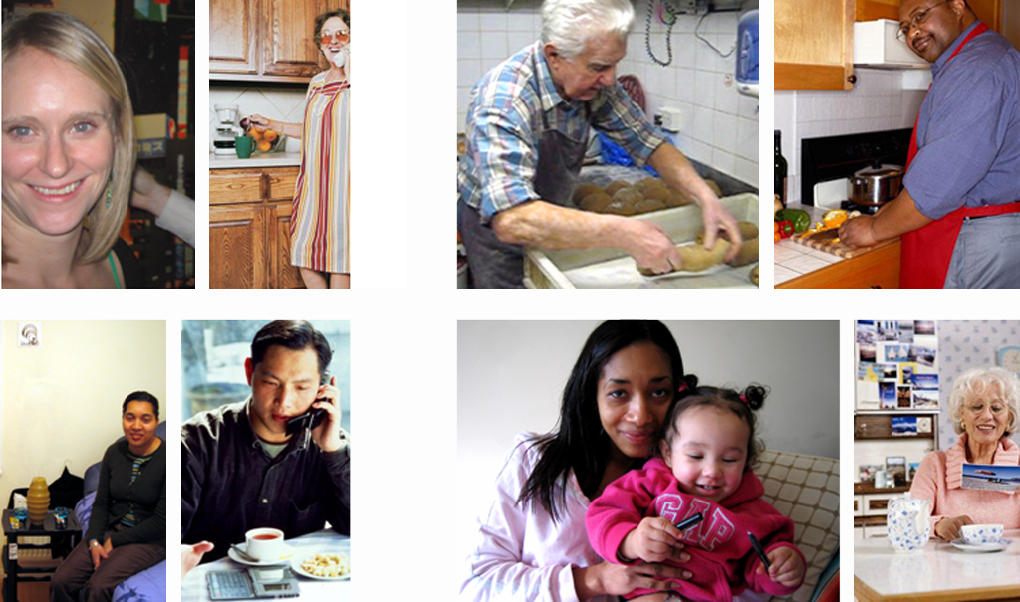
Our Users: Their Kitchen Tales…
Helena, 27
Betty, 75
Albert, 82
Darren, 28
Malika, 31
Jon, 35
Honie, 25
Mrs. Milford, 86

Slide 29












Working with business
130 people-centred design projects
90 companies
3 million GBP invested by companies
We matchfund these projects
Real-life inclusive design

Slide 30
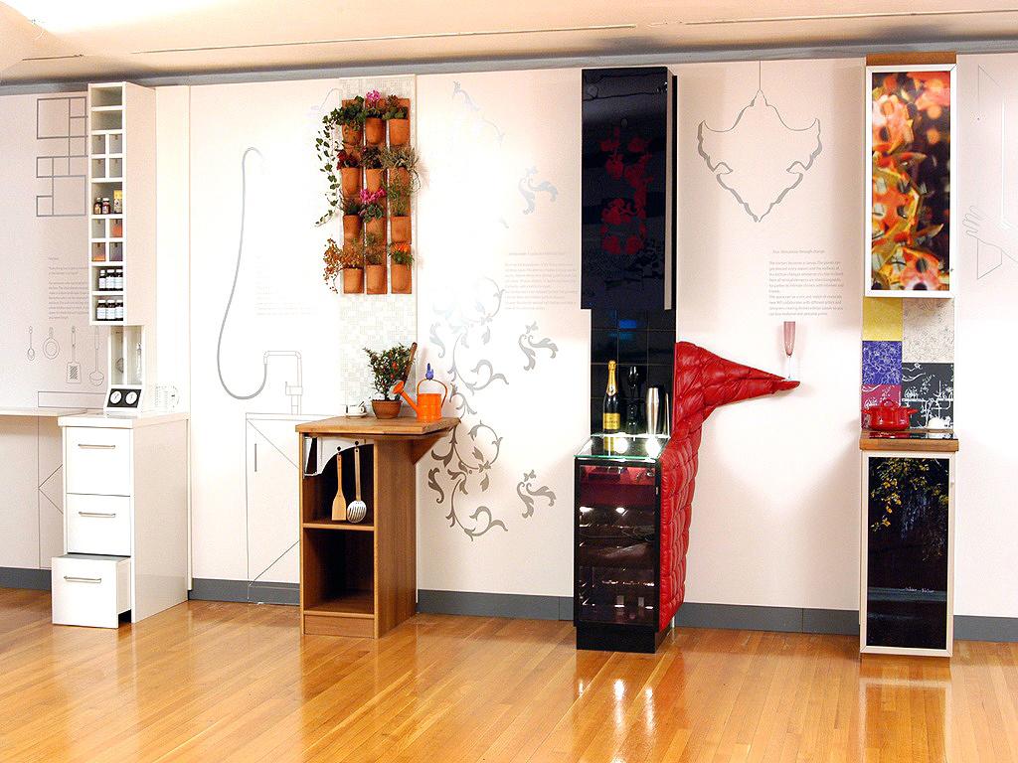

Slide 31
Design for Dementia
Kitchens, Bedrooms and Care Homes

Slide 32
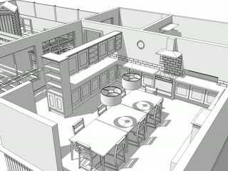
Notes:
I show a wide ranging proposal for adapting existing interior layouts and products to ensure food culture is more accessible and socially inclusive for residents.

Slide 33
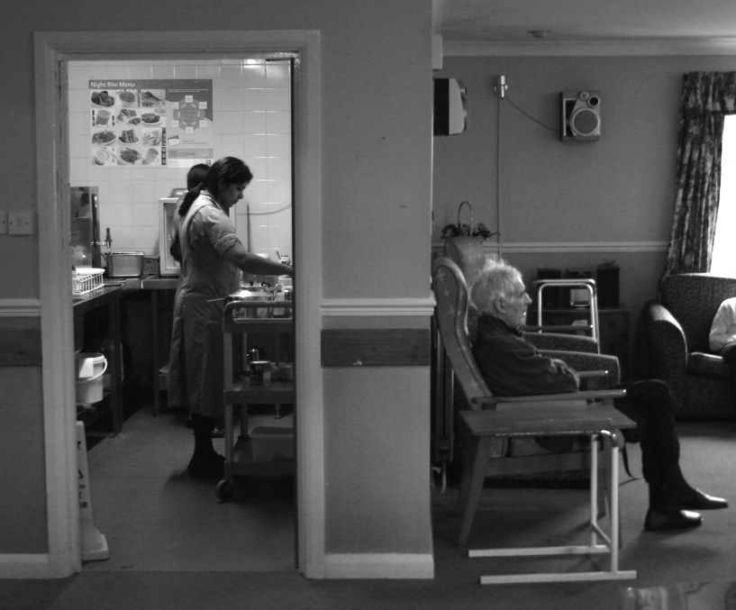
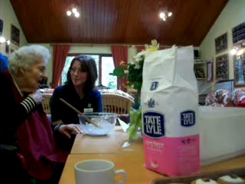
Notes:
I take a critical look at the removal of food preparation from residential areas for reasons of health and safety questioning the values that are lost with this separation

Slide 34
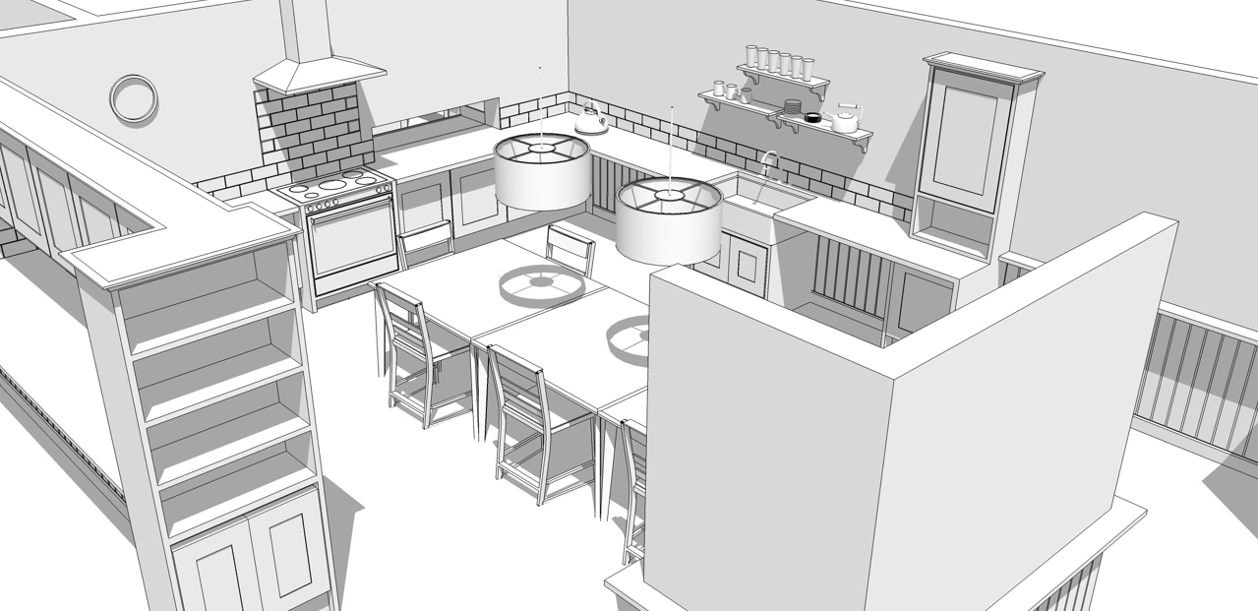
Notes:
and propose new ways of reintroducing safe kitchens into homes which capitalize on redundant space and offer amenities to improve carer/resident interaction

Slide 35
Notes:
I show how current table designs and lighting levels can prohibit people in wheelchairs and those with poor visual acuity from gaining easy access to dinning.

Slide 36
Notes:
And propose simple flat bottomed tables and retrofit lighting to compensate for these difficulties.

Slide 37
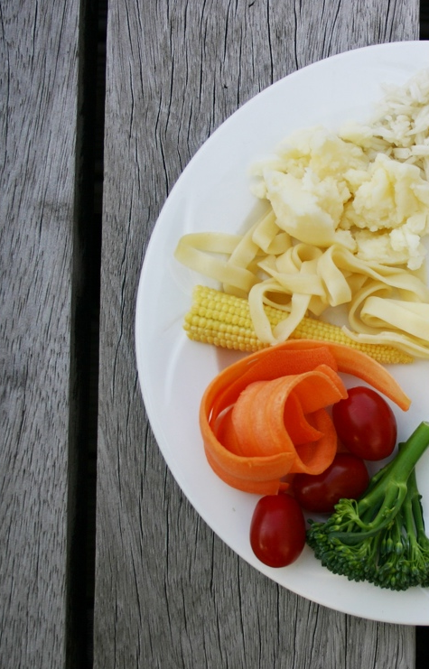
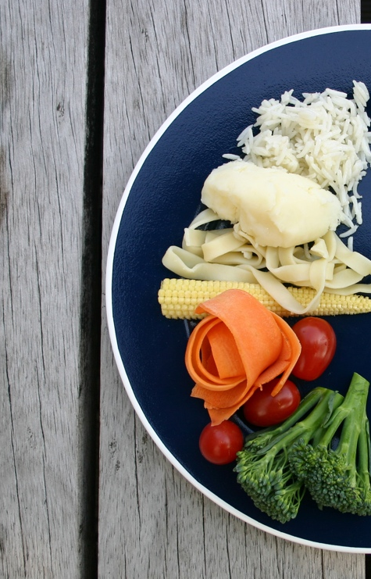
Notes:
Plates which improve color contrast for those with poor visual acuity
allowing food to be more easily located in order to pick it up.

Slide 38
Notes:
High lipped plates for those with limited dexterity which helps push the food onto the spoon.

Slide 39
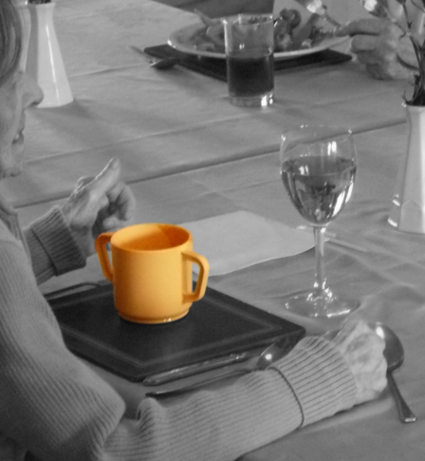
Notes:
Cups with insulated cavities which answer the need while challenging the aesthetic of standard care cups

Slide 40
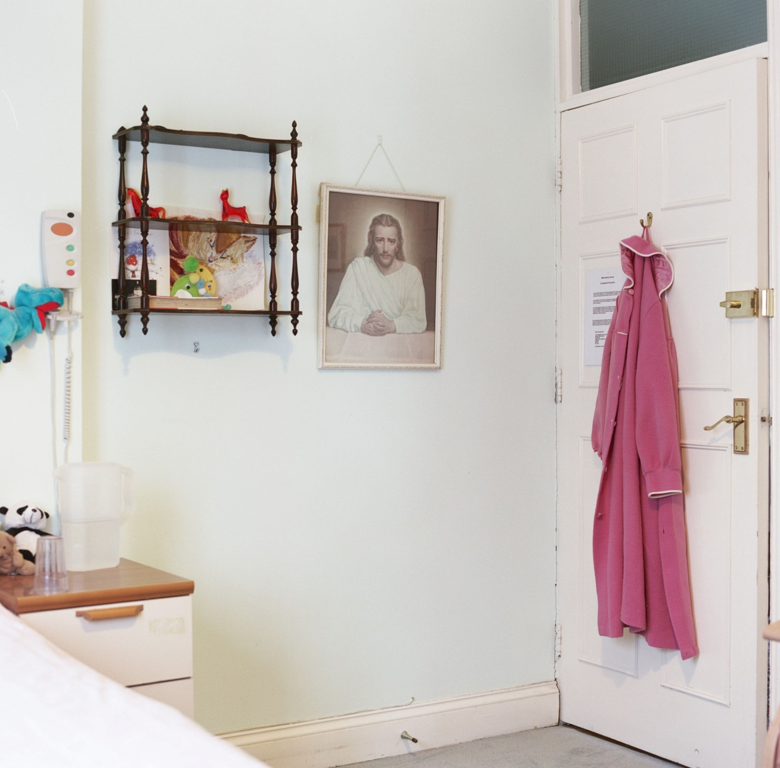
40
Notes:
You will be able to read about the positive impacts that personalization of private space can have. How this personal customization can enable residents to retain independence for longer. As well as making living in care a more positive and less stressful experience.

Slide 41
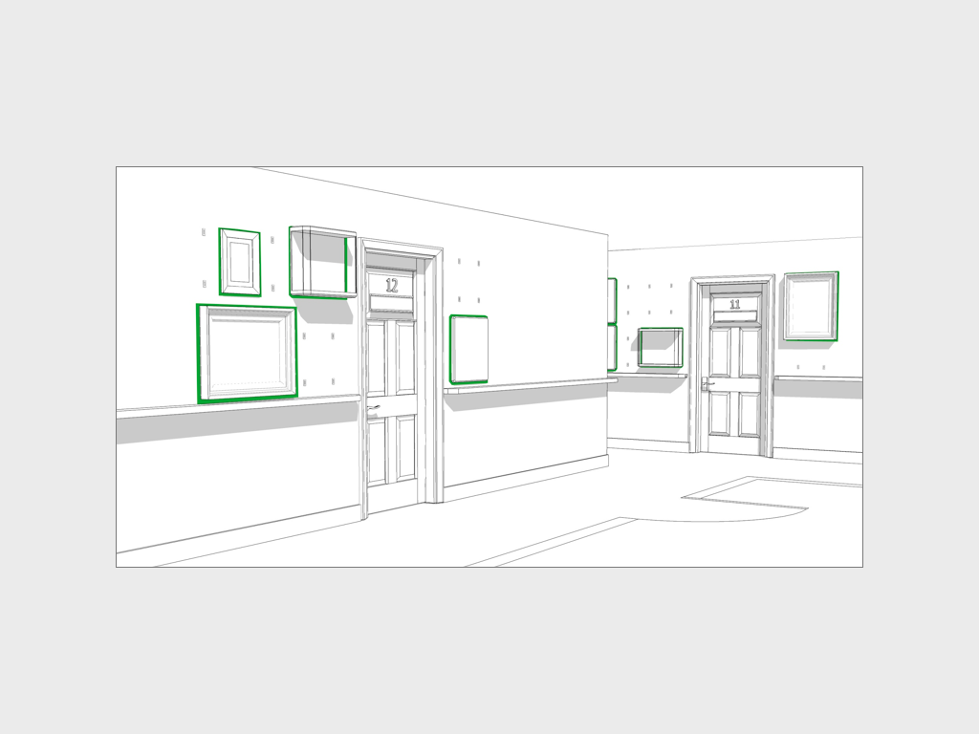
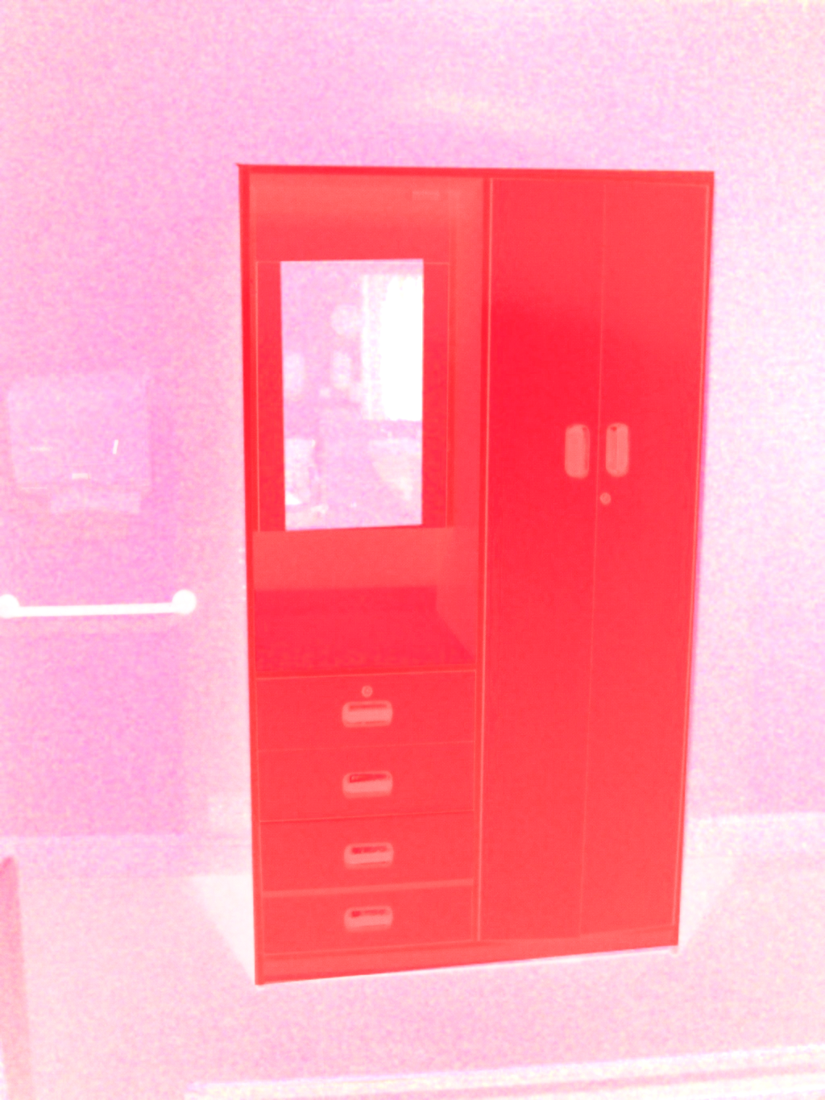
To be
Replaced
41
Notes:
We will show you how continuing personalized customization into adjacent communal areas can build on some products that are already available. Allowing for greater personal identification, ideologies of ownership and way-finding. All while helping instill pride in residents.

Slide 42
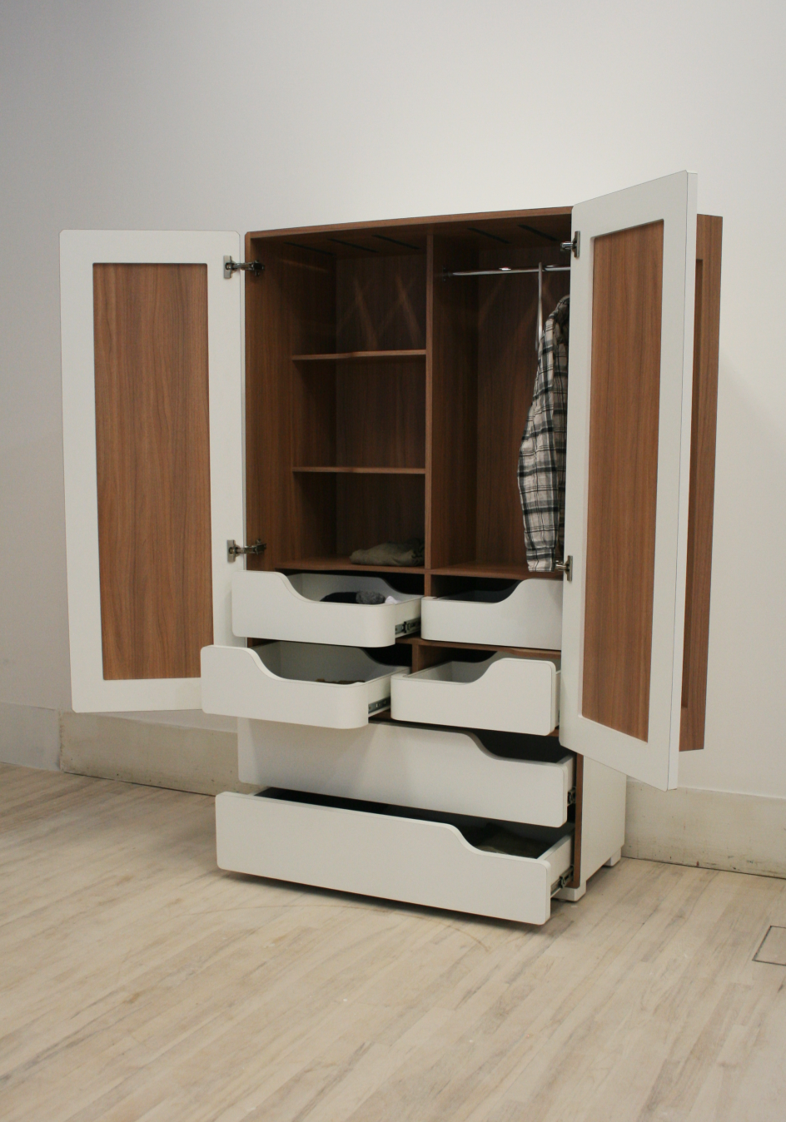
42
Notes:
Features such as contrasting colours and materials, height reduction for accessibility

Slide 43
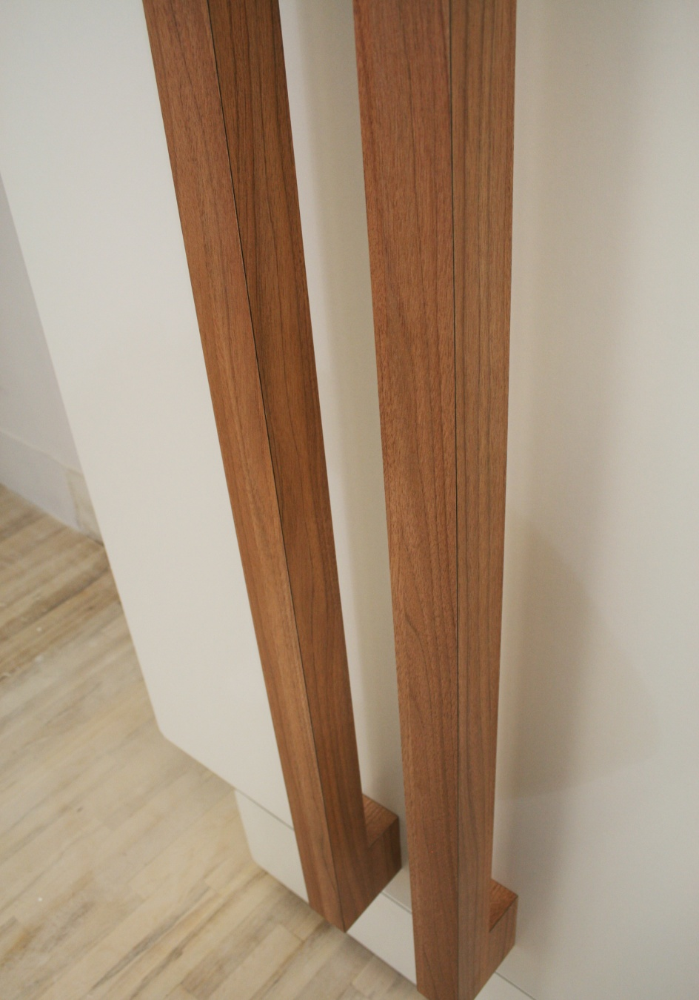
43
Notes:
And over-sized handles can assist in enabling people with Dementia

Slide 44
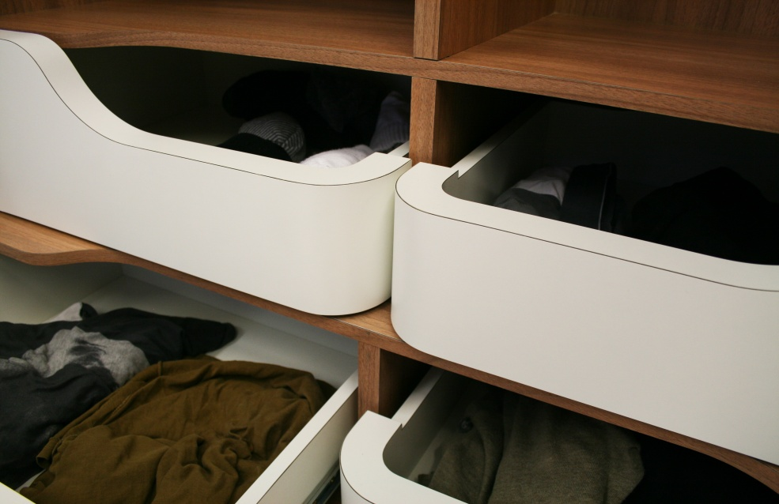
44
Notes:
How content-visible drawers,

Slide 45
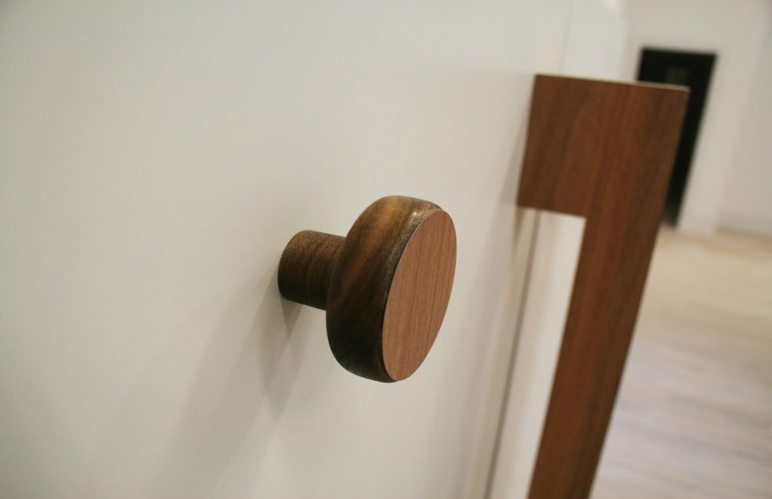
45
Notes:
hangers,

Slide 46
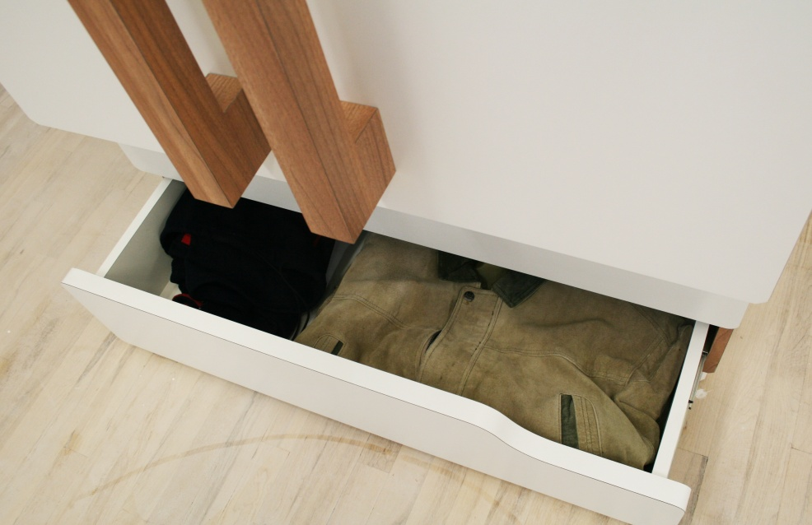
46
Notes:
out of season storage and

Slide 47
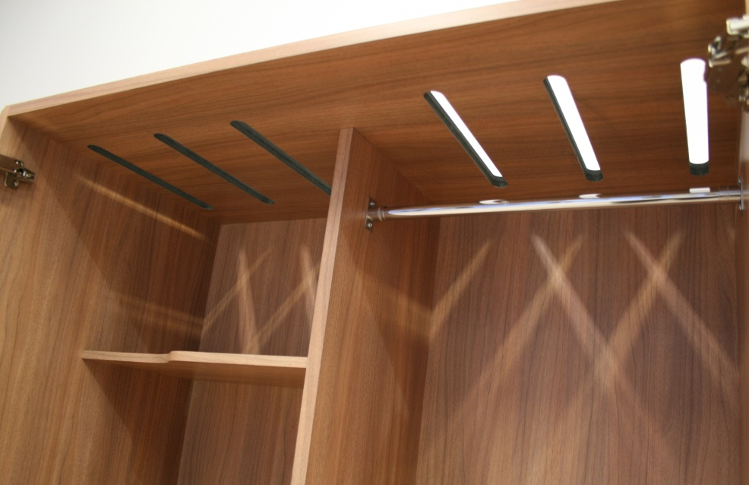
47
Notes:
low-tech illumination can all assist residents in retaining their dressing independence for longer.

Slide 48
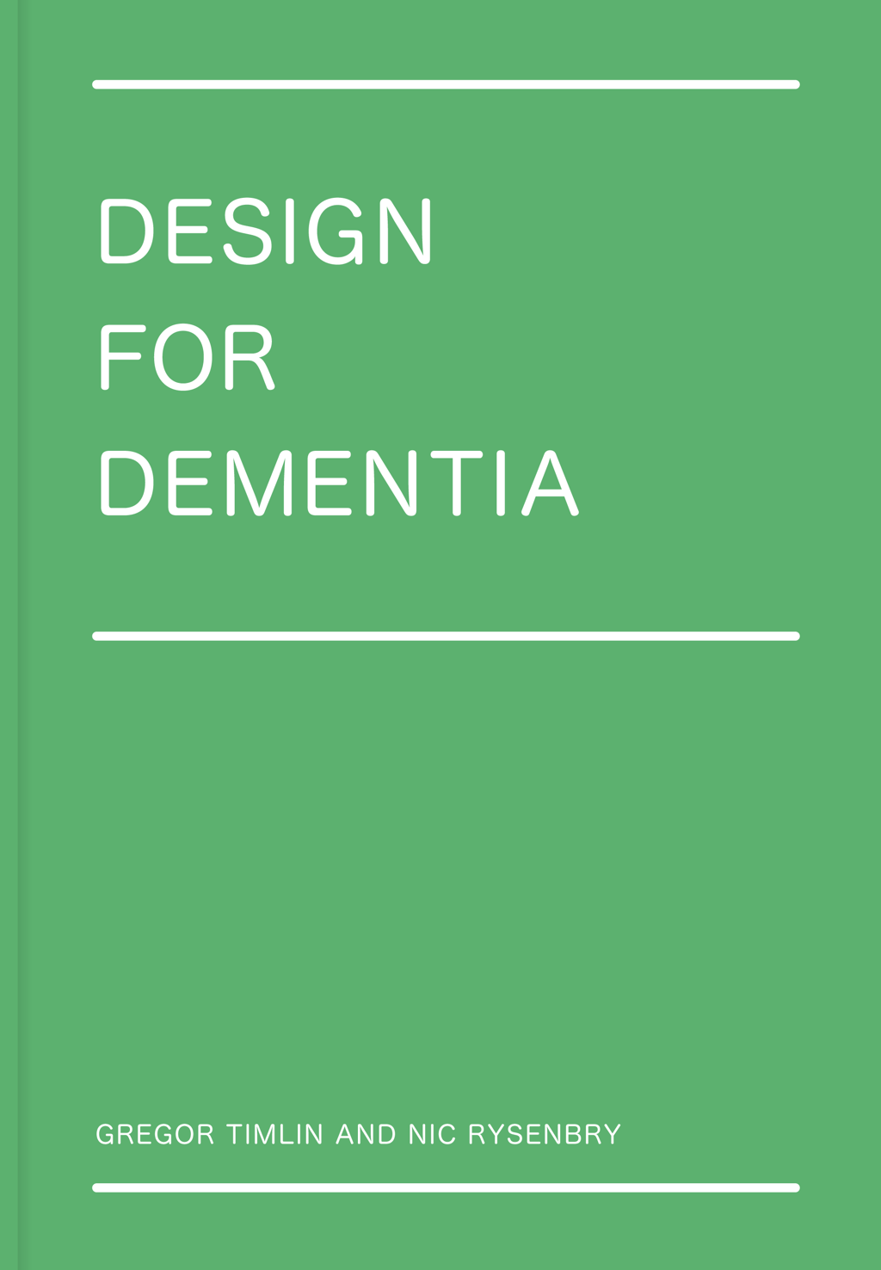
Notes:
These ideas we have been exemplified in two case studies which are captured in a book “Design for Dementia” which is on display upstairs.

Slide 49

www.bettercarehomes.org
Notes:
Most importantly, this site, Better Care Homes.Org is an open access site for anyone to look at and use. We are very grateful to Bupa for allowing this and for their partnership over the last three years.

Slide 50
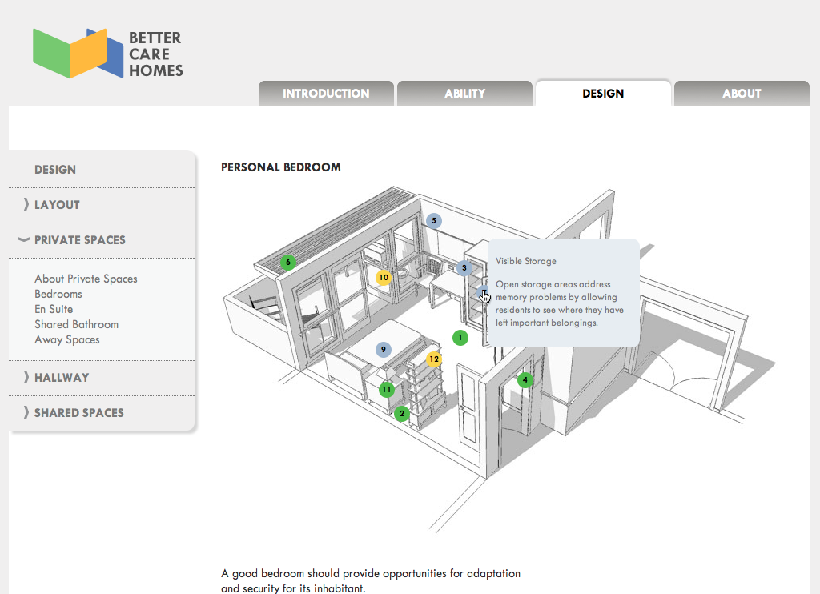
Notes:
The website content is interactive allowing us to show the principles behind each idea.
Here is a bedroom layout. This can be personalised to create a sense of ownership and the belonging. Room shape and size can allow furniture to be moved and layout customised. The rail around the room allows pictures to be hung without destroying the walls.

Slide 51
OVER 120 OTHER PROJECTS

Slide 52
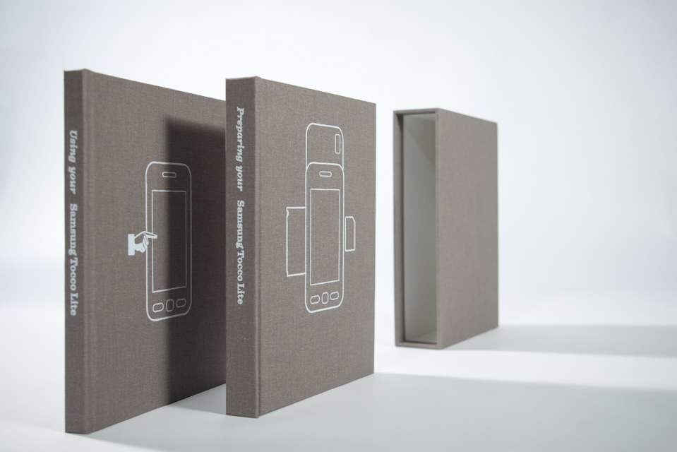
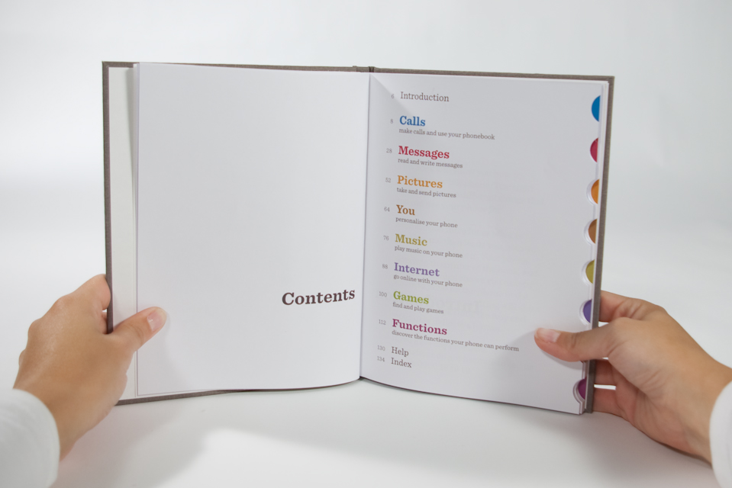
Notes:
Before users didn’t know where to keep the flimsy manuals that came with their phones, now they can live on their bookshelf because we transformed the box into two quality hardback books.

Slide 53
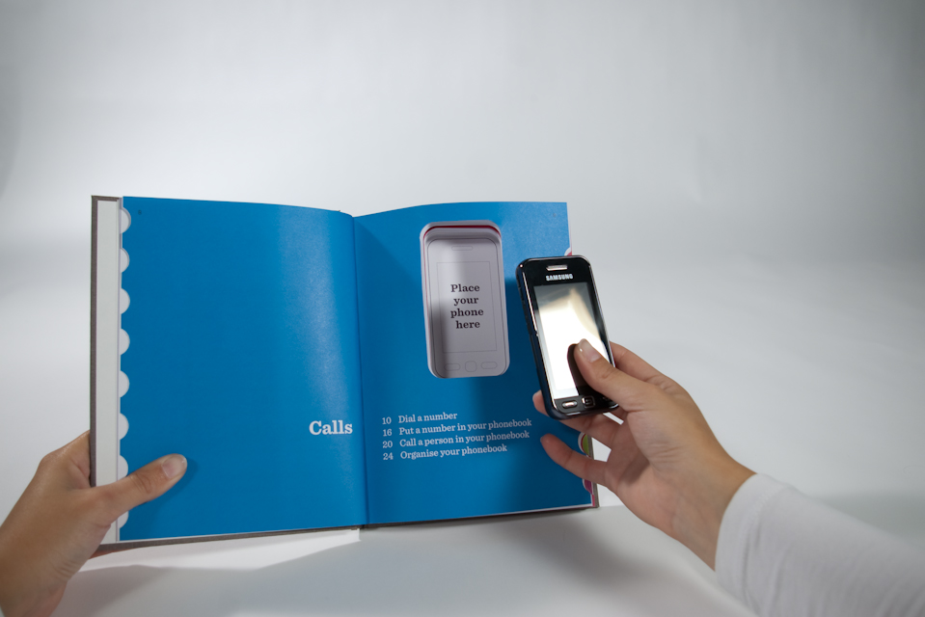
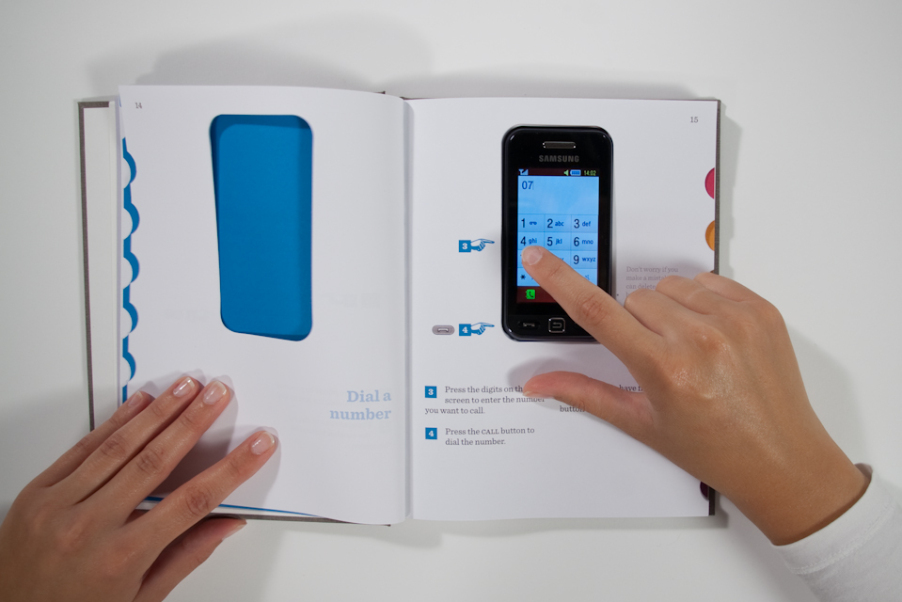
Notes:
The second book is the main manual – the phone actually slots into this and becomes the center of attention.
Arrows point to the exact locations the user should press, avoiding confusion and eliminating the feeling of being lost in a menu.

Slide 54
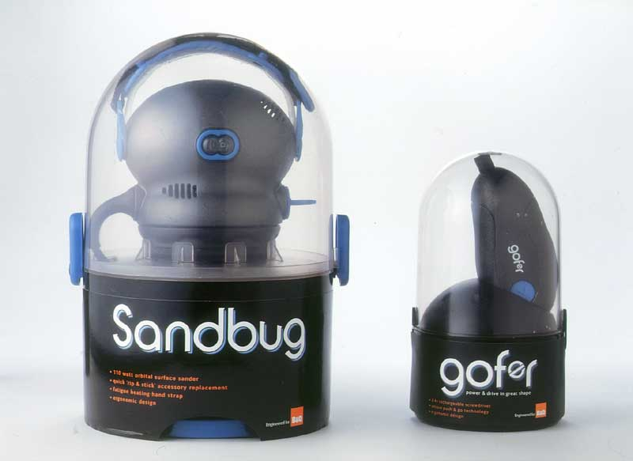


Slide 55
FINAL THOUGHTS

Slide 56
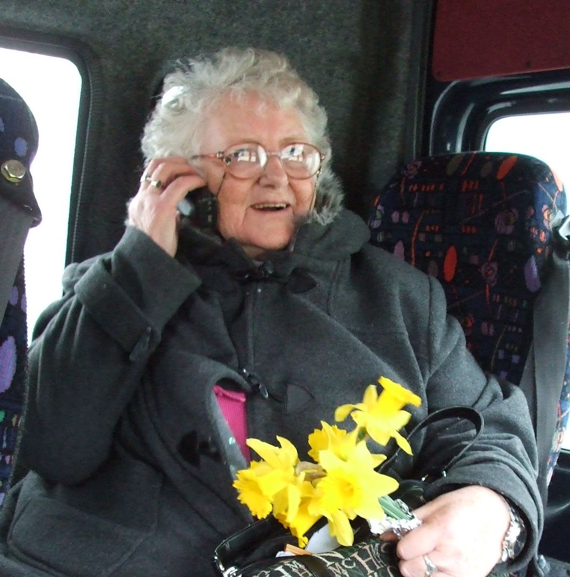

Going beyond stereotypes – seeing the ‘person’ not just the ‘user’
Photo: Katrin Trautner

Slide 57

A people-centred future!
Notes:
ONNY So we look forward a people-centred future and building an inclusive approach and exploring what that might mean.

Slide 58
People differ ..
physically
mentally
culturally
socially
spiritually
emotionally

Slide 59

www.hhc.rca.ac.uk
@HHCDesign @RamaGheerawo

