Slide 1
Housing and the Living Environment

Slide 2
Volunteers of America Overview
Founded in 1896 by Maud and Ballington Booth
National, spiritually based nonprofit organization
Nation’s largest and most experienced nonprofit provider of quality low-income and senior housing
Total number of seniors served nationally – 231,000

Slide 3
About Volunteers of America
In the United States, Volunteers of America is:
The largest nonprofit provider of affordable senior housing
The 4th-largest nonprofit provider of skilled nursing care
The 6th-largest nonprofit provider of assisted living for seniors

Slide 4
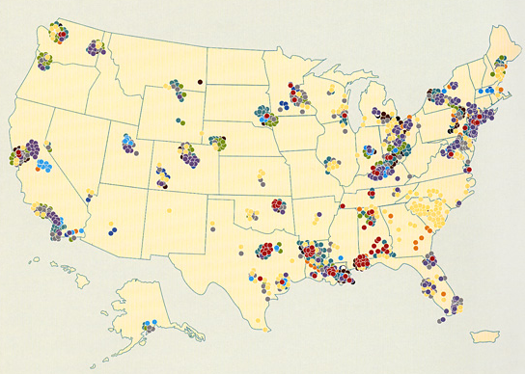
Volunteers of America Overview
Helping more than 2 million people in over 400 communities in 44 states
4

Slide 5
Housing Design – Multi-story

Slide 6
Housing Design – Garden Style

Slide 7
Design Features in Elderly Housing
Accessible bathrooms – grab bars, roll in showers
Accessible kitchens – roll under sinks, HC stoves and refrigerators,
All doors are 36” wide
Light switches and sockets are HC height throughout
Emergency pull cords in bedrooms and bathrooms
Units for hearing and visual impairment
All common areas are accessible
Automatic entry doors to main building

Slide 8
Services in Elderly Housing
Service Coordinator
Anchor for community supportive services
Assessment after move-in
Assist seniors in identifying, locating and acquiring the services necessary for them to age in place in their own homes and maintain
Avoid premature admission to more costly institutionalized care

Slide 9
Services in Elderly Housing
Transportation
Health Care
Personal Care – bathing, dressing, medication
Social Activities and Companionship
Meals – nutrition classes and home delivered meals
Homemaker Services
Assistance with Pets
Money Management and Tax Preparation
Notes:
Fall prevention classes, blood pressure screening, Meals on Wheels, safety training

Slide 10
Technology in Elderly Housing
Computer Learning Center
Security Cameras and Personnel
Energy Saving Devices
WellAware
IN2L – It’s Never Too Late

Slide 11
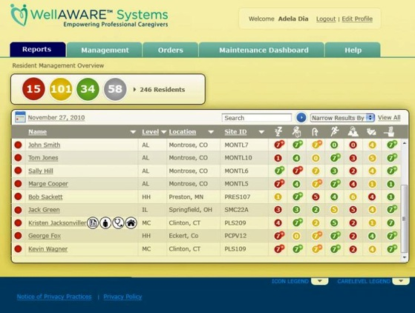
WellAWARE® Systems Overview
WellAWARE is the leading non invasive wellness monitoring & analytics platform. Delivering higher quality, more efficient, and less costly healthcare
Over 250 years of Health Care Industry experience & leadership
Current application across full spectrum of sub-acute & home care settings
Ecosystem, Interoperable Business Model
Strong IP
Protection

Slide 12
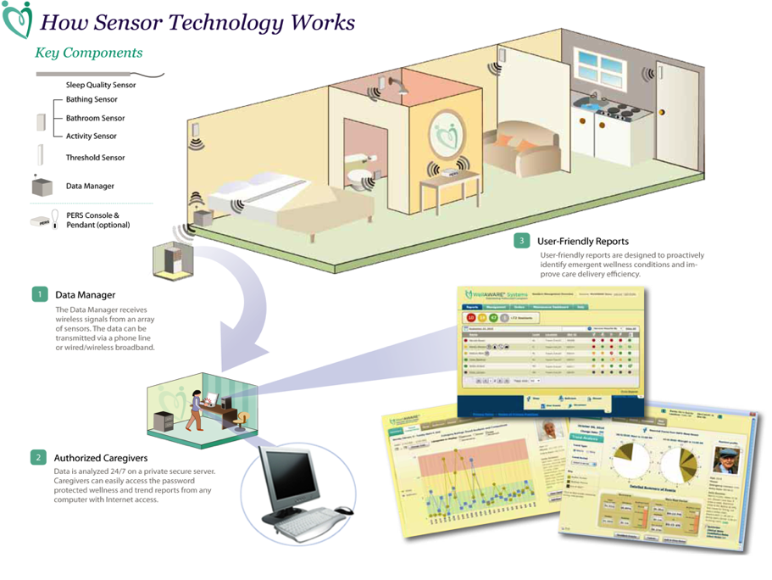
How WellAWARE® Systems works

Slide 15
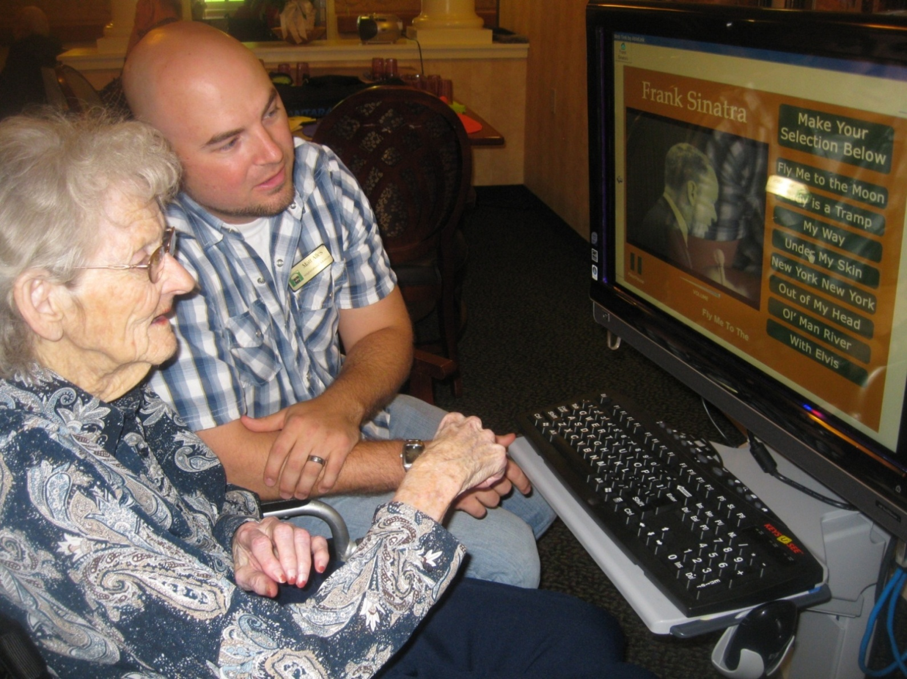

Slide 16
MORE THAN A HOME

Slide 17
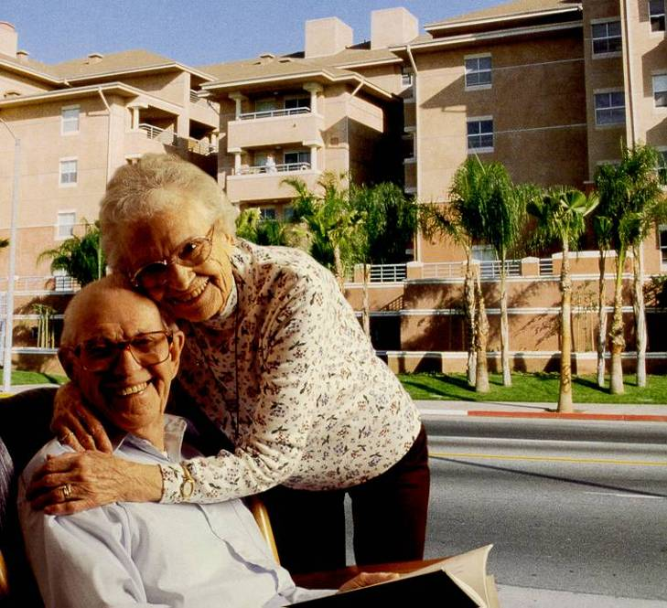
Sea Mist Towers, Long Beach, California, 74 Apartments,

