Slide 1
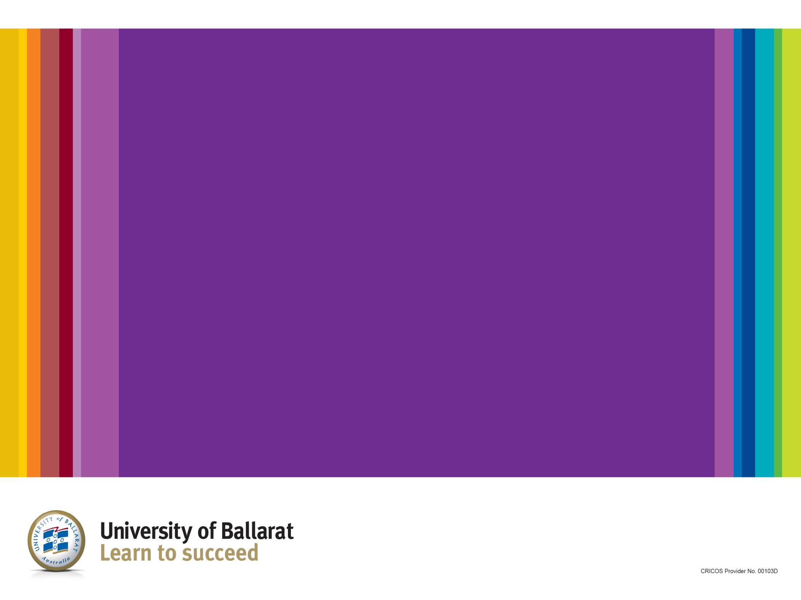
Connecting Health and Well-being Narratives of Older People
Dr Suzanne Blume
Dr Jennifer Macgill
Ballarat, Victoria, Australia

Slide 2
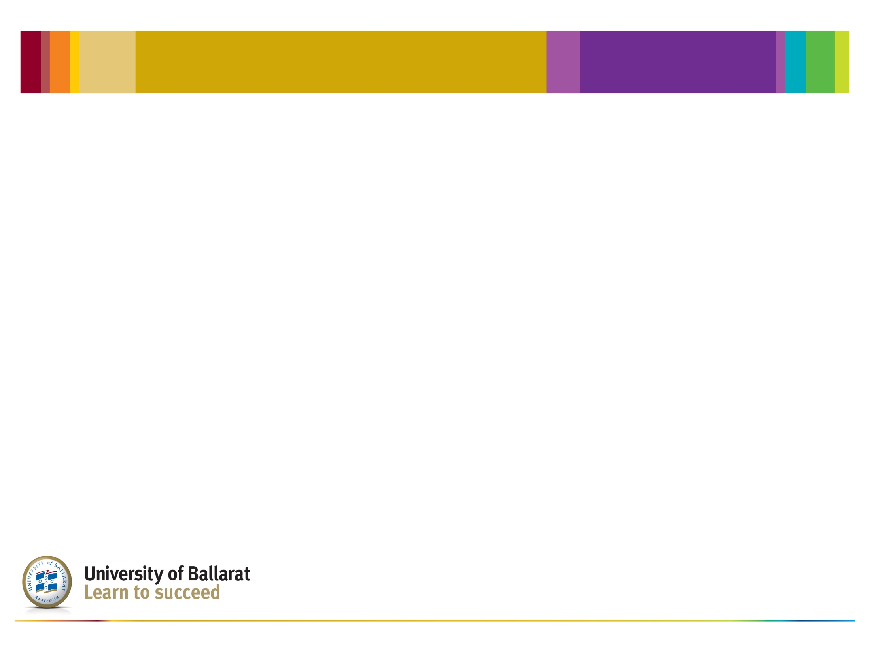
Ballarat is…

Slide 3
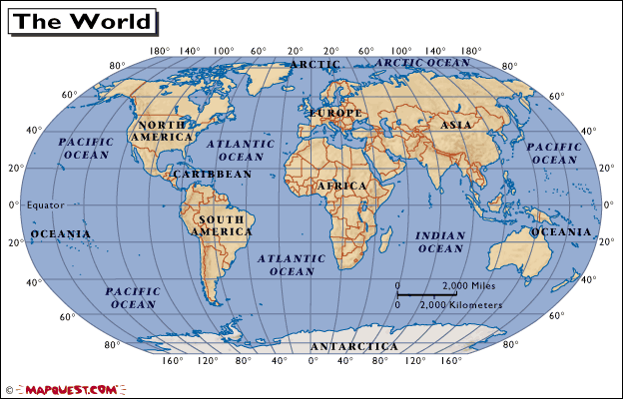

Slide 4
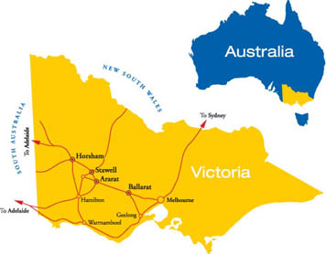

Slide 5
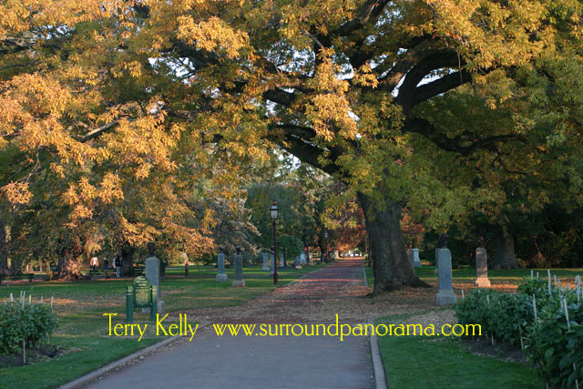

Slide 6


Slide 7
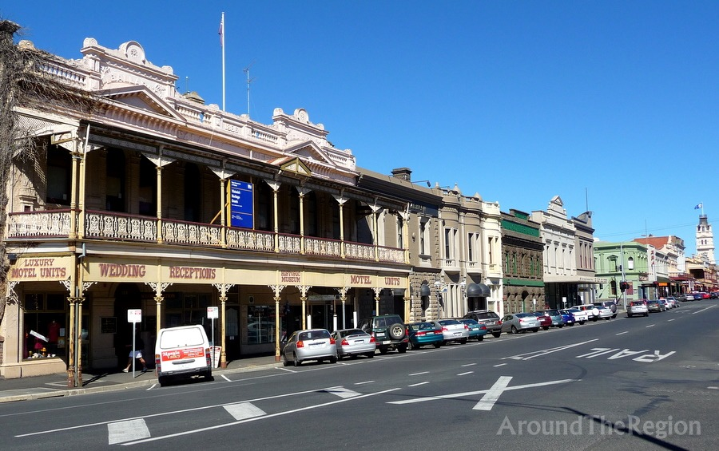
Lydiard Street North, Ballaarat

Slide 8
Abstract
Many older Australians have a positive approach to life and are ageing well. This study explored a small number of stories of older people who are living the life they want to live, and realised the potential of establishing a website by which older people could continue to talk about their ageing experiences. This living database of stories could inform, encourage and engage older people in conversations about mental and physical health and well-being and the strategies used to maintain their lifestyles. Social participation through story telling and electronic publications has benefits for individuals, communities and populations.

Slide 9
Previous Study
Interviews were conducted with a small group of older people (aged 60 years plus) who were perceived to be ageing positively to identify the strategies used to enhance mental and physical health and wellbeing.

Slide 10
Findings
Older people wanted to:
be connected with their peers and the broader community
share their stories and experiences of ageing
AND
saw being connected with others as synonymous with:
increased happiness, sense of belonging, self-worth,
enhanced mental and physical health and well-being

Slide 11
Context
Developed from the previous study and a program of research about:
mental health,
well-being,
retirees,
older people.

Slide 12
Background
Many older people lack ability to have face to face communication
Benefits of story-telling as a means of communication have been proven
Offering older people a means to communicate via a public, accessible, cost-free medium/platform for story-telling/sharing
Sharing experiences leads to:
  Social connectedness
  Enhanced health and well-being
  Increased self-worth and self-value
Emancipatory research

Slide 13
Concept
Exploring the what, how and where of:
Providing a platform for older people to share their stories of health and well-being,
and
Establishing a database for further research.

Slide 14
Questions
What is available for older people in Australia?
How can this technology be made accessible?
Where should it located?

Slide 15
Current situation
Websites for public access
Disabled people sharing stories (Griffith University, Australia)
Facebook
Limitations - family, friends only (Boldt Sousa et al 2011a & b)
Internet use by older Australians Surprisingly good rates of use (COTA, 2012).
For information, communication, commercial purposes (Sum et al, 2008)
National Broadband Network
Topography & distance

Slide 16
Literature Review
Technological advances that enhance electronic connectivity
Caven & Bigham, 2011.
Methods of increasing electronic connectivity of older people
Dickinson, Eisma, Gregor, Syme, & Milne, 2005.
Morris, Goodman, & Brading, 2007.
Sayago & Blat, 2011.
Benefits of electronic connectivity
Boldt Sousa, Tenreiro, Silva, & Rodrigues, 2011.
Sum, Mathews, Hughes, & Camp, 2008.

Slide 17
Aims
.
An “Electronic story-writing” website for older people to share:
        experiences
        information
        strategies
        resources
Repository of data for research purposes

Slide 18
Intention
For older people, enhanced:
        Connectivity
        Sense of belonging
        Mental and physical health and well-being
For researchers, access to:
Rich database
Ready information

Slide 19
Strategy
Web design and production
Marketing to older people

Slide 20
Challenges
Cost
Editing
Maintenance

Slide 21
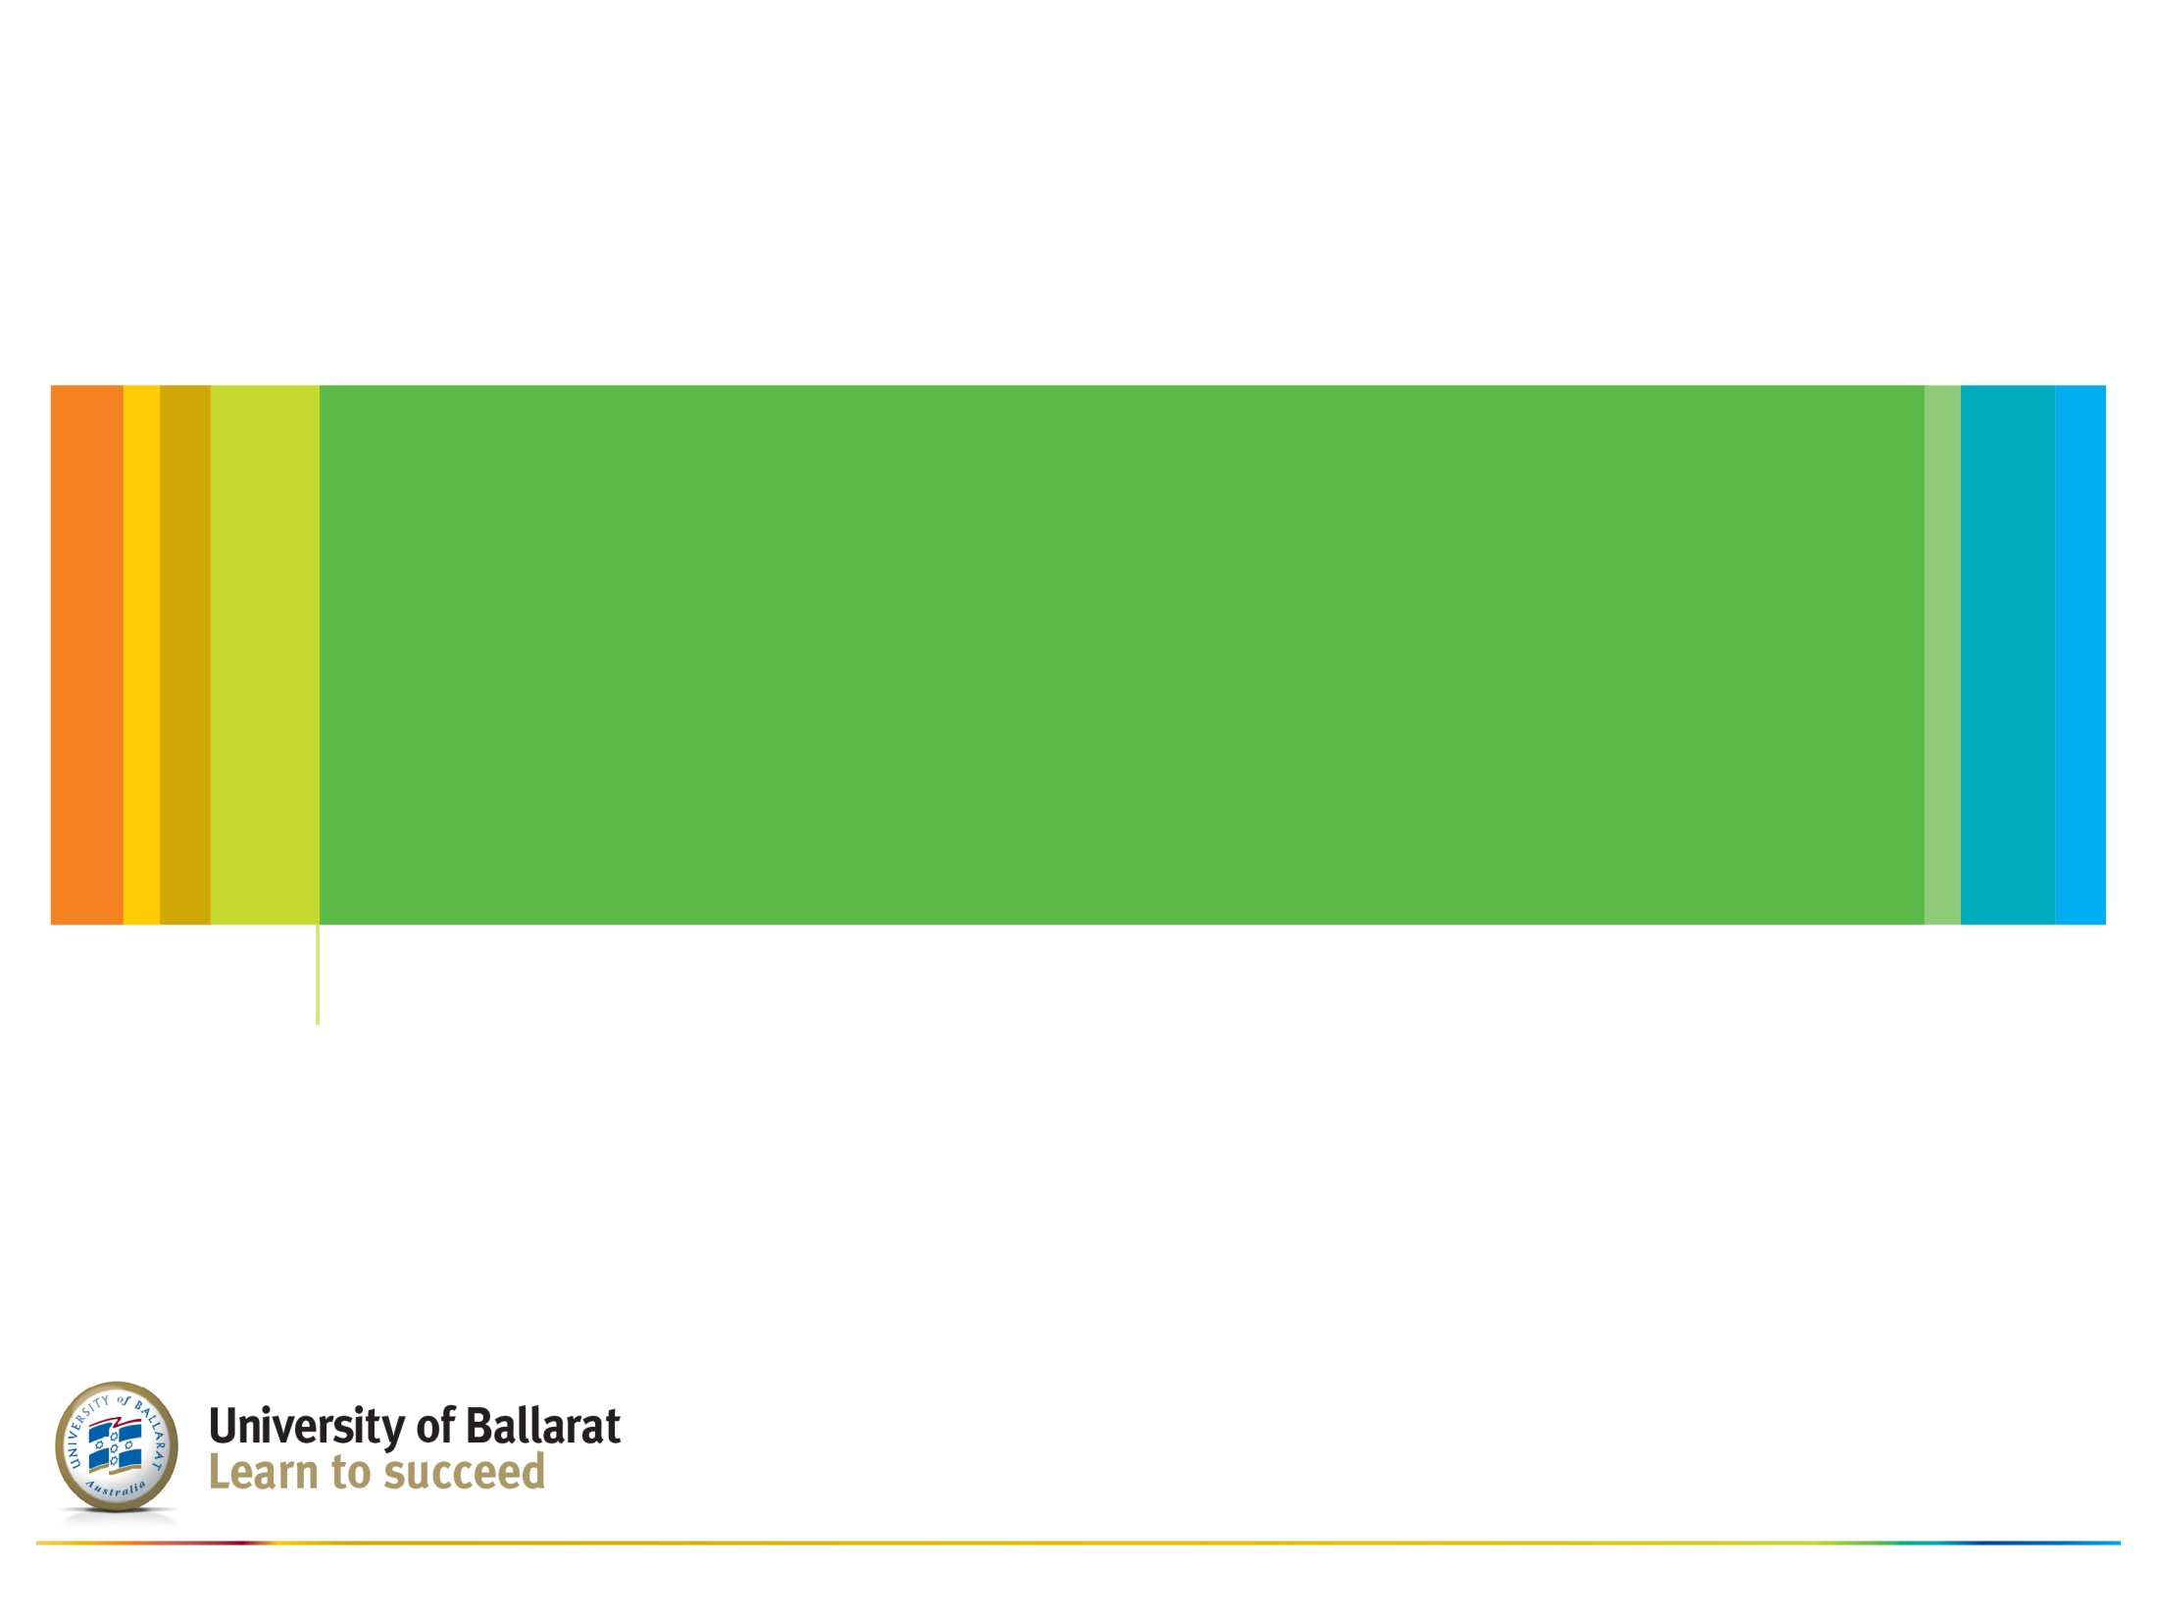
Future Direction

Slide 22
Future Direction
Globalisation
More research
Publications

Slide 23
A few final thoughts….

Slide 24
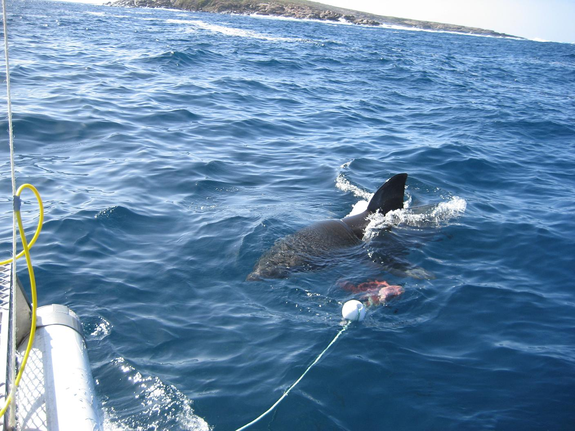

Slide 25
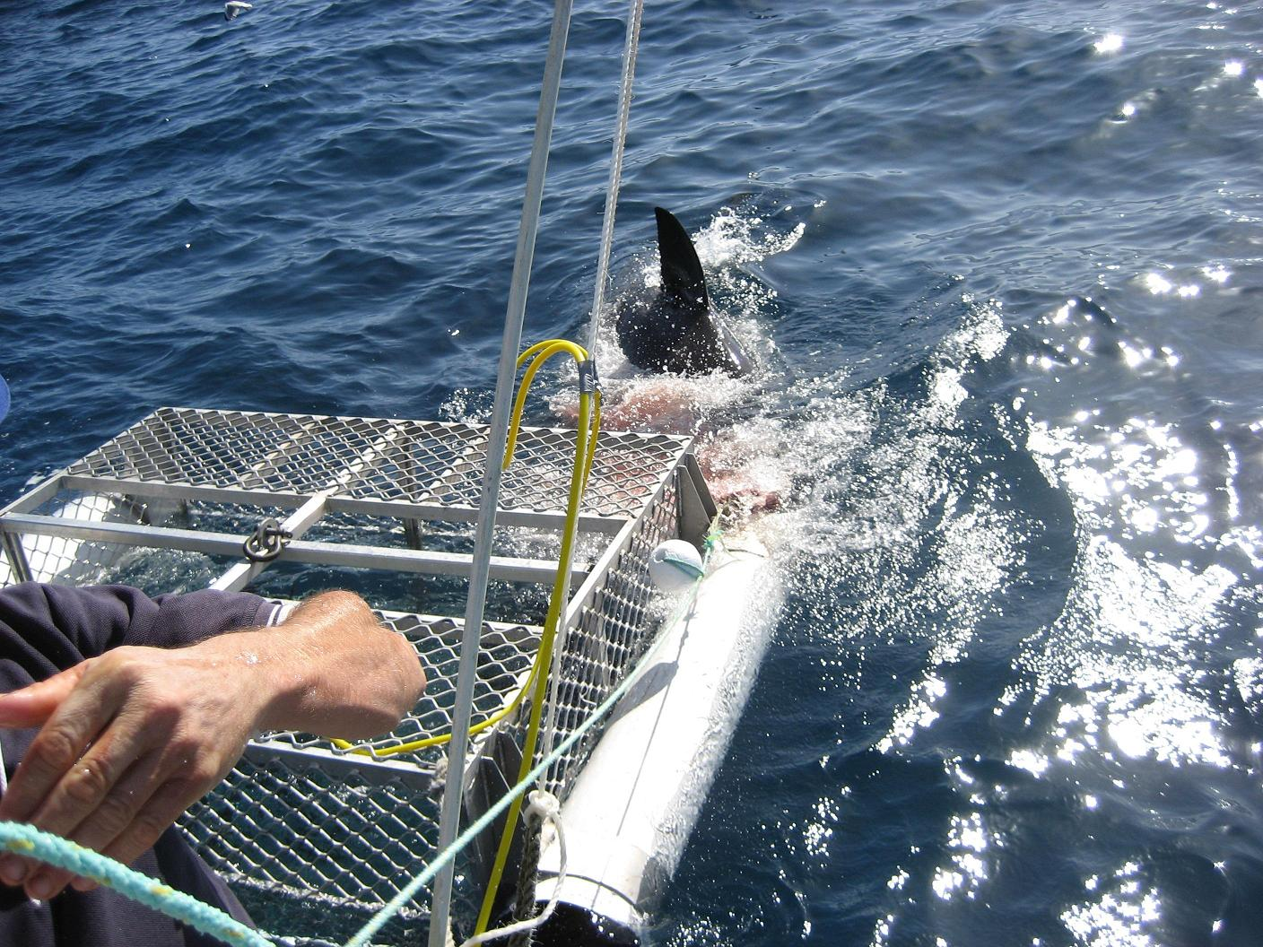

Slide 26
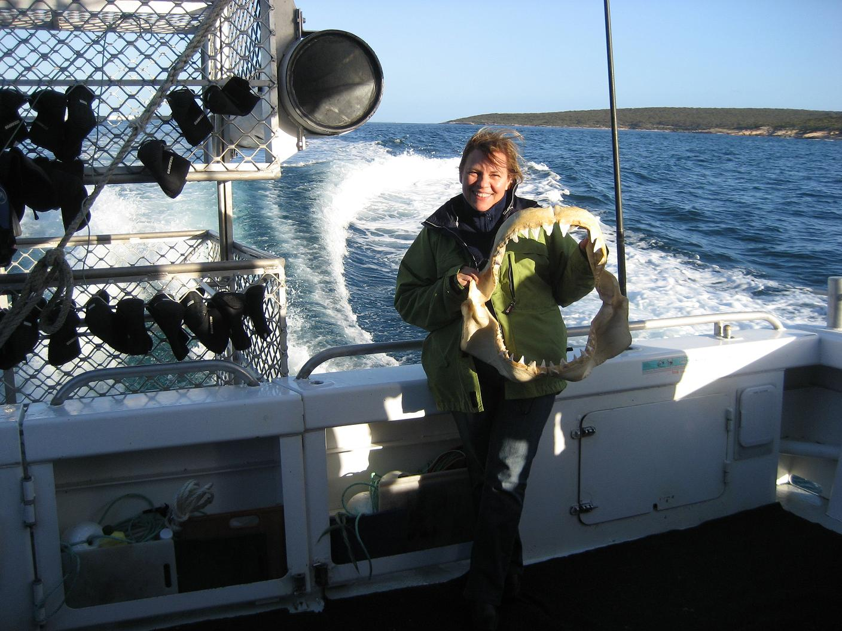
Problems can be overcome….

Slide 27
References
Boldt Sousa, T., Tenreiro. P., Silva, P.A. & Rodrigues, E.M. (2011). Storytelling meets the social web: An HTML5 cross-platform application for older adults. INTERACT, Part IV, LNCS 6949, 364–365.
Boldt Sousa, T., Tenreiro. P., Silva, P.A., Nunes, F., & Rodrigues, E.M. (2011) Cross-platform social web application for older adults with HTML 5. ICEC, LNCS 6972, 375–378.
Caven, A.C., & Bigham, J.P. (2011). Toward web accessibility for older users. Universal Access in The Information Society (Univ Access Inf Soc), 10, 357–358.
Council on the Ageing (COTA)(2012). Older Victorians Online: A community survey exploring the usage patterns of older Victorians online. Melbourne, Victoria, Australia: COTA.
Dickinson, A., Eisma, R., Gregor, P., Syme, A., & Milne, S. (2005). Strategies for teaching older people to use the World Wide Web. Univ Access Inf Soc, 4, 3–15.
Morris, A., Goodman, J., & Brading, H. (2007). Internet use and non-use: Views of older users. Univ Access Inf Soc, 6, 43–57.
Sayago, S. & Blat, J. (2011). An ethnographical study of the accessibility barriers in the everyday interactions of older people with the web. Univ Access Inf Soc, 10, 359–371.
Sum, S., Mathews, M., Hughes, I., & Camp, A. (2008). Internet use and loneliness in older adults Cyberpsychology & Behavior, 11(2), 208-211.

