Slide 1
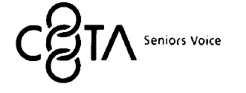
Are Baby Boomers Healthier than their Parents?
11th Global Conference of the International Federation of Aging
28May to 1st June, 2012
Dr Jennifer Buckley
Dr Lisel O’Dwyer
Professor Graeme Hugo
University of Adelaide,
Australian Population and Migration Research Centre

Slide 2
Overview
Conceptual Framework
Methods
Impact of Social Change
Health Differences
Implications
Baby boomer attitudes to ageing – belief and practice
Comparison of sub-groups

Slide 3
Conceptual Framework Why Study Cohort Differences?
Demographic Theories of Social Change
Generational Units (Mannheim)
Cohort Flow, Inter-cohort comparison (Ryder)
Ageing and Society Paradigm (Riley et al)
Socio-cultural Theories of Social Change
Late Modernity (Giddens)
Risk (Beck)
Non-biological factors which influence the ageing process
Differences in ageing patterns between cohorts

Slide 4
Methods
Methods
Comparing same age-group at two different time points
1989-90 Australian NHS data 1989-90 (n=54 576)
2007-08 Australian NHS data (n=20 788)
Surveys use a stratified multistage area sample
Birth Cohort | Age Range in Census Year
 | 1989-90 | 2007-08
1927-1936 – Pre-war Cohort | 53-62 n=1458
1946-1955 – Baby Boomers |  | 53-62 n=2498
*
*
**
**
**
*
*
*
*
**
**
**

Slide 5
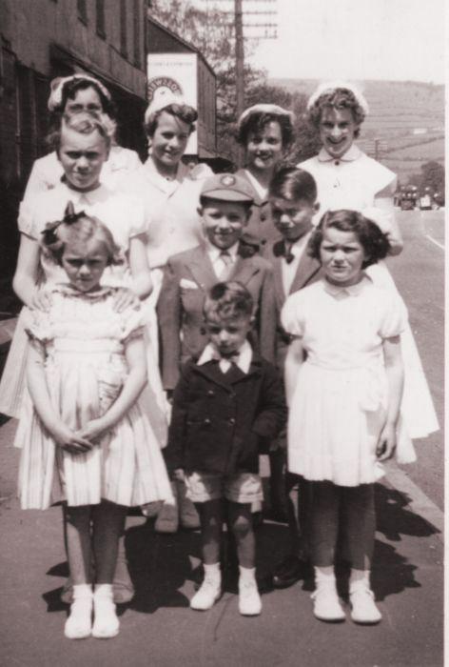
Impact of Social Change

Slide 6
Key Changes to the Social Context
Factors related to changes in values and lifestyle
Post World War II
Economic Security
Welfare State
The Pill
Feminism
Communications technology
Transformation of everyday institutions
Education
Religion
Marriage
Family
Work

Slide 7
Educational Attainment Baby Boomers and their Parents at Age 45-54
Source: ABS 1981; 2006

Slide 8
Registered Marital Status Baby Boomers and their Parents at Age 50-59
Source: ABS; NHS 1989-90; 2007-08

Slide 9
Household Structure
*
*
**
**
**
*
*
*
*
**
**
**
**
Source: ABS Census, 1986; 2006

Slide 10
Employment Status Baby Boomers and their Parents at Age 50-59
Source: ABS; National Health Survey, 1989-90; 2007-08

Slide 11
Employment Status by Gender Baby Boomers and their Parents at Age 50-59
Source: ABS; National Health Survey, 1989-90; 2007-08

Slide 12
Children Ever Born Females – Pre-war Cohort and Baby Boomers Age 50-59
Source: ABS Census, 1986; 2006

Slide 13
Implications for Health
Reduced social support
Higher proportions divorced
Fewer children
Higher proportions living alone
Multiple commitments extended over longer time
The sandwich generation
Women in paid work and caring
More uncertainty in relation to work and relationships
More diversity
Education
Family structures
Experiences
Marital status

Slide 14
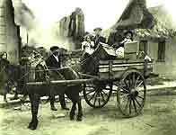
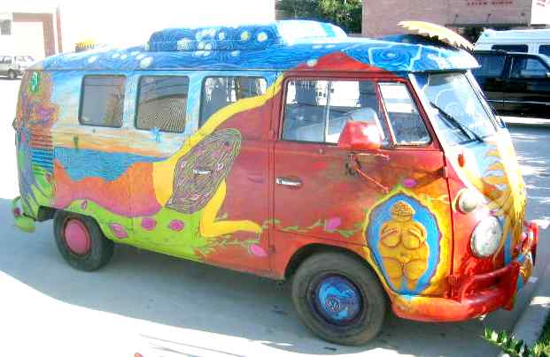
Impact of Social Change - Lifestyle

Slide 15
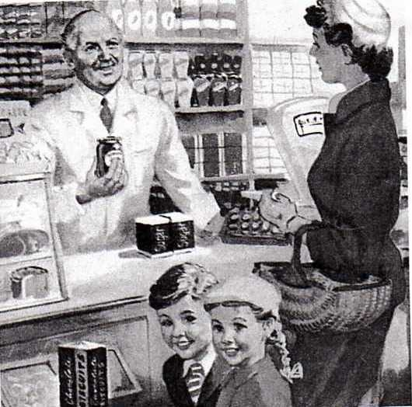
Increased Food Variety & Food Availability

Slide 16
Changes to Physical Activity Levels
Activity | Calories Burned | Activity | Calories Burned
Email Colleague 1 min | 2 | Walk to colleague’s office – 1 min | 4
Ride Elevator – 2 mins | 3 | Take stairs – 2 min | 19
Order take-out – 1 min | 1 | Cook meal | 70
Load dishwasher – 10 min | 23 | Wash dishes | 80
Watch TV - | 35 | Play cards | 52
Go to car wash | 35 | Wash car at home | 104
Play video game | 53 | Play basketball | 280
Mow lawn/ride-on mower | 88 | Mow lawn/power mower | 280
Source: OECD ......

Slide 17
Changes in Lifestyle Patterns
Loss of predictable routine
Demise of the 1950s meal system

Slide 18
Health
Status

Slide 19
Variables
Self report data
Have you ever been told by a doctor or nurse that you have ... ?
Do you have any other long term health conditions?
Multiple Conditions variable
Arthritis
Kidney disease
Diabetes
Depression
COPD
Asthma
*
*
**
**
**
*
*
*
*
**
**
**
**

Slide 20
Comparison of Risk Factors
*
*
**
**
**
*
**
*
**
*
**
*
**
**
**
**
**
**p=<.001
Source: ABS; NHS 1989-90; 2007-08

Slide 21
Comparison of Chronic Conditions
**
*
*
**
**
**
**
**
**
*
**
*
*
*
*
**
**
**
**
**p=<.001; *p=<.05
Source: ABS; NHS 1989-90; 2007-08

Slide 22
Multiple Chronic Conditions by Cohort
**
**
*
*
**
**
**
**
*
*
*
*
**
**
**
**
**p=<.001
Source: ABS; NHS 1989-90; 2007-08
Notes:
Baby boomers were less likely to have no chronic conditions and more likely to have either two, or 3 or more chronic conditions. Indeed, those with 2 or more conditions has almost doubled while those with three or more has increased by 92%

Slide 23
Self-rated Health by Cohort
*
*
**
**
**
*
*
*
*
**
**
**
**
**p=<.001
Source: ABS; NHS 1989-90; 2007-08
Notes:
Given the previous slides it is, perhaps, surprising that the proportion of baby boomers reporting poor-fair SRH was significantly lower than for the pre-war cohort. We haven’t found any research that reports such a large difference in SRH. Results from UK and US studies are inconsistent with some finding that slightly more baby boomers report poor-fair health and others finding slightly more report better health. Equally, some have found significantly poorer health in baby boomer women. It may be that the inclusion of an additional category on the positive pole of this global health measure may have had greater impact on comparability than we expected.
***
Reasons – cohort differences in attitudes to reporting health, or in how they interpret their health with this being linked to health expectations
Rice et al UK: more bbs reported health as bad or very bad than wartime cohort but not significant (notes that its important not to over-interpret the meaning of trends in self-rated disease prevalence.
Martin et al US: bbs less likely to report poor-fair health

Slide 24
Gender Differences – Asthma and Migraine
**
*
*
*
**
**
**
*
*
*
*
**
**
**
**
**p=<.001; *p=<.05
Source: ABS; NHS 1989-90; 2007-08
Notes:
For several of the conditions and risk factors there were also some significant gender differences. CLICK For instance increases in the prevalence of both asthma and migraine were only significant for female baby boomers but not males.

Slide 25
Gender Differences – High Cholesterol
**
**p=<.001
Source: ABS; NHS 1989-90; 2007-08
Notes:
On the other hand, the increased prevalence of high cholesterol was only significant for baby boomer males.

Slide 26
Gender Differences – Alcohol Risk
*
*
**
**
**
*
*
*
*
*
**
**
**
**
**p=<.001; *p=<.05
Source: ABS; NHS 1989-90; 2007-08
Notes:
Gender differences in nicotine and alcohol use are particularly interesting. Although alcohol risk for males is similar for both cohorts, baby boomer females are significantly more likely to drink at risky levels than females in the pre-war cohort and are less likely to have no risk.

Slide 27
Gender Differences - Smoking
**
**
*
*
**
**
**
**
**
*
*
**
*
*
**
**
**
**
**p=<.001
Source: ABS; NHS 1989-90; 2007-08
Notes:
Baby boomer males were significantly less likely to be smokers than pre-war males and were more likely to be ex-smokers or to have never smoked. Although female baby boomers were also more likely to be ex-smokers the proportion who were current smokers was virtually the same as for pre-war females. In addition, baby boomer women were significantly less likely to have never smoked.

Slide 28
Use of Other Health Practitioners
**
*
*
**
**
**
**
*
*
**
*
*
**
**
**
**
**
**p=<.001
Source: ABS; NHS 1989-90; 2007-08
Notes:
Baby boomers were significantly more likely to use all of the practitioners shown here except for acupuncturists. In terms of gender differences, males were more likely to use osteopaths and dieticians while females were more likely to use naturopaths and acupuncturists.

Slide 29
Private Health Insurance
*
*
**
**
**
*
*
*
*
**
**
**
**
Source: ABS; NHS 1989-90; 2007-08
Notes:
The proportion with some level of private health insurance did not differ significantly between the cohorts.

Slide 30
Private Health Insurance – Gender Differences
*
*
*
**
**
**
*
*
*
*
*
**
**
**
**
*p=<.05
Source: ABS; NHS 1989-90; 2007-08
Notes:
However this did vary by gender. Baby boomer women were less likely to have hospital only and more likely to have hospital and ancillary cover. By contrast, private health insurance for males has hardly changed.

Slide 31
Conclusion
Chronic conditions – worse health
Self-reported health – better health
Gender differences
Policy
Strategies for obesity and physical activity
Equitable access to health care and services
Effective integration of private and public health provision
*
*
**
**
*
*
*
*
**
**
**
**

Slide 32
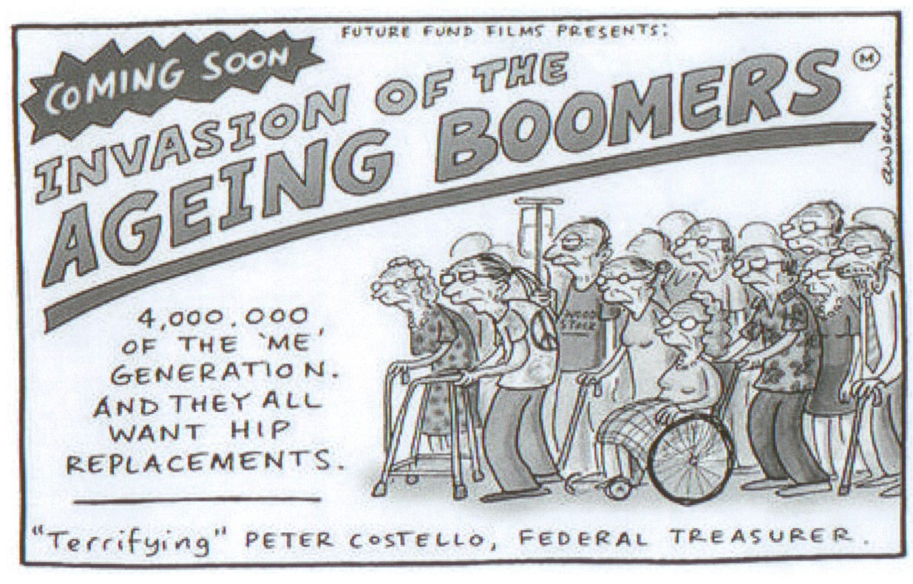
Wittert 2006

Slide 33
Acknowledgements and Contact Details
Acknowledgements
This research was funded through an Australian
Research Council Linkage grant
To Graeme Tucker and Rhiannon Pilkington for
their assistance with the National Health Survey
data
Contact Details
Jennifer Buckley
Email: jennifer.buckley@adelaide.edu.au

Slide 34
Limitations re Equivalence of Variables
SRH – extra category in 2008
Diabetes - Diagnostic criteria
In 1989-90 - ≥7.8 mmol L
In 2007-08 –≥ 7.0 mmol L
We have not adjusted for this difference
*
*
**
**
**
*
*
*
*
**
**
**
**
Notes:
In addition, scoring methods for some variables, such as physical activity and alcohol risk, have changed. However, the data collected on these items was largely equivalent and so it has been possible to re-calculate levels of risk using the same method for variables in both surveys. Equally it is important to note that medical practices and technology have changed over the intervening years and this may, in some instances, result in higher rates of diagnosis for some conditions. Diabetes is one example, with Australian guidelines for the diagnosis of diabetes changing between the two time periods from a fasting plasma glucose level of equal to or more than 7.8 to one of equal to or more than 7.0 mmolL

Slide 35
Notes on Multi Stage Area Sampling and weights used in the NHS
Multistage sampling is a complex form of cluster sampling. Instead of using all the elements contained in the selected clusters you randomly selects elements from each cluster. Constructing the clusters is the first stage. Deciding what elements within the cluster to use is the second stage.
How the ABS does it: household surveys conducted by the Australian Bureau of Statistics begin by dividing metropolitan regions into 'collection districts', and selecting some of these collection districts (first stage). The selected collection districts are then divided into blocks, and blocks are chosen from within each selected collection district (second stage). Next, dwellings are listed within each selected block, and some of these dwellings are selected (third stage). This method means that it is not necessary to create a list of every dwelling in the region, only for selected blocks. In remote areas,
Stratified multi-stage area sampling frame of private dwellings – therefore does not allow statistical treatment as a simple random sample. This dealt with by using replication methods to estimate variances for the complex sample design and weighting procedure used in the NHS. The replicate weights are a series of variables that contain the information on the primary sampling unit and the strata used in the sampling design that allows correct calculation of the standard errors when analysing complex survey data.
Weighting

