Slide 1
Health 2.0 trends and threads: Ultrabook™ based services to minimize risks and maximize benefits of web 2.0 for end users
Pavel Kubů M.D.
Intel World Ahead Program, Healthcare and Education
Notes:
Health 2.0 it´s up to you
The term '2.0' is currently being applied to many fields of endeavour: Politics 2.0,
Science 2.0, Trendwatching 2.0, Education 2.0, Police 2.0, Consultancy 2.0,
Civil Service 2.0, etc. Within the health and welfare sector we see the terms Health
2.0, Healthcare 2.0, Care 2.0, Welfare 2.0 and Medicine 2.0, to name but a few. All
are derived from the term 'Web 2.0', which was coined by Tim O’Reilly and Dale
Dougherty to refer to collaboration within networks which rely on 'collective intelligence'.
The more people involved, they contend, the greater the effects will be.
Many definitions of the term '2.0' refer to the new generation of websites which are
more dynamic and interactive than earlier (Web 1.0) examples. Rather than a 'solitary
web experience' such as reading an online newspaper or corporate brochure,
Web 2.0 users communicate with each other, and can even determine the type and
form of the information which appears on the monitor before them.
A significant component of Web 2.0 is therefore 'the wisdom of crowds'. The more
people who take part in a social network, the greater the value they create

Slide 2
Web 2.0 is changing patient – care giver relationship

Slide 3
Critical mass is networking online

Slide 4
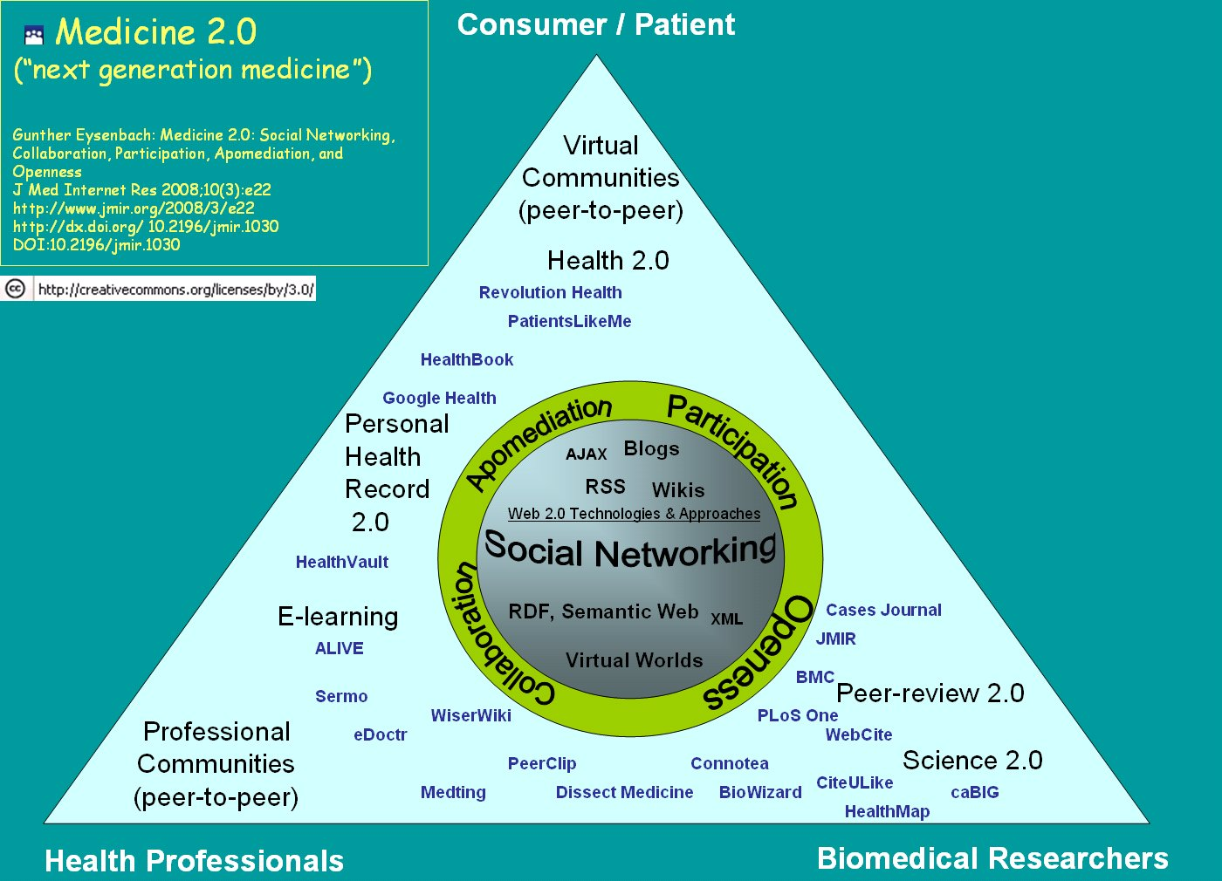
The wisdom of crowds: The more people who take part in a social network, the greater the value they create.
Source: Health 2.0 It’s up to you, Council for Public Health and Health Care for the Minister of Health, Welfare and Sport, Hague 2010

Slide 5
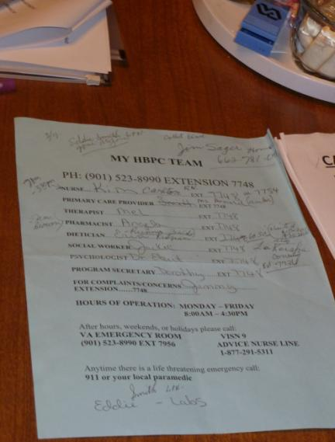
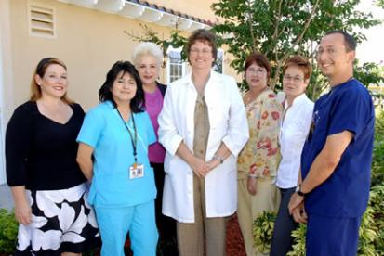
Example: Home based primary care (HBPC) in the VA
Patients with complex, chronic, disabling disease--too sick for the clinic!
Av age 76 years old, 8 chronic conditions
Care delivered in the home by inter- disciplinary team
24% reduction in total cost of care
63% reduction in hospital days
87% reduction in nursing home days
INTEL DOING ETHNOGRAPHIC STUDY OF HBPC TO HELP THEM SCALE QUALITY,COORDINATED CARE TO MORE VETS BY IMPLEMENTING HEALTH I.T. TOOLS IN THEIR WORKFLOW.

Slide 6
Threads of Virtual World
Source: 2011 Internet Crime Report, Internet Crime Compliant Center

Slide 7
Auto - Auction Fraud
In fraudulent vehicle sales, criminals attempt to sell vehicles they do not own. Criminals create an attractive deal by advertising vehicles for sale at prices below book value. Often the sellers claim they must sell the vehicle because they are moving for work or being deployed for the military. Because of the alleged pending move, criminals refuse to meet in person or allow inspection of the vehicle, and they often attempt to rush the sale.
To make the deal appear legitimate, the criminal instructs the victim to send full or partial payment to a third-party agent via a wire transfer payment service and to fax their payment receipt to the seller as proof of payment. The criminal pockets the payment but does not deliver the vehicle.
Source: 2011 Internet Crime Report, Internet Crime Compliant Center

Slide 8
Romance Scams
Victims believe they are “dating” someone decent and honest. However, the online contact is often a criminal with a well-rehearsed script that scammers use repeatedly and successfully. Scammers search chat rooms, dating sites, and social networking sites looking for victims. Although the principal group of victims is over 40 years old, divorced or widowed, disabled and often elderly, all demographics are at risk.
Scammers use poetry, flowers and other gifts to reel in victims, while declaring “undying love.” These criminals also use stories of severe life circumstances, tragedies, family deaths, personal injuries or other hardships to keep their victims concerned and involved in their schemes. They also ask victims to send money to help overcome alleged financial hardships.
Source: 2011 Internet Crime Report, Internet Crime Compliant Center

Slide 9
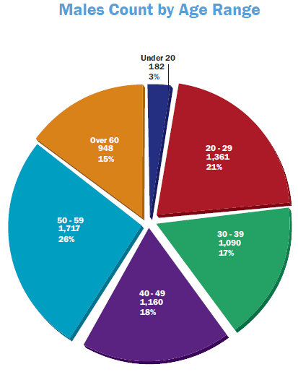
Work from Home Scams
Consumers continue to lose money from work-from-home scams that cyber criminals use to move stolen funds. Regrettably, due to their participation, these individuals may face criminal charges. Organized cyber criminals recruit their victims through newspaper ads, online employment services, unsolicited emails or “spam,” and social networking sites advertising work-from-home “opportunities.”
Participating with a legitimate business, the consumer becomes a “mule” for criminals who use the consumer’s or other victim’s accounts to steal and launder money. In addition, the scammers may compromise the victim’s own identity or accounts.
Source: 2011 Internet Crime Report, Internet Crime Compliant Center

Slide 10
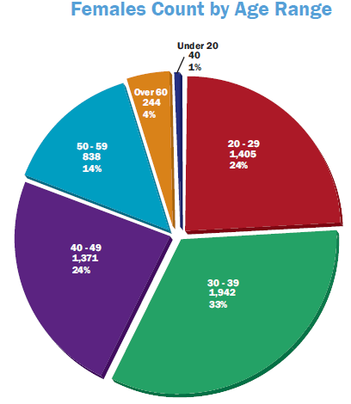
Loan Intimidation Scams
In these scams, a caller claims that the victim is delinquent in a payday loan and must repay the loan to avoid legal consequences. The callers purport to be representatives of the FBI, Federal Legislative Department, various law firms or other legitimate-sounding agencies. They claim to be collecting debts for various companies.
One of the most insidious aspects of this scam is that the callers have accurate information about the victims, including Social Security numbers, dates of birth, addresses, employer information, bank account numbers, and names and telephone numbers of relatives and friends. The method by which the fraudsters obtained the personal information is unclear, but victims often relay that they had completed online applications for other loans or credit cards before the calls began.
The fraudsters relentlessly call the victims’ homes, cell phones and places of employment. They refuse to provide the victims any details of the alleged payday loans and become abusive when questioned. The callers threaten victims with legal actions, arrests, and in some cases physical violence if they refuse to pay. In many cases, the callers even resort to harassment of the victims’ relatives, friends and employers.
Source: 2011 Internet Crime Report, Internet Crime Compliant Center

Slide 11
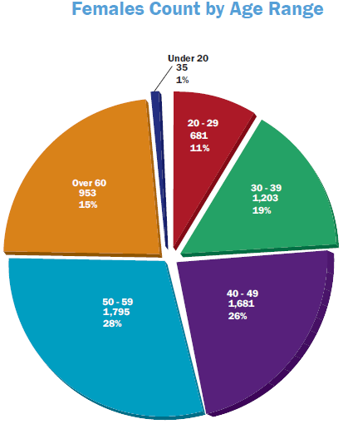
FBI Impersonation Email Scams
The names of various government agencies and high-ranking government officials have been used in spam attacks in an attempt to defraud consumers. Government agencies do not send unsolicited emails.
Complaints related to spam emails purportedly sent from the FBI continued to be reported with high frequency to IC3. In 2011, IC3 received about 39 complaints per day of this type.
Source: 2011 Internet Crime Report, Internet Crime Compliant Center

Slide 12
2B+
Worldwide Internet Users
247,000,000,000
Emails Sent Every Day
2B
Videos Viewed per Day
2.5B
Images Uploaded to Facebook per Month
Source: joaogeraldes.wordpress.com/2010/09/05/31-infographic-explores-internet-facts-figures-history-statistics/
Source: worldometers.com
Notes:
It’s all there in the numbers:
YouTube: over 2 billion videos viewed every day, over 2.5B images uploaded to facebook
Email: you an I both know that is HUGE…
Netflix: 14 million subscribers and growing at 35% a year.
Behind it all, of course, is the unstoppable growth of internet: the ultimate distribution channel for our Personal Media Machines. With more than 2 billion internet-connected users worldwide, it’s becoming clear that the most common language on the web is no longer English, Chinese or Spanish…It’s pictures. Especially moving pictures.

Slide 13
User
Experience
User
Experience
USER EXPERIENCE
Software (OS, Apps)
Software (OS, Apps)
Processor/
Hardware
Processor
H/W
Notes:
Customers expectations are changing – with the advent of many new devices, it has become very clear that experience is clearly what customers are really looking for. Our research has shown that customers really want to be in control of their task and do not like to wait – now, a key point to note here is that while experience is what the consumer is looking for, it needs a great package of software and hardware to deliver that experience.
So, our mind set has to shift to right sizing our products to the customer expectations – with the great experience - driven by powerful hardware and software – behind the scenes.

Slide 14
“Don’t be encumbered by history. Go and create something wonderful.”
— Robert Noyce
Notes:
Fix the full Quote

Slide 15
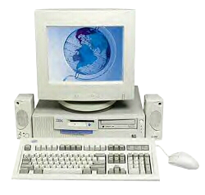
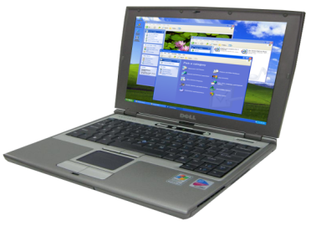
We Know How to Transform Experiences
1995
2003
2012+
Multi-media
CD ROM
Uncompromised
Mobility
Ultra Thin
Ultra Responsive
Ultra Secure
Ultra Connected
Ultrabook™
Notes:
Time to do it again -

Slide 16
The Ultrabook™ Beyond Thin and Light
PERFORMANCE
RESPONSIVE
SECURE
POWER / BATTERY LIFE
Projected Features
Notes:
Performance, Responsive, Secure, Battery Life
The Ultrabook is a result of how we are transforming our thinking around the PC – focusing on the experience and then developing the features need to deliver the experience.

Slide 17
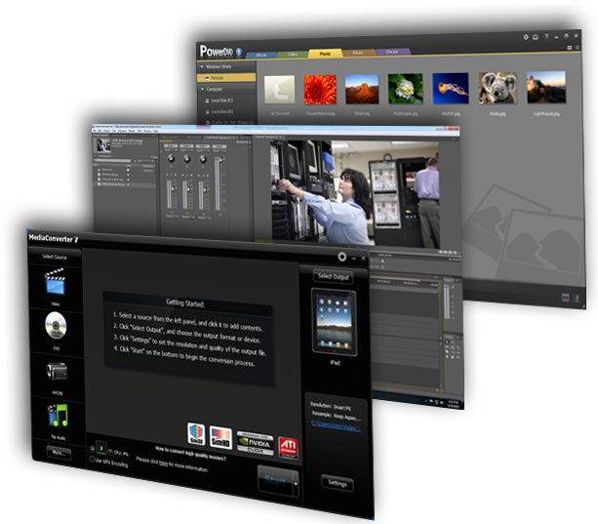
MEDIA
Intel® Quick Sync Video
TECHNOLOGY
Ultrabook™ devices deliver outstanding media experiences
Other brands and names are the property of their respective owners.
Notes:
Let look at the processor graphics -> One of things you notice is that these technologies that we introduced earlier all drive a great “media experience”

Slide 18
Intel®
Smart Response
Technology
Enabling SSD-like performance with HDD capacity
Intel®
Smart Connect
Technology
Content continuously updated while the notebook is asleep!
Intel®
Rapid Start
Technology
~7 seconds to wake from hibernate!
No need to shut down the PC – Days, not hours of battery life.

Slide 19
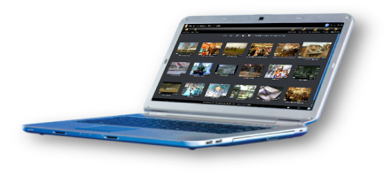
PCs are Stolen Frequently with Sensitive Data
“
People are storing
200,000
more and more personal data on their laptops
laptops lost or stolen every year at European airports
12,000 laptops lost or stolen every week at US airports”
”
- Dell-Ponemon study
Notes:
Laptop theft is serious worldwide problem and it is getting worse all the time. As you can see from the statistics, every 12 seconds a laptop gets stolen in the U.S. According to a Dell-Ponemon study, 200,000 laptops are lost or stolen every year at European airports, 12000 laptops are stolen EVERY WEEK at US Airports. The
Laptop users store valuable records, such as bank statements, or private information, such as credit card details, on their laptop. Loss of personal laptop and the data it contains can be an emotional and financial loss. Intel AT delivers peace of mind by helping lockdown lost or missing laptops.
How does Intel Anti-Theft Service bring Intel AT Technology to life? What’s the difference between Intel® Anti Theft Technology and Intel Anti Theft Service? Lets take a look.

Slide 20
Security and Trust Built In
Intel®
Identity Protection
Technology
Intel®
Anti-Theft
Technology
Notes:
20

Slide 21
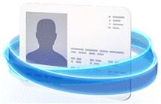
A path to building a Service for end user…
Intel® IDENTITY PROTECTION
Intel® INSIDER™
Security is top concern for PC users¹
ID theft is lead consumer and business concern, followed by Malware³
Users spend over 4 hours per month viewing online video on a PC⁵
Online video market $6.9B in 2014 (46% CAGR)⁶
Worldwide 30 million apps (not app updates) are downloaded each day⁷
200K laptops lost or stolen every year at European airports/12K laptops lost or stolen every week at US airports²
600K Facebook* IDs compromised every day⁴
1. Source: Intel market research “Voice of the Customer” - global customer survey
2. Source: Dell-Ponemon Study
3. Source: Intel Market Research Voice of the Customer Survey
4. Source: The Guardian, October 2011
6. Source: Screen Digest
Notes:
Partner with Intel to define and deliver value-add software marketing activities designed to build awareness and preference before the sale, add value at time of sale, and enhance the customer experience after the sale.
Intel works extensively with the software ecosystem to ensure applications are ‘Enhanced for Core’.
Work with your Intel representative to identify apps for gaming, digital content creation, security, and – coming soon – touch, sensor, gesture, and more.
Engage with Intel, our software fellow travelers, and our creative agency to define and deliver activities in support of your Ultrabook™ marketing and sales objectives.
Examples include high-value software bundles, online promotional contests, social media activities, experiential marketing, events, etc.
protected data – secure transactions - rich content – new UX is what customers are looking for. Services and SW deliver that experience. Look at what is driving some of this behavior – the scarey stuff - 200k laptops stolen in European airports per year. 600k facebook ids compromised per day and the opportunity – online videos are what consumers are looking for.
1. Source: Intel market research “Voice of the Customer” - global customer survey
2. Source: Dell-Ponemon Study
3. Source: Intel Market Research Voice of the Customer Survey
4. Source: The Guardian, October 2011
6. Source: Screen Digest

Slide 22
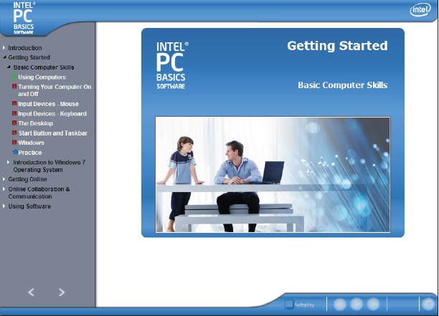
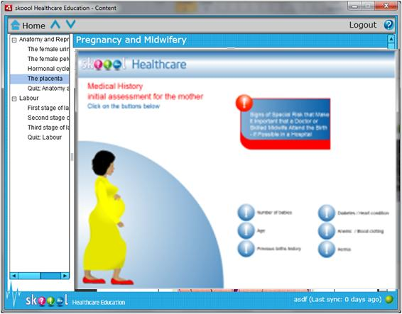
Enabling the Ultrabook™ Experience for Ageing population

Slide 23
“The best way to predict the future
is to invent it.” — Alan Kay
Computing Pioneer
Notes:
Born in 1940 now 72 years old computing science living legend. Starting in 1984, Kay was an Apple Fellow at Apple Computer until the closing of the ATG (Advanced Technology Group), one of the company's R&D divisions.^{[4]} He then joined Walt Disney Imagineering as a Disney Fellow and remained there until Disney ended its Disney Fellow program. After Disney, in 2001 he founded Viewpoints Research Institute, a non-profit organization dedicated to children, learning, and advanced software development.
Later, Kay worked with a team at Applied Minds, then became a Senior Fellow at Hewlett-Packard until HP disbanded the Advanced Software Research Team on July 20, 2005. He is currently head of Viewpoints Institute.

Slide 24
pavel.kubu@intel.com

