Slide 1



Age-Friendly Manitoba Initiative
Jim Hamilton, MSc, MPA
Associate Director, Centre on Aging
University of Manitoba

Slide 2

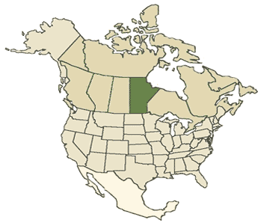
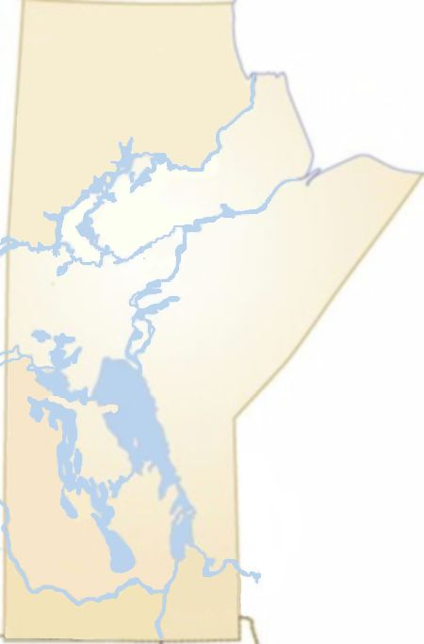
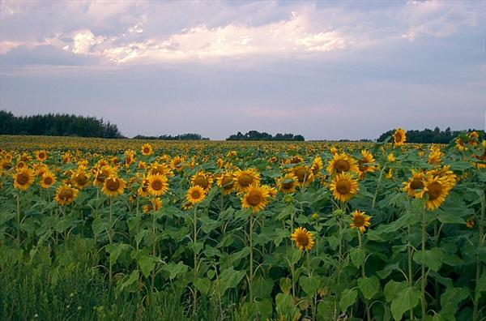
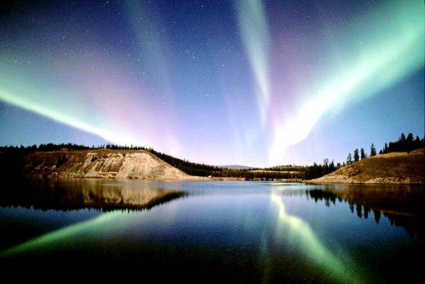

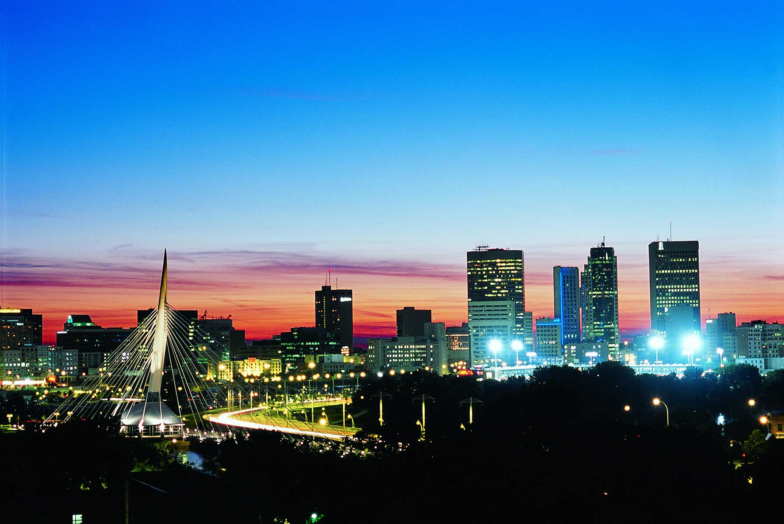
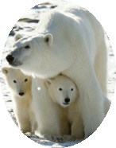
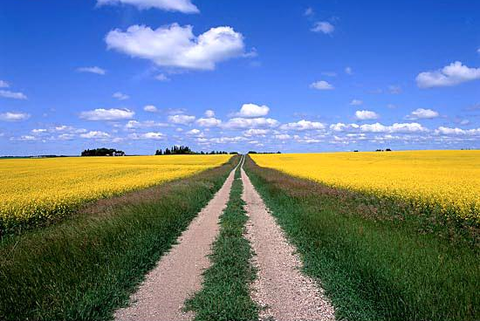
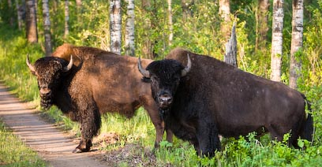

Slide 3
Define rural and remote!?
 | Population (m) | Density (km²) | Area (km²)
Manitoba | 1.2 | 2 | 650,000
Canada | 34.5 | 3 | 9,985,000
Australia | 22.6 | 3 | 7,618,000
Ghana | 24.2 | 101 | 238,000
United Kingdom | 62.3 | 255 | 243,000
Japan | 127.9 | 337 | 378,000

Slide 4
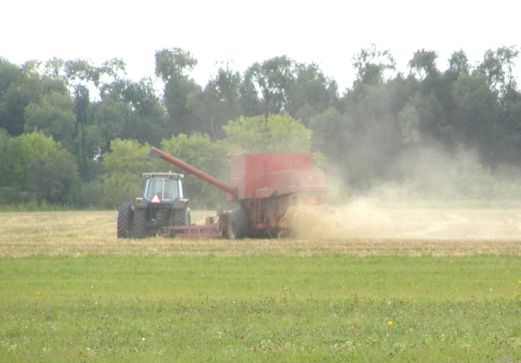
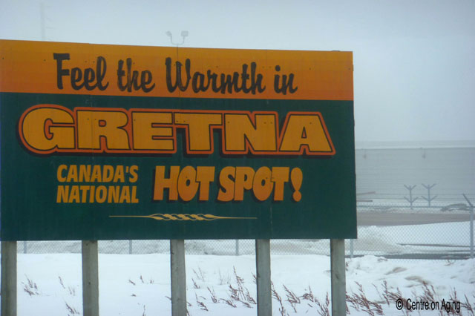
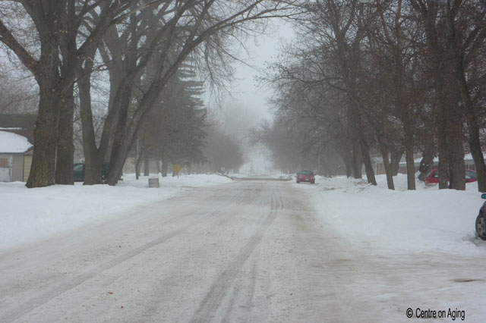
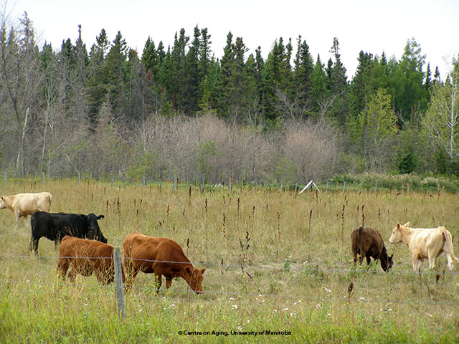
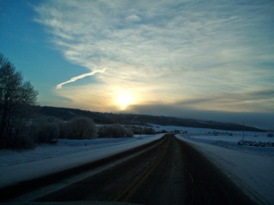
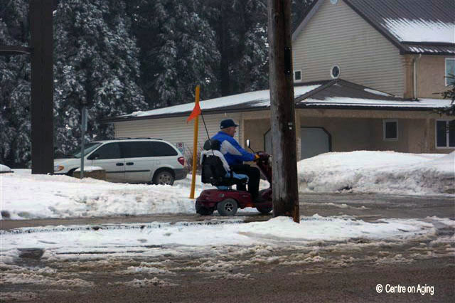
A portrait of rural Manitoba
Notes:
Top photos (left to right) Deer in Pinawa, cows in pasture (Pinawa), country road in Notre Dame de Lourdes
Bottom photos (left to right) harvesting fields RM Brokenead, fields in Pinawa area, Wetland conservation area with Canadian geese in Flin Flon

Slide 5

Age-friendly communities
Rounds 1, 2, 3, 4, 5
Rural Municipalities
Villages
Towns
Cities
80% of Manitobans
Snow Lake
Pinawa

Slide 6
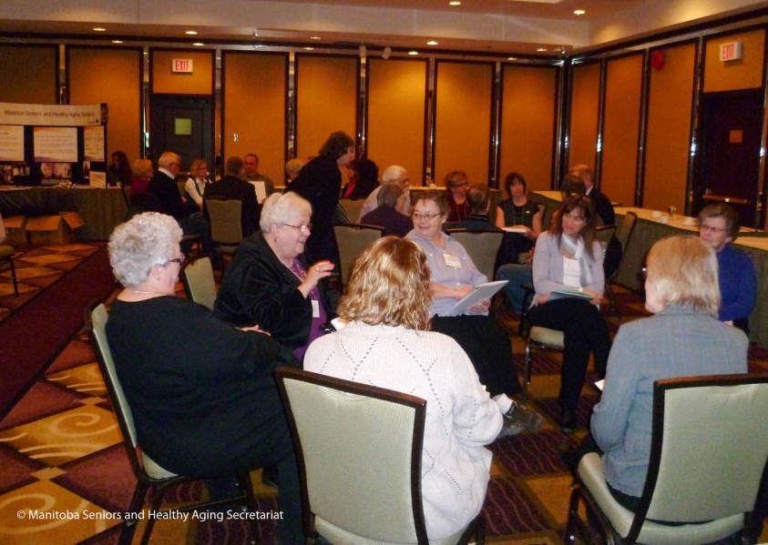
Challenges: capacity
Helping communities with the “human resources”
Money and grants to implement age-friendly changes
You can have all the funding in the world, but it’s pointless if you don’t have the people to do the work
The problem is this: it’s finding the labour, the labour to do these projects
I mean, we have lots of ideas, you know, we’d like to do lots of things, but where does the money come from?

Slide 7
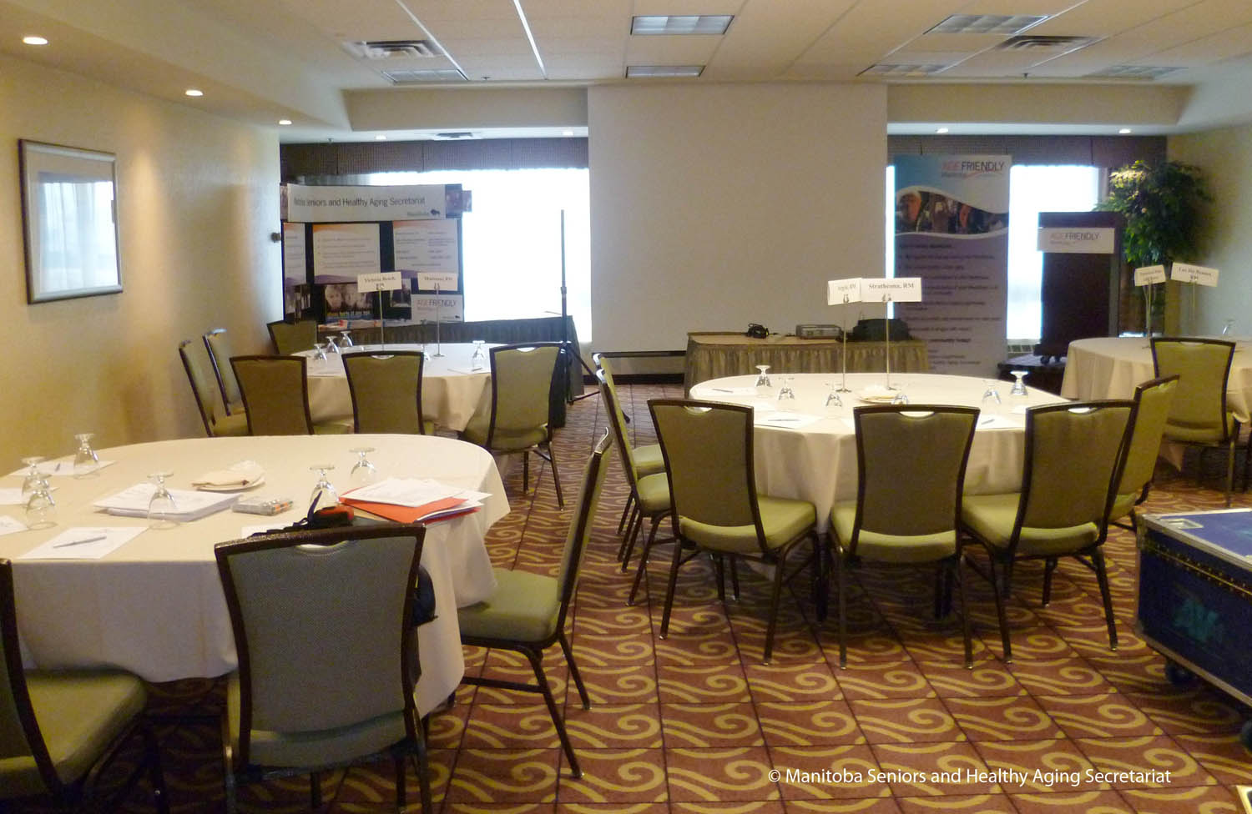
Challenges: awareness & buy in
Endorsement of the Age-Friendly Initiative by Municipal Council
Convincing the community that the Age-Friendly Initiative is worthwhile
Keeping the age-friendly momentum going!
Getting people on board
Well, I think one of the things is having people understand what the Initiative is about

Slide 8
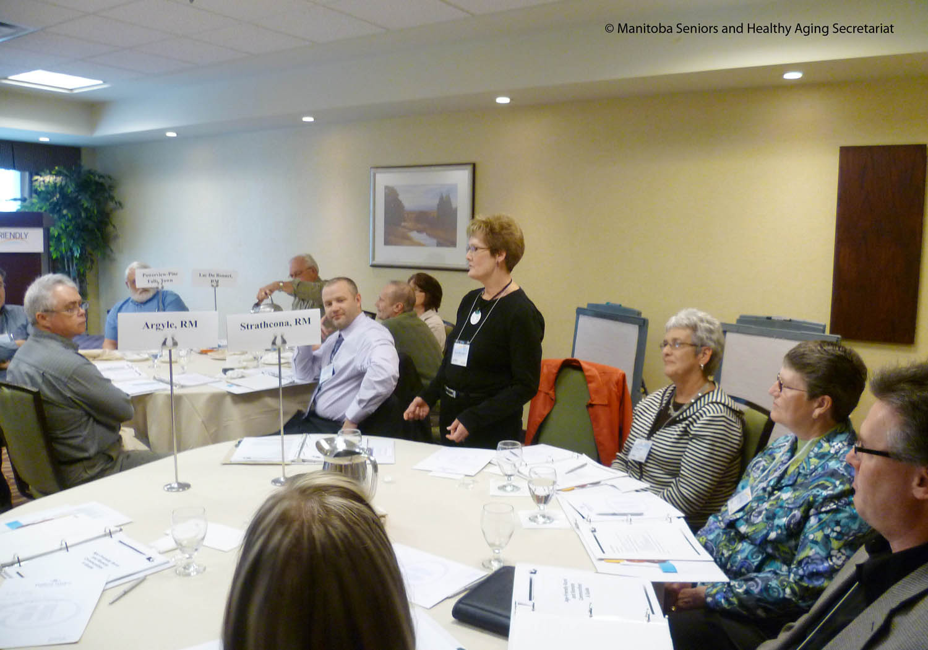
Becoming more age-friendly
Power doors
Senior parking stalls
Sturdy benches with armrests
We were very fortunate to have a student working here last winter and fall. She created a senior resource booklet, which will be printed
[The community consultation report] was very useful…The Economic Development officer put benches around town and put up large street signs

Slide 9

Age-Friendly guides

Slide 10
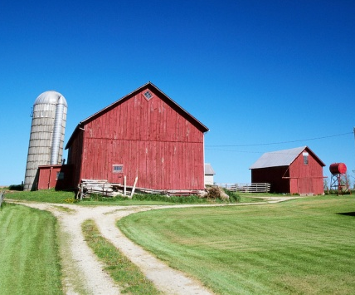



Partnerships
next
Manitoba communities
next
Public Health Agency of Canada
Chamber of Commerce
Association of
Manitoba Municipalities

Slide 11
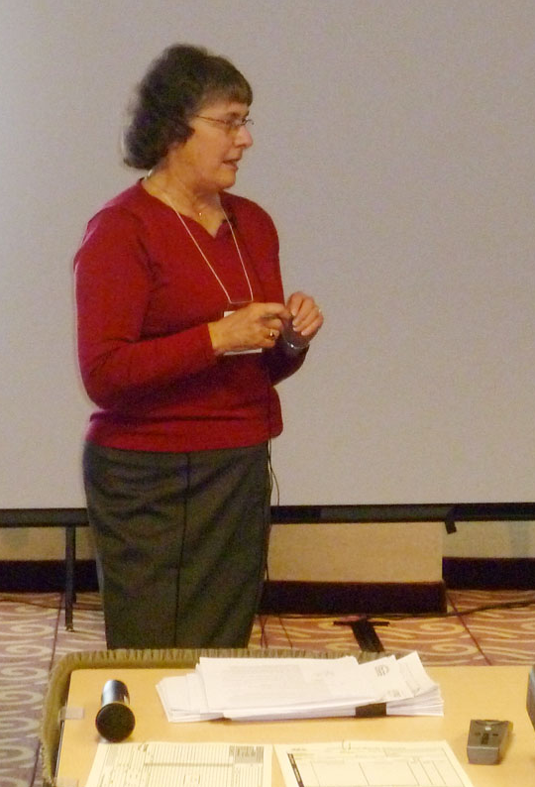
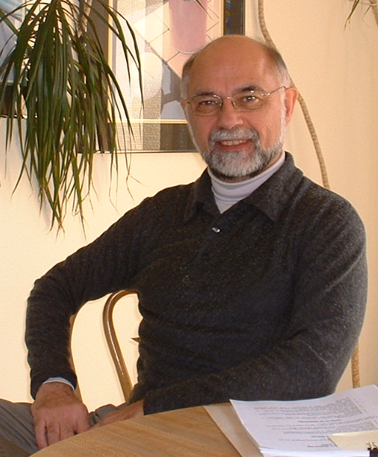
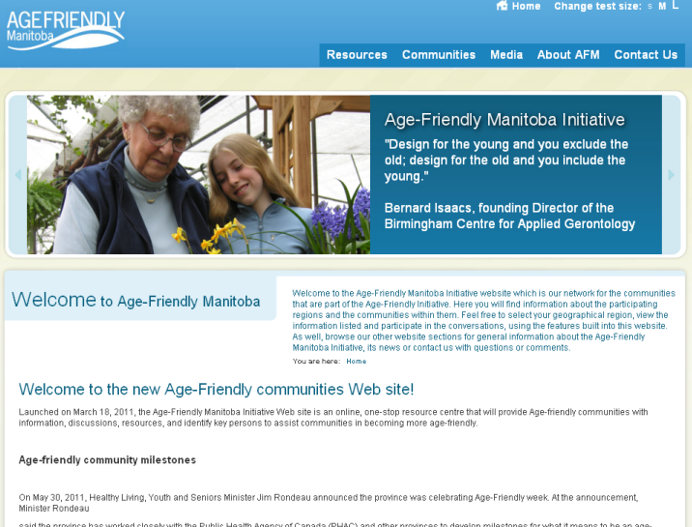
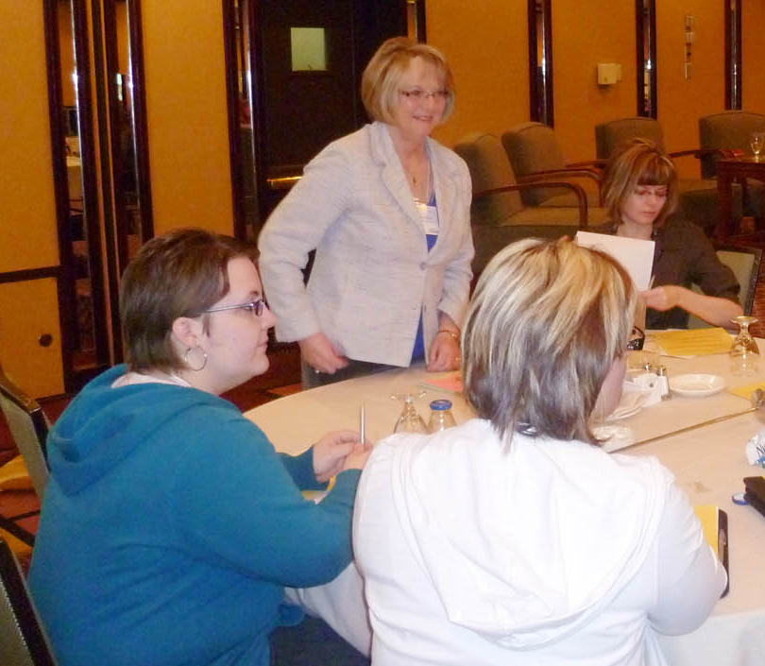
Key resources
Web site
Resource team

Slide 12
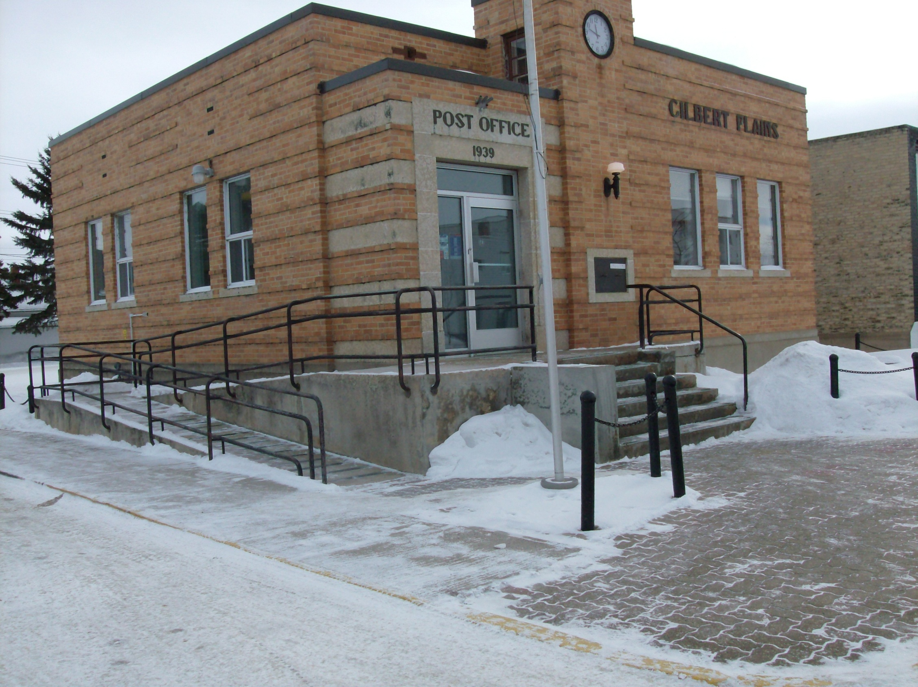
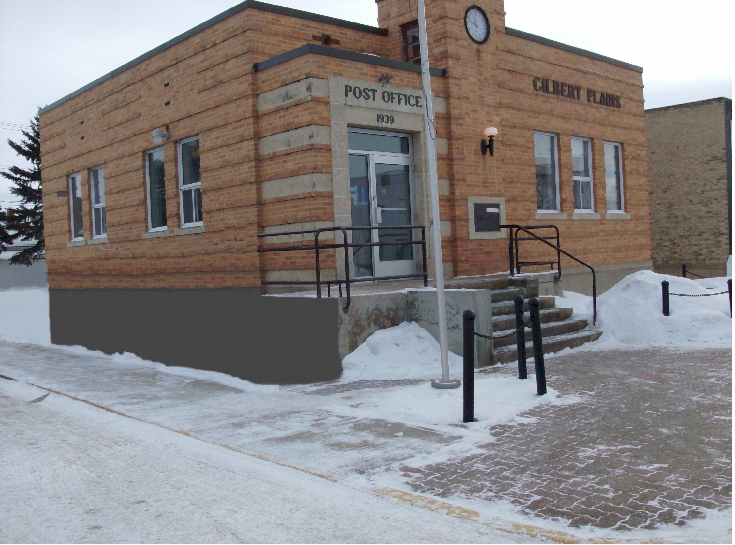

Slide 13
Questions?
Contact information
Jim Hamilton
Centre on Aging, University of Manitoba
338 Isbister Building
Winnipeg MB Canada R3T 2N2
Email: Jim_Hamilton@UManitoba.CA
Web: www.umanitoba.ca/centres/aging
www.agefriendlymanitoba.ca

