Slide 1
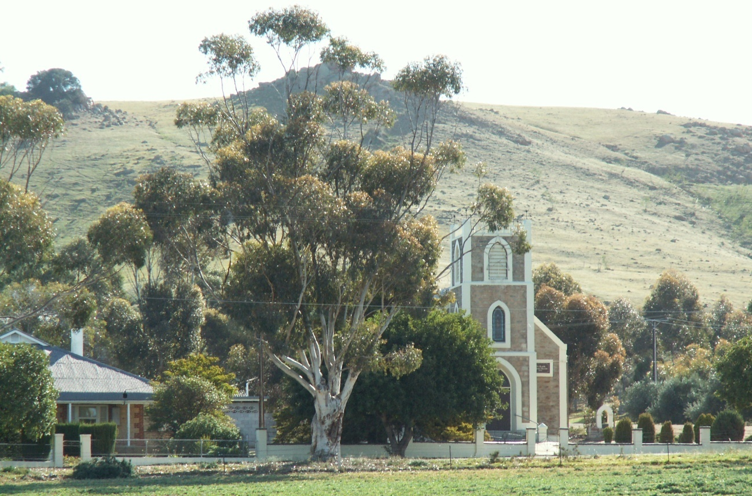
Social Spaces, Rural Places
Helen Feist PhD | Deputy Director
Australian Population and Migration Research Centre
helen.feist@adelaide.edu.au

Slide 2
Presentation Outline
Ageing Australian Rural Populations
Why Social Connections are so Important?
Brief Outline of the Two Studies
Aspects of Social Networks from the Two Studies
Enabling Social Connections AND Ageing-in-Place
Regardless of Location

Slide 3
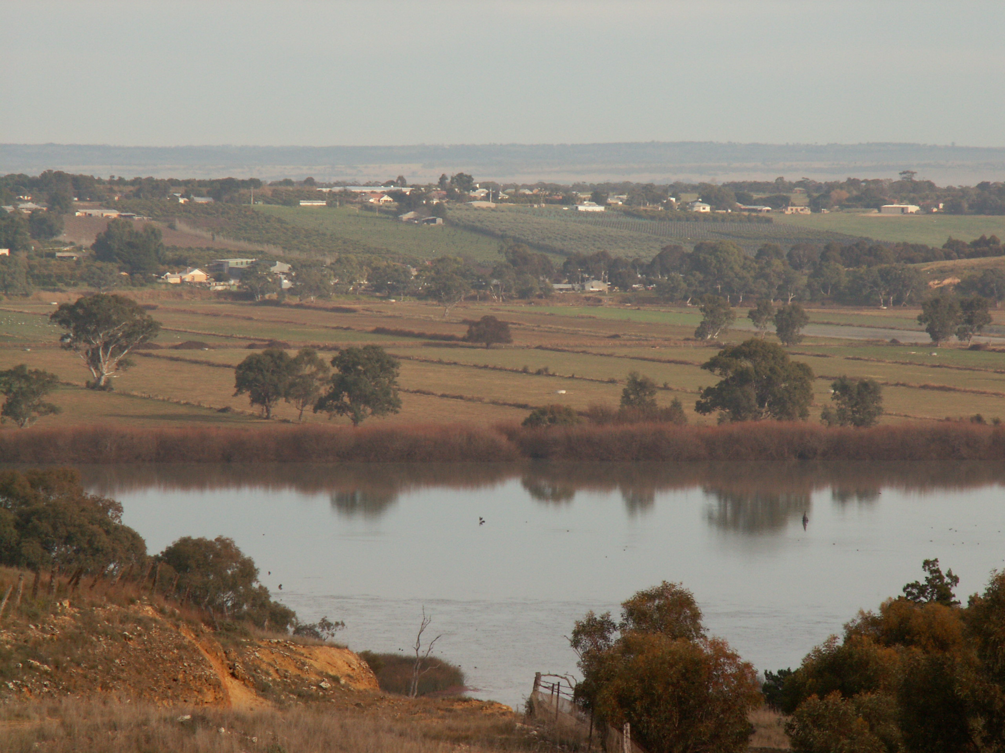

Slide 4
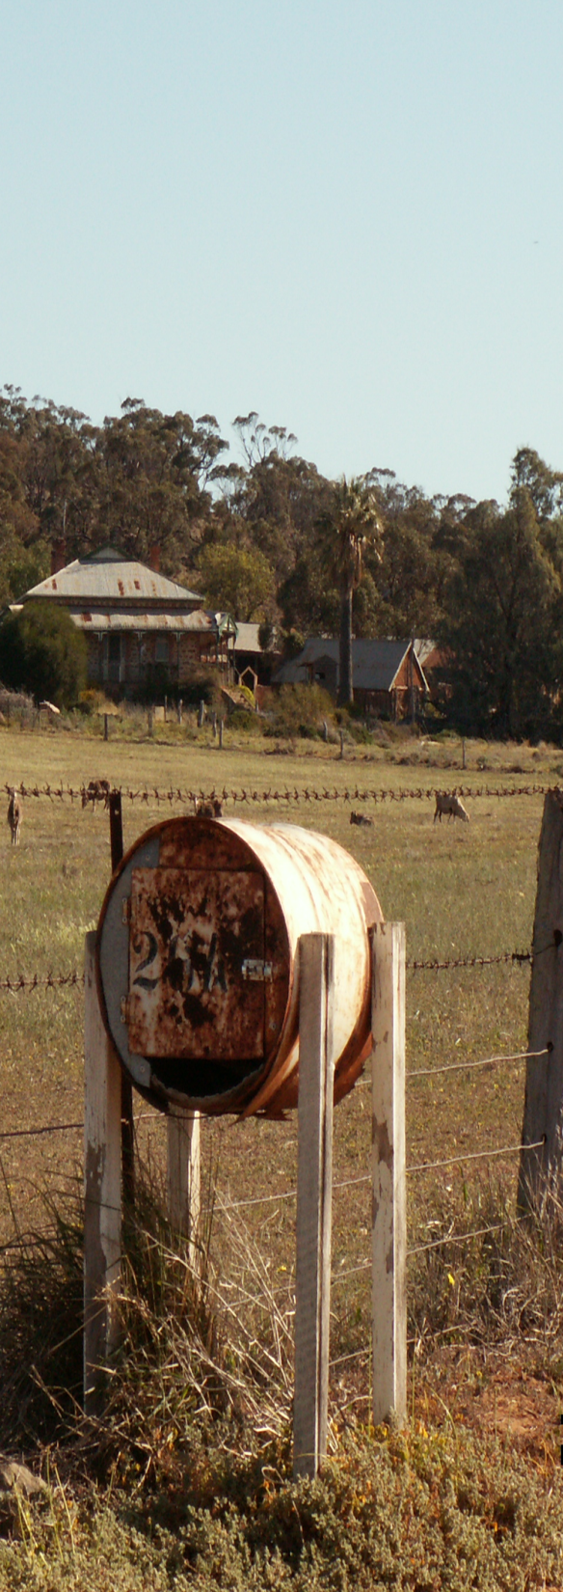
The Older We Are The Less Likely We Are To Move

Slide 5
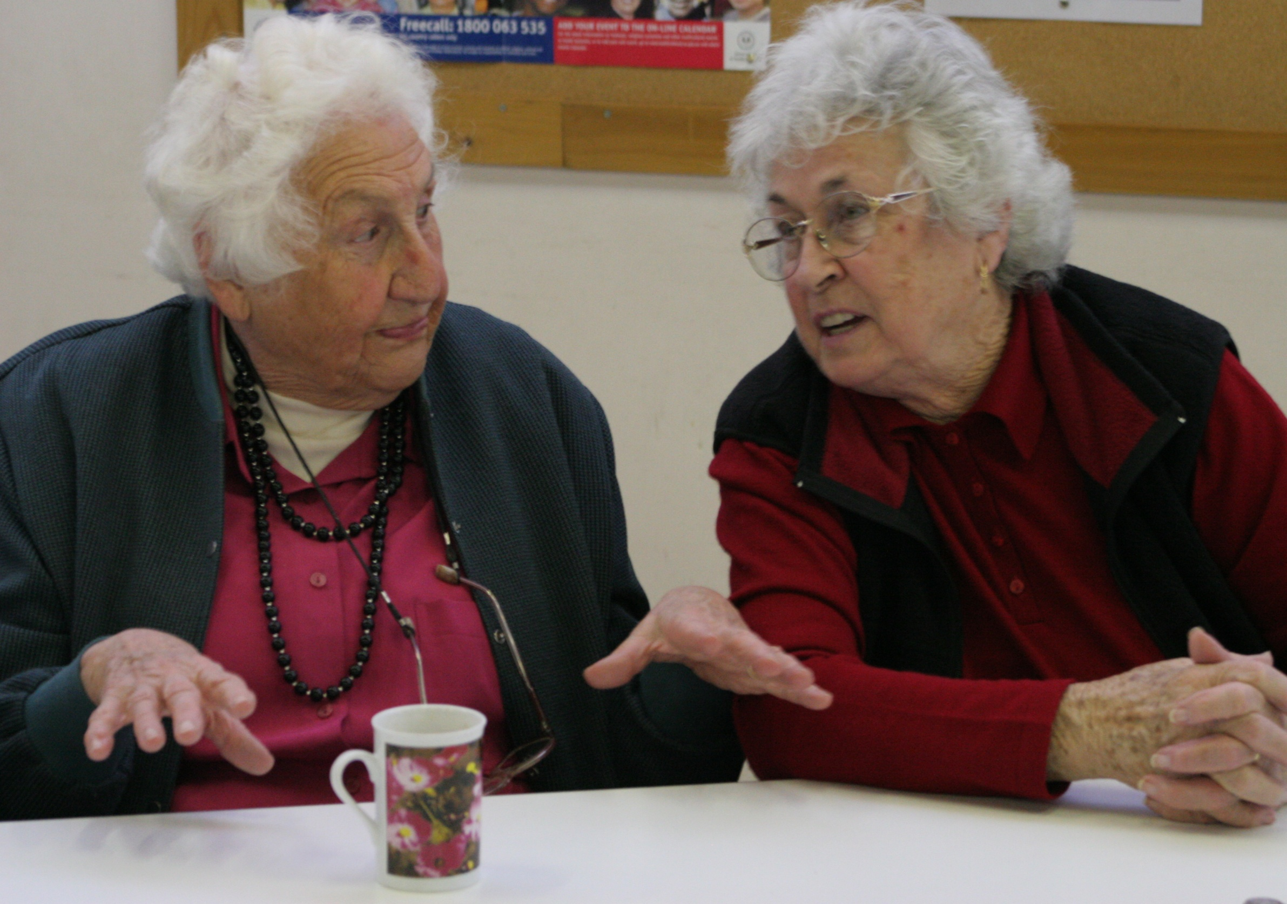

Slide 6
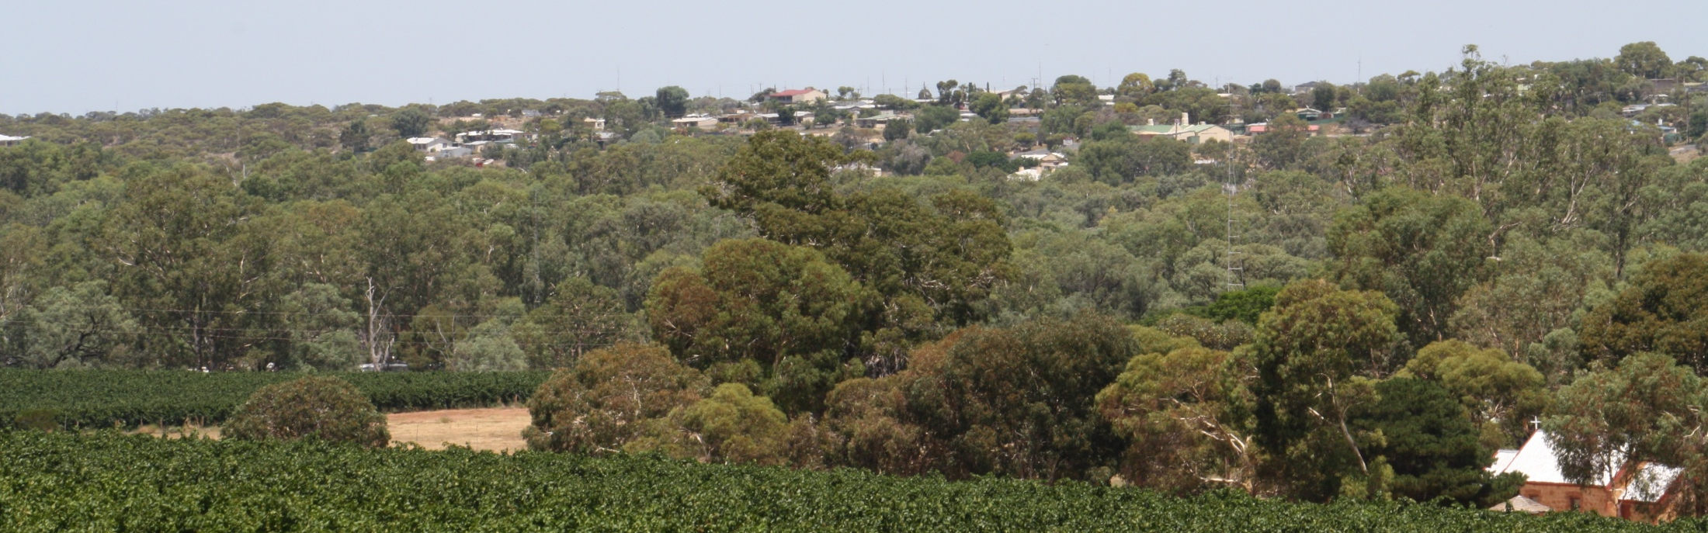
For older adults in rural regions of Australia the issues of distance, accessibility and social connectivity associated with rural living add another dimension to the physical and social challenges associated with ageing

Slide 7
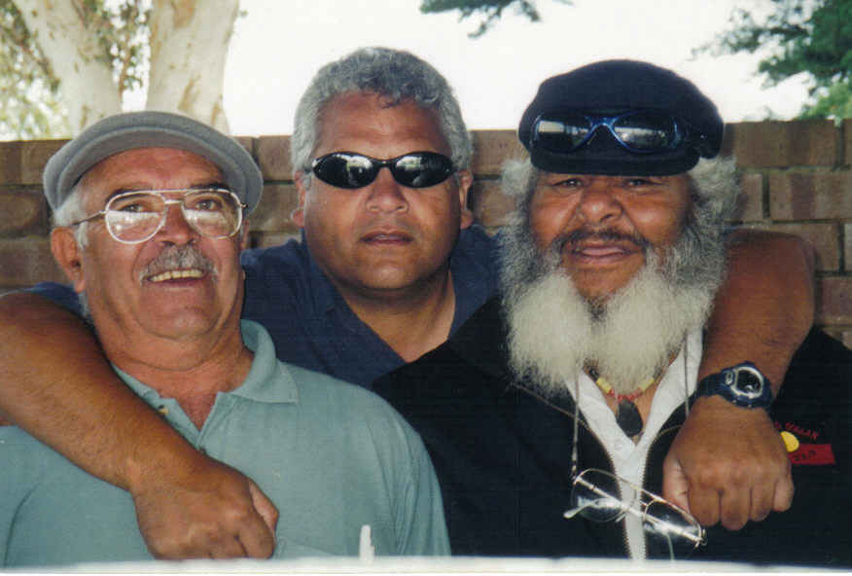

Slide 8
The Murray Lands Study Region
48,186 square km
12 Local Councils
Regional City of
Murray Bridge

Slide 9
Social Spaces and Rural Places
The older person as an individual
The place the person lives in
Who is in their social network
The spatial properties of those
networks

Slide 10
Comparative Overview of Studies
 | Study One | Study Two
Number of Participants | 223 | 201
Gender Ratio | 95 m 128 f | 93 m 108 f
Median Age | 78 years | 72 years
Living Alone | 38% | 31%
Self-rated Health as Excellent/Very Good | 25.9% | 27.4%
Still Driving | 73% | 89%
Intend to Age-in-Place | 76% | 79%

Slide 11
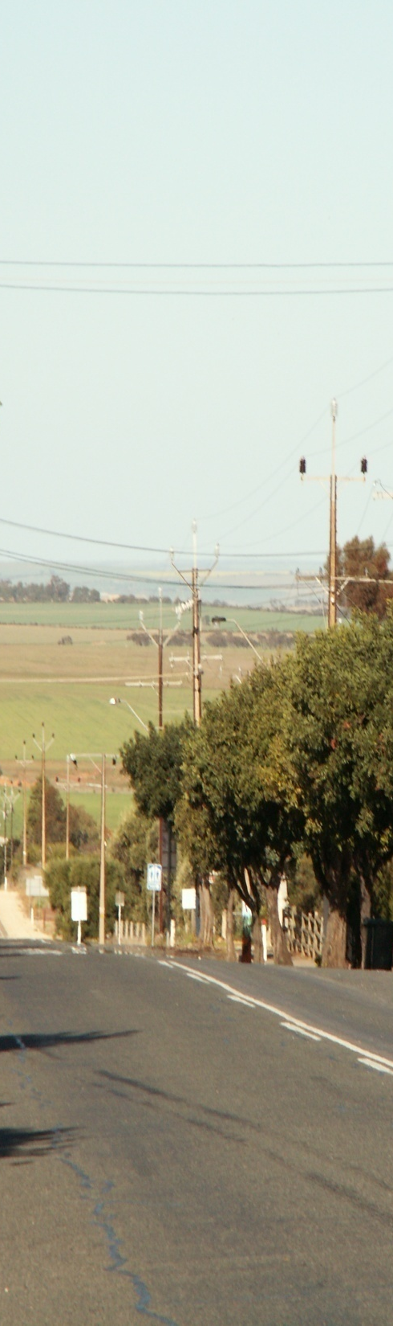
Social Network Size
Average network size: 14.4 ties
Females recorded larger networks than males
Poorer self-rated health was associated with smaller network size
Participants who lived alone, were no longer driving and/or who lived on farms and in small towns were more likely to have smaller networks

Slide 12
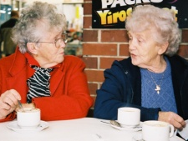
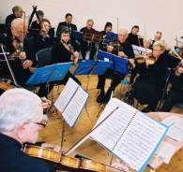
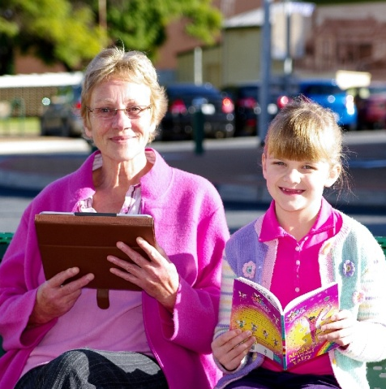
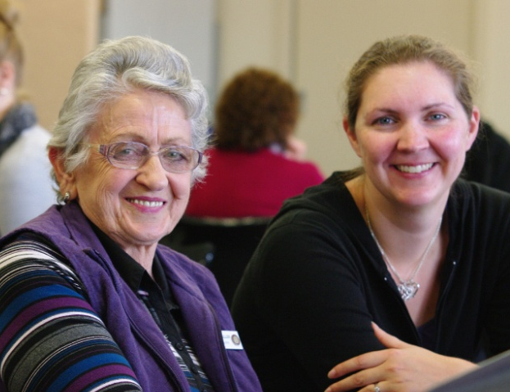
Social Network Typologies
Family matter!
Groups and informal activities represented over a quarter of nominated network ties
Services were not commonly represented
Nominated ties do not necessarily reflect all social and community contact

Slide 13
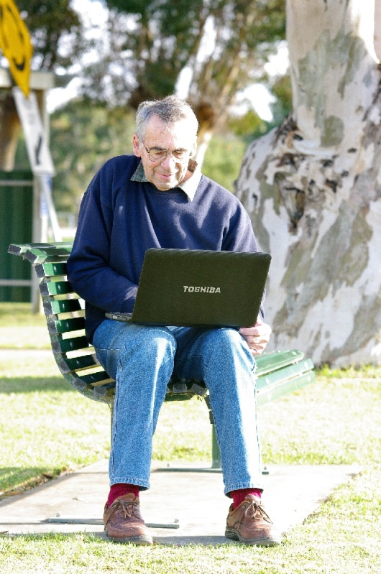
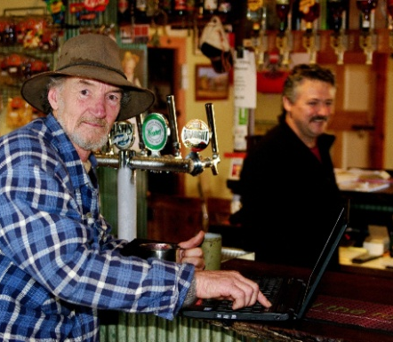
Mode and Frequency of Contact
The majority of social network ties were kept in person
Contact with children was more likely to be frequent
Those networks that were face-to-face were more frequent and more likely to be reciprocal in nature
Distance mattered – the closer the network tie the more frequent the contact

Slide 14
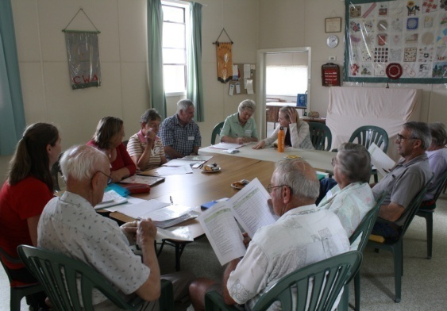
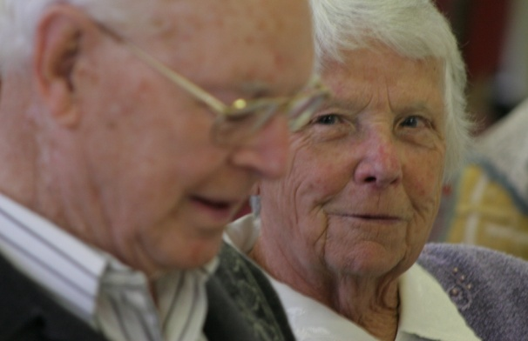
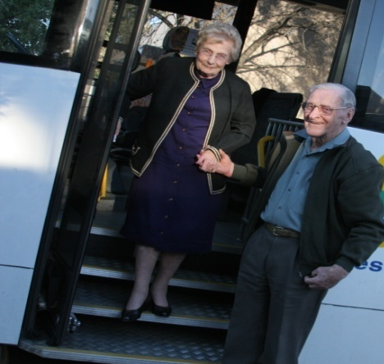
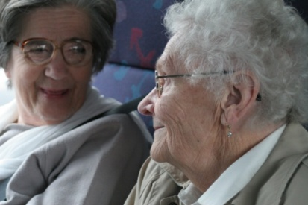
The Spaces of Social Networks
Localised Ties: Neighbours, Services, Friends, Activities and Groups
Family network ties were the least likely to be localised
Localised ties more likely to face-to-face and a mixture of face-to-face and telephone
Contact with distant ties occurred less frequently

Slide 15
Thank you helen.feist@adelaide.edu.au

