Slide 1
When the place where we age changes: Older people’s experiences of social exclusion in two Montréal neighbourhoods undergoing change
Jean-Pierre Lavoie^{1,2,3}, Damaris Rose⁴, Victoria Burns^{1,2},
1. Centre de Recherche et d’Expertise en Gérontologie Sociale (CREGÉS)
2. McGill University, School of Social Work
3. Université du Québec à Montréal, École de Travail social
4. Université INRS, Centre Urbanisation Culture Société
Montréal, Canada
IFA Conference, Prague, May 2012

Slide 2
Aging in a neighbourhood undergoing change
“Aging in Place” literature (social gerontology, geographies of aging) postulates that neighbourhood scale of daily life grows more important as people age
  Instrumental attachment
    Spatial proximity of services as personal mobility declines
  Affective attachment to place
    familiarity: sense of security, sense of continuity
    locally-based strong and/or weak social ties
But these presumed qualities of neighbourhood for older adults are based on assumption of a stable environment
Research is scarce on impacts of changes in neighbourhood—especially those linked to gentrification
Notes:
Why did we decide to do this study? Improve our understanding of how older people who are aging in place experience a neighbourhood undergoing change
In recent years, extensive research on aging in place….BUT… Most research has focused on the person rather than the place in the person-environment paradigm
Place is key to consider because the immediate environment becomes more important as people age. Why does it become more important?
The literature speaks of instrumental attachment (or ties) which are important because people become less mobile with age
The literature also speaks of affective attachment: With age, locally-based strong and weak social ties take on more importance
Gap in the literature! Research is scarce on impacts of changes in neighbourhood- especially those linked to gentrification

Slide 3
Research questions
What place does the neighbourhood have in the everyday lives of older residents?
  What places do they frequent?
  Where are their social networks situated?
  What neighbourhood resources and services do they use?
What neighbourhood changes do older residents notice?
How do neighbourhood changes affect older residents’ experiences of social exclusion/inclusion?

Slide 4
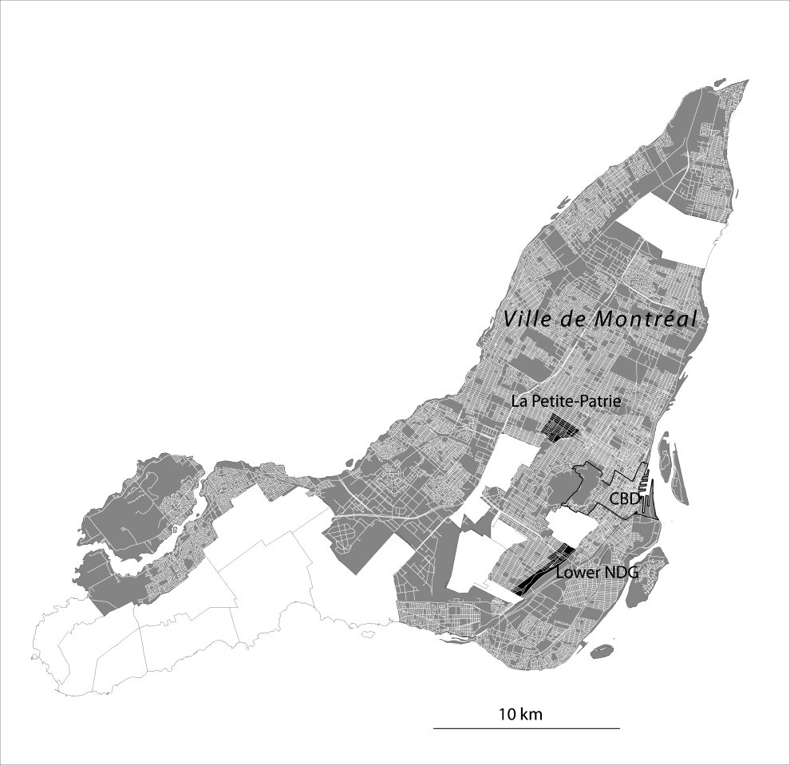
Our study
Montréal study areas
Older adults’ perspectives on gentrification in four neighbourhoods (2 in Montreal, 2 in Toulouse):
  Montreal: La Petite-Patrie and Lower NDG (St-Raymond)
  Toulouse: Les Minimes and Marengo
Target population:
  Current and former residents aged 70 and over who are mobile
  Key informants
Semi-structured interviews
  fully transcribed and coded (inductive & deductive)
Notes:
Mention that this presentation is on the two Montreal neighbourhoods.
Inductive: Grounded theory, deductive: conceptual frameworks (attachment, social exclusion, indirect displacement)

Slide 5
Participants
Petite-Patrie: N = 18
  Age : 68 to 89
  13 women; 5 men
  13 current residents; 5 former residents
  12 French speaking; 6 Italian speaking
  13 renters (4 LCH); 5 home owners (all Italian speaking)
Lower NDG: N = 12
  Age: 70 to 95
  7 women; 5 men
  11 current residents; 1 former resident
  7 English speaking; 5 Italian speaking
  3 renters; 9 home owners
10 key informants
  6 in La Petite-Patrie and 4 in Lower NDG
  municipal councillor, priest, community workers, etc.)
Notes:
LC= Low cost housing
All lived in neighbourhoods for at least 10 years, most were living for more than 30
Low education: 2/3 have 7 years or less of formal education

Slide 6
The Petite-Patrie neighbourhood
Early C20; 5 km from downtown, 2 subway lines
Working-class French-Canadian, Italian minority –founding neighbourhood of Italian immigration to Mtl
Major attractions: Jean-Talon Market, Little Italy
Re-branding - Little Italy (shopping destination, fine foods…) by local state and business actors including Italian community
Recent gentrification
  overspill from adjacent areas, sharp increase in property values and rents, arrival of a younger, highly educated population
Slight decrease in visible minority population 1996-2006
Notes:
DR is going to skip this slide entirely and talk from the map slide instead
Between 1996 and 2006
Population 65 and over is declining in absolute and relative terms [from 2,025 (12,8%) to 1,740 (11,3%)]
Proportion of population with university degree doubled and overtook that of the Mtl Census Metropolitan Area (CMA) [: 15.4% to 31.3 (Montreal CMA: 15.4% to 21.0%)]
Rates of low income remain high but are declining faster than in the CMA as a whole
[% of low income households: 58.6% to 40.4% (Montreal CMA: 27.3% to 21.1%)
Average total personal income ratio (CMA = 1): 0.60 to 0.72]
Visible minority actually decreased: 26% to 24%

Slide 7
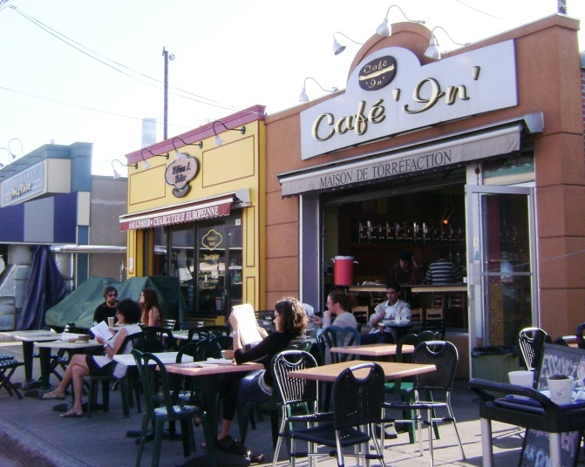
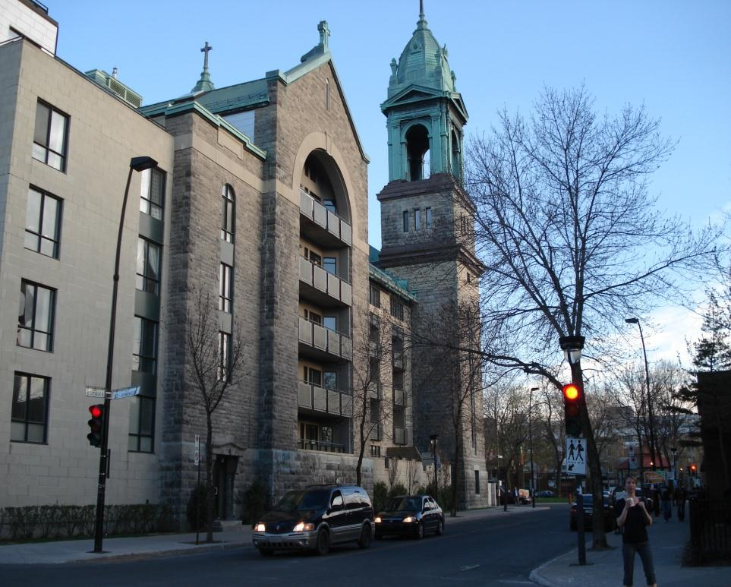
La Petite-Patrie: transformation of significant local spaces
Saint-Jean de la Croix Church transformed into luxurious condos (photo: Paula Negron-Poblete, 2011)
One of several trendy cafés adjoining the Jean-Talon market (photo: Damaris Rose, 2009)

Slide 8
Perceived changes in P-P (1)
Perception of influx of new immigrants (Latin-American, Haitian), leading to strong sense of strangeness:
  “You have to go to McDonald’s to see that! We don’t feel at home!” (F, 79, renter)
Although some older residents perceive changes that we as researchers (and our key informants) would see as signs of gentrification…
  Increase in housing costs
  New condos
  Revamping of a commercial street and public market
  New stores and trendy boutiques
…few of the study participants note the arrival of a younger, wealthier population
Notes:
The perception of an influx of immigrants contrasts with the reality reflected by census data on the resident population which shows that neither new immigrants nor visible minorities are growing in absolute or relative terms. There is, however, a place of worship catering to members of Montréal’s Haitian community.

Slide 9
Perceived changes in P-P(2)
The disappearance of most Golden Age clubs and bingo halls is an unfortunate change for some :
  “It made me mad, because it was the only pleasure we had. You know, seniors don’t go to bars. I don’t drink. Since it’s closed: “Stay home!” And we stay home […] It’s like for seniors… you’re too old, so wait to die and that’s it!” (F, 77, French-Canadian, renter)
  These closures due to decline of the French-Canadian Catholic church plus changing demographics—lack of new volunteers
The Italian Golden Age club has survived…
Notes:
On the 4 golden age clubs of the neighbourhood, 3 closed in recent years

Slide 10
Perceived changes in P-P (3)
Changes more appreciated by Italian participants
  Community preserved its institutions, social and cultural spaces
  Business interests met by “rebranding” Little Italy
Lower comfort level among many French-Canadian participants
  Lost institutions, stores & places to socialize
According to two key informants
  Increased invisibility of older French-Canadians
  Loss of local political influence
Notes:
[Italian business persons actively participated in rebranding.]

Slide 11
Lower NDG neighbourhood
Mid C20; 5 km west of downtown Montreal
Low- to lower-middle income, majority English-speaking; Italian minority
Enclave, poorly deserved by services
Income trends stable over last 10 years but % of university degree holders higher than CMA
Older population stable in absolute but not relative terms
Marked increase in visible minority population
Major university hospital project under construction, expected to ignite gentrification
Notes:
Ne pas présenter cette diapo. Donner information avec la carte et les photos.
Unlike La Petite-Patrie, the main socioeconomic trend over the past decade or so has been one of stability, even stagnation relative to the metropolitan area, rather than increasing income levels
.75 (1996) to .74 (2006) yet % with university degrees has increased (21.1 to 29.8) which is higher than CMA: 15.4 to 21.0
Elderly population is holding its own in absolute terms, but not in relative terms: 1996 aged 65 and over:1,110 compared to 1120 in 2006. But % of population in 1999: 11.6 compared to 10,9 in 2006
Visible minorities: 29% (1996) to 36% (2006)
Ethnic minorities: Italian population halved in last decade (6% to 3.2%)
MUHC planned over a decade ago, construction began 2009

Slide 12
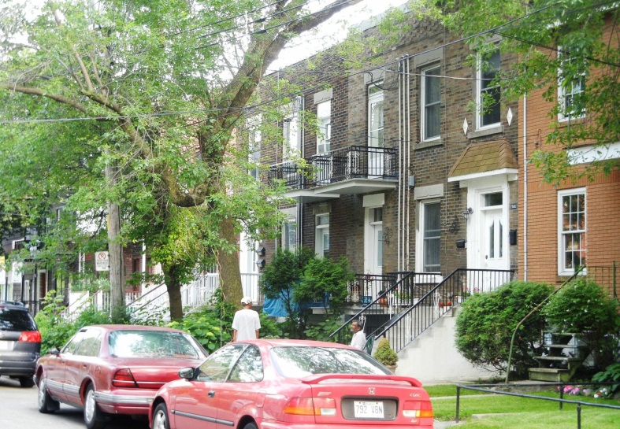
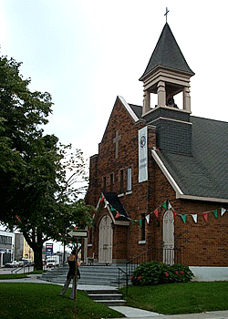
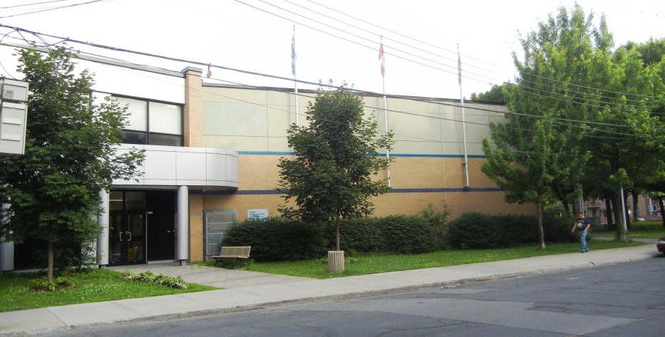
Lower NDG: St-Raymond sector
Église St-Raymond
(Photo: Victoria Burns, 2009)
St-Raymond Community Centre
(Photos: Jean-Pierre Lavoie, 2011)

Slide 13
Lower NDG: Perceived changes (1)
Mixed perceptions of new immigrants and minorities
Feeling less secure:
  “Put it this way, you ask me, if I feel at home on my street, yes. Ask me if I could go down to Saint-James, after 9 o’clock, no!” (74, F, owner).
No reports of wealthier population, rather reports of decline
Yet some do forecast changes related to gentrification with arrival of new mega-hospital
Notes:
Minorities: Transition residence for First Nations flown in from the North for medical care

Slide 14
Lower NDG: Perceived changes (2)
Loss of institutions:
  “I like my new church but I mean I loved my old church. That was a surprise, but I can worship anywhere.” (F, 74, English, owner)
  Used to seeking out services and activities outside of neighbourhood.
Conversely, establishment of a new community centre catering, in part, to older people:
  “At least now we have a place to go in the winter, where we can go for 2-3 hours during the evening.”[translation] (F, 70, Italian, owner)

Slide 15
Conclusion (1)
Participants more inclined to note clearly visible changes than socioeconomic changes
Impacts vary by ethno-cultural community
  Italians preserved social & cultural institutions in both neighbourhoods
  Loss of Golden Age Clubs, churches & abandonment of certain businesses had greatest impact among French and English speaking populations, leading to
    Feelings of strangeness (‘territorial exclusion’)
    Invisibility (‘symbolic exclusion’)
    Loss of influence on neighbourhood planning (‘socio-political exclusion’)
Notes:
Mention that English speaking home owners seem to stand between these two contrasting groups in that they were similar to the renters (less attached to the neighbourhood, less able to maintain institutions) but there were also similarities between English home owners and Italian home owners (rootedness, autobiographical attachment)

Slide 16
Conclusion (2)
No reports of economic exclusion
  Incomplete gentrification
  Tenant protection legislation
Critical role of places in the neighbourhood for connecting with peers
Study underscores relevance of interrogating potentially exclusionary consequences of gentrification among low-income older adults
Notes:
new community centre in lower NDG led to feelings of inclusion in spite of neighbourhood stagnation, increasing insecurity and elements of “strangeness”

Slide 17
Recommendations
Housing
  Implement low cost adapted housing for seniors.
  Reinforce existing tenant-protection measures, notably protecting people aged 75 years and over from eviction.
  Increase support services to older tenants.
Spaces for seniors
  Create and maintain spaces dedicated to seniors (community centers with recreational and cultural activities)
Political participation
  Implement mechanisms for providing information to and consulting with the older population (in local neighbourhood spaces accessible and dedicated to seniors)
Urban planning
  Maintaining a social and demographic mix in neighbourhoods.

Slide 18
Acknowledgments
Funding: Social Sciences and Humanities Research Council of Canada (Standard Research Grant no. 410-2008-0224)
We wish to thank all our study participants
  the older adults
  the key informants
The following community organizations lent their encouragement and support to this research:
  Comité logement de La Petite-Patrie
  Notre-Dame-de-Grâce Senior Citizens’ Council
  Table de concertation des aînés de l’Île de Montréal
Additional assistance: Amy Twigge-Molecey, doctoral student, Université INRS & Véronique Covanti, research assistant
Cartography: Nathalie Vachon, Université INRS

Slide 19


Contact info
jean-pierre.lavoie@mcgill.ca
McGill University/CSSS Cavendish
http://www.creges.ca/
damaris_rose@ucs.inrs.ca
Université INRS
http:// www.ucs.inrs.ca

