Slide 1
Research Centre for Innovation in Health Care comprises
three research groups dealing with innovations in
health care. It’s always about a greater autonomy and
independence of the patient. For the activities of the
Research Centre
www.innovationsinhealthcare.research.hu.nl
Students and lecturers of the Hogeschool Utrecht
University Of Applied Sciences can participate in the
Research Centre’s projects.

Slide 2
Expanding e-Health Knowledge for older adults Research Group Demand Driven Care
Prof. dr. Helianthe S.M. Kort,
Utrecht University Of Applied Science
Faculty Of Health Care
Prague IFA May 2012

Slide 3
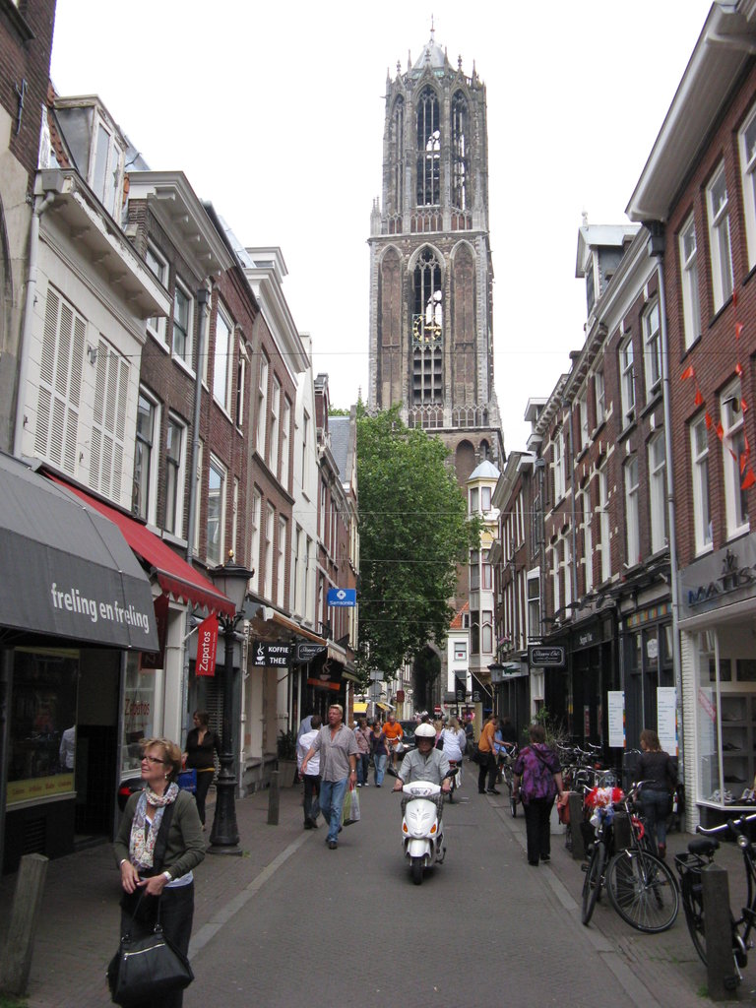
Presentation overview
Research Center
Research Group
iKOP project Expanding e-Health Knowledge

Slide 4
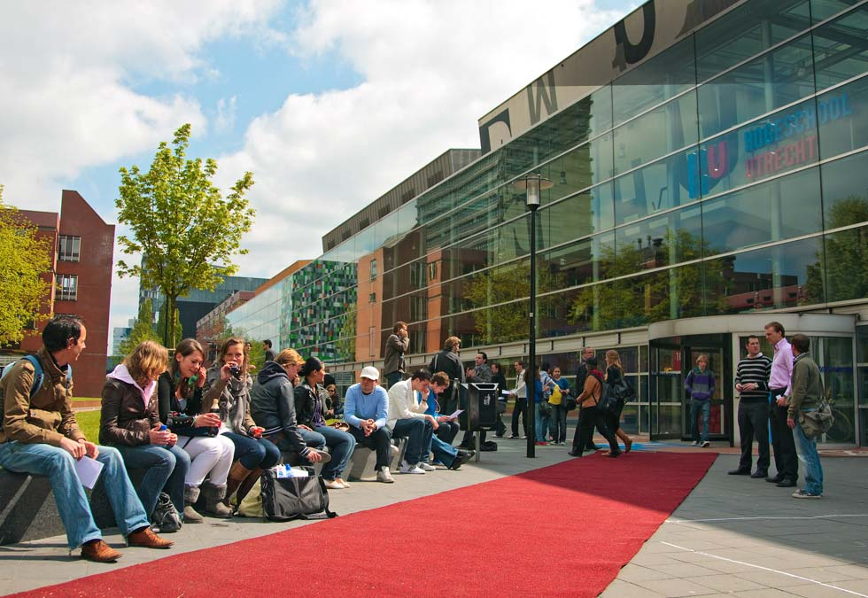
Research Center For Innovations in Healthcare
Care for older people and family care
Lifestyle and Health
Demand Driven Care
Speech Therapy
Dissemination of Pharmaceutical innovations

Slide 5
Mission
the ability of professionals trained at the Faculty of Health Sciences to act critically and reflectively within professional practice;
process existing and new knowledge in such a way that this is applicable in the care sector;
produce knowledge in response to concrete questions from the field.

Slide 6
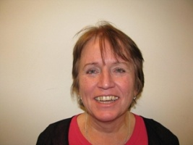
Research Group Demand Driven Care
Marianne Sinoo Msc, Psychology, major social Psychology
Sigrid Vorrink Msc, Human Movement Sciences, Rehabilitation
Emelieke Huisman MSc studied Architecture, Real Estate and Housing
Ansam Barakat, Msc
Life style & Chronic disorders
Angelo Antonietti, Msc, Human Movement Sciences, Rehabilitation
Saïda de Vries Management Assistant
Prof. Helianthe Kort Phd, MSc, Med Medical biology, Home and Health

Slide 7
Trends in Care
Ageing of the population
Growth in 55-plus
Hazing of the population
Potential working force decreases
Increase of chronic diseases
Limitations in care supply (professional and family)
Ageing in Place

Slide 8
Increasing care demand
Older adults deteriorating health
Diseases increases
Dementia, COPD, Diabetes mellitus,
Mental disorders
Limitation in ADL
Domestic work
Mobility
Personal Care

Slide 9
Availability of professional carers
The need for professional care givers increases every year, by 2% on average.
More than one out of ten people of the professional population work in the care- and welfare sector.
of which 78% are women working part time.
Approximately 22% of the work force should be employed in the care- and welfare sector by the year 2025.

Slide 10
Telecare
Care after hospital admission
Admission length ↓
Re-admission ↓
Therapy compliance ↑
Care and support
Travelling time
Satisfied customers
Satisfied employees
Smart Homes (AAL)
Comfort and safety
Information and Entertainment
Services (alarm / telehelp)

Slide 11
iKOP E-Health Knowledge for SMB’s & Older Adults
The project is funded by SIA RAAK 2009-1-005-INT

Slide 12
Partners: An international consortium
Rotterdam University of Applied Sciences, The Netherlands
the Center for Ageing Services Technologies (CAST), USA
Simon Fraser University (department Gerontology , technology and ageing), Canada,
International Society For Gerontechnology (ISG),
Smart Homes , The Netherlands
HU-UAS

Slide 13
Aim
All Partners;
are expanding their knowledge about e-Health and are working together to transfer (research) findings on the use of innovative e-Health to the industry
to achieve knowledge about the current situation regarding e-Health internationally.
to provide (frail) senior citizens with the options to stay independent and to age-in-place.

Slide 14
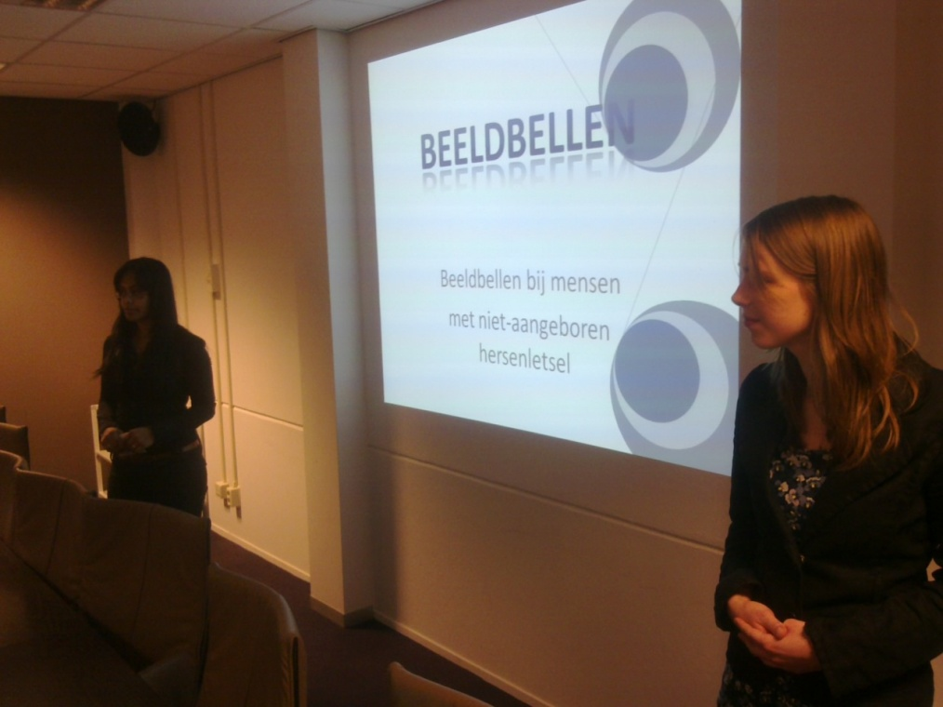
SMB’s
5 SMB’s
Personal alarm receiver
Sensor Technology
Electronic Locks
Video communication
Family Websites
2 Home care organizations
had a research question related to e-Health

Slide 15
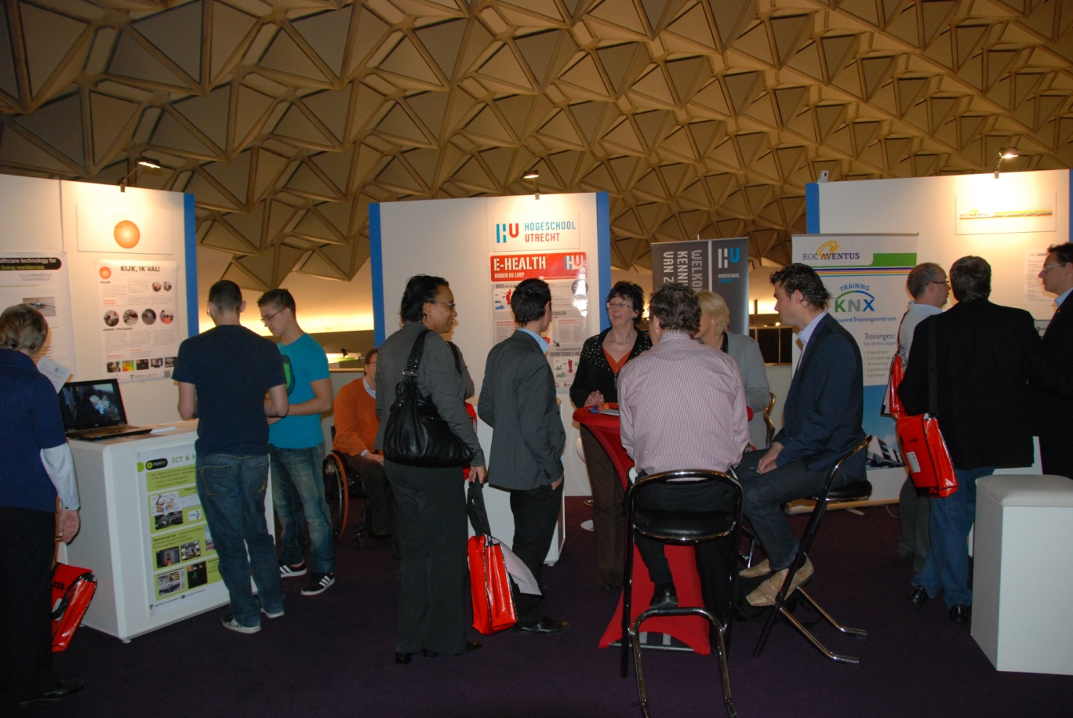
Instruments
Newsletter
LinkedIn group
Website: IKOP
Meetings
Papers
Presentations
Booth

Slide 16
Helianthe.Kort@hu.nl, www.helianthekort.research.hu.nl

Slide 17
SENSOR TECHNOLOGY, THE PERCEPTION OF FAMILY CARERS AND OLDER ADULTS, a pilot study Research Group Demand Driven Care. J. Dijkstra; J Coppes, F Raymakers, S van Vliet , J Willemsen .
Prof. dr. Helianthe S.M. Kort
Utrecht University Of Applied Science
Faculty Of Health Care
Prague IFA May 2012

Slide 18
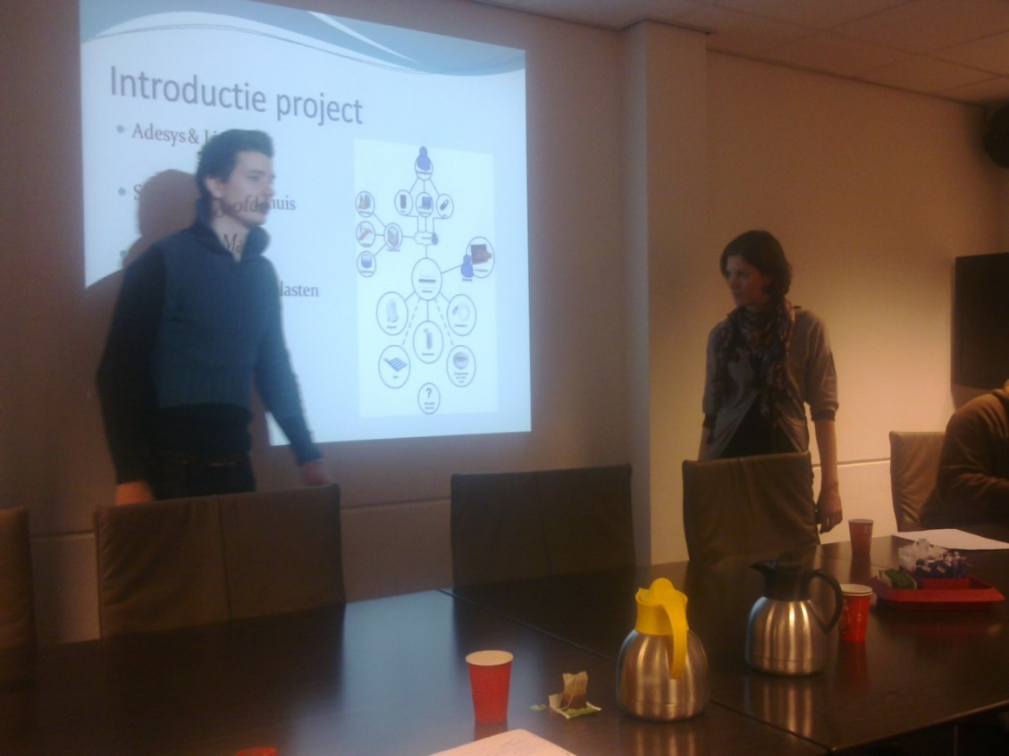
Presentation overview
Background
E-Health solution
Aim
Method
Results
Conclusion

Slide 19
Background
An important factor in ageing-in-place is:
family care
The largest volume of care.
In the near future the volume of care will decrease
50%.
Therefore, SME’s design and develop several E-Health solutions.

Slide 20
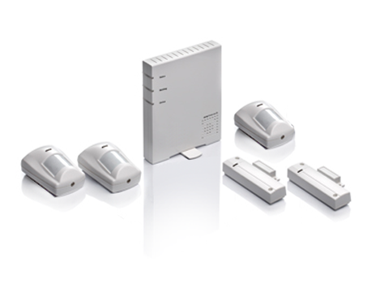
E-Health solutions
Sensor technology
family carers
older adults
Sensors
at home
Long term care
Provides information to family carers
information about daily activities
via the Internet
the mobile phone
Alarms ICE.

Slide 21
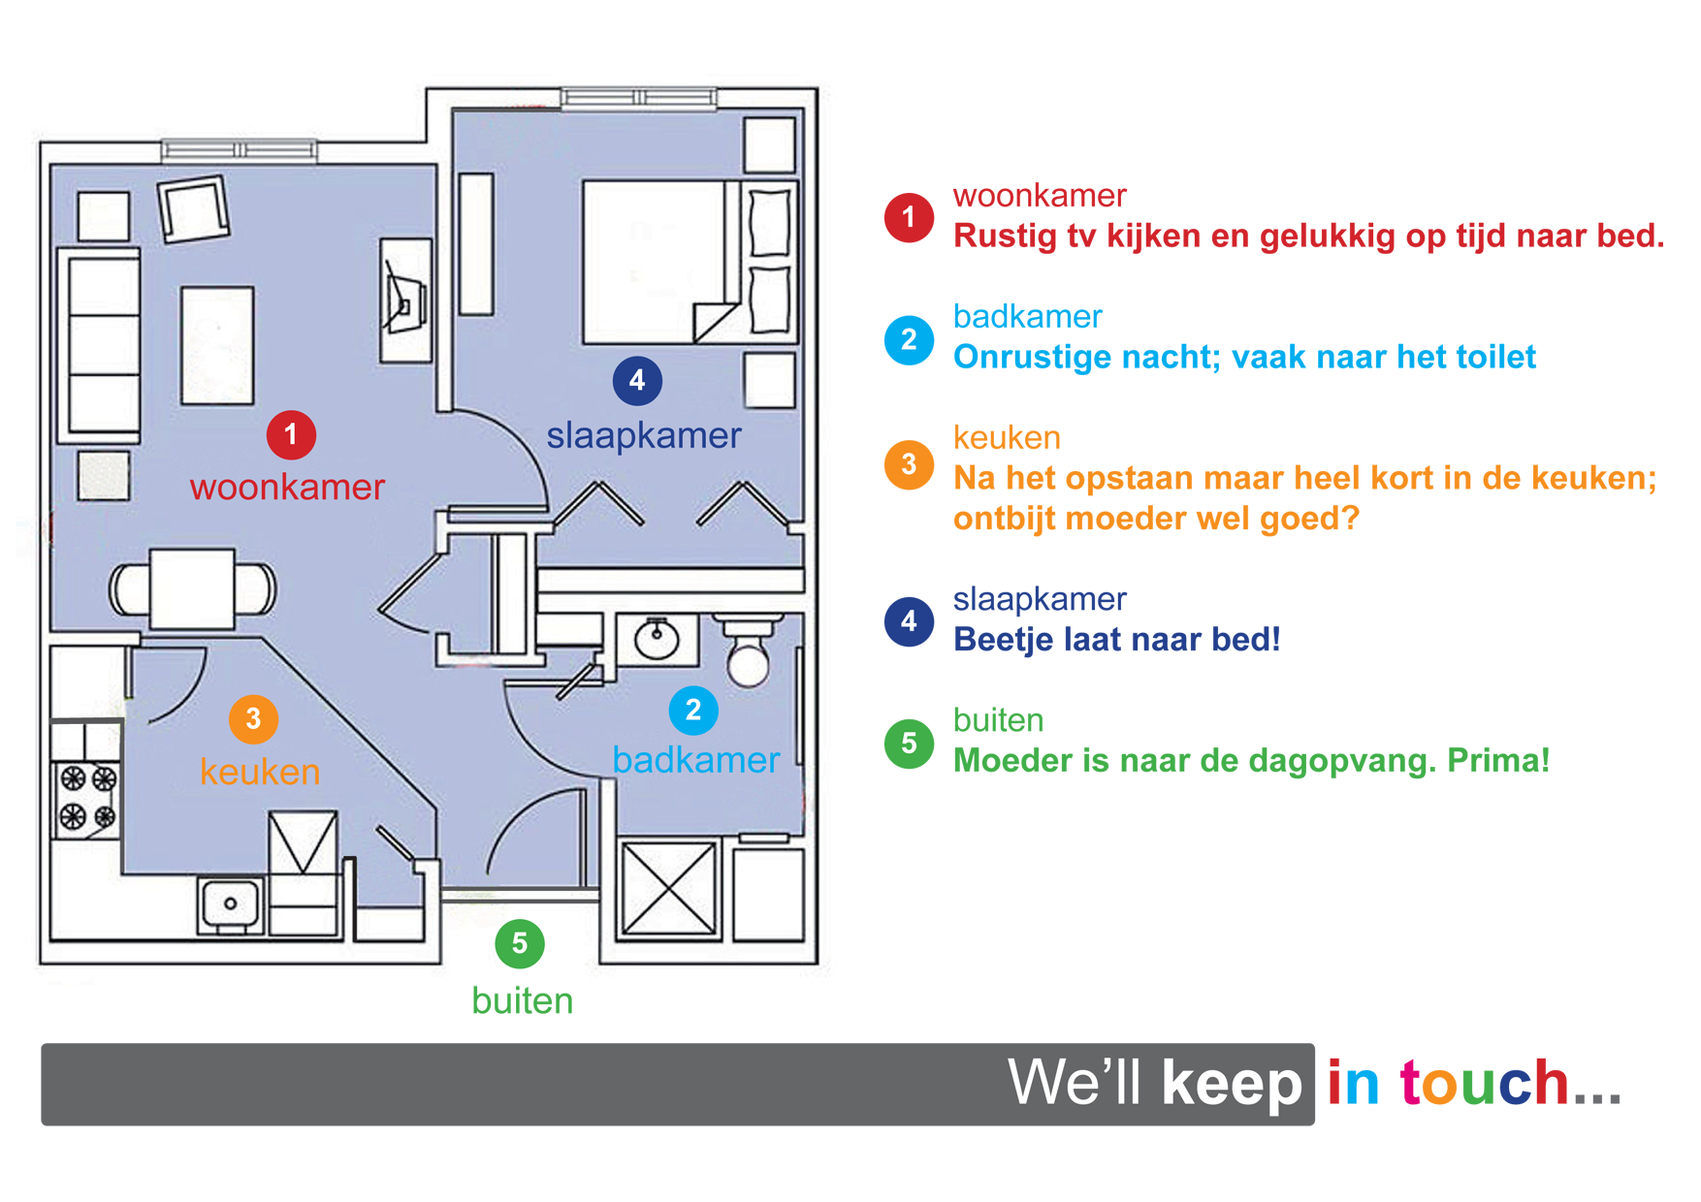
The system

Slide 22
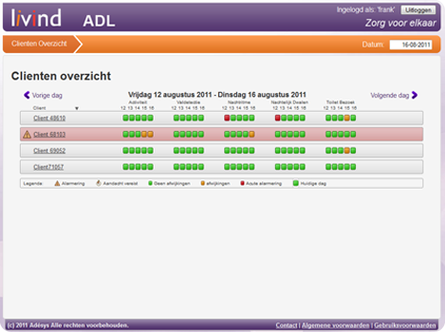
Aim
Question of the SMB
Could we develop a sensor system at home to monitor ADL and to alert family ICE
Gain insight about how both family carers and older adults perceive the use of sensor technology to monitor daily living at home.

Slide 23
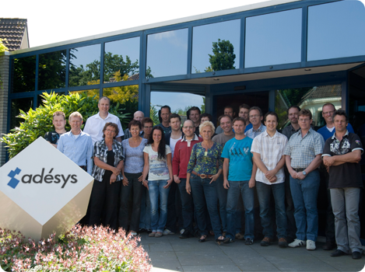
Method
Interview with the SMB
Clarify their question
Literature search
Structured interviews
social status
independency,
demand for care,
Pro & cons of the sensor system
Analyses

Slide 24
Results older Adults
8 older adults average age 84
7 female
1 male
used mobile phone or internet
Frequency of visits 1 a week
assistance needed for domestic work
6 use of assistive aids
Worrying about personal safety
Wish to stay independent
Expect ADL system to support them to AiP
4 +; 2 +-; 2-
Sensor systems
5+ ; 3 –
Burden to family cares
Big Brother

Slide 25
Results older Adults
8 older adults average age 84
Requirements
Sensor system should be connected to a care organization
No burden for the family
Embedded systems
Additional systems for smoke, water, gas alarms

Slide 26
Results family carers
19 Family cares, age > 35 years
16 child – parent related
3 sibling related
16 females
3 males
All use both mobile phones and the internet
15 taken care of parent
2 taken care of sibling
1 taken care of relative
1 taken care of friend
Days of family care
1 a week N= 9
2 – 3 days week N= 7
every day 3
Variable 2

Slide 27
Results family carers
19 Family cares,
Travel time
Within 15 min ( N=13)
Within 60 min ( N=2)
More than 60 min ( N=4)
Other activities next to family care
Enough time ( N = 13)
No (N = 2)
Variable ( N = 4)

Slide 28
Results family carers
19 Family cares,
with a sensor system contact time
Will stay the same (N = 9)
Will decrease ( N = 6)
Will increase ( N = 4)
Value of the sensor system
Postive ( N = 13), special in case of dementia (3)
Negative ( N = 2)
Don’t know (N = 4)

Slide 29
Results family carers
19 Family cares,
Expected support by the sensor system
Alarm and life pattern ( N= 13)
No idea ( N= 3)
Willingness to pay
less than 30 euro (N = 5)
More than 100 euro (N = 2)
No idea (N = 9)
Hire or buy
Hire (N= 7)
Buy (N=1 )
No preference (N = 3)

Slide 30
Results
The majority of the family carers interviewed is taking care of a parent and are worried about their health.
Family carers and older adults are mainly positive about the use of a sensor technology system to monitor their relatives at home when it supports them to age-in-place.

Slide 31
Conclusion
Both family carers and older adults indicated that in case of physical decline, it could be useful to be alerted by the sensor system in an emergent situation.
Further studies should examine the predictors for use of sensor technology at home.

Slide 32
Helianthe.Kort@hu.nl, www.helianthekort.research.hu.nl

