Slide 1
Use of Video communication for E-mental Health in an ageing society iKOP Expanding E-health knowledge.
Angelo Antonietti MSc.
Junior researcher at Utrecht university of applied sciences.
Angelo.antonietti@hu.nl
29/05/2012
www.innovationsinhealthcare.research.hu.nl
Notes:
Welcome Everybody. My name is Angelo Antonietti from the Utrecht University of Applied Sciences. I work as a PHD candidate on the topic of e-health use in older adults. I would like to tell you Something about this part of the IKOP project I started in November 2011. In this presentation I would like to tell tell something about video communication in general and how video communication fits in this project. Afterwards I would like to tell something about the company that developed the video communication tool and finaly I will tell something about the pilot study in a mental health care institution we are doing where video communication is about to be tested.

Slide 2
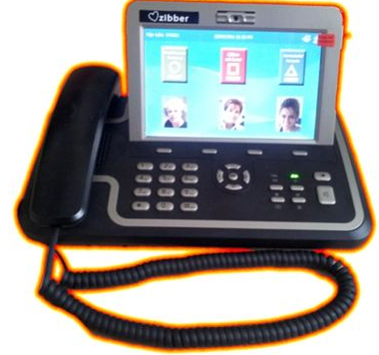
Content
Introduction, E-health, Video communication
SME: Zibber.me
Pilot Study

Slide 3
IKOP Expanding E-health Knowledge
What are the criteria e-Health needs to fulfill, in order to be:
understandable for professionals
used by older adults
lead to a lessening of the burden of care
enable people to remain living in their own home?
Notes:
- Main question, very broad. Divided in subquestions. Main goal is to: let older adults age-in-place independantly, dispite of the hinderance they experience because of a chronical disease or because of the disturbing effects of the biological ageing process.
- Each subquestion starts at an SME (Medium or small business that is involved in an E-health innovation: eg: developer of passive alarmsystems, or doorkey systems.
- Research Centres of Applied sciences of the HU, Rotterdam, vague question → workable research question → research by students and researchers (me).
Answer → new question, and hopefully a better product or a breakthrough by the SME. Also beneficial for the education, by expanding knowledge and direct by student internships.

Slide 4
51
…definitions¹
Health
Technology
E-health
E-consults
Digital key
Video Communication
Telemedicine
Sensor system
¹ Oh et al. (2005)
Notes:
Before questionnaires for user requirements are develloped 3 students performed a literature study, of which the results will be seen in this slide. Unfurtunately this slide is not finished yet….
The main outcome is that E-health is an unbrella term with a lot of different original definitions. 51, that’s a lot. Universal term: Health and Technology. One of the terms

Slide 5
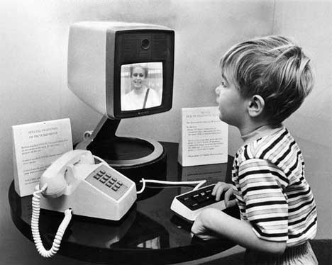
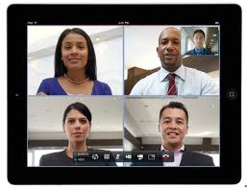
Video Communication
1st two-way video communication in public 1927
Videophone in the 70’s
Videophone today
Notes:
The SME that we did research for is specialized in video communication products.
First Audio-video connection was already made in 1927. In 85 years we made some big steps fortunately, because now videocommunication looks more like this…

Slide 6
VC in Dutch healthcare
Vilans knowledge centre long-term care
Database: 58 VC pilot projects
2004-2012
Main subjects:
Older adults
Health care professionals

Slide 7
> 10 Pilots
Netherlands
Belgium
Friese Land
2009 - now
>100 Older adults (More Voluntary Carers)
1 care centre

Slide 8
Functional Options
Video + audio calls
Group sessions
Contact with peers
Care agenda management
Making notes
Look back safed video’s
Time registration
Link with other smarthome devices

Slide 9
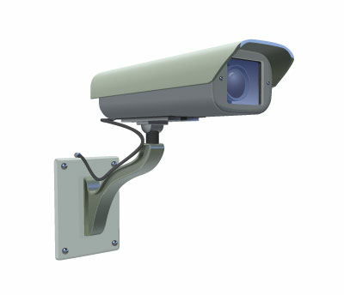
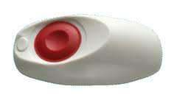

Slide 10
Technology
Connection
User
Notes:
Zibber, a company in the Netherlands specialized in development of video communication tools. They same software can be used for older users (video phone that resambles a traditional telefphone) and younger users (might prefer app in smartphone)

Slide 11
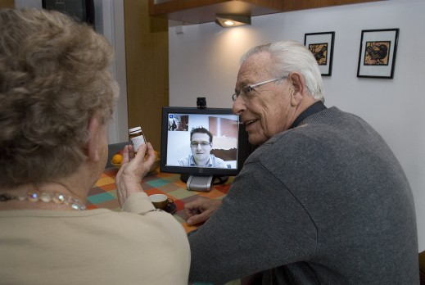
Software
Notes:
1 of the 2 devices
Software can also be linked to other devices, like sensorsistems of alarm devices like you can see at the bottom right

Slide 12
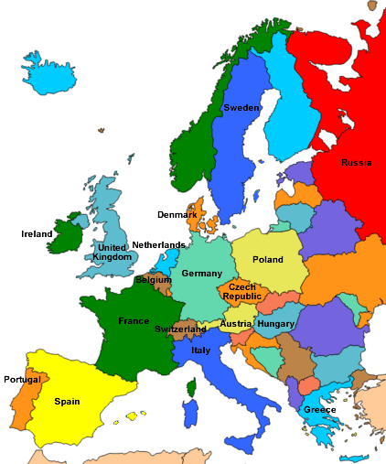
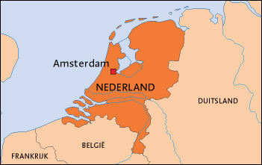
Pilot Study
Mental Healthcare Organization
1200 Health care pro’s
6000 Clients
Rotterdam area
Pilot group (future users):
6 Health care pro’s, app. 20 inpatients

Slide 13
Skype
Problems:
Not controlable by IT
Software size too big
Disturbance
Slow
Sulution: Zibber.me’s Videophone?

Slide 14
Zibber.me’s Questions
Before the start of the pilot:
Does the pilotgroup want to use VC?
Why / why not?
What features / options?

Slide 15
Research Question
What requirements should video communication have according to future users in an E-mental health setting.
Future users’ option needs
Future users’ attitude
Requirement differences (young vs. old)
Future users: Health care pro’s & older adults
Notes:
Research question still too broad, so divided in subquestions. out the videoUsers are both health care professionals and older adults.
Reason for this question is a Pilot group that is about to try system of zibber. This pilot group consists of 6 mental health carers and 20 clients.

Slide 16
Use of Video communication for E-mental Health in an ageing society iKOP Expanding E-health knowledge.
Angelo Antonietti MSc.
Junior researcher at Utrecht university of applied sciences.
angelo.antonietti@hu.nl
29/05/2012
www.innovationsinhealthcare.research.hu.nl
Notes:
If you have any unanswered questions or remarks, please mail to angelo.antonietti@hu.nl

Slide 17
Next steps
Test user requirements at larger group within MHI
3 week trial by the pilot group
Test user requirements again
Test in Client Friendly pilot groups

Slide 18
First results
Notes:
Preliminary, only 4 respondents till so far.

Slide 19
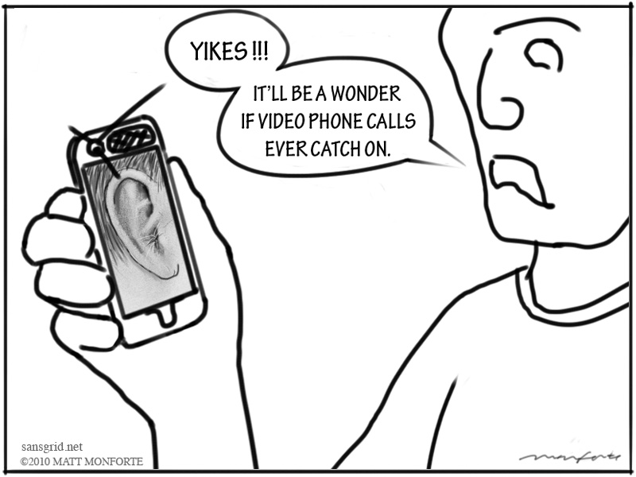

Slide 20
IKOP Expanding E-health Knowledge
Central Question: “What are the criteria e-Health needs to fulfill, in order to be understandable for professionals, in order to be used by older adults, in order to really lead to a lessening of the burden of care, and in order to enable people to remain living in their own home?”
Research
Answer
Question SME
Research Centre Demand-Driven Care, HU
Notes:
- Main question, very broad. Divided in subquestions. Main goal is to: let older adults age-in-place independantly, dispite of the hinderance they experience because of a chronical disease or because of the disturbing effects of the biological ageing process.
- Each subquestion starts at an SME (Medium or small business that is involved in an E-health innovation: eg: developer of passive alarmsystems, or doorkey systems.
- Research Centres of Applied sciences of the HU, Rotterdam, vague question → workable research question → research by students and researchers (me).
Answer → new question, and hopefully a better product or a breakthrough by the SME. Also beneficial for the education, by expanding knowledge and direct by student internships.

Slide 21
Introduction
Notes:
As Hilly introduced The IKOP expanding e-health project I would like to address once more that the main reason for this project is that the older population in the Netherlands, but I think it’s a worldwide problem, is growing rapidly. In this graph you can see the relative population of older adults in the Netherlands. Not only the the population of 65+ is growing, but the population older adults is getting older (as you can see the population of 80+ is growing in time). The bigger aim of this project is to find ways older adults can live at their own homes independantly as long as they want.

Slide 22
Video Communication
Videophone
Telemedicine
Remote Care
Video Conferencing
Screen Care

Slide 23
Partners
General Partners:
Partners subproject:
Notes:
HU, Utrecht University of Applied Sciences, department demand driven care
Rotterdam, Uni of applied sciences, department
CAST: Centre of ageing Services Technologies (translation of the results of the research project)
ISG: International Society of Gerontechnology (translation of the results of the research project)
Simon Frasier University in Vancouver, Canada.
Smarthomes: Dutch cooperation of 80-90 SME’s who are all involved in home automation technology.
Financed by SIA

