Slide 1
Videoconference as a tool in telehealth for the elderly
Yvonne Schikhof
Rotterdam University of Applied Sciences
Centre of Expertise Innovation in Care
Research on Integrated Care for Older Persons
Technology for Care

Slide 2
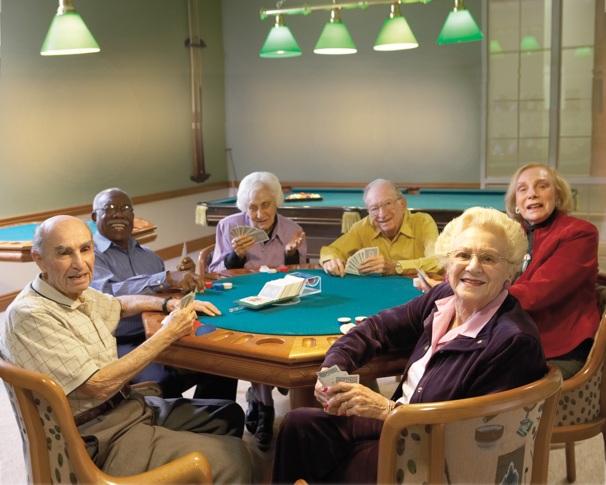
Welcome !
Choose your Care!
seniors in charge in homes for the elderly
Marleen Goumans, PhD & Evelyn Finnema, PhD, RN
Research on Integrated Care for Older Persons
Notes:
Welcome and thanks for attending this presentation.
I will briefly present you some findings on research from the Netherlands, where videoconferencing is a more and more popular tool in telehealth for the elderly. On this subject the Rotterdam University is working together with our collegues from Utrecht.My name is Yvonne Schikhof and I work in a centre of expertise Innovation in Care

Slide 3
Centre of Expertise Innovation in Care
One of the 6 Centres of Expertise of the Institute of Research and Innovation at Rotterdam University
Closely related to the institute of Health Care studies:
nursing students and allied health professional students (2575) and educators (190);
Researchers / lecturers (50) and professors (7);
One strategic research programme;
Diversity in research projects;
Technology for Care; Integrated Care for the Elderly; Evidence Based Care Nursing; Participation and
Selfmanagement;
Partnership in iKOP and other projects
Notes:
Here is some information of the centre .
As our research is initiated by questions formulated by the practice, and our goal is both to be of revelance to practice and education, we are very keen on working with a multidiciplinary approach. I personally like to work with engineers, ict specialists, doctors, SMB’s, students in health care technology, nursing, paramedics, informatics and with care professionals who like a challenge.

Slide 4
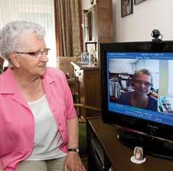
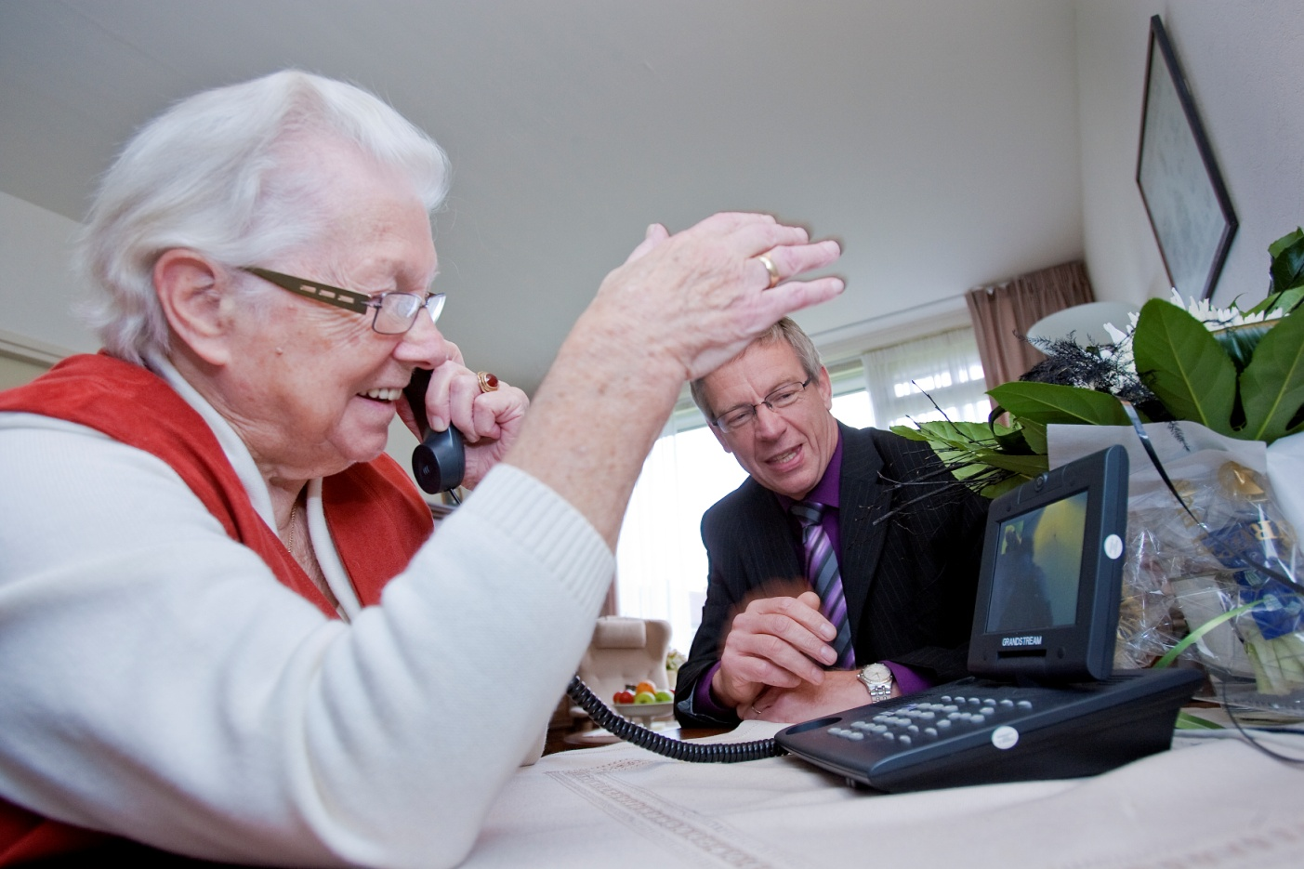
Screen-to-screen care in the Netherlands
In home care
By means of set-top box, camera and television screen with remote control
Later also by means of videophone
First projects evaluated in Qualitative Monitor reports (2005; 2006; 2008) by ActiZ
Quantitative Monitor reports by NIVEL (last: 2009)
2009: total of 765 clients in home care
Notes:
In 2005 the experiences of the first projects were published and discussed in the Netherlands .
Research by Actiz, Organization of Health Care providers and NIVEL, Netherlands Inistitute for health Services Research.
In 2009 765 clients in home care were using screen-to-screen care.
At first the televsion was used and later new interfaces like the videophone.
Advantage videophone: always “on line” . At the moment touch screen videophones are available.

Slide 5
Qualitative results
Changes in infrastructure and further development of screen-to-screen care can lead to a system innovation
Clients: more safety and confidence, less complications
More contact, especially video communication with family and friends, contributes to quality of life
Less stress informal care givers
Notes:
Further development can change the way health care is provided to clients at home. In pilots screen-to-screen care is often only additional care.
Safety is very important for clients. When video contact with relatives was available, clients said that they appriciated this the most!
Overall it contributes to QoL
Also it was reported that the informal care givers, like children, experienced less stress

Slide 6
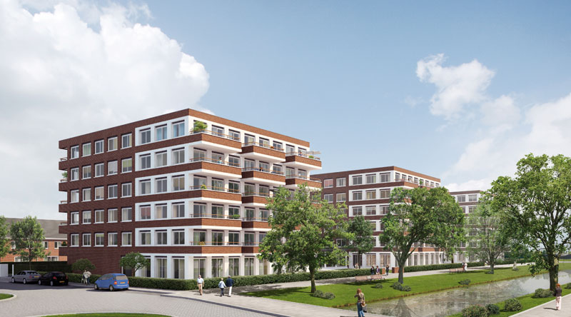
Other settings
Combining care as in a home for the elderly and in a nursing home in a new apartment complex
Video conferencing between nursing staff and residents
Video conferencing between doctor and patient
Ambulant care for people with ABI
Video conferencing with care centre
Notes:
In the last few years other health care settings opt for video conferencing in contacts with clients.
In Rotterdam new care apartments were built to house clients who othjerwise should have to move to an old people’s home to receive the needed care or even to a nursing home. Exclusion criterium is dementia.
The health care organization opted for an integrated system with a videophone. Not only the nursing staff could contact the residents by means of videophone, but also the elderly care physician, who is responsible for the care of the so called nursing home patients.
Family and friends can also use video communication with their PC and webcam, tablet, etc..
In the IKOP project a small business had a client who wanted to know if there was evidence that people with ABI could also benefit from videoconferencing. This health care organization provided ambulant care and wanted to use a care centre to answer unscheduled demand of care. They wanted to use videophones.

Slide 7
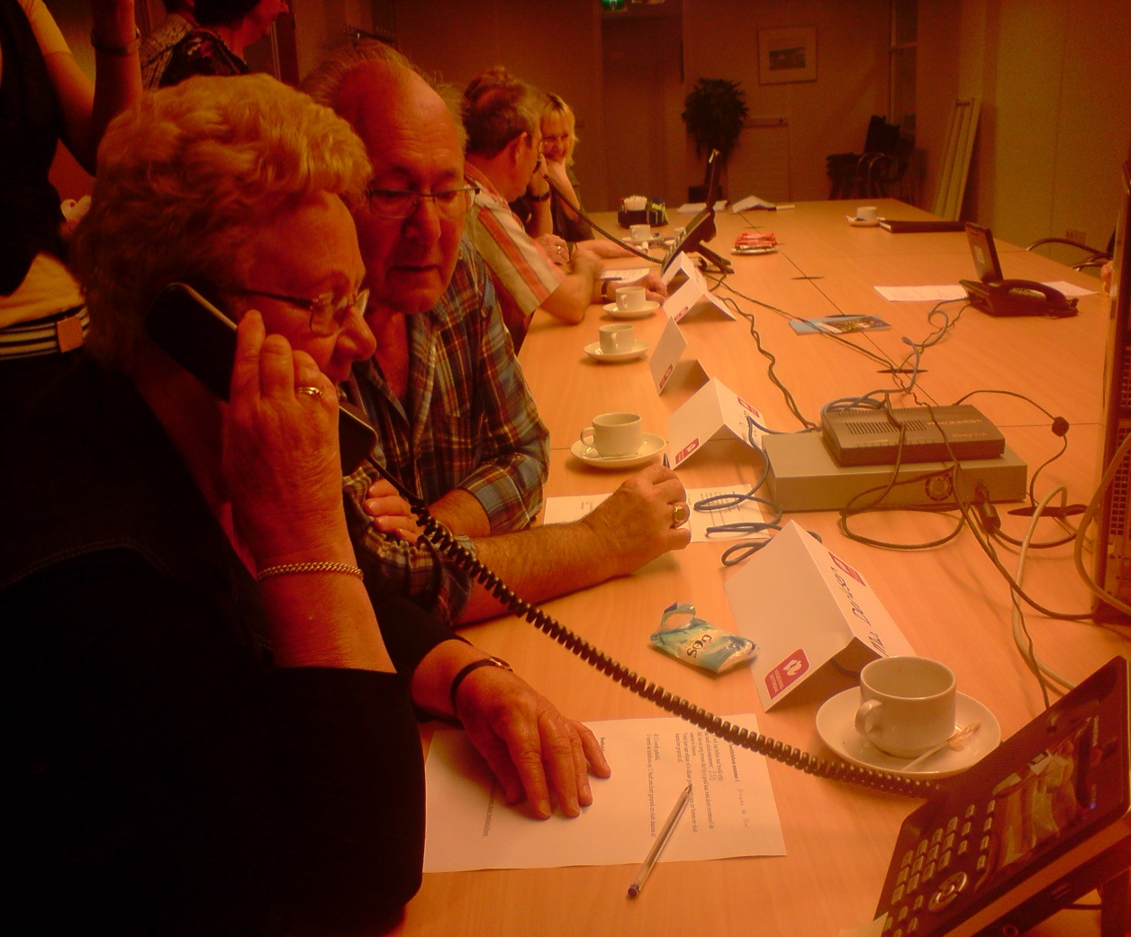
Notes:
During research in Rotterdam we tested seceral videophones with older people

Slide 8
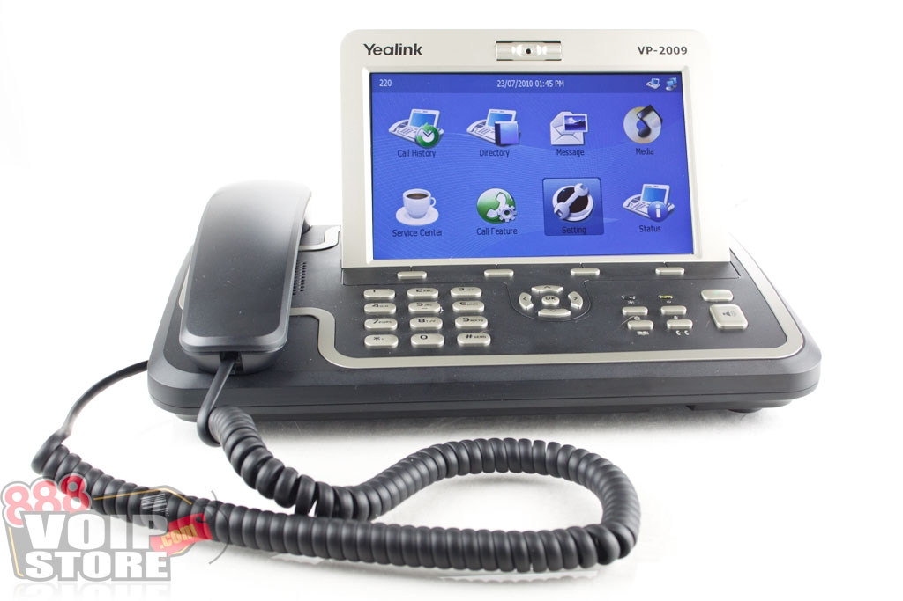
Results focusgroup interface
Videophone:
Touch screen preferable to buttons
Touch screen is easy to learn
Not too big / intrusive in the living room
Rating video and sound
Notes:
The newest videophones with a touch screen were more easy to use than push buttons. Beacause the videophones are designed for use in the office, lots of options are available. So consequently trhat means lots of buttons!
Using the touch screen is easy to learn. Remarkable was the wish for a smaller screen because a big screen looked like a computer. Most participants of the focus group found this too intrusive or not attractive in their living room! Perhaps this will change over the next years.
Ofcourse the quality of video and sound was very important.

Slide 9
Results international literature
(Acquired Brain Injury, by students )
Peer reviewed
Recent, ≥ 2000
Databases: Cinahl plus, Cochrane, Nursing Allied Health Collection, PEDro, Picata, Trip database, Pubmed, NARCIS and Gerontechnology (ISG Journal)
Case-studies
1 RCT
Promising results
Health care organization is now preparing a pilot
Notes:
For the target group of people with ABI students conducted a literature search.
The conclusion was that there were promising results, mostly based on case studies, but no solid evidence. Only 1 relevant RCT was found.
Nevertheless the health care provider has decided to start a pilot, based on the business case written by the SMB.
Of course they want to compare the use of videoconferencing with their face to face visits, and they are very interested how this will influence the job satisfaction of their professionals.

Slide 10
First survey professionals before pilot
Job satisfaction and technology:
Job satisfaction higher than average before pilot
Positive about promotion prospects
Operational autonomy is an important factor?
Propositions about videoconferencing with clients:
positive attitude
Notes:
Within iKOP the first survey has been executed and the preliminary results are currently discussed, so this is a sneak preview!
Quantitative mrthod: validated questionaires were used with added statements for connection with technology.
The job satsisfaction of the respondents was higeher than the national average. Proeffesionals who are included in the pilot were more positive about promotion prospects. There was no significant difference, but nevertheless a difference in the valuing of operational autonomy for the professionals in the pilot. These professuonals have a positive attitude towards the use of thechnology and aslo expect their clients to benefit from videoconferencing.
The job satisfaction

Slide 11
Notes:
Back to the elderly who can’t live at home any more

Slide 12
First experience
Elderly Care Physician
Contact with patients in apartment complex by videophone:
Pleasurable contact, timesaving
More feedback than by phone: emotion visible
Conversation with patient or partner : videophone first choice for contact
Answering questions / reporting results
Notes:
The elderly care physician responsible for the so called nursing home patients in the care apartments, has used her videophone for the first week.
These are her first experiences. Her homebase is a nursing home on a distance.

Slide 13
Notes:
Of course this is blended care: face to face contact when needed and videocommunication when possible.

Slide 14
First experiences care professionals
Videophone for evening rounds
Difficult to stop habits like “visiting resident because I am on the same floor”
Some residents prefer contact by videophone: less intrusive than visit
Some residents contact staff by using their alarm instead of videophone: quick response
Notes:
The care professionals are still in the process of implementing videoconferencing in their daily practice.
There is also a personal alarmdevice for every resident, but having two interfaces means that the videophone is used less than expected. Residents know that the alarm will generate a quick response.

Slide 15
Residents in care apartments
First results
“Younger” residents (<70 y.) make good use of the videophone and also call each other
Many residents understand the basics of the videophone, like opening the door, contacting and answering staff
Residents who need much instruction how to use the videophone, often haven’t used a mobile phone
Inclusion criteria for care apartments are very important
Self ability is needed and needs stimulation!
Notes:
The residents form a heterogeneous group, not only considering their health problems but also condidering their self-ability.
Inclusion croteria for movung to care apartments will have to be discussed.
Also training of staff how to stimulate self ability is needed.

Slide 16
Conclusions
Telehealth, using videoconferencing, is promising for an ageing target group, but still a challenge
Challenges for health care providers, the ageing and researchers
We can learn from pilots but we need more research data and dissemination (international)
We have to focus on all end users: both older people and health care professionals
We have to share experiences with health care professionals and SMB’s
Concerning the interfaces: there is no “one size fits all”
Notes:
Discussion / questions??

