Slide 1


ANTON TRSTENJAK INSTITUTE
of Gerontology and Intergenerational Relations
EXPOSURE TO RISK OF POVERTY AMONG ELDERLY WOMEN IN SLOVENIA
Ksenija Saražin Klemenčič, PhD Econ
Professor Jože Ramovš, PhD
11th Global Conference on Ageing, Prague, 28th May - 1st June 2012

Slide 2

ANTON TRSTENJAK INSTITUTE
of Gerontology and Intergenerational Relations
ANTON TRSTENJAK INSTITUTE
of Gerontology and Intergenerational Relations
ANTON TRSTENJAK INSTITUTE OF GERONTOLOGY AND INTERGENERATIONAL RELATIONS (Since 1992)
… is national scientific and expert institution.
… was founded by few experts as private individuals in 1992 and later cofounded by Slovenian Academy of Sciences and Art (1995) and in 2004 by the Government of the Republic of Slovenia.
… its work is interdisciplinary and includes social and medical sciences …
… has quite early realised the seriousness of demographic changes in Slovenia and therefore carried out studies, developed and implemented new social programmes in this field.
… it focuses on development of new programmes for quality ageing and good intergenerational relations.

Slide 3
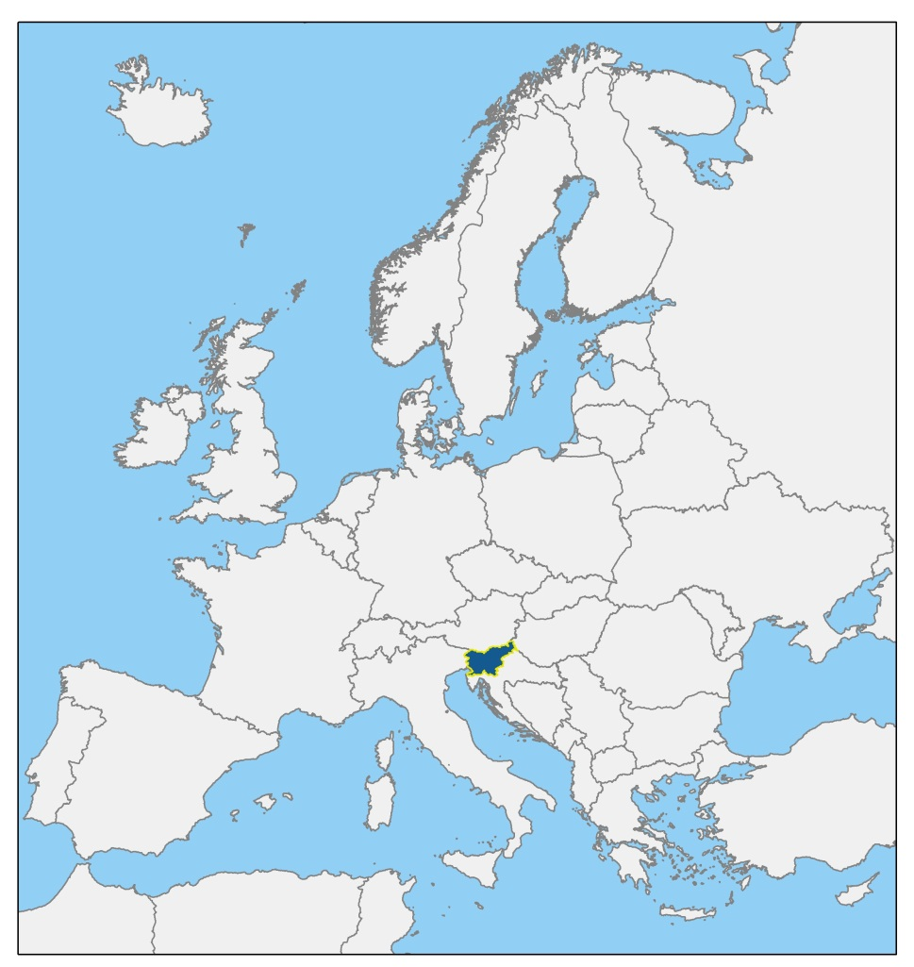
ANTON TRSTENJAK INSTITUTE
of Gerontology and Intergenerational Relations
SLOVENIA AND EU

Slide 4
ANTON TRSTENJAK INSTITUTE
of Gerontology and Intergenerational Relations
Risk of poverty among the elderly and in total population, 2008
 | 65+ |  | Total
 | Women | Men | population
Slovenia | 28 | 12 | 21
EU-27 | 22 | 16 | 17
Sources:
SORS (online code: novica_prikazi.aspx?id=3356)
EIGE (online data code: EIGE-100-inequalities-Factsheet.pdf)

Slide 5
ANTON TRSTENJAK INSTITUTE
of Gerontology and Intergenerational Relations
RISK OF POVERTY AMONG ELDERLY WOMEN
The share of people below the poverty line or socially excluded is in Slovenia higher among the elderly than in the rest of the population. Especially women are affected.

Slide 6
ANTON TRSTENJAK INSTITUTE
of Gerontology and Intergenerational Relations
WOMEN LIVE LONGER THAN MEN
Table 1. Life expectancy at selected ages by gender
 |  |  |  |  |  |  | Years
 | Year¹ | Gender | Age
 |  |  | 0 | 1 | 15 | 45 | 65
EU-27 | 2008 | M | 76.4 | 75.7 | 61.9 | 33.4 | 17.2
 |  | F | 82.4 | 81.7 | 67.8 | 38.5 | 20.7
Slovenia | 2009 | M | 75.8 | 74.9 | 61.1 | 32.5 | 16.2
 |  | F | 82.3 | 81.5 | 67.6 | 38.2 | 20.1
EU-27 | 2008 | F-M | 6.0 | 6.0 | 5.9 | 5.1 | 3.5
Slovenia | 2009 | F-M | 6.5 | 6.6 | 6.5 | 5.7 | 3.9
Sources: SORS, Eurostat (http://ec.europa.eu/eurostat, 14. 10. 2011)
¹ Last available year

Slide 7
ANTON TRSTENJAK INSTITUTE
of Gerontology and Intergenerational Relations
WOMEN HAVE LOWER INCOME THAN MEN

Slide 8
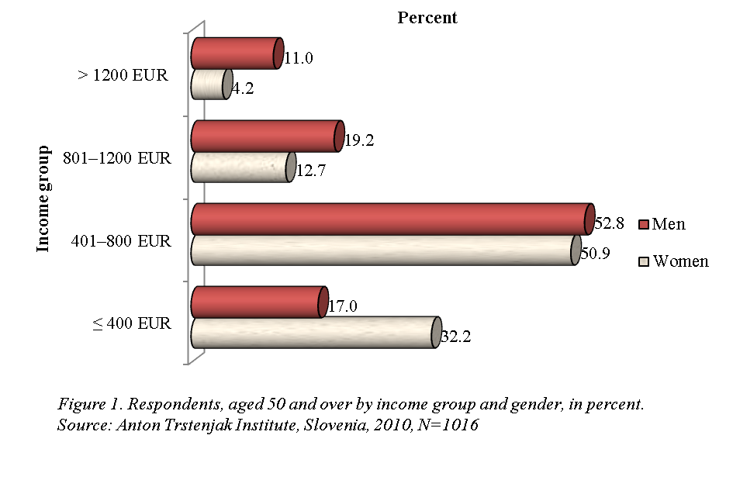
ANTON TRSTENJAK INSTITUTE
of Gerontology and Intergenerational Relations
WOMEN HAVE LOWER INCOME THAN MEN (CONTINUE)

Slide 9

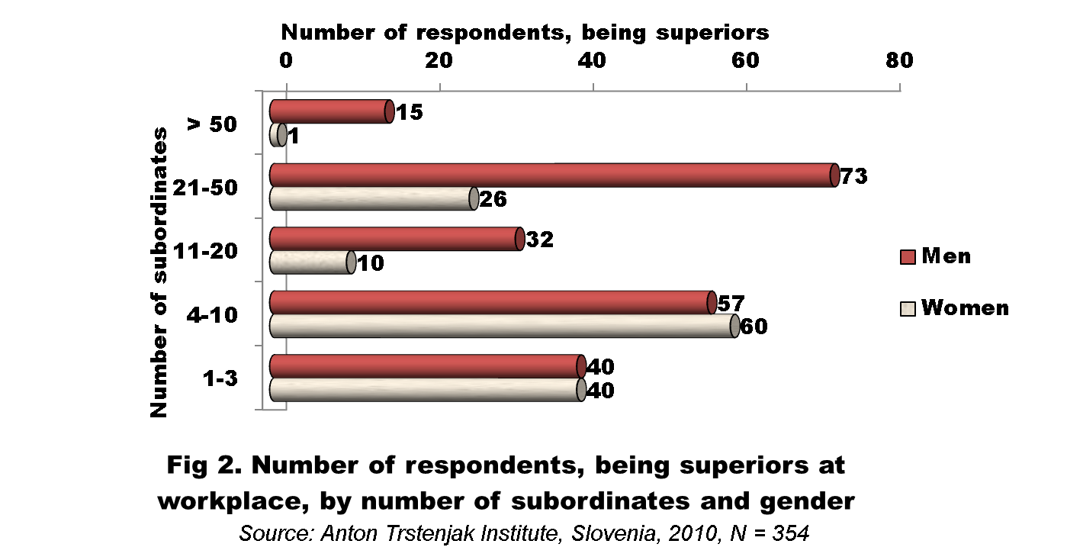
ANTON TRSTENJAK INSTITUTE
of Gerontology and Intergenerational Relations
WOMEN HAVE LOWER INCOME THAN MEN (CONTINUE)

Slide 10
ANTON TRSTENJAK INSTITUTE
of Gerontology and Intergenerational Relations
WOMEN HAVE LOWER EDUCATION THAN MEN
Study results show that
64 % of women in Slovenia, old 50 and more have vocational school or less (59 % of men)
36 % of women have high school or more (41 % men)

Slide 11
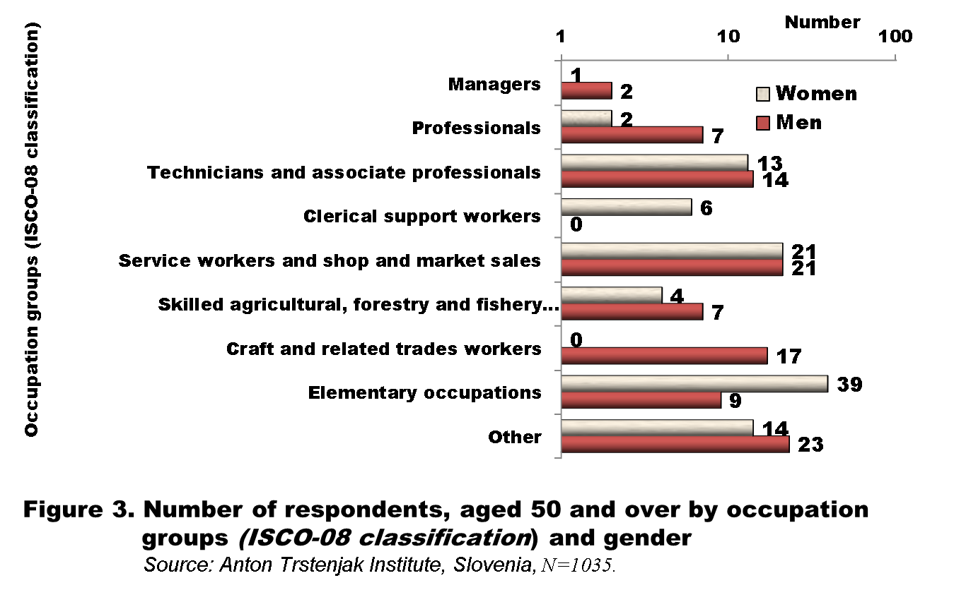
ANTON TRSTENJAK INSTITUTE
of Gerontology and Intergenerational Relations
WOMEN HAVE LOWER EDUCATION THAN MEN (CONT.)

Slide 12
ANTON TRSTENJAK INSTITUTE
of Gerontology and Intergenerational Relations
WOMEN LEAVE LABOUR MARKET EARLIER THAN MEN
Years of work and length of retirement
Women have on average 29 years of work (men: 35 years) and
Women are on average retired 15 years (men: 13 years)

Slide 13
ANTON TRSTENJAK INSTITUTE
of Gerontology and Intergenerational Relations
Conclusions
The exposure to poverty is highest among elderly women
not included in labour force (31.8 %)
older than 64 years (24.9 %)
and lesees (24.0 %)
Social transfers try to alleviate this, but the risk still exists. Generally, the posts are not adapted to older workers and it is difficult to fulfil UN Madrid International Plan of Action on Ageing (MIPAA), referring to enhancing the employability of older workers through appropriate measures.

