Slide 1
LEARNING IN LATER LIFE
THIRD AGE UNIVERSITIES FOR ALL IN BASHKORTOSTAN AS RUSSIA AGES
Gulnara Minnigaleeva, PhD, Research fellow
Centre for Studies of Civil Society and Nonprofit Sector
State University Higher School of Economics
Moscow, Russia
CEO, Organization of Retired persons Wisdom Ripening
Tuymazy, Bashkortostan

Slide 2
USSR
Russian
Federation

Slide 3
Facts
160 ethnic groups
Education:
90% secondary education
60 % professional and higher education
Minimum pension 150 Euros

Slide 5
Who is an older person in Russia?
Pensionable age
55 Women
60 Men
Life expectancy (2008)
Women 73
Men 62

Slide 7
So what is available?

Slide 8
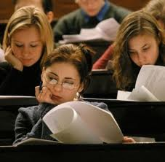
University programs?
NO!!!
Stereotypes
Fees
No options

Slide 9
Government programs?
Yes, few
Government social service centers
Some regional programs

Slide 10
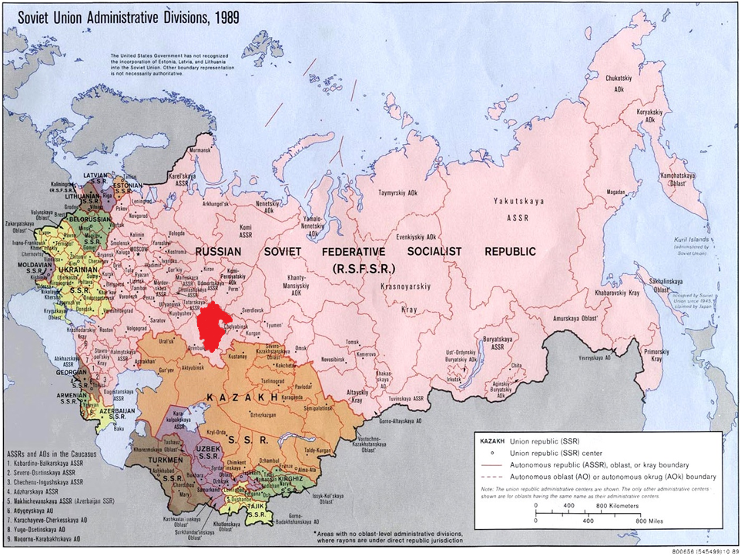

Slide 11
Republic of Bashkortostan
Third Age Universities
(4 courses)
Social tourism

Slide 12
Third Age Universities in Bashkortostan
In 2011 - 2 200 000 rubles (55 000 EURO)
- all cities in Bashkortostan
- 16220 students
- no cost for seniors

Slide 13
Third Age Universities in Bashkortostan
Problems:
Funding available for licenced educational institutions only
School teachers are not prepared to teach older learners
Limited courses (4): health, English, computer basics, psychology

Slide 14
NGO programs?
YES !!!
Network of NGO «Knowledge» (16 branches all over the country)
Individual NGOs

Slide 15
Advantages and disadvantages
Diversity of programs
Involve older learners in other activities
Better teachers
Difficult to sustain
Not always good cooperation with the government
Little resources available

Slide 17
Experience of the Organization of Retired Persons «Wisdom Ripening»

Slide 18
Students’ preferences

Slide 22
References
I started going to the U3A in 2010. I like it very much. I attend singing, PT. We recently had a celebration. It was great. We danced, sang, socialized, listened to music . I’d also like to go for trips to other cities. Let’s live happily! Ww only live once.
I started going to the U3A from its start. I was mostly interested in technical skills such as comp[uter skills and camera work. I had to work hard, i often had to study at home. I have managed to learn what I wanted. Thanks to everyone.
Our time requires developing yourself. These courses help me

Slide 23
References
Thank you for the opportunity to extend my life beyond my home.
Here I have gained myself the way I deserve
I am greatful to the organizers for this university. The university cheers us up, and therefore helps to stay healthy, prevents isolation. This organization makes us closer to each other, and this is great happiness at our age. I wish all to be active and life will be marvellous.

Slide 24
Thank you! And see you in Bashkortostan!
Conference «Advantageous ageing»
23-25 October 2012
Ufa, capital of Bashkortostan, Russian Federation
m.gulnara@gmail.com
+79166296264

