Slide 1
Education in later life
Part 2
Franz Kolland, University of Vienna

Slide 2
Barriers to participation in late-life education
Which conditions are responsible for the declining participation in education in old age and which factors can help to increase participation rates?
3 kinds of barriers: (Cross 1981)
  Institutional: provision, fees, entry qualifications
  Situational: family-life cycle (women!)
  Dispositional: attitude towards learning, self-determination, perception of usefulness, images of ageing
Dispostional barriers are most difficult to overcome → importance of learning motivation in old age!
Notes:
Interrelations: e.g. Older employees are less often encouraged to participate in continuing education because management believes they are less likely to learn. Thus, they encounter and eventually adapt negative stereotypes and are less likely to be intrinsically motivated to learn

Slide 3
Motivations not to learn
The meaning of learning motivation makes it clear that learning opportunities do not automatically create participants who want to engage in them!
participation in education is often compulsory/extrinsically motivated → freedom to choose in old age
Non-participation is not necessarily perceived as a lack (Coffield 2000) → in certain situations resignation from participation can be rational (Wittpoth 2011)
many challenges in life cannot be coped with by attending an educational course cannot help individuals to cope with adequately

Slide 4
Self-determination as a challenge to learning
New learning culture promotes self-care & self-directed learning (Klingovsky 2009, Kade 2007)
Normative: Pursue self-directed activity in old age, take care of yourself and take responsibility for your actions!
But: not all old people are able to act in a self-determined way (Bubolz-Lutz 1999) – self-directed learning favours certain groups of society who are more independent to begin with
Self-efficacy theory: judgement of one’s own capability of asserting control (Bandura 1997); perception of oneself as the source of one’s own behaviour (Deci & Ryan 2004)
Changes in self-efficacy across the lifespan: low in childhood, increasing until midlife, declining in old age (Heckhausen & Schulz 1998)

Slide 5

The role of the learning biography
The personal learning biography is one of the most influential dispositional factors for learning in later life
“Cooling Out”: negative learning
biography
  little learning opportunities in
  earlier life stages
  negative learning experiences
  →feedback loops of failure
  (Clark 1960)
  Labeling , Stigmatization
  Adoption of a habitus that is characterised by distance from institutionalised education

Slide 6
Perception of Usefulness
3 types of learning orientations: (Houle 1961; also comp. Boshier 1971: EPS)
  Goal-orientation: education as means for achieving clear-cut goals
  Activity-orientation: education as a means for satisfying social needs
  Learning-orientation: seek knowledge for its own sake
What is the goal of education after retirement?
  shift from attainment of qualifications towards cultural orientation (e.g. finding of meaning, reflection, empowerment)
3 goals: (Staudinger & Heidemeier 2009)
  Development goals: self-actualisation
  Ability to participate: social participation
  Value creation: productivity

Slide 7
Variety of Learning Motivations
Learning motivation in old age is based upon: (McClusky 1971)
  Coping needs: economic, self-sufficiency, physical fitness
  Expressive needs : participation in activities that are intrinsically motivated
  Contributive needs: social activities
  Influence needs: desire to be politically active, acquire wisdom
  Transcendence needs: transcend the frailty associated with old age
Types of learning motivations: (Sommer & Kuenemund 1999)
  appropriate knowledge that could not be appropriated before
  meeting people
  organising the new leisure time
  coping with identity crises
  staying mentally fit
  social inclusion and participation
  sustaining purpose
  sustaining independence

Slide 8
Age-related differences in learning motivation
Old & Young learners: (Wlodkowski 2008)
Older Adults…
  …are more pragmatic learners - they rate usefulness higher than intellectual value
  …learning motivation relies on their accumulated experience
  …want to be successful learners – if they don’t expect to be, they won’t participate
3rd & 4th age: new skills vs health & ageing issues
Cohorts / Educational generations (Antikainen et al 1996)

Slide 9

Outlook:
For a new educational charter
To encourage life-long learning in later life a new educational charter is necessary which focuses on a four-generation society (Schuller 2010).
It should envision the fair distribution of educational resources across all four ages. (-25, -50, -75, 75+)
Education has to be seen in its generative function and not only as an activity
that each generation pursues for itself.

Slide 10
Finally……
What sort of educational/learning opportunities do we want for ourselves?

Slide 11
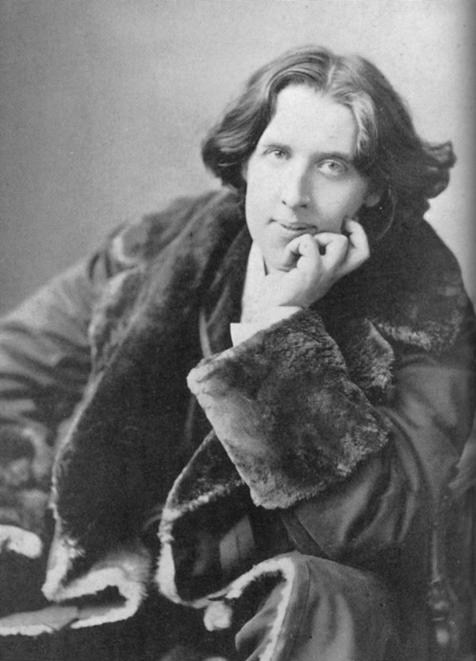
The old believe everything, the middle aged suspect everything, the young know everything.
Oscar Wilde (1854-1900)

